Slide 2
Need to read:
Thackeray 2012- mismatching revisited: what is trophic mismatching from the perspective of the plankton

Slide 3
Cushing (1990) refined the ‘‘match–mismatch’’ hypothesis for marine fish, whose spawning within a relatively narrow time window was suggested to lead to their larvae either matching or missing the subsequent peak of their zooplankton food
Notes:
While there is no doubt that a changing climate induces differences
in the timing of predators and prey, the ecological ramifications
of this are far from clear.

Slide 4
Match-mismatch
Match-mismatch hypothesis states that if the most energetically expensive part of the breeding phenology of the higher level (i.e. the predator) occurs at the same time as the peak availability of the lower level (i.e. the prey) , then recruitment will be high. If there is a mismatch between food requirement and food availability , then survival and thus recruitment of the predator will decrease
Hypothesis suggests that fitness is related to the degree of temporal synchrony between the energetic needs of the offspring and their food supply; teherfore fitness will be highest when the most energy consuming part of the breeding cycle coincides with the peak availability of the food

Slide 5
Approach
Use operational definition of mismatch
Time-based definition

Slide 6
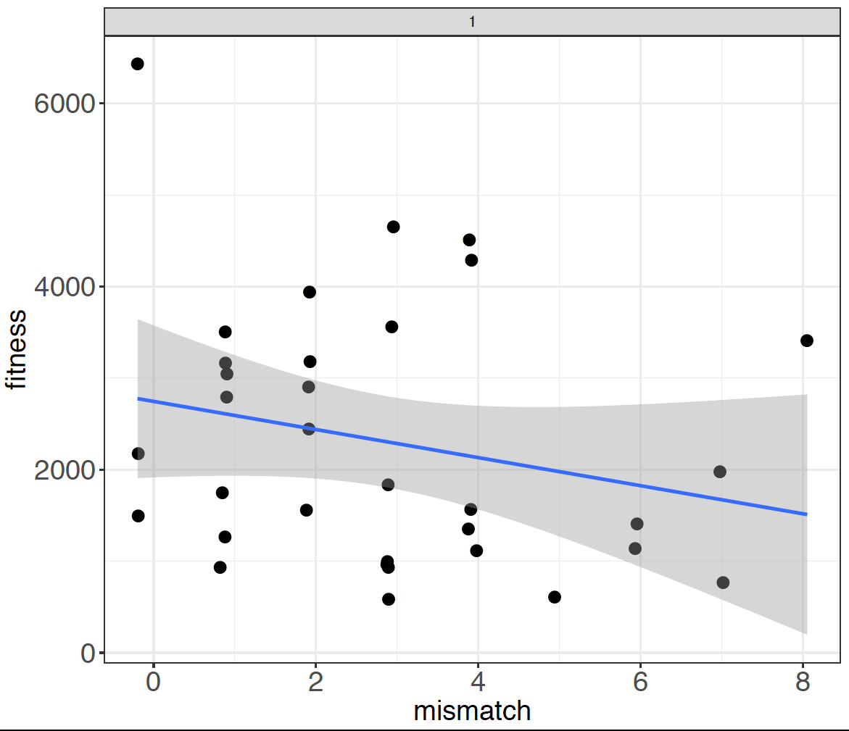
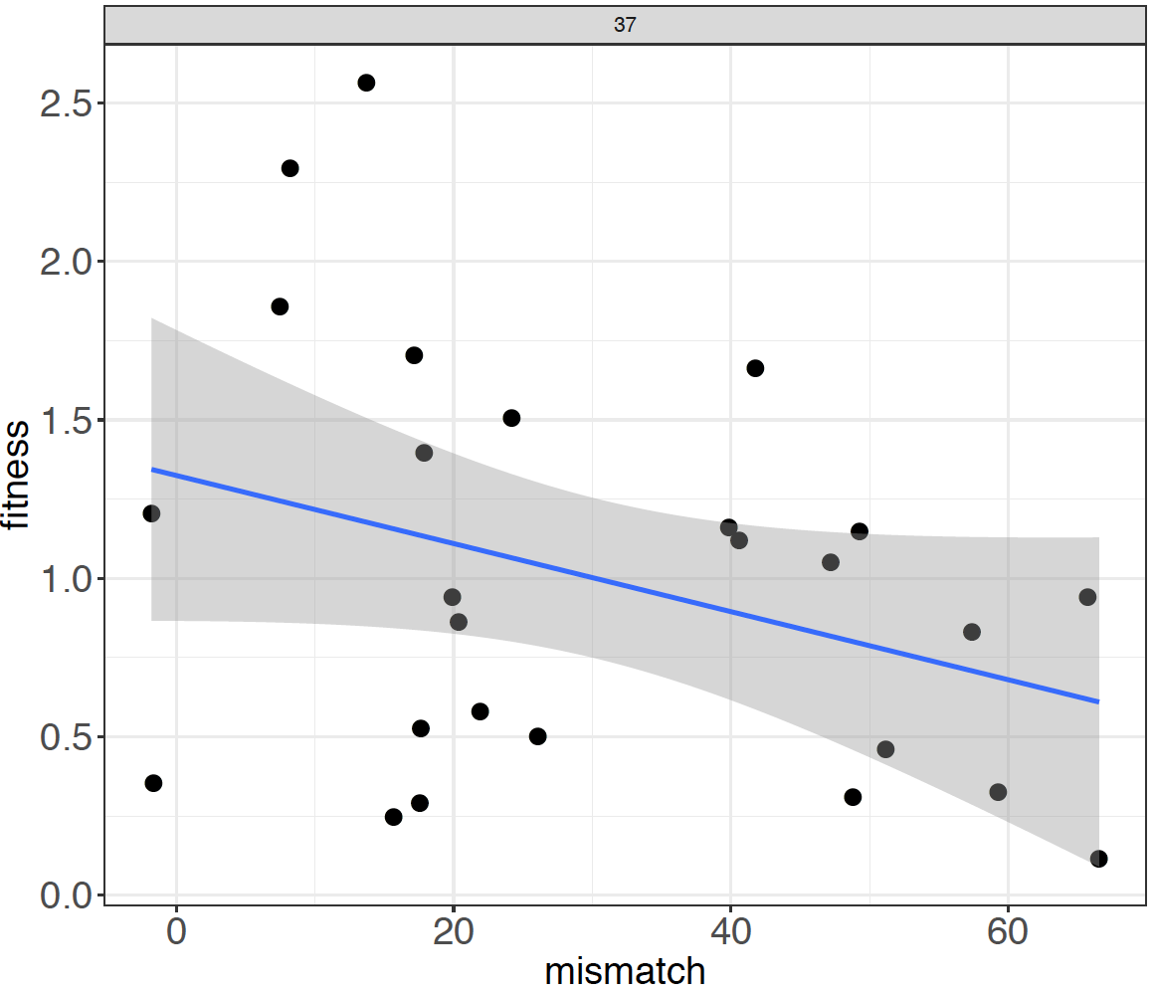
Just magnitude

Slide 7
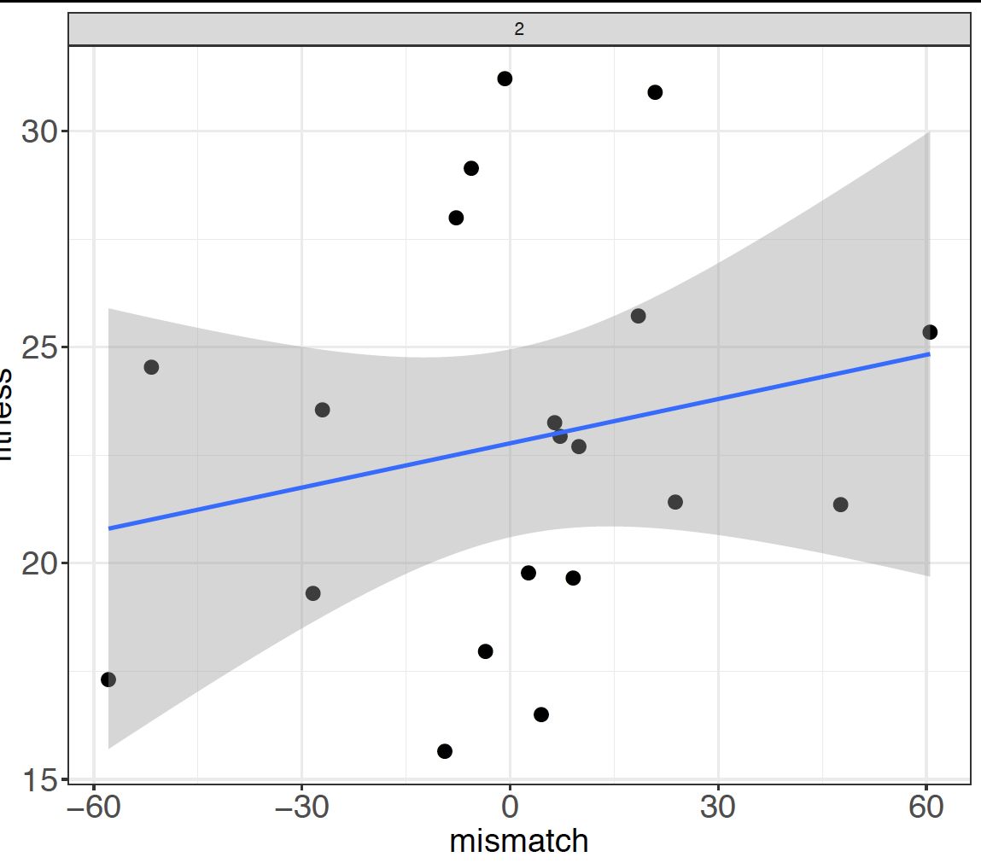

Slide 8
Limitations
Proxies here might be crude index of actual success
Did not incorporate amount of food or changes in amount, just timing (good timing but low food can be outweighed by poor timing but large amount- HMK003)

Slide 9
Discussion
Why its difficult to evaluate overall and/or long-term consequences of mismatch
Age-size strucuture of population (via density dependence)
Individual vs. population level
Effect of other resources
Resilience- ability to overcome (e.g. generation time)
Life history tradeoffs- mistiming with optimum food may not be so selectively disadvantageous if this means a lower predation risk
When is mismatch likely to be important?
Highly seasonal, pulsed systems
Specialist feeders
Narrow windows for consumers, narrow production pulses in resources
When is mismatch likely NOT to be important?
Strong intraspecific competition
Less important when strong density dependence because overrun by environmental stochasticity more than phenology
Inter-annual variability in food quantity (and environment??)
High food baseline levels
Turnover rates and prolonged seasonal availability allowing extended periods of production

