Slide 1
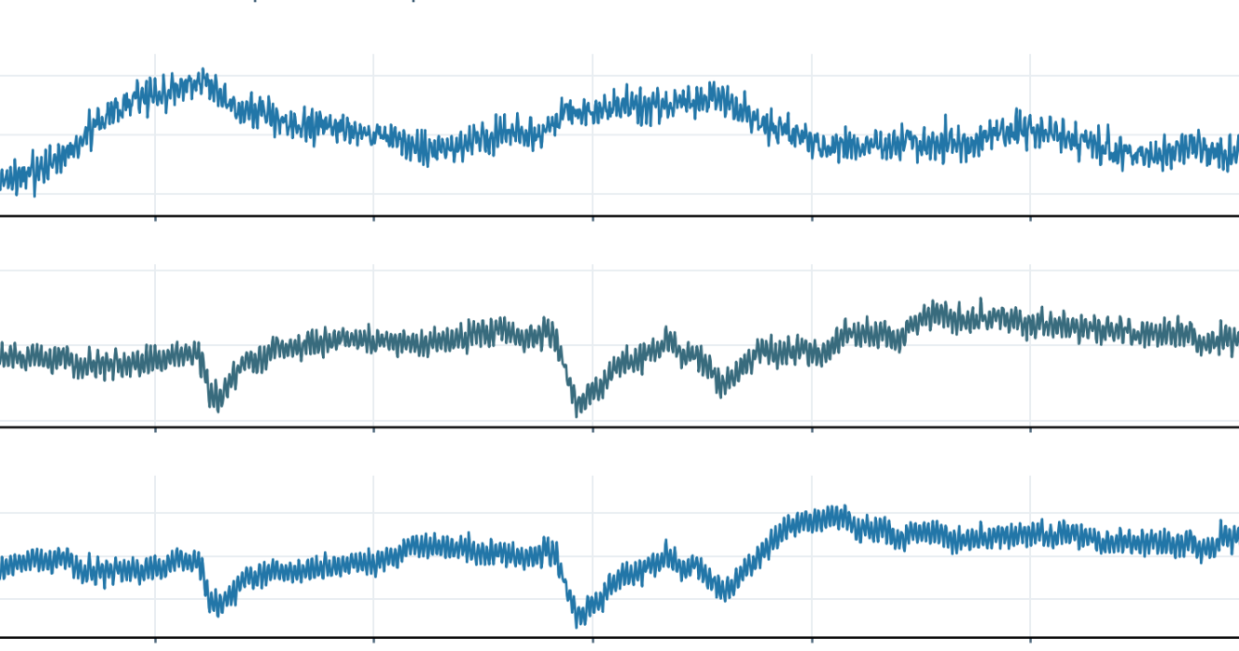
Dataset sources and recording evidence
Source metadata for three cohorts; one uploaded EEG excerpt shown separately
01
NEMAR / OpenNeuro ds004504
OFFICIAL METADATA (NOT EEG)
88 participants
dataset_description.json · verified fields
36 AD | 23 FTD | 29 CN
Name: A dataset of EEG recordings from
Alzheimer's disease, Frontotemporal
dementia and Healthy subjects
19 EEG channels • 500 Hz
Eyes-closed resting-state EEG
License: CC0 | BIDSVersion: v1.2.1
Raw recordings: EEGLAB .set
02
Isfahan MCI EEG
UPLOADED EDF-BASED PREVIEW
61 screened; 49 retained (EEG_1: 25, EEG_2: 24) • 19 EEG channels • 256 Hz
Fp1, F3, C3 | Cropped from the supplied 30-36 s excerpt; no amplitude-unit claim
03
CAUEEG
OFFICIAL SPLIT METADATA (NOT EEG)
Controlled-access source | 21 recorded channels: 19 EEG + ECG + photic | 200 Hz
Dementia no-overlap benchmark: 1,122 recordings
TRAINING
VALIDATION
LOCKED TEST
950 recordings
82 recordings
90 recordings
367 Normal | 334 MCI
34 Normal | 28 MCI
35 Normal | 33 MCI
249 Dementia
20 Dementia
22 Dementia
Primary binary test: 57 recordings (35 Normal + 22 Dementia). The 33 MCI test recordings are descriptive only.
EVIDENCE NOTES
NEMAR and CAUEEG panels show metadata; only the Isfahan panel has an uploaded EEG trace.
Isfahan amplitude tick labels omitted: source EDF physical units require a local validation.
CAUEEG raw signals are deliberately not reproduced because redistribution permission is unverified.
Notes:
[Sources]
NEMAR: https://nemar.org/dataset/on004504
OpenNeuro ds004504: https://openneuro.org/datasets/ds004504
CAUEEG: Kim et al. 2023 benchmark no-overlap design, official source metadata, no raw trace reproduced.
Isfahan uploaded preview: 02_Isfahan_MCI_EEG_Real_EEG_Preview.png, user-supplied provenance sha256 dcad9335a665de59951274c222077135e6fb35f0e27789e76d9a57e460459427; plot pixels cropped, not synthesized. Physical amplitude scaling not verified.
Independent EEG signal data not available in local project.

