Slide 1
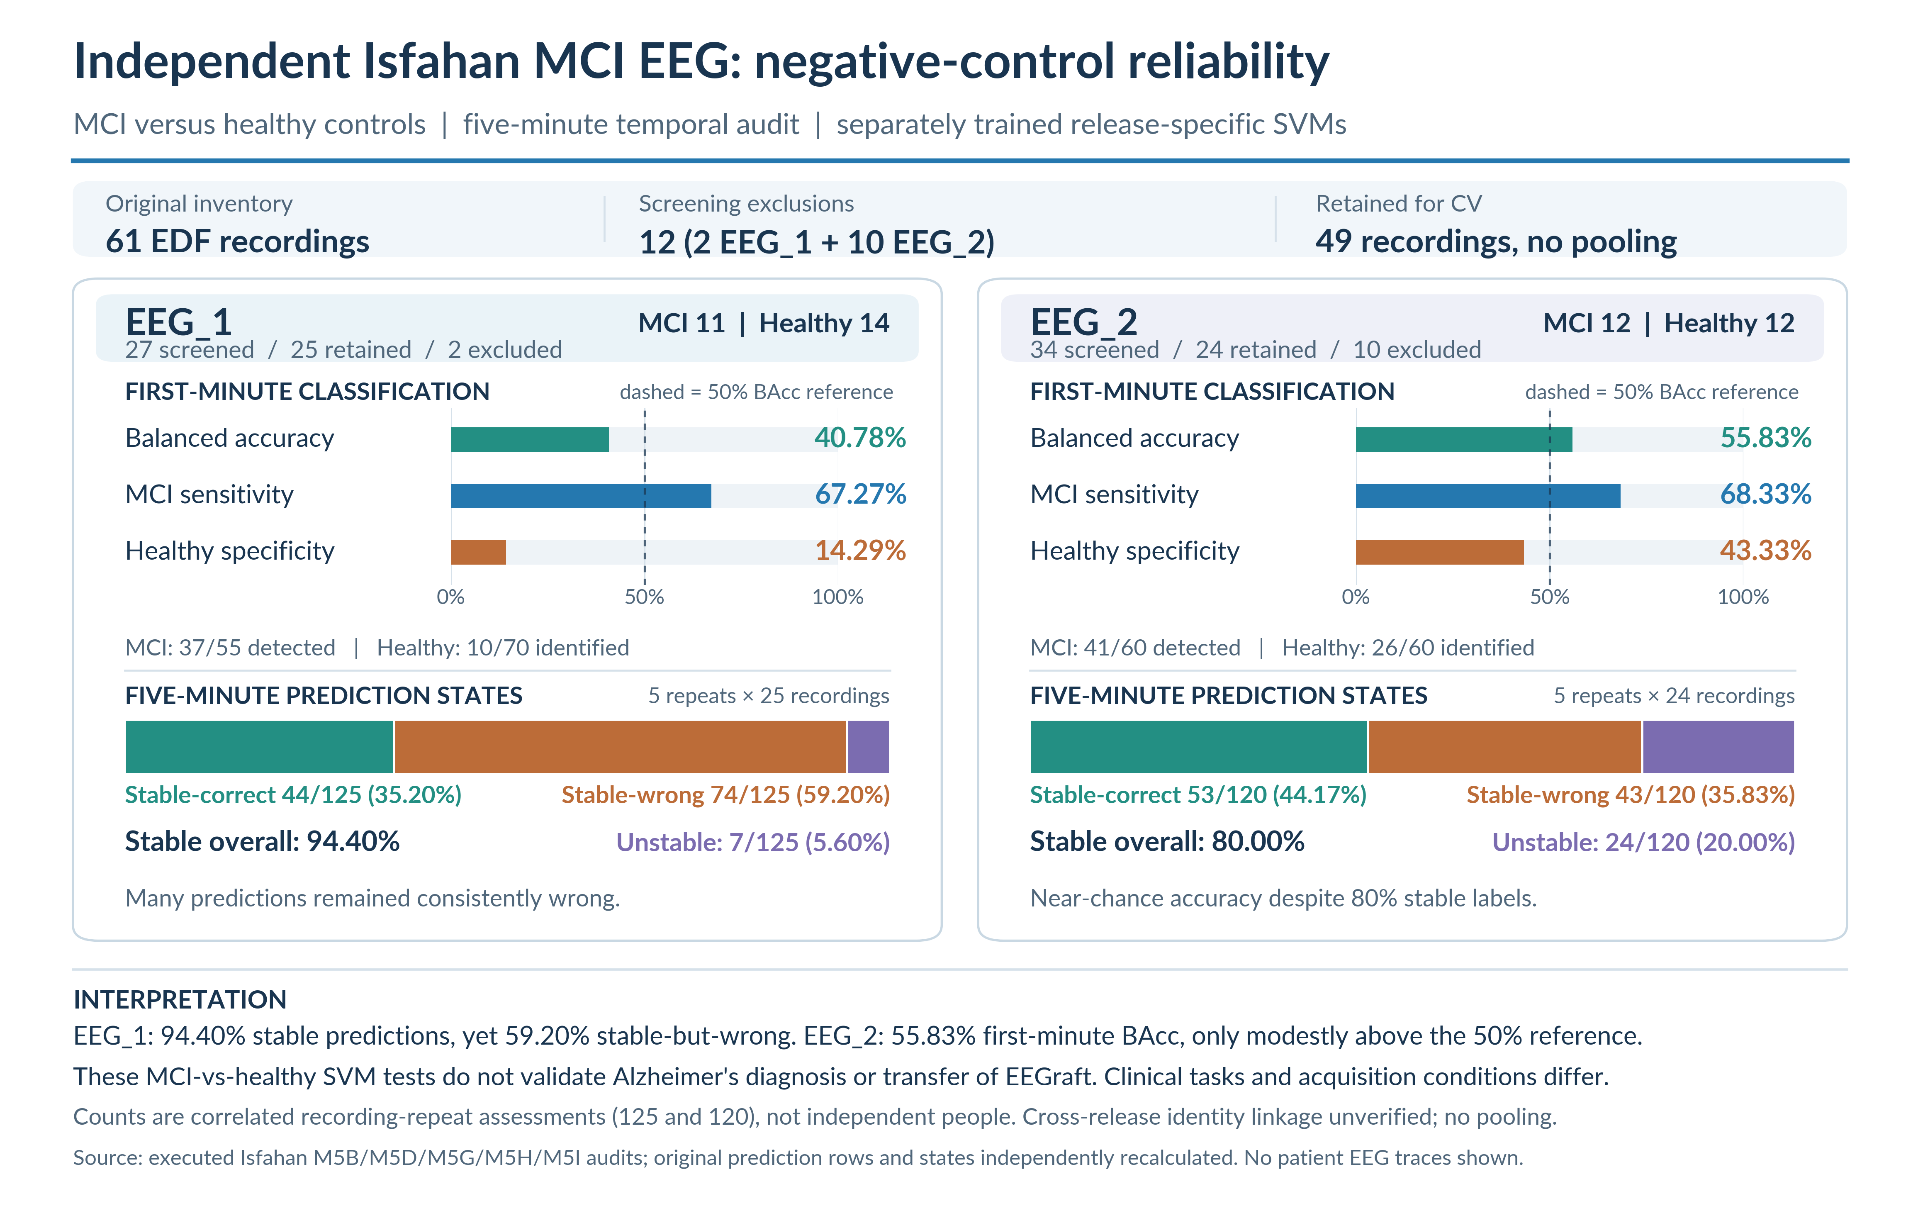
Notes:
Sources: EEGraft archived M5B, M5D, M5G, M5H and M5I investigation.
[Sources]
https://github.com/kharul98/eeg-dementia-thesis-backup-20261107T215131Z
Source paths and hashes documented in VERIFICATION_REPORT.md. These are separate MCI-versus-healthy SVM negative controls, not AD classification. Repeated CV rows are correlated.

