Slide 1
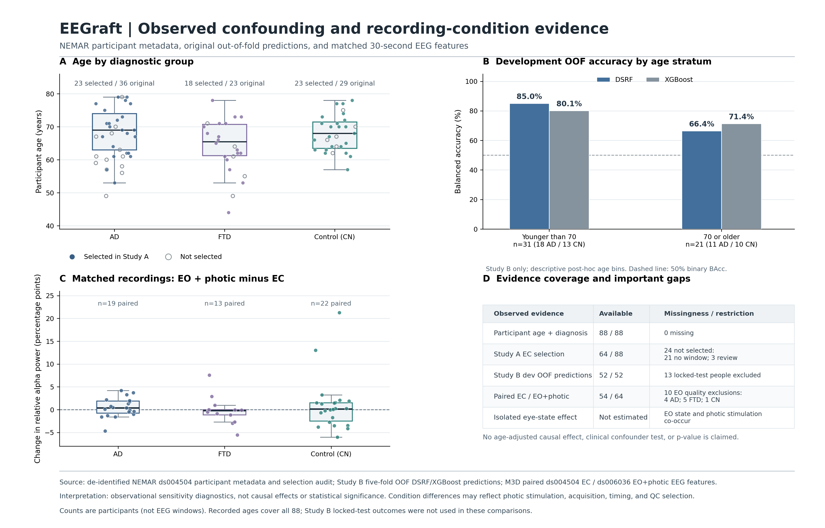
Notes:
[Sources]
- https://github.com/kharul98/eeg-dementia-thesis-backup-20261107T215131Z/blob/main/source/alzheimers-thesis/reports/thesis_final/audit/participant_audit.csv
- https://github.com/kharul98/eeg-dementia-thesis-backup-20261107T215131Z/blob/main/source/alzheimers-thesis/eeg_foundation_thesis_starter/eeg_foundation_thesis/manifests/ds004504_ad_cn_preprocessed.csv
- https://github.com/kharul98/eeg-dementia-thesis-backup-20261107T215131Z/blob/main/source/alzheimers-thesis/reports/thesis_final/milestone_3d_30s_condition_transfer_v1/condition_30s_spectral_features.csv
- https://github.com/kharul98/eeg-dementia-thesis-backup-20261107T215131Z/blob/main/source/alzheimers-thesis/reports/thesis_final/milestone_3e_condition_shift_audit_v1/paired_band_shifts_by_group.csv
- Study B subject predictions for 5 saved development folds, both DSRF and XGBoost (see separate verification report)
[Interpretation]
Observed age and recording-condition diagnostics are descriptive. Neither significance testing nor causal identification is claimed. The two eye conditions have different acquisition/recording release and photic stimulation. Original 13 locked-test participants were excluded from age-stratified prediction analysis.

