Slide 1
Building Generic Code-Mixed Chatbot for Banking System
By Mentored By
Mancha Vinay(17046/244) Dr.Sanjay Chatterji
Chintam Ravi Chandra(17029/227)
Khasha Pavan Kalyan Raju(17043/241)

Slide 2
Introduction
This world is a package of emotions and values. People transfer their traditional and cultural values to the next generation.
In India ,in which where we can find all people speaking different languages like Telugu , Hindi, Marathi, Bengali….. etc, most people prefer to communicate in their Mother tongue.
Our project is based on this idea by helping in solving queries related of bank multi languages and code mixed.[Telugu , English, Hindi]

Slide 3
Chatbot in Banking Sector
Banking → impact good economical Life . But Problems :waiting time for simple queries like Checking Balance, monitor transaction history, send money and lack of customer care agents and many other..
Chat bot improves above problems and give
Friendly UI
Cost reduction
Improve Efficiency

Slide 4
Data
We prepared a dataset of 30 most frequently asked question and answers related to banking from different banking web pages
We converted them into two other languages which are Hindi and Telugu respectively.
These collected data are stored in the API in a dictionary format where question is the key and value are the respective answer.

Slide 5
Data
English: How to block a ATM card? >> Debit card can be blocked as below Through SMS:SMS syntax for blocking ATM/Debit Card: CARDBLOCK<SPACE>XXXX (XXXX Last four digits of A/c No.) to 56161
Telugu: ఎటిఎం కార్డును ఎలా బ్లాక్ చేయాలి? >> డెబిట్ కార్డును ఈ క్రింది విధంగా బ్లాక్ చేయవచ్చు ఎస్ఎంఎస్ ద్వారా: ఎటిఎం / డెబిట్ కార్డును నిరోధించడానికి ఎస్ఎంఎస్ సింటాక్స్: కార్డ్బ్లాక్ <స్పేస్> XXXX (XXXX చివరి నాలుగు అంకెలు A / c నం) నుండి 56161 వరకు
Hindi: एटीएम कार्ड को कैसे ब्लॉक किया जा सकता है? >> डेबिट कार्ड को एसएमएस के माध्यम से नीचे ब्लॉक किया जा सकता है: एटीएम / डेबिट कार्ड को ब्लॉक करने के लिए एसएमएस सिंटैक्स: कार्डब्लॉक <SPACE> XXXX (XXXX पिछले चार अंकों के ए / सी नंबर) से 56161

Slide 6
Approach

Slide 7
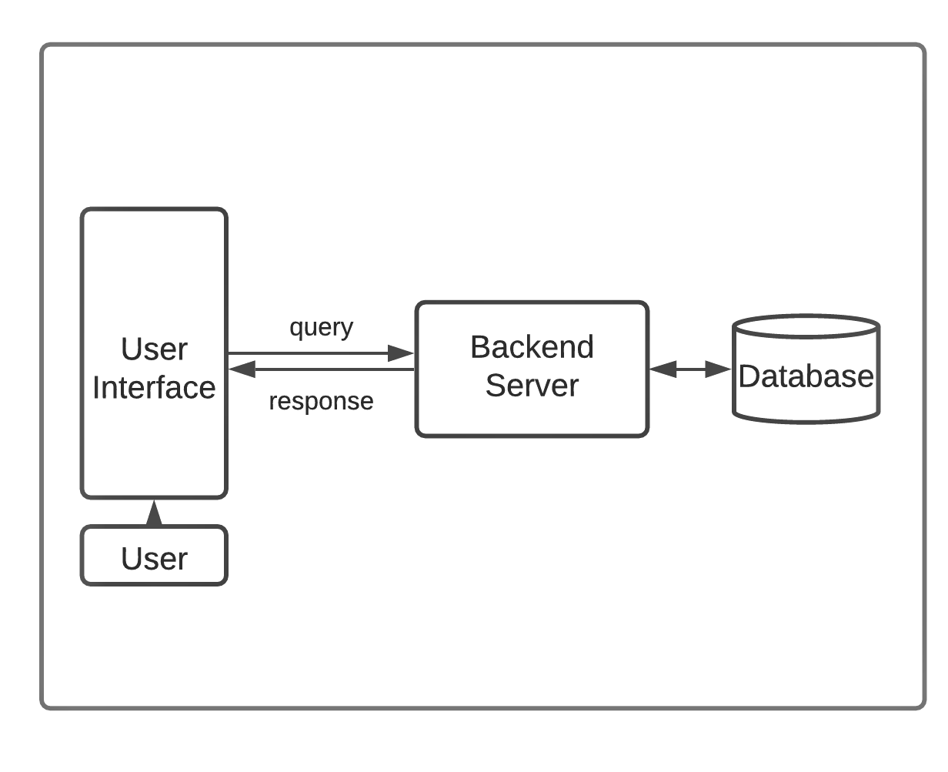
System Architecture

Slide 8
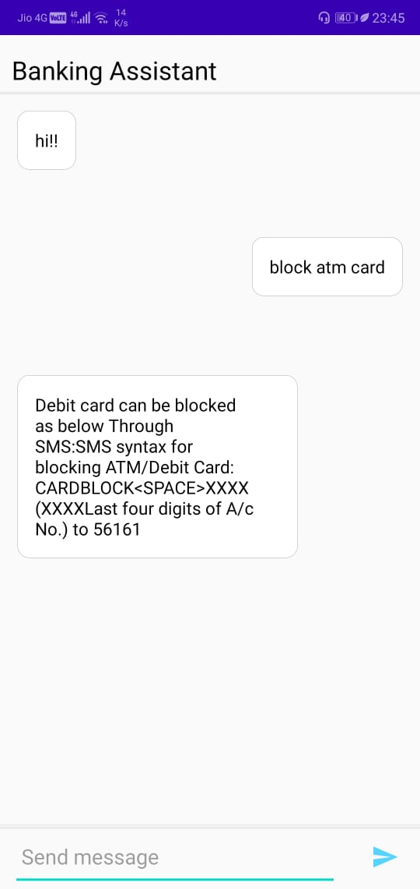
Chat Interface
Android Chat Application
Interacts with the Customer
User can input the Query in any language with Google Keyboard
Sends the query to backend using Flask Api
Receive response using Flack api
If the Query Doesn’t exit Gives Default Message (I can't answer your question now!! Please call our Customer care number +917989167234.)

Slide 9
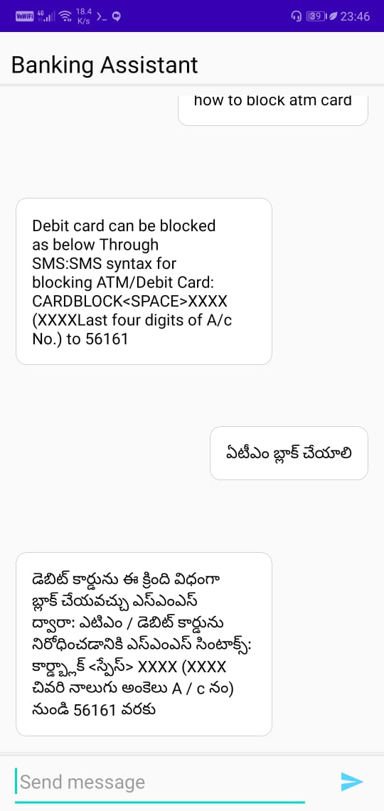
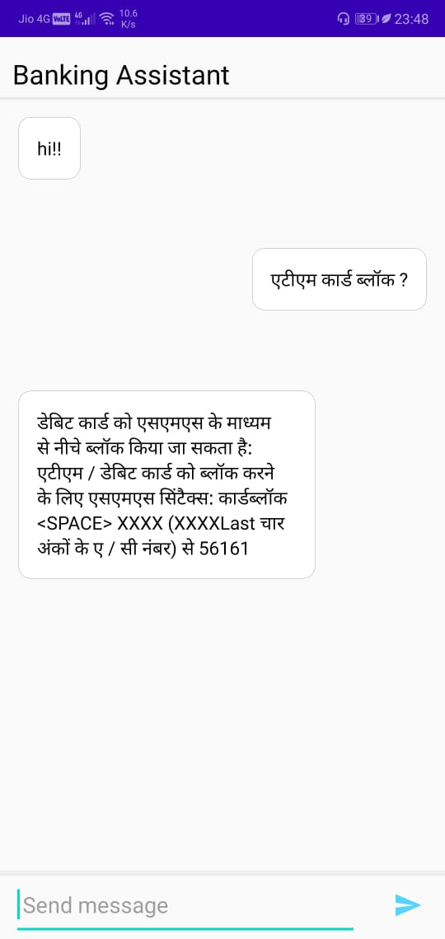

Slide 10
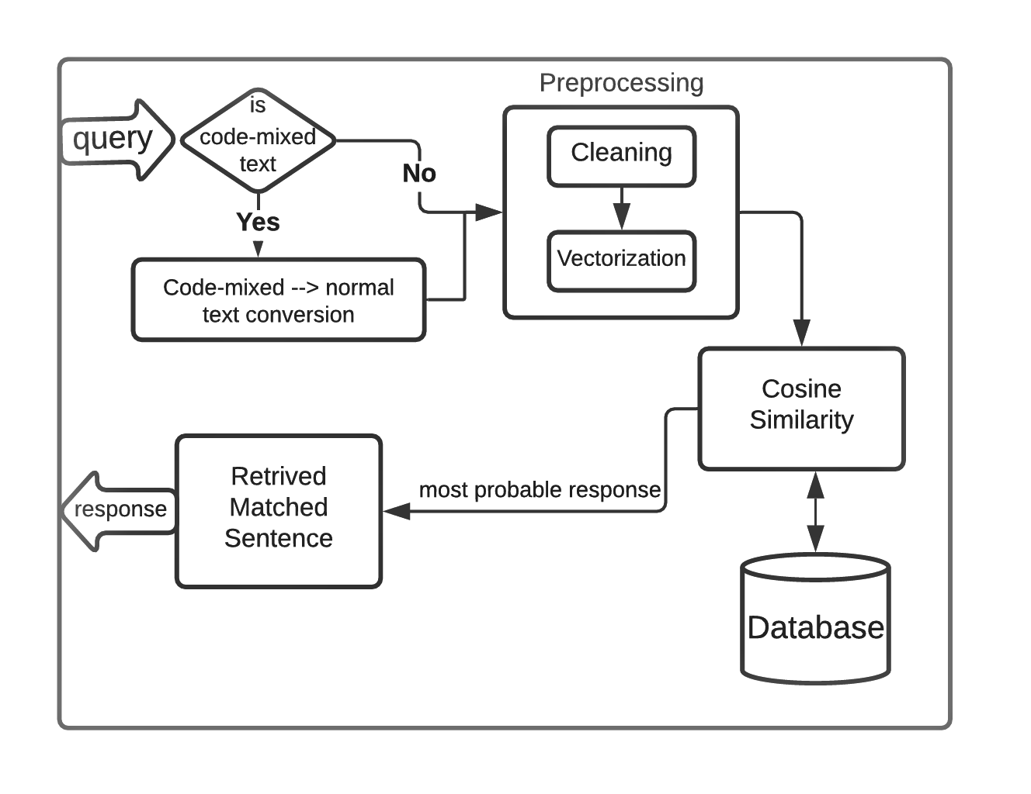
Backend Architecture

Slide 11
Working
1.User input the Query in chat interface
2.the Chat interface sends the query through a POST request to the Flask app
3.The query is then sent to the language identification system that helps us to differentiate a code-mixed text apart from a normal text.
4.If it is a code-mixed query then it is converted to a monolingual text and is passed through pre-processing else the normal query is directly passed to the pre-processing stage.
.

Slide 12
Code-Mixed Text Conversion
Code-Mixed text are text which have mixed words of English, Telugu in English and Telugu in UTF format.
The inputted query which is a code-mixed text is converted to a monolingual Telugu text by the following steps:
1. The English words are identified by using a bag of words (around 57000 English words) and are translated to their respective Telugu UTF format using Google translation.
2. The words which are not English are identified as Telugu words and are transliterated to their respective Telugu UTF format using Google transliterate API.

Slide 13
Text PreProcessing
The query is then cleaned by removing punctuations, special characters etc.
Then it is vectorized in which the text is mapped into words or phrases from vocabulary to a corresponding vector of real numbers which used to find text similarities.

Slide 14
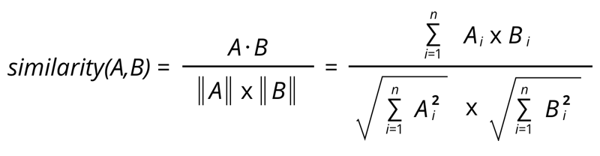
Sentence Similarity
Cosine similarity is being used to check the similarity between two sentences.
A probability is assigned to the query and each question in the database using Cosine Similarity.
The most probable question is found among the questions from the database which have probability above a certain threshold.

Slide 15
Retrieve the matched sentence
The respective answer related to the Most probable question is retrieved from the and displayed in the user interface.
If there is no most probable query among the questions in the database that crossed the threshold then a default response is displayed to the user.
Exampe:We're unable to answer your query. Please contact our customer care number +917989167234 for further details.

Slide 16
Results and Analysis
We have tried different queries to validate the implementation of banking chatbot.
The responses are expected/correct 78.9% of the total queries (19 queries) and the rest are Incorrect.

Slide 17
Conclusion
A Chatbot is a great tool for conversation. Here the application we created helps to reduce waiting time of the user and also improve quality of customer service. It removes the burden from the bank service by directly delivering the answer to the user using an expert system and removes the burden for the user to visit the bank for every simple query. The user interacts within the chat interface which uses the cosine similarity to obtain the proper answer for the query. The App interface is developed for the users, to gain knowledge of banks within their reach.

Slide 18
References
Vinod Kumar Shukla, Lekha Athota, Ajay Rana, Nitin Pandey. Chatbot for Healthcare System Using Artificial Intelligence (2020).
Google Transliteration API:
https://www.google.com/inputtools/try/
English Bag of Words:
http://www.mieliestronk.com/wordlist.html
Google Translate:
https://translate.google.co.in/
Enocer Decoder with attention:
https://www.tensorflow.org/tutorials/text/nmt_with_attention
Bahdanau attention:
https://arxiv.org/pdf/1409.0473.pdf

Slide 19
References
Cosine Similarity: https://en.wikipedia.org/wiki/Cosine_similarity
http requests: https://www.tutorialspoint.com/http/http_requests.htm
Flask API Server: https://www.flaskapi.org/
Common Questions data gathered from:
Andhra Bank
SBI
HDFC

Slide 20
Thank You
Thank You for letting us be a part in this project.
Dr. Sanjay Chatterjee

