Slide 1

Project Part -1
PID- 43
ChargeX: Intelligent EV Charging Station Locator with Slot Booking and Smart Assistance
J.Gnana Shreeya-160122733076
Kukati Pragnya-160122733081
Dr.R.Ravinder Reddy
Professor
18/09/2025
ChargeX: Intelligent EV Charging Station Locator with Slot Booking and Smart Assistance
1

Slide 2

Problem Statement
EV users face range anxiety and unexpected delays as existing apps only show nearby stations without checking battery reach or predicting wait times. Most depend on internet connectivity, lacking offline support.
ChargeX solves this with range-based filtering, wait predictions, personalized recommendations, and offline verification for seamless usability.
18/09/2025
2

Slide 3
Objectives
Range-Based Filtering: Show only stations reachable with current battery level.
Dynamic Wait Time Prediction: Predict waiting time at busy charging stations.
Offline Verification: Allow scanning and verifying stations without internet.
Personalized Recommendations: Suggest optimal stations based on user preferences.

Slide 4
Introduction
EV adoption faces issues like range anxiety, station availability, and network dependency.
Current apps show nearby stations but lack range validation and wait time prediction.
Dependence on internet connectivity limits use in low-network areas.
ChargeX solves this with range-based filtering, dynamic wait predictions, offline slot booking, and chatbot support.
18/09/2025
3

Slide 5

Literature Review
Sno | Title | Author | Methodology | Gaps analysed
1. | Dynamics of an EV Charging Station considering Queuing Theory (Transportation Research Procedia, 2025) | Hasan Masrur, Ali T. Al-Awami (2025) | Used queueing theory to mathematically analyze how EVs arrive and wait at a single charging station. Considered random (non-uniform) arrivals, exponential charging times, and multiple chargers to predict waiting times and service capacity. | Focuses only on a single station, no advance reservations, no dynamic waitlist/cancellation handling, no network-level station coordination, and lacks practical user-side features like slot booking, mobile integration, or offline scanner/verification support.
2. | Planning of EV charging stations: An integrated deep learning and queueing theory approach (Transportation Research Part E, 2024) | H. Pourvaziri et al. (2024) | They used AI to guess how many cars would arrive and how long they’d wait, then applied an optimization method to decide the best places to build stations.They compared different ways of serving cars in line (first-come-first-serve vs grouped lines) and tested how changes in arrival or charging times affect the results.” | Focus is planning (where/how many chargers) rather than operational booking; no explicit reservations or waitlists; relies on synthetic/assumed processes; does not address real-time user experience (filters, SOC/range-aware station choice) or offline check-in

Slide 6
Literature Review
Sno | Title | Author | Methodology | Gaps analyzed
3. | Management of EV charging stations under advance reservations schemes in electricity markets | R. Bernal, D. Olivares, M. Negrete-Pincetic, et al. (2020) | They suggested a system where charging slots can be reserved in advance. This helps station operators plan resources better by assigning chargers ahead of time, reducing uncertainty and making services more reliable | The system mainly looks at reservations from the operator’s side and doesn’t cover real-life cases like walk-in users, overbooking, or managing waitlists. It also doesn’t consider how users behave when waiting is uncertain, and it lacks app features like maps or station filters.
4. | Dynamic modeling and real-time management of a system of EV fast-charging stations. | D. Yang, N.J.S. Sarma, M.F. Hyland, R. Jayakrishnan (2021) | They built a computer simulation of a regional charging network to study how drivers choose stations, how queues form, and how pricing can control demand. By adjusting prices based on demand, they showed waiting times could drop by about 26% and overall user experience improved. | No explicit advance reservations / waitlist logic; assumes one operator across stations; limited evidence on no-shows/cancellations and offline verification; user-side UX (station discovery, filters) is outside scope.

Slide 7
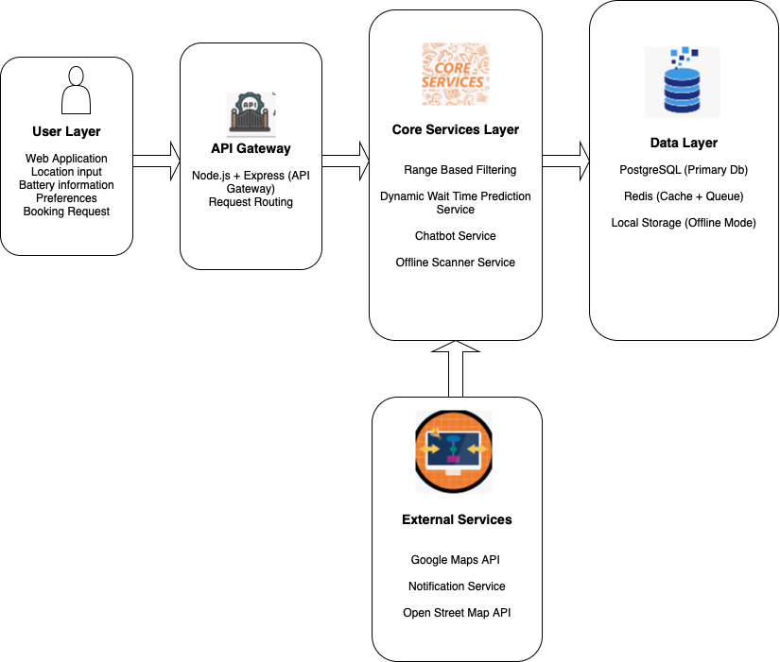
Architecture

Slide 8
Architecture
User Layer
Collects user data through a web application interface such as location, battery status, preferences, and booking requests.
Initiates the interaction and communicates requests to the backend via the API Gateway.
API Gateway Layer
Handles request routing using Node.js and Express, acting as the entry point for all user communications.
Connects the user layer to the core services for streamlined and secure data flow throughout the system.

Slide 9
Architecture
Core Services Layer
Executes core business logic: range-based filtering, dynamic wait time prediction, chatbot, and offline scanner services.
Integrates with both external services and the data layer for data retrieval, prediction, and validation processes.
Data Layer
Stores all persistent data in PostgreSQL (primary DB), with additional caching and queue management through Redis.
Supports offline mode through local storage to ensure reliability during network disruptions.

Slide 10
Architecture
External Services Layer
Provides real-time map, traffic, and routing data using APIs such as Google Maps and Open Street Map.
Handles notifications sent to users and enriches core service functionality with additional real-world data inputs.

Slide 11
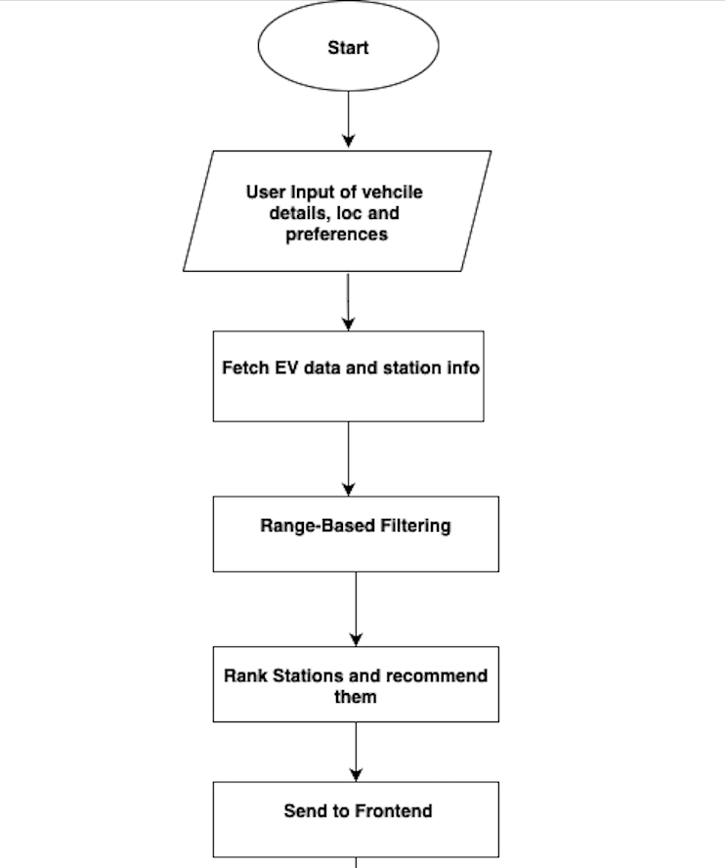
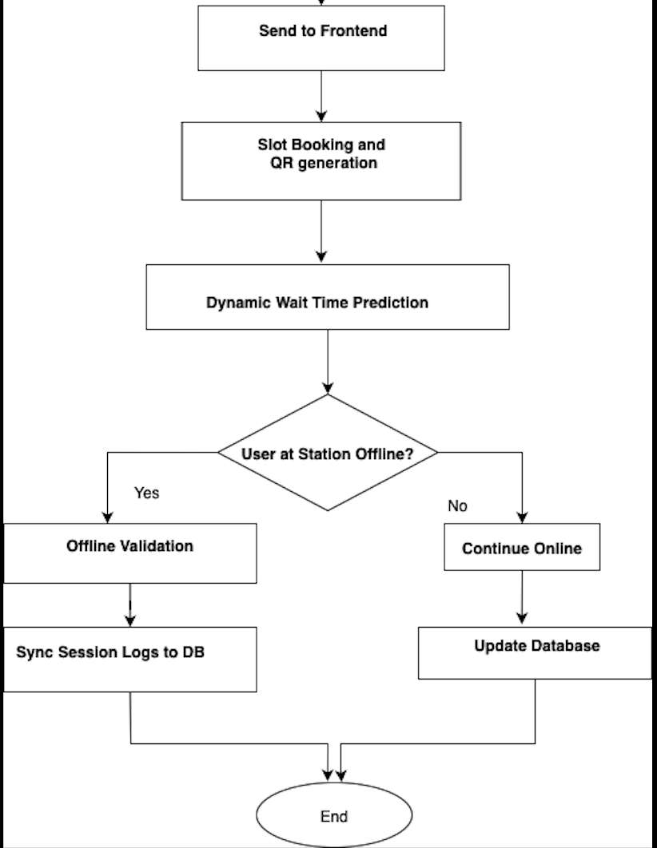
WORK FLOW DIAGRAM

Slide 12
Workflow
1. User Input & Initialization
User opens app/website → inputs EV details
App fetches current SoC, battery capacity, and location
System checks user preferences (charger type, nearest, fastest)
2. Range-Based Filtering
System collects station locations and types
Fetches distance, traffic, and elevation from Google Maps API
Features are prepared: SoC, battery, traffic, elevation, speed
Regression model predicts reachable range (km)
Stations beyond predicted range are filtered out
Remaining stations ranked by distance, availability, charger type
Recommendations sent to frontend (map + list)
18/09/2025
11

Slide 13
Workflow
3. Dynamic Wait Time Prediction
User selects a station
System fetches real-time occupancy, slot bookings, arrival times
Preprocess data: time, day, traffic, charger usage
ML/analytics model predicts wait time + next available slot
Display predicted wait time to user
User can book slot or choose another station
4.Slot Booking & Offline Validation :
User books → server issues token + QR
Booking details cached locally for offline mode
At station: scan QR → validate locally
If valid → charging session starts, logs stored
Once online → sync logs to server for billing & confirmation
11/09/2025
12

Slide 14
Workflow
5.Chatbot Assistance
User asks query → chatbot receives input
BERT model detects intent + entities
Backend processes query → fetches data from DB/APIs
Generates response (nearest station, wait time, booking info)
Reply sent to user in real-time
6.Continuous Updates & Feedback
Station data, traffic, and battery info continuously updated
Models retrain periodically with new data for better predictions

Slide 15
Tech Stack
Backend: Node.js + Express.js, Python (ML), PostgreSQL, Redis (cache)
Frontend: React.js, Google Maps API, QR Scanner
ML / AI: Regression (range), ML/analytics (wait time), BERT (chatbot)
Offline: Local cache + sync module
11/09/2025
9

Slide 16
Conclusion
Our project ChargeX , provides an all-in-one EV charging solution.
Ensures reliable station discovery and slot booking.
Reduces range anxiety with ML-based predictions.
Works smoothly in offline or poor network conditions.
Supports scalable,sustainable, user-friendly EV adoption for the future.
11/09/2025
14

