Slide 1
Marketing Analytics Project 1: Customer Segmentation
Group 7: Ocean’s 5’7
Myra Liu, Philipp Scherbel, Khasim Shaik, Jacky Yang, Kivi Zuo

Slide 2

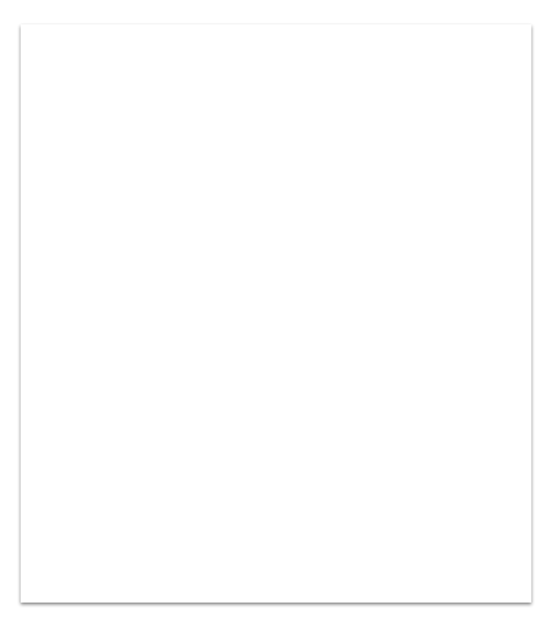
Agenda
Data Exploration
Product, Customer and Store insights
Modeling Procedures
Cluster analysis on Customer
Cluster analysis on Products
Cluster analysis on Stores
Conclusion

Slide 3
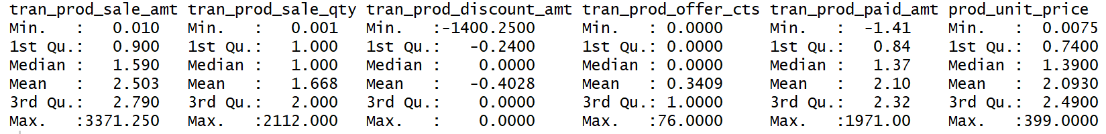
Background and Data exploration
Background:
Pernalonga, a leading supermarket chain with over 400 stores in Lunitunia wants to experiment on personalized promotions to grow revenue.
Descriptive Analysis:
The dataset consists of ~ 8000 customers and ~ 30 mio rows of transactional data from 2 years
6 numerical features: Sales Amount, Sales Quantity, Discount Amount, Discount yes/no, Amount paid per single item, unit price per item
12 categorical features: category ID, subcategory ID, store ID, transaction # etc.

Slide 4

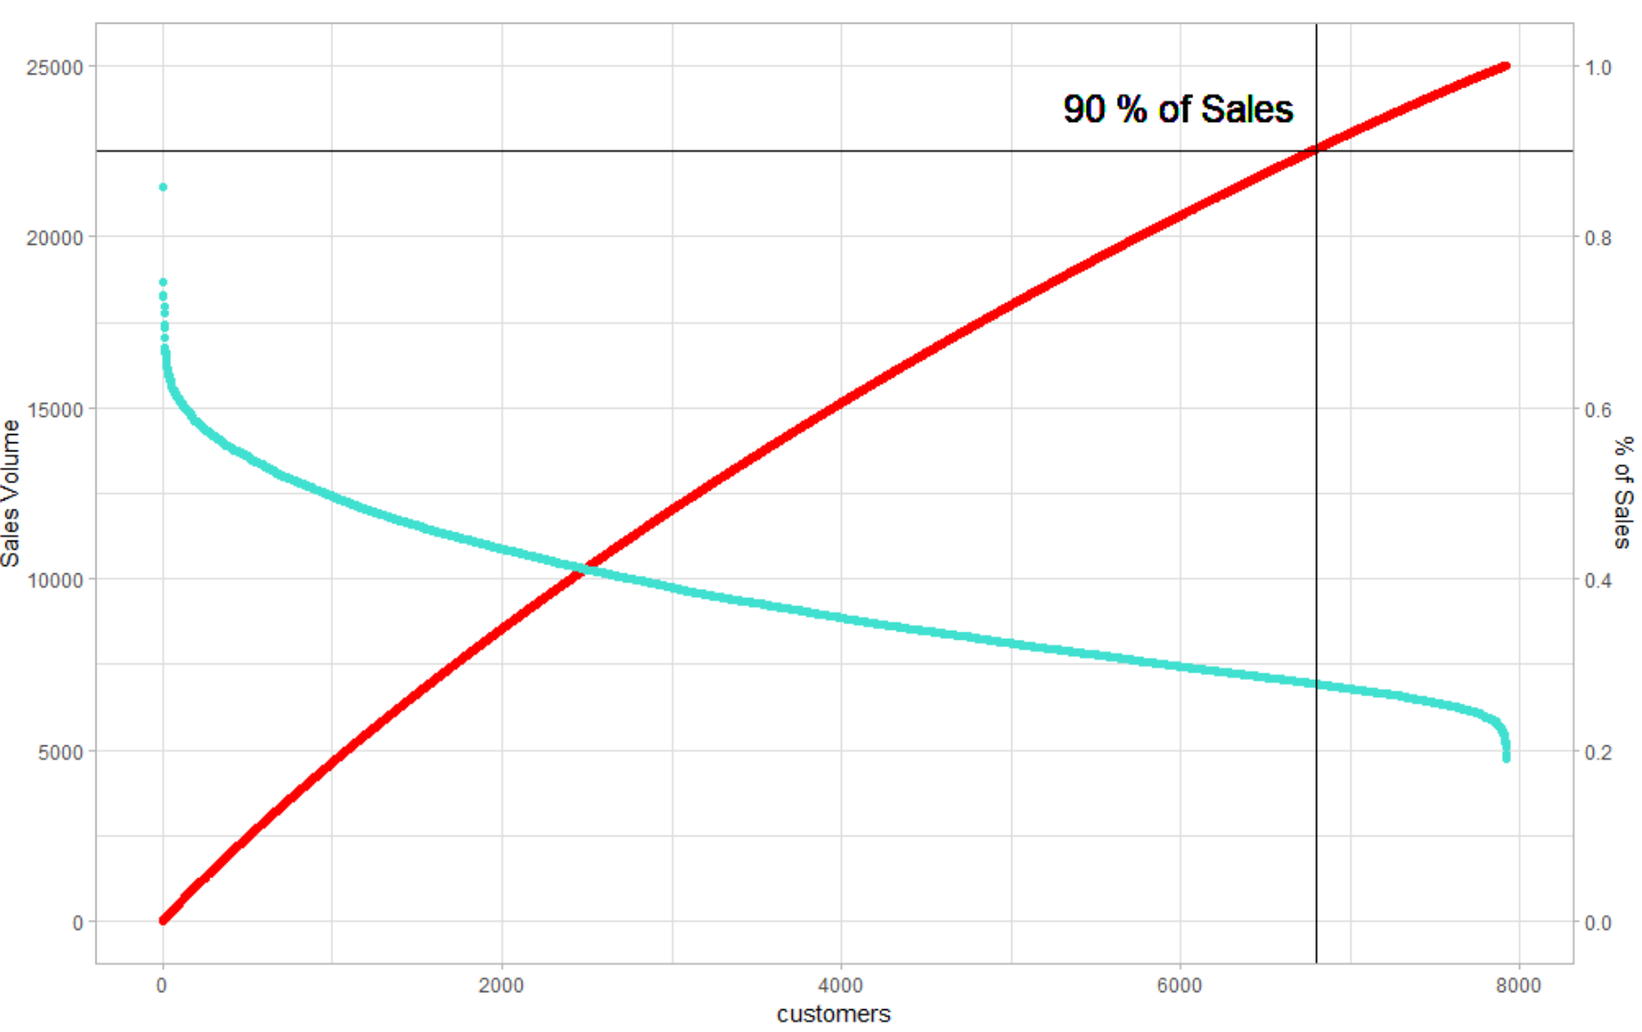

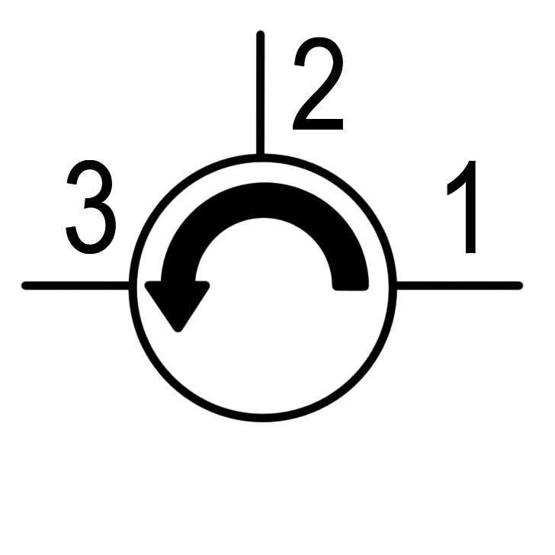

Top 1000 customers account for 20 % of total sales volume
Customer contributions to total sales
Top Pernalonga customers
Highest Sales
21,444.94 total sales (rank 1)
94 unique products
62 transactions
Highest Frequency
12,430.58 sales (rank 990)
253 unique products
724 transactions
Most unique products
9,103.575 sales (rank 199) 1,972 unique products
303 transactions

Slide 5

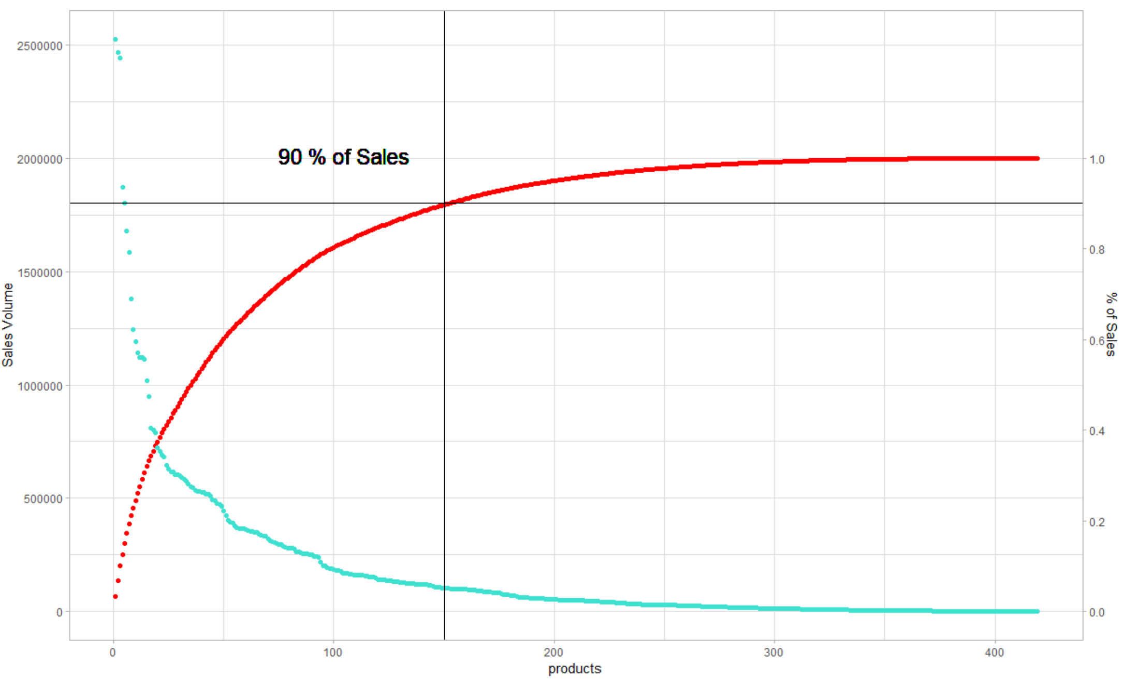
Expensive products boost sales - rather than top seller
150 product categories make up 90 % of the sales volume → this results in a very long “tail” of products that barely contribute to revenue
Category | Sales ($) | Sales (units)
FRESH PORK | 2525657.9 | 834359.8
FRESH BEEF | 2468050.2 | 429175.5
FRESH POULTRY MEAT | 2443876.3 | 915344.1
FINE WINES | 1871669.8 | 557988.0
DRY SALT COD | 1802943.1 | 184339.8
BEER WITH ALCOHOL | 1679173.6 | 853643.0
WASHING MACHINE DETERGENTS | 1584967.1 | 130911.0
COFFEES AND ROASTED MIXTURES | 1380687.9 | 388186.0
FROZEN FISH SERVICE | 1242226.2 | 209459.5
FINE WAFERS | 1188805.6 | 844872.0

Slide 6
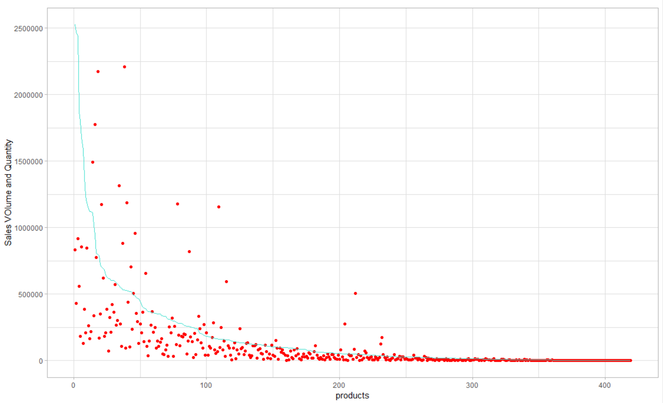
Expensive products boost sales - rather than top seller (cont’d)
Best products in terms of sales are expensive products which are sold in relatively low quantities like fresh meat
Mineral Water
Pao Manufacture
Frozen Bread
Bags

Slide 7
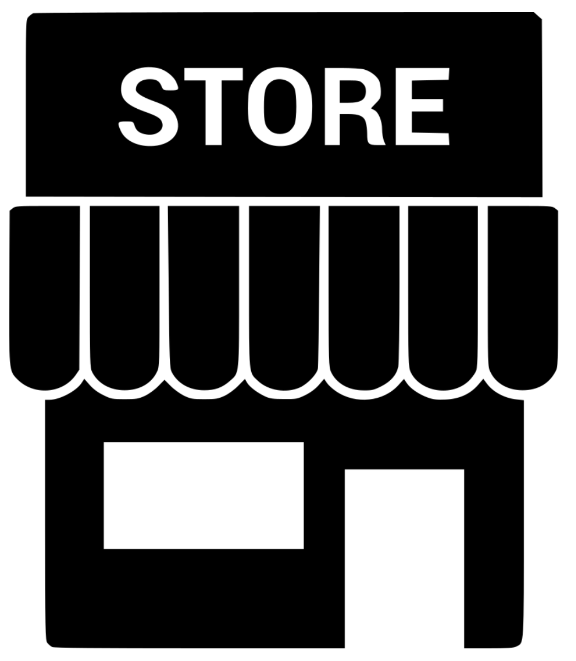
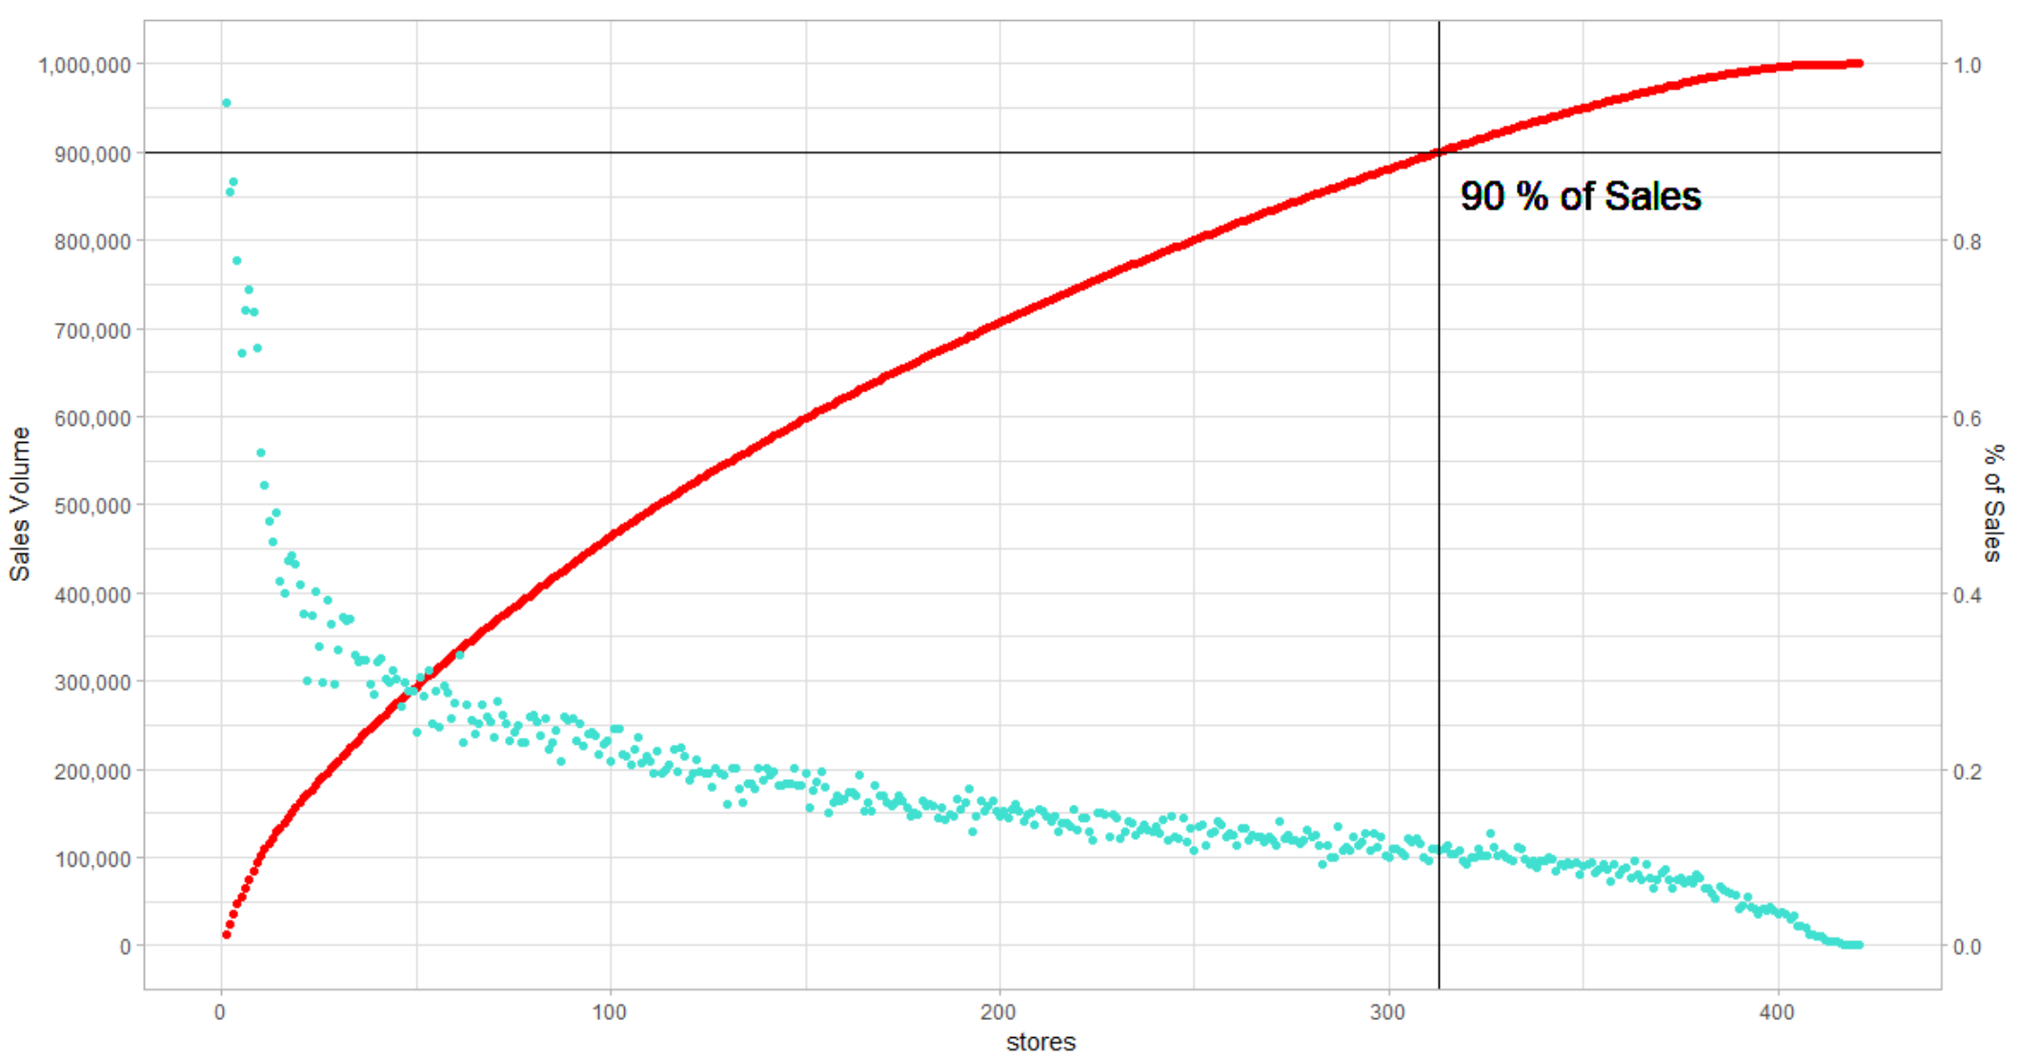
Top 50 stores out of over 400 stores account for 20 % of sales
Store contributions to total sales (~ 74 mio)
Top Pernalonga stores
Highest Sales
Sales: 955668.72 (rank 1)
Customers: 567
Categories: 418 (rank1)
Most customers
Sales: 776703.40 (rank 4) Customers: 836
Categories: 407

Slide 8
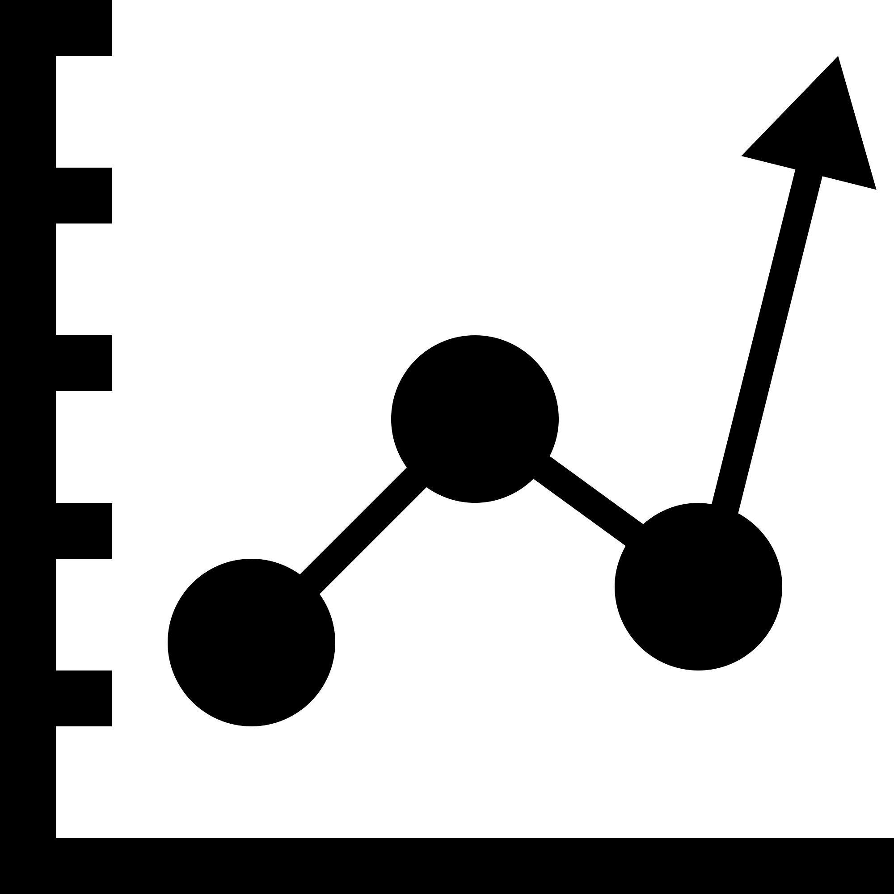
Our approach to modeling and evaluation
K-means is used as an unsupervised learning method to segment amongst customers, products and stores
Standardize all created features in the data set (K Means clusters based on distance)
Elbow method to find the best number of clusters
Relatively lower SSE with a smaller K returns better results
Silhouette score to find the optimal number of clusters
Higher scores indicate better results.
K-means clustering with the optimal number of clusters.
To present and analyze the cluster features by observations that are closest to the centroids
Preparation
Analysis
Modelling

Slide 9
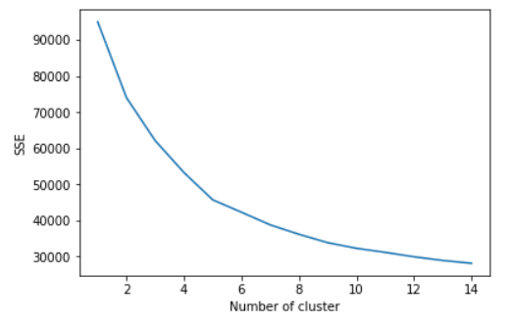
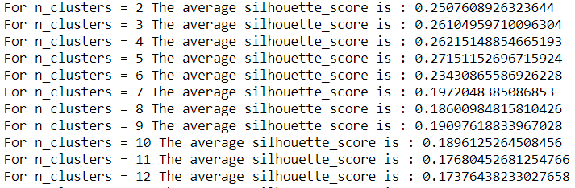
We clustered customers using K-means
Attributes created for each customer
We selected the optimum number of clusters using “Elbow method” & “Silhouette Method”
Feature | Attribute
Basket Diversity | Number of unique products
Promotion Sensitivity | Total discounted amount/sales # discounted products/total discount % per product avg discount % on products Q2 discount % on products Q3 discount % on products Q4 discount % on products
Store Loyalty | Number of unique stores visited
Purchase Behavior | Avg sales amount per transaction Q2 sales per transaction Q3 sales per transaction Q4 sales per transaction

Slide 10
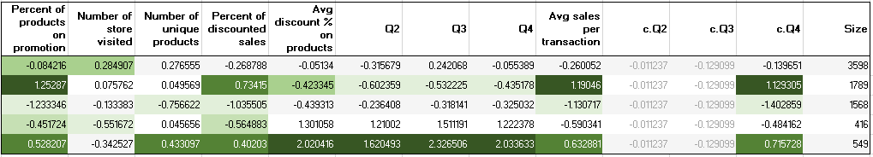
We clustered customers in 5 segments using K-means
Standardized values are used to assess the cluster features
Values are color scaled with darkest representing the highest
Not very straightforward right? Next slide!

Slide 11
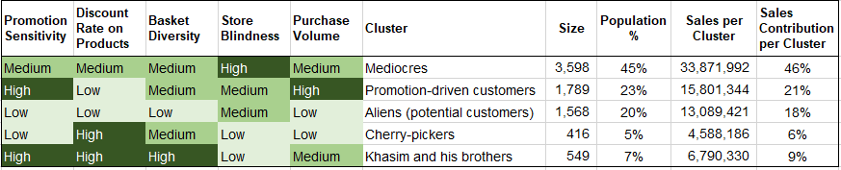
Customers can be clearly distinguished amongst 5 major segments
Personalized promotion are more feasible for mediocres and Khasim & brothers (big family) as they are promotion sensitive and have medium purchase volume
Aliens are the potential customers that can be converted to be more profitable

Slide 12
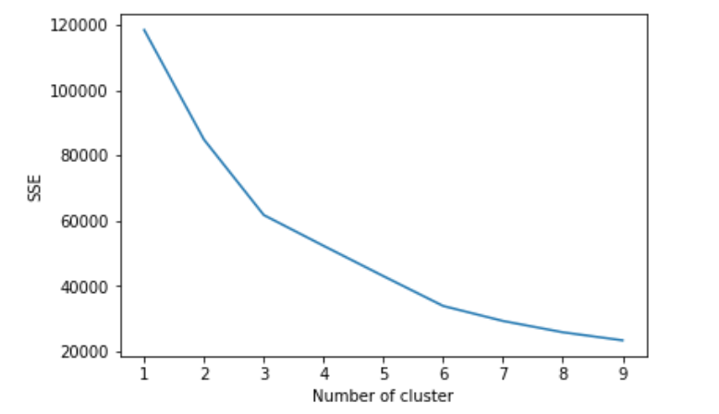
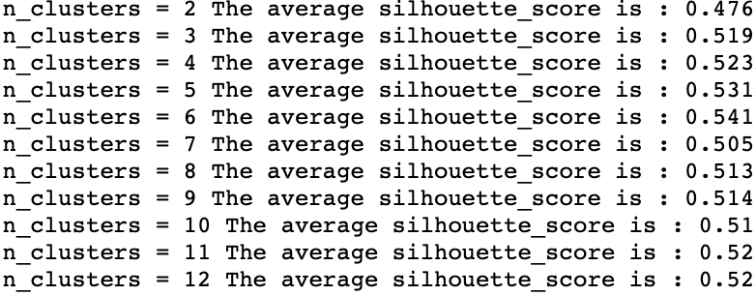
We clustered products using K-means
Attributes created for each product
We selected the optimum number of clusters using “Elbow method” & “Silhouette Method”
Feature | Attribute
Value driver | total revenue
Traffic driver | number of transactions
 | avg unit per transaction
 | Q2 unit per transaction
 | Q3 unit per transaction
 | Q4 unit per transaction
promotion | # discounted transactions / total transactions
 | avg discount
 | Q2 discount
 | Q3 discount
 | Q4 discount

Slide 13
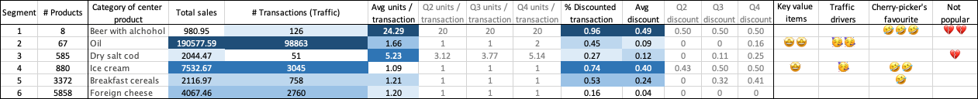
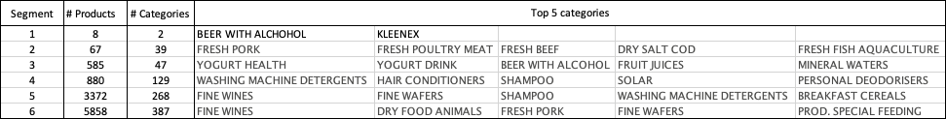
We found that all our products with over 400 categories can be clustered in 6 segments
Segment 2: Tier 1 key value drivers and traffic drivers - cross selling with “teasers” of new-to-market goods
Segment 4: Tier 2 value drivers and cherry pickers’ favourite - major products to be promoted
Segment 6: Contains mainly non-fast-moving products; worth personalized recommendations

Slide 14
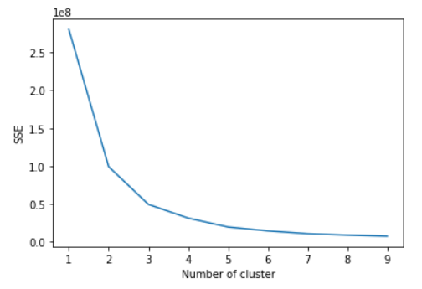
We clustered stores using K-means
Attributes created for each store
We selected the optimum number of clusters using the “Elbow Method”
Feature | Attribute
Promotion | # Item Discounted / total items sold
Customer diversity (loyalty) | Avg # Transactions in this store / total transactions for each customer
 | Q2 # Transactions in this store / total transactions
 | Q3 # Transactions in this store / total transactions
 | Q4 # Transactions in this store / total transactions
Traffic | # of transaction in this store/ total number of transactions in all store
Avg $ customer spent | $ per customer in this store/ total $ per customer in all store
Notes:
The idea is that we want a small SSE, but that the SSE tends to decrease toward 0 as we increase k (the SSE is 0 when k is equal to the number of data points in the dataset, because then each data point is its own cluster, and there is no error between it and the center of its cluster). So our goal is to choose a small value of k that still has a low SSE, and the elbow usually represents where we start to have diminishing returns by increasing k.

Slide 15
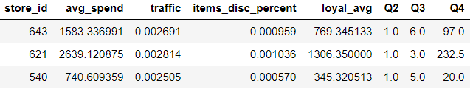
Pernalongas 421 stores can be clustered into three easily distinguishable segments
Three stores that are closest to three centroids
Clusters | Avg. Spend | Traffic | Discount Percent | Loyal Customers
1 | Mid | Mid | Mid | Mid
2 | High | High | High | High
3 | Low | Low | Low | Low

Slide 16
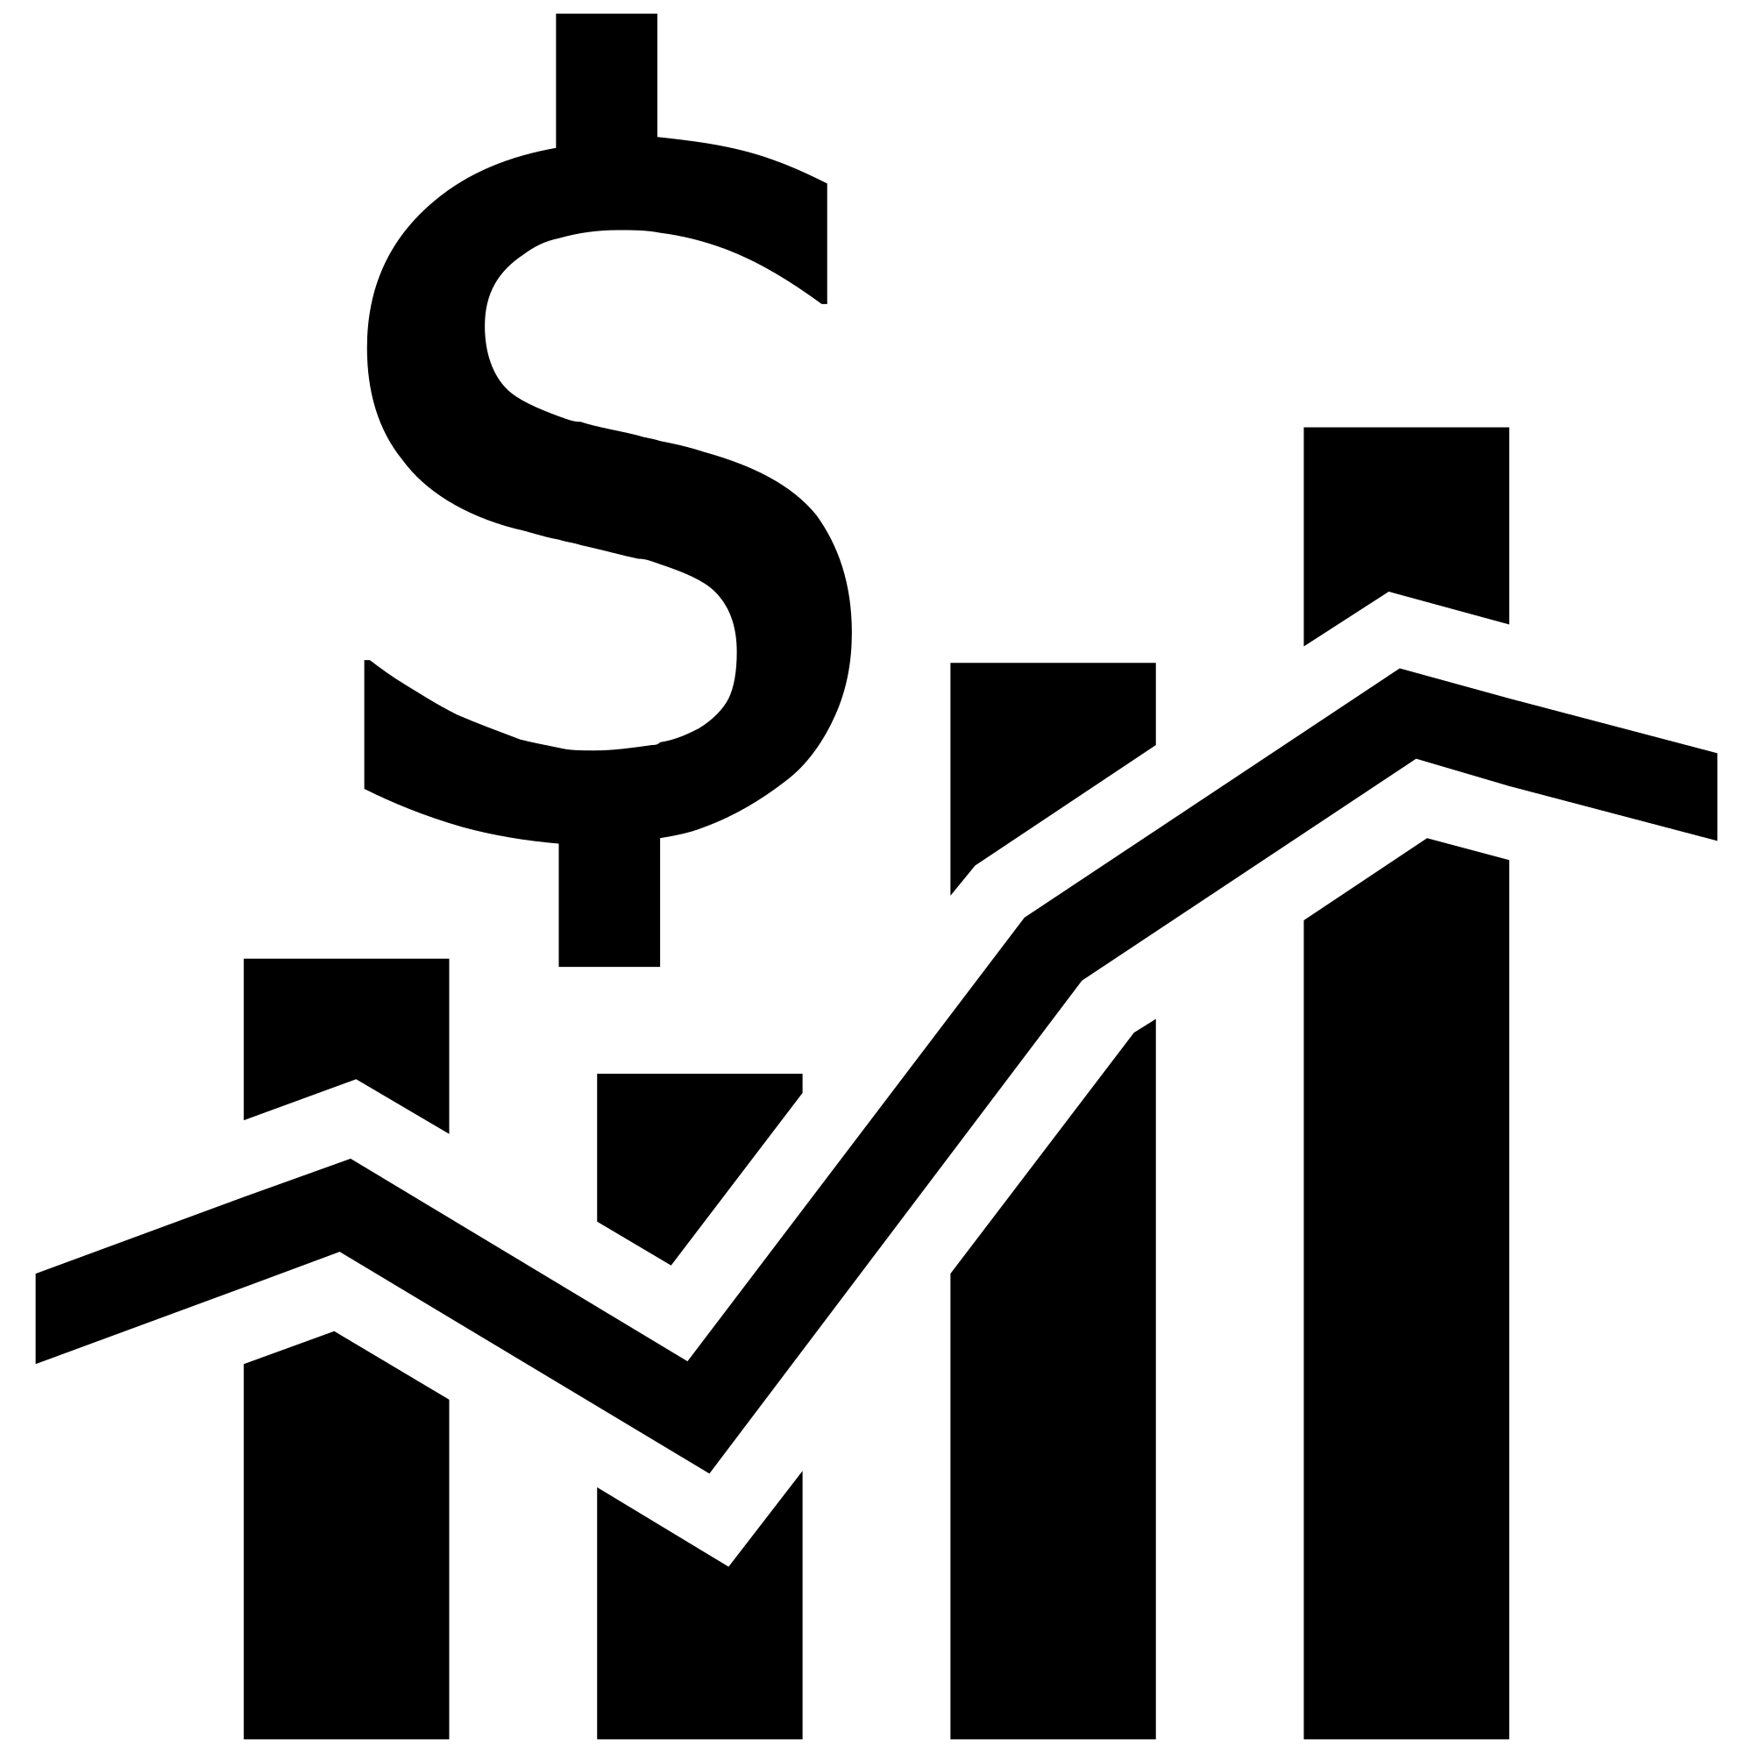
Our recommendations for growing sales
Individual offers for each store based on their customer base
Start with giving more personalized promotions to product segment 6 in store cluster 2
→ target promotion-driven customers
Avoid the (ever growing) product tail
Develop comprehensive understanding of popular items on customer and store levels
Decide which items to stock
→ reduce inventory fluctuation
→ increase the accuracy of demand planning
Next Steps
→ We can test some of the strategies on a small sample for each cluster and them ramp it up
→ Overall goal is to customize our stores and their promotions based on specific customer segments visiting that store the most

Slide 17
Thank you for your attention!
Any Questions before we cluster the class as well?

