Slide 1

Linux Introduction-Day01
Presenters:
Manoj Kanala

Slide 2
Overview
Interactive Session.
What do you know about Linux?
What do you think is the difference between Linux & Other Operating Systems?
History of Linux
Why Linux?
Working environment in Linux.
Linux Concepts.
Working in Linux.
Notes:
If you are here you probably wonder about what is Linux and if it will be a good idea to switch to use Linux instead of Windows.
Today class is an introductory class for Linux. Class following this one will be hands on Linux introduction.

Slide 3
Topics Covered
Day-01:
Linux History
Why Linux?
Linux Structure
Introduction to Linux GUI
Linux CLI
File-System Hierarchy
Day-02:
Accessibility Permissions
SSH/Telnet
User Administration
Day-03:
VI-Editor
Process Management
Network File System
Day-04:
Patch/Package Management
RAID (Redundant Array of Independent Disks)
Job Scheduling in Linux
Basic Networking in Linux
Day-05:
Logical Volume Manager
Trouble Shooting
Summary

Slide 4
Comparison: Linux Vs UNIX Linux Vs MS-Windows

Slide 5

Linux!= Windows
Linux | Windows
Freely distributed | Proprietary
Open Source | Closed Source
Multi User | Single User
Command Line Based | GUI Based
Support wide range platform | Limited platform support
More Secure | Less Secure
OS Comparison

Slide 6



Linux != UNIX
Linux | UNIX
Freely distributed | Proprietary
Open Source | Closed Source
Everyone. From home users to developers and computer enthusiasts alike. | Mainly for mainframes, servers and workstations
Originally developed for Intel's x86 | PA-RISC and Itanium machines
Ext2, Ext3, Ext4, | jfs, ufs, xfs, zfs
Inspired by MINIX | Developed by a group of AT&T employees at Bell Labs and Dennis Ritchie
Ubuntu, Fedora, Red Hat, Debian, Archlinux, Android etc. | AIX, HP-UX, Solaris
OS Comparison

Slide 7
History of Linux

Slide 8

History
In 80’s, Microsoft’s DOS was the dominated OS for PC.
Apple MAC was better, but expensive.
UNIX was much better, but much, much more expensive. Only for minicomputer for commercial applications.
People was looking for a UNIX based system, which is cheaper and can run on PC.
Both DOS, MAC and UNIX were proprietary, i.e., the source code of their kernel is protected.
No modification is possible without paying high license fees.
History of Linux

Slide 9
UNIX
UNIX is one of the most popular operating systems worldwide because of its large support base and distribution.
It was originally developed at AT&T as a multitasking operating system for minicomputers and mainframes in the 1970’s, but has since grown to become one of the most widely used operating systems.
Linux is a free version of UNIX developed by LINUS TORVALDS at the university of Helsinki in Finland.
History of Linux

Slide 10

GNU project
Established in 1984 by Richard Stallman, who believes that software should be free from restrictions against copying or modification in order to make better and efficient computer programs
GNU is a recursive acronym for “GNU's Not Unix”
Aim at developing a complete Unix-like operating system which is free for copying and modification
Companies make their money by maintaining and distributing the software, e.g. optimally packaging the software with different tools (Redhat, Slackware, Mandrake, SuSE, etc)
Stallman built the first free GNU C Compiler in 1991. But still, an OS was yet to be developed
History Of Linux

Slide 11

Beginning of Linux
A famous professor Andrew Tanenbaum developed Minix, a simplified version of UNIX that runs on PC
Minix is for class teaching only. No intention for commercial use
In Sept 1991, Linus Torvalds, a second year student of Computer Science at the University of Helsinki, developed the preliminary kernel of Linux, known as Linux version 0.0.1
Minix system that is developed by Andy Tanenbaum, inspired him to develop the 1st version of Linux. However, the Linux kernel uses no code from AT&T or any other proprietary source.
On October 5, 1991, Linus announced the first “official” version of Linux ,which was version 0.02.
History Of Linux

Slide 12
Linux Today
Linux has been used for many computing platforms
PC, PDA, Supercomputer,…
Not only character user interface but graphical user interface is available
Commercial vendors moved in Linux itself to provide freely distributed code. They make their money by compiling up various software and gathering them in a distributable format
Red Hat, Slackware, etc
About Linux

Slide 13
Linux - free software
Free software, as defined by the FSF (Free Software Foundation), is a "matter of liberty, not price." To qualify as free software by FSF standards, you must be able to:
Run the program for any purpose you want to, rather than be restricted in what you can use it for.
View the program's source code.
Study the program's source code and modify it if you need to.
Share the program with others.
Improve the program and release those improvements so that others can use them.
About Linux

Slide 14
Available Linux providers (Distributions/Vendors)
Red Hat Linux : One of the original Linux distribution. The commercial, non-free version is Red Hat Enterprise Linux, which is aimed at big companies using Linux servers and desktops in a big way. Free version: Fedora Project.
Debian GNU/Linux : A free software distribution. Popular for use on servers. However, Debian is not what many would consider a distribution for beginners, as it's not designed with ease of use in mind.
SuSE Linux : SuSE was recently purchased by Novell. This distribution is primarily available for pay because it contains many commercial programs, although there's a stripped-down free version that you can download.
Mandrake Linux : Mandrake is perhaps strongest on the desktop. Originally based off of Red Hat Linux.
Gentoo Linux : Gentoo is a specialty distribution meant for programmers.
About Linux

Slide 15
Why Linux?
Linux is a UNIX like operating systems.
Multi-user, Multi-tasking and Multi Processor Support.
Software Development Supports
Linux runs on nearly any CPU
Linux works very well as a personal computer UNIX for the desktop
Linux works well for server operations
X-Window system (An excellent window system called X)
About Linux

Slide 16
Linux Structure
User
Bash, Tcsh, Zsh, Ksh
→ls
→pwd, →whoami
→cat
→uname
Kernel
Shell
System
H/W
Commands
Linux Structure

Slide 17
Linux Kernel
Kernel is heart of Linux OS.
It manages resource of Linux OS, like store data, print data on printer, memory, file management etc .
Kernel decides who will use this resource, for how long and when.
Acts as an intermediary between the computer hardware and various programs/application/shell.
It performs following task :-
I/O management
Process management
Device management
File management
Memory management
Linux Kernel

Slide 18
Linux Shell
Shell interprets the command and request service from kernel.
Similar to DOS but DOS has only one set of interface while Linux can select different shell
Bourne Again shell (Bash), TC shell (Tcsh), Z shell (Zsh), Korne shell (Ksh).
Different shells has similar but different functionality.
Bash is the default for Linux.
Graphical user interface of Linux is in fact an application program work on the shell.
Linux Shell

Slide 19
Linux Shell Responsibilities
Program Execution
The shell is responsible for the execution of all programs that you request from your terminal.
I/O Redirection
It is the shell's responsibility to take care of input and output redirection on the command line.
Environment Control
Allows you customize your environment, like home directory, command prompt, paths, etc.
Interpreted Programming Language
Shell has its own built-in programming language. This language is interpreted, meaning that the shell analyzes each statement in the language one line at a time and then executes it.
Linux Shell

Slide 20
Different Linux Shells
/bin/sh
It is the default UNIX shell.
/bin/csh :
C Programming shell, having features of C programming language.
/bin/tcsh
C & CPP shell, a shell that incorporates elements from C & CPP language.
/bin/ksh
Korn shell, is a programming shell, compatible with bash, supporting advanced programming features.
/bin/bash
Bourne Again Shell, is a default shell for most of the Linux operating systems today.
Linux Shell

Slide 21
Shell Scripting/Programming
Shells are interactive, i.e. accepts command and execute them. You can use command one by one, so you can place them to a text file and tell shell to execute this file.
Shell script is defined as:
"Shell Script is series of command written in plain text file. Shell script is just like batch file is MS-DOS but have more power than the MS-DOS batch file."
Why to use them
Saves lots of time.
To automate some tasks of day today life.
Useful to create our own commands.
Linux Shell Programming

Slide 22
Linux GUI & CLI

Slide 23
The Menu Panel
Introduction to Linux GUI
Applications - The Applications menu contains a variety of icons that start software applications. It is similar to the Microsoft Windows Start menu.
Places - The Places menu contains a customizable list of directories, mounted volumes, recent documents, and a Search function. Volumes that are mounted may be external USB drives (flash, hard disk, CD, etc.), directories shared across a network, or other media devices such as a portable music player.
System - The System menu contains a variety of items.

Slide 24
System menu
Linux GUI
Log Out
About
Help
Lock Screen
Preferences
System Settings: configuration tools that are for administrative purposes and usually require root access; that is, when those applications are started, the root password must be entered to continue.

Slide 25






Some Default Applications
Mozilla Firefox web browser
Evolution mail client and personal information manager
OpenOffice.org Writer is a word processing program
OpenOffice.org Impress is for creating and giving presentations
OpenOffice.org Calc is a spreadsheet tool

Slide 26
The Desktop Area
Computer - This contains all volumes (or disks) mounted on the computer. These are also listed in the Places menu. Computer is equivalent to My Computer on Microsoft Windows.
Home - This is where the logged-in user stores all files by default, such as music, movies, and documents. There is a different home directory for each user, and by default users cannot access each others' home directories. Home is equivalent to My Documents on Microsoft Windows.
Trash - Deleted files are moved to Trash. Empty Trash by right-clicking the icon and clicking Empty Trash.
To permanently delete a file and bypass the file's move to Trash, hold down the [Shift] key when deleting the file.
Right-clicking on the desktop presents a menu of actions related to the desktop area. For example, clicking on Change Desktop Background lets you choose a different image or photograph to display on the desktop. It is possible to choose not to have any desktop background.

Slide 27
Office Software
word processor,
spreadsheet
presentation
database application
Introduction to Linux GUI
Notes:
There are a variety of office type applications for GNU/Linux, but one of them stands alone. The defacto, full-featured, office suite is called OpenOffice.org. 'Openoffice.org' :
word processor,
spreadsheet,
presentation and
database application
OpenOffice.org is completely compatible with many other office suites, including Microsoft Office.

Slide 28
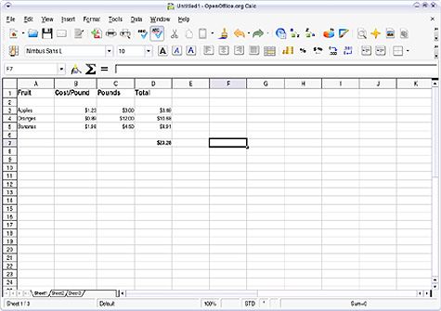
Open Office Calc

Slide 29
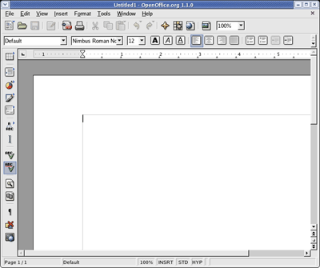
Open Office Writer

Slide 30
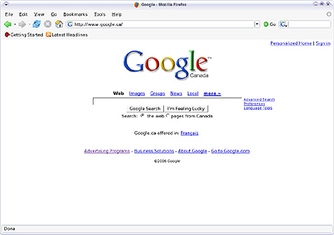
Web Browser: Firefox
Introduction to Linux GUI

Slide 31
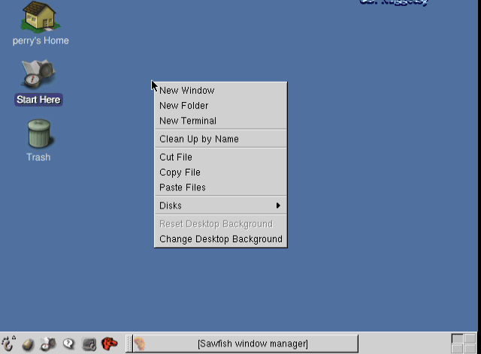
Terminal Window
4 MONITORS
Introduction to Linux GUI
Notes:
To open Terminal window right click on the desktop
This grid of four boxes on the left represents four monitors. This really isn't four monitors; it's as if you had four different monitors connected to your computer. If you need more space to lay out files, or to segment your multimedia applications from your office applications while you're working, you can click in one of the empty boxes to access a completely fresh, uncluttered copy of your desktop along with a fresh panel. You can see which of your virtual desktops has open windows by looking in this box.

Slide 32
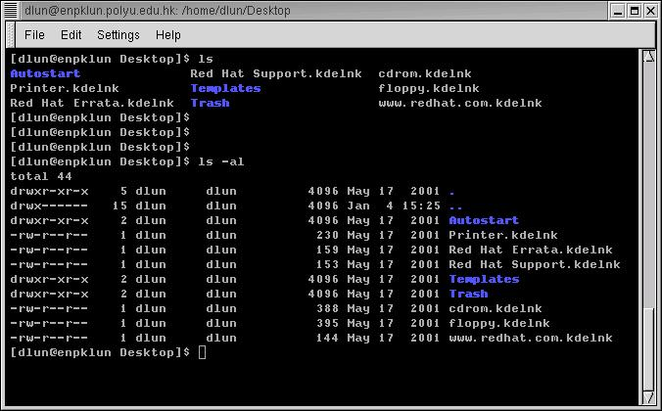
Linux CLI
command to show the content of current directory
The prompt # shows that bash shell is using
command to show the content of current directory with option -al
All LINUX commands start with the name of the command and can be followed by options and arguments.
Introduction to CLI

Slide 33
Linux CLI
The concept of simple file and directory is similar to DOS
Names in blue are directories, indicated by a letter d at the beginning of the line
Introduction to CLI

Slide 34
Linux Basic Commands
/root – home directory of the user root
pwd – you can see your home directory
df – to see disk space available
cd – to change to different directory or to go back to home dir
.. - move to parent directory
ls – list the contents of a directory; Options: -l (more info) -a (displays hidden files)-t (sort by time) -r (oldest first)
Example: ls –ltr : display an long list of files that are sorted by time, display the oldest ones first
cp – copy one file to another
rm – remove a file
man – ask for the manual (or help) of a command
e.g. man cd ask for the manual of the command cd
cat – to show the content of a text file
e.g. cat abc.txt show the content of abc.txt
whoami – to show the username of the current user
Some of the basic commands you should learn are the ones that help you navigate the file system.
Introduction to CLI

Slide 35
Linux Basic Commands
# ls
# pwd
# cat
# touch
# mkdir
# rmdir
# rm
# cd
# date
# w
# who
# logout
# cp
# mv
# find
# mail
# ps
# top
# uname
# uptime
# users
# hostname
# locate
# exit
Introduction to CLI

Slide 36
File System Hierarchy

Slide 37
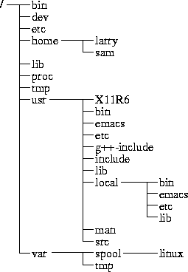
Directory Tree
(root)
When you log on the the Linux OS using your username you are automatically located in your home directory.
File-System Hierarchy
Notes:
Root Directory ( / )
Top of the file system. Similar to \ in DOS
/bin
Contain the binary (executable code) of most essential Linux commands, e.g. bash, cat, cp, ln, ls, etc.
/boot
Contain all the files needed to boot the Linux system, including the binary of the Linux kernel. E.g., on Red Hat Linux 6.1, the kernel is in /boot/vmlinux-2.2.5-15 file
/dev
Contain the special files for devices, e.g. fd0, hd0, etc.

Slide 38
Linux File Systems
ext
Introduced with Linux OS, provides basic UNIX like file system.
Uses inodes to track information about the file stored
Inode table for each separate device
The name comes from additional info it stores
ext2
ext2 and is a journaling file system
Can't handle files larger than 2 GB.
Windows
--------------
FAT
FAT32
NTFS
exFAT
Inode | File Name | Size | Owner | Group | Access Permissions | Pointer to disk
ext format + | created | modified | Last accessed time
File-System types

Slide 39
Journaling File-Systems
Journaling file systems provide new level of safety to the Linux system.
Instead of writing data directly to the storage devices and then updating the inode table, it writes changes into a temporary file (called journal) first.
After data is successfully written to storage & inode table, the journal entry is deleted.
Data Mode | Both inode and data journaled, low risk, poor performance
Ordered Mode | Only inode written to journal, not removed until data written successfully.
Write Back Mode | Only inode data written to journal, no control over when file is written. High risk of losing data.
File-System types

Slide 40
The most important subdirectories inside the root directory are:
/bin : Important Linux commands available to the average user.
/boot : The files necessary for the system to boot. Not all Linux distributions use this one. Fedora does.
/dev : All device drivers. Device drivers are the files that your Linux system uses to talk to your hardware. For example, there's a file in the /dev directory for your particular make and model of monitor, and all of your Linux computer's communications with the monitor go through that file.
/etc : System configuration files.
/home : Every user except root gets her own folder in here, named for her login account. So, the user who logs in with linda has the directory /home/linda, where all of her personal files are kept.
/lib : System libraries. Libraries are just bunches of programming code that the programs on your system use to get things done.
File-System Hierarchy

Slide 41
The most important subdirectories inside the root directory are:
/mnt : Mount points. When you temporarily load the contents of a CD-ROM or USB drive, you typically use a special name under /mnt. For example, many distributions (including Fedora) come, by default, with the directory /mnt/cdrom, which is where your CD-ROM drive's contents are made accessible.
/root : The root user's home directory.
/sbin : Essential commands that are only for the system administrator.
/tmp : Temporary files and storage space. Don't put anything in here that you want to keep. Most Linux distributions (including Fedora) are set up to delete any file that's been in this directory longer than three days.
/usr : Programs and data that can be shared across many systems and don't need to be changed.
/var : Data that changes constantly (log files that contain information about what's happening on your system, data on its way to the printer, and so on).
File-System Hierarchy

Slide 42
Home directory
You can see what your home directory is called by entering
pwd (print current working directory)
File-System Hierarchy

Slide 43
Linux Introduction-Day02
Presenters:
Manoj Kanala

Slide 44
File/Directory Permissions

Slide 45
About Linux Permissions
Each file and directory has three user based permission groups.
Owner
Groups
Other
d rwx rwx rwx root root 10 12 testdir
- rwx rwx rwx root root 10 12 test.txt
read – Capability to read the contents.
Write – Capability to write or modify.
Execute – Capability to execute a file or view directory contents.
Accessibility Permissions

Slide 46
Octal Permissions
Every permission has weight attached to it, as below
r – 4
w – 2
x – 1
Permissions Octal
--------------------------------------------------
- - - 0
- - x 1
- w - 2
- w x 3
- r - - 4
r - x 5
r w - 6
r w x 7
--------------------------------------------------
Accessibility Permissions

Slide 47
Some Examples
# chmod 660 file.txt
# chmod u=re,g=rw,o=r file.txt
# chmod u-r,g-r file.txt
# chmod u+x,g+x file.txt
# chmod a=rwx file.txt
# chmod a-x file.txt
# chmod -R a+rx *
Accessibility Permissions

Slide 48
Changing Ownership
-rw-r--r--. 1 root root 8K Oct 17 02:36 test
To change the owner of the file
# chown manoj test
-rw-r--r--. 1 manoj root 8K Oct 17 02:36 test
To change the group of file
# chgrp unix test
-rw-r--r--. 1 manoj unix 8K Oct 17 02:36 test
Owner Ship

Slide 49
SSH, Telnet
SSH (Secure Shell) is a terminal emulation protocol that allows a user to connect to a remote host via an encrypted and secure link.
Telnet is a terminal emulation protocol that lets a user log in remotely to other computers on the Internet; it has a command line interface.
SSH/Telnet

Slide 50
SSH Secure Shell
Included License key must be imported.
Start SSH client.
Click Help.
Select "Import License File."
Browse to the location of the "license.dat" included in zip file.
SSH/Telnet

Slide 51
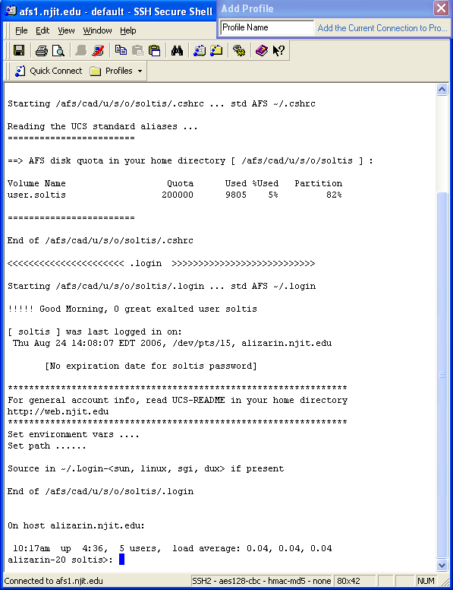
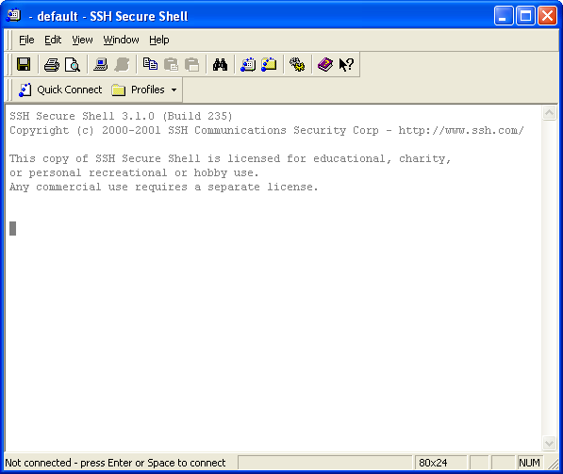
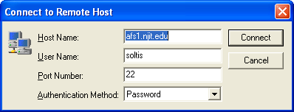

SSH/Telnet

Slide 52
Linux Users
There are three types of users in Linux OS
- Super User
- System users
- Local Users
Super user (root) is the user with all the privileges (in both single and multi-user mode) and can do system administration. It has ID 0 associated with.
System users are the users associated with local services but they never log into the system. System users have ID's from 1 to 499.
Local users are the user who can log into the system and work on the system. The local users can have ID's from 500 to 6500.
User Administration

Slide 53
User Administration
- Adding the user with the default settings
# useradd manoj
- To add the user with mentioning comments
# useradd -c “Manoj Kanala" manoj
- To add user with mentioning home directory
# useradd -d /tmp/manoj manoj
- To add user with expiration date
# useradd -e 2013-12-31 manoj
- To get the short info about user account passwd
# passwd -S manoj
To lock the user
# usermod -L manoj
User Administration

Slide 54
User Administration
- To unlock the user account
# passwd -u manoj
To force user to change the password
# passwd -e manoj
- To add user with mentioning secondary groups to it
# useradd -G IT manoj
- To add user while home directory will not be created for it
# useradd -M manoj
- To create a user with duplicate UID
# useradd -u 500 -o manoj
User Administration

Slide 55
User Groups
Primary Groups
It is a default group created while created a user.
Primary Group is the default group your account is associated when you login
Secondary Groups
Secondary Group is any Group(s) you are a member of other than your Primary Group
To change the user group
# usermod –G UNIX manoj
To make UNIX as primary group
# usermod –g UNIX manoj
User Administration

Slide 56
User Management
To change the name of the user
# usermod -l Manoj manoj
To change the shell of the user
# usermod -s /bin/csh manoj
To change the users ID
# usermod -u 580 manoj
To change the users expiry date
# usermod -e 2013-12-31 manoj
To modify the users comment
# usermod -c "test User"
User Administration

Slide 57
Linux Introduction-Day03
Presenters:
Manoj Kanala

Slide 58
VI Editor

Slide 59
VI Editor
Opens from terminal window
Screen oriented editor
Designed to run in command line and GUI
It is the most popular text editor in the Linux / UNIX world.
VI-Editor
Notes:
From the command line, type vi blah
The editor will appear on-screen, with a tilde, ~, on evey line, and at the bottom of the screen it says "blah" [new file]. If you want to put anything into this file, you have to put vi into insert mode. Do this by typing the letter 'i' on its own. "-- INSERT --" appears on the bottom of the screen. Now you can type in anything you want. Try typing "Hello", and then on a new line "World". Now try going back up to the line above, using the cursor keys and try to delete Hello. You wont be able to. When you give a Carraige Return (Press Enter in other words), the text on that line becomes static. If you want to delete it, heres how.
Press your Esc button on the top left of the keyboard, and the "-- INSERT --" at the base dissapears. Vi is ready to accept a new command. The only thing here is that vi will only delete what is in front of the cursor, let me show you. Bring the cursor to the start of Hello, and press the x key once. Now only 'ello' remains. This doesnt really make any sense, so we'll delete the line altogether. Press 'd' twice in quick sucession. Now we have the word 'World' on its own. Press 'i' and insert "Hello" again. This time, leave the text in insert mode. Press the "Insert" key on your keyboard, its above the cursor keys. The "-- INSERT --" at the base of the screen has been replaced with "-- REPLACE --". Now type the word "Nurse" over the existing "World". Press Esc again to return to the ready mode.
Vi has a search tool too, which I find indispensable. From the ready mode, type in a slash, /, and input the text you want to look for. Remember, since Linux is case sensitive, looking for "money" is not the same as looking for "Money".
Well, what about saving the file, or quitting without saving? What about just quitting? Its easy. From the ready mode, type in ":w" to write the file ... you already supplied the file name when you typed 'vi blah' earlier. The editor will return this on the status line : "blah" [New File] 1 line, 12 characters written. Lets quit out of it altogether. Type in ":q“or :quit!. You have been returned to the command prompt. There was an easier way of doing that ... from the ready mode in the editor, you could have just typed in, in cap:itals, "ZZ" ... this saves the file and quits. If you had wanted to quit without saving the changes, you could have just typed in ":q!", and nothing would have saved ... blah wouldn't have existed.

Slide 60
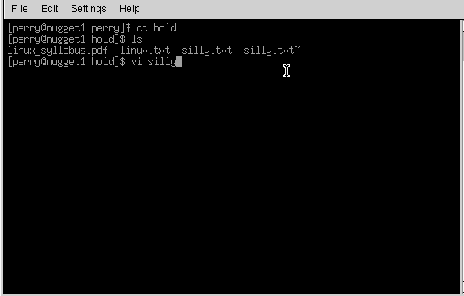
VI Editor
VI-Editor

Slide 61
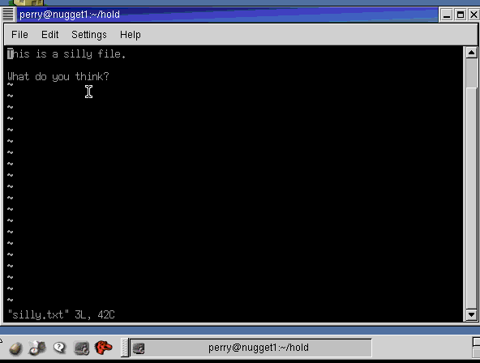
VI Editor
http://www.linux.ie/newusers/beginners-linux-guide/
VI-Editor
Notes:
Smaller program, more primitivy.
There are 3 modes:
Command mode
X mode
Edit mode
go into insert mode (by either pressing the letter 'i' or the insert key)
delete text to the right of the cursor one character at a time with 'x'
delete text one line at a time by pressing 'd' twice in quick succession
search for text with '/'
save text to a file (:w) and exit vi (:q or :q! if you don't mind losing changes).
“Exc” key will take you to the command mode.
I – Insert
Esc
Shift “:” and “wq” – write my changes and quit
“dd” delete line of text
“cat” prints file to the screen
Say that again. You can have a command repeated a number of times by first typing in the amount of times that you want the command to occur so to delete a seven lettered word just type '7x'. You might wonder about the above line 'delete text to the right of the cursor' - is this excess pedantry or is it leading on to something useful? The latter applies; pressing 'X' deletes the character immediately to the left of the cursor and typing 7X, for example, deletes any seven characters that are immediately to the left of the cursor.
So what happens if you are at the end of a 21 character line and you type '30X' - do nine charaters of the preceding line get deleted? No, the above line will remain intact but any the text to the left of the cursor will indeed get deleted.
You can, if you want to, repeat a command just once; by pressing '.', this I suppose could be called the 'redo' button; it has a counterpart ('u') which will undo the last change.
There's more than one way...to delete a word. Now, just to get back to deleting words. I mentioned that you could use '7x' to delete a seven lettered word. That's all well and good if you don't mind counting off the number of letters in whatever word it is that you want to delete. There's a better way to do this (there's always a better way). You can delete words with 'dw' and 'db'; use 'dw' for deleting words to the right of the cursor and 'db' for deleting words to the left - and if you want to delete seven words then use '7dw'.
Moving the cursor. This moves on (hur, hur) rather nicely to the next thing that I want to get to - moving the cursor around. Obviously you can use the cursor keys but there are other ways of doing it. For example, if you want to move to the start of the previous sentence use '(', if you want to move on to the next one then press ')'. You can go squiggly if you want to move around one paragraph at a time and use '{' or '}' respectively. If you only want move around by a few words then use 'W' and 'B'. The great thing about all of this is precision.
And I haven't even gotten to the good stuff yet.
Cut & Paste. Do you remember about 'dd', and that it deletes lines one at a time? Well here's something nifty that you can do with it and just one other command. Let's say that you have a four line block of text that you want to move (be it source code or whatever). Move the cursor to the first line of that block of text and type '4d', then move the cursor to where you want to put the text and type 'p'. This will put the text you previously deleted back in, after the cursor. Using 'P' will insert the deleted text before the cursor.
Copy & Paste. So now you know how to cut and paste text in vi. The next thing to learn is how to copy and paste text and there really isn't anything to it at all; instead of putting text into the memory buffer by deleting it text needs to be put there without deleting it. This is done by yanking the text. If you want to yank four lines of text into the buffer, move the cursor to the first line of that block of text and type '4Y'. You can then use 'p' or 'P' to place a copy of that text elsewhere.
Other ways to change text. There are a few other ways that you can use to edit text. If, for example, you have typed in 'ilug' where you meant 'ILUG' you can either press 'R' with the cursor at the start of 'ilug', type the abbreviation in with caps lock on and press ESC to get out of replace mode. Or you can do it quickly by positioning the cursor and then typing '4~'. And if you want to delete to the end of a line 'D' will work just fine.
Windows. Sometimes it can be quite handy to have more than one file open in vi at the same time - specifications in one 'window' and the source code in another for example. To do this you need to have one file open first and then press Ctrl & w (the control and 'w' keys at the same time) followed by 'n'. This will result in a new window created at the top of the screen, with the screen divided equally between the two windows. To edit a file in this new window you need to type ':e' followed by the name of the file. You can keep on doing this until you have as many files open as is needed.
Moving between the windows is fairly simple. Press Ctrl & w first to let vi know that you want to do something about the windows and then press:
t if you want to move to the top one
b if you want to move to the bottom window
Up arrow or down arrow to move to a window in the middle, you can also use 'j' or 'k' if you don't have any arrow keys for some reason.
Typing ':q' will close the window that the cursor is in, if you want to close all other windows then press 'Ctrl & w' followed by 'o'.

Slide 62
Vi Modes
Normal Mode:
For navigation and manipulation of text. This is the mode that vim will usually start in, which you can usually get back to with ESC
Insert Mode:
It is the mode for inserting new text.
Command Mode:
For entering editor commands
Within the command-line you can run commands, enter search patterns.
At the bottom, command line appears where you can enter the command.
After one command the editor returns into normal mode.
VI-Editor

Slide 63
Vi-Screen Manipulation
H – Move to top of screen
M – Move to middle of screen
L – Move to bottom of the screen
nH – Move to nth line of the screen
Navigation
j – move down
k – move up
l – move right
h – move left
VI-Editor

Slide 64
Vi-Control Commands
“Ctrl + f” -- Move forward one full screen
“Ctrl + b” -- Move backward one full screen
“Ctrl + d” -- Move forward 1/2 screen
“Ctrl + u” -- Move backward 1/2 screen
Deleting Characters
x -- Deletes the character under the cursor location.
X -- Deletes the character before the cursor location
dd -- Deletes the line the cursor is on.
D -- Deletes from the cursor position to the end of the current line.
VI-Editor

Slide 65
Searching in Vi-Editor
/word -- Searches forward for the word
?word -- Searches backward for the word
Set Commands
:set nu – Displays lines with line numbers on the left side.
:set nonu -- Unset line numbers on the left side.
:set ro -- Changes file type to "read only"
Getting Out
:w – save
:wq – save & quit
:q! – quit forcefully
:wq! – Save quit forcefully
VI-Editor

Slide 66
String Substitution in Vi-Editor
:g/Local Searches for the word Local and prints every occurrence of that line from the file
:/s/Local/Remote Substitute Remote for the word Local on the current line
:/s/Local/Remote/g Substitutes the first occurrence of the word Local on every line of the files with the word Remote
:/s/Local/Remote/gp Substitutes every occurrence of the word Local with the word Remote in the entire file, and then prints each line so that you can see the changes
VI-Editor

Slide 67
Process Management

Slide 68
Process States
R : Running/Runnable : The process is either running (it is the current process in the system) or it is ready to run (it is waiting to be assigned to one of the system's CPUs).
S : Sleeping/Suspended : means the process is waiting on a timer or a slow device (<< 20 Sec)
I : Idle : That is process is sleeping for > 20 secs
D : Waiting : waiting for an event or for a resource, means it is waiting on a fast device (generally I/O)
P : Waiting on Page in
T : Stopped : A process which has been frozen until killed or resumed.
Z : Zombie/defunct : This is a halted process which, for some reason.
Processes

Slide 69
Using “top” utility
- To refresh the top command o/p
# top <spacebar>
Type "c" in running to see absolute path for the running processes
Type "z" in running top command, to see o/p in color mode
To see all the running processes for a user
# top –u manoj
Type “Shift +o ”, to change the process sorting type
Processes

Slide 70
Checking Running Processes
- To see all the existing processes
# ps -ef
- To find a particular process
# ps –ef | grep abcd
- Processes for a particular user
# ps -U apache
- To display a tree of processes.
# pstree
- List the processes based on PIDs
# ps -f --ppid 9576
- To get security info
# ps –efZ
List the processes based on PIDs
# ps -f --ppid 9576
Processes

Slide 71
Killing / Aborting Processes
- To kill the process
# kill -9 PID
( sends a process a SIGKILL signal)
- To kill more than one process
# kill pid1 pid2 pid3 pid4.....
To sent a SIGKILL signal
# kill -9 1234
To list all signals from the environment
# man -k signal
- Use below command to find the kill command signals
# kill -l 9
# kill -l 2
# kill -l 15
Processes

Slide 72
Network File System

Slide 73
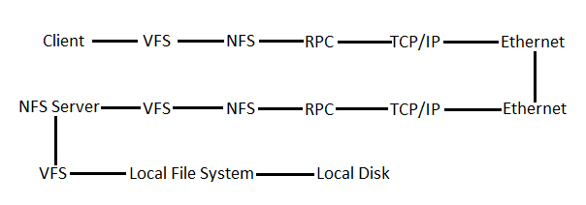
About NFS
Network File System (NFS) is a distributed file system protocol originally developed by Sun Microsystems in 1984, allowing a user on a client computer to access files over a network in a manner similar to how local storage is accessed
RPM allows programs to execute procedure(subroutine) in another address space (generally on another computer within network)
A VFS is an abstraction layer on concrete file system.
VFS allows client applications to access different types of concrete file systems in a uniform way.
A VFS can, for example, be used to access local and network storage devices transparently without the client application noticing the difference
Network File System

Slide 74
Basic NFS Sharing
To share any directory through NFS, edit “/etc/exports” (Server side)
# vi /etc/exports
See the visible mounts from clients by
# showmount –e 192.168.242.170
Mount the shared NFS, on local mount
# mount 192.168.242.170:/nfs_share /mnt/nfs /manoj1
You can give below command
# mount -t nfs4 192.168.242.170:/nfs_share /mnt/nfs /manoj1
Network File System

Slide 75
NFS with Autofs
Edit “/etc/auto.master” file, as (on client side)
# vi /etc/auto.master
------------------------
/test /etc/auto.misc --timeout 60
------------------------
Add the following line to “/etc/auto.misc”
------------------------------------------------
/test –rw,soft,intr,rsize=8192,wsize=8192 192.168.242.170:/nfs_share
------------------------------------------------
Network File System

Slide 76
Linux Introduction-Day04
Presenters:
Manoj Kanala

Slide 77
Patch/Package Management

Slide 78
RedHat Package Manager (RPM)
RPM stands for RPM Package Manager", its a recursive acronym.
The name RPM variously refers to the .rpm file format, files in this format, software packaged in such files, and the package manager itself.
Typically contains the compiled version of the software, to store and maintain software's.
Features of RPM include:
RPM packages can be cryptographically verified with GPG and MD5
Original source archive(s) (e.g. .tar.gz, .tar.bz2) are included in SRPMs, making verification easier.
PatchRPMs and DeltaRPMs, the RPM equivalent of a patch file, can incrementally update RPM-installed software
Automatic build-time dependency evaluation.
Patch Management

Slide 79
RPM Queries
To list all the packages installed
# rpm –qa
To see if any particular package is installed
# rpm -q vsftpd
To Query package owning <file>.
# rpm –qf /etc/fstab
To list all the files from the packages
# rpm –ql vsftpd
To list documentation files
# rpm –qd vsftpd
To list all configuration files
# rpm –qc vsftpd
To see all the dependancies
# rpm -qR vsftpd
# rpm –q –requires vsftpd
To see the file states
# rpm –qs vsftpd
To show all available information for each file
# rpm –q --dump vsftpd
Patch Management

Slide 80
RPM Management
To install an RPM package
# rpm –ivh nx-3.5.0-2.el6.centos.i686.rpm
- To Upgrade a RPM Package
# rpm -Uvh nx-3.5.0-2.el6.centos.i686.rpm
- To Remove a RPM Package
# rpm -evv nx
- To verify all RPM Packages
# rpm -Va
Patch Management

Slide 81
YellowDog Updater Modified (YUM)
- To install
# yum install package1.rpm
# yum install package1.rpm package2.rpm
To update
# yum update package1.rpm
# yum update package1.rpm package2.rpm
- To search
# yum search package1.rpm
# yum search package1 package2
To remove/uninstall
# yum remove package1.rpm
# yum remove package1.rpm package2.rpm
Patch Management

Slide 82
YellowDog Updater Modified (YUM)
- To update
# yum check-update
# yum update
# yum update –y
# yum update yum
- Get info
# yum info yum
# yum info vsftpd
- To see the lists
# yum list all
# yum list available
# yum list installed
To clean
# yum clean package1.rpm
# yum clean all
- To see what provides
# yum provides vsftpd
# yum provides yum
# yum whatprovides vsftpd
# yum whatprovides /etc/passwd
Patch Management

Slide 83
YellowDog Updater Modified (YUM)
When managing several identical systems, Yum also allows you to perform a transaction on one of them, store the transaction details in a file, and after a period of testing, repeat the same transaction on the remaining systems as well.
# yum -q history addon-info id saved_tx > file_name
Copy paste this file onto other system
# yum load-transaction file_name
Note, however that the rpmdb version stored in the file must be identical to the version on the target system.
To list the yum history
# yum history list all
Starting New Transaction History
# yum history new
Patch Management

Slide 84
RAID (Redundant Array Of Independent Disks)

Slide 85
RAID concepts
13.1 What is RAID:
RAID (redundant array of independent disks; originally redundant array of inexpensive disks) is a way of storing the same data in different places (thus, redundantly) on multiple hard disks. By placing data on multiple disks, I/O (input/output) operations can overlap in a balanced way, improving performance. Since multiple disks increases the mean time between failures (MTBF), storing data redundantly also increases fault tolerance.
The need for RAID can be summarized in two points given below. The two keywords are Redundant and Array.
An array of multiple disks accessed in parallel will give greater throughput than a single disk.
Redundant data on multiple disks provides fault tolerance.
RAID Concepts

Slide 86
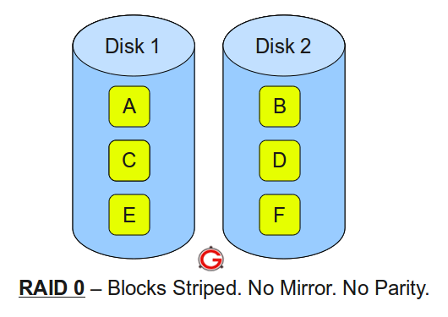
RAID concepts
RAID Levels:
On most situations you will be using one of the following four levels of RAIDs.
• RAID 0
• RAID 1
• RAID 5
• RAID 10 (also known as RAID 1+0)
This article explains the main difference between these raid levels along with an easy to understand diagram.
In all the diagrams mentioned below:
A, B, C, D, E and F – represents blocks
p1, p2, and p3 – represents parity
RAID LEVEL 0
Following are the key points to remember for RAID level 0.
• Minimum 2 disks.
• Excellent performance ( as blocks are striped ).
• No redundancy ( no mirror, no parity ).
• Don’t use this for any critical system.
RAID Concepts

Slide 87
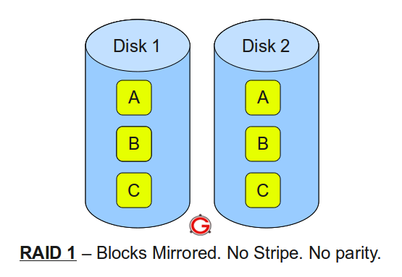
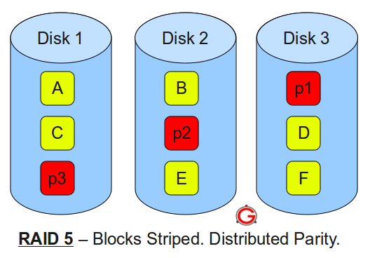
RAID concepts
RAID LEVEL 1
Following are the key points to remember for RAID level 1.
• Minimum 2 disks.
• Good performance ( no striping. no parity ).
• Excellent redundancy ( as blocks are mirrored ).
RAID LEVEL 5
Following are the key points to remember for RAID level 5.
• Minimum 3 disks.
• Good performance ( as blocks are striped ).
• Good redundancy ( distributed parity ).
• Best cost effective option providing both
performance and redundancy.
Use this for DB that is heavily read oriented.
Write operations will be slow.
RAID Concepts

Slide 88
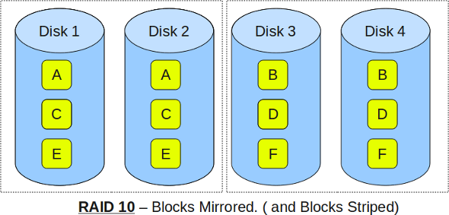
RAID concepts
RAID LEVEL 10
Following are the key points to remember for RAID level 10.
• Minimum 4 disks.
• This is also called as “stripe of mirrors”
• Excellent redundancy ( as blocks are mirrored )
• Excellent performance ( as blocks are striped )
• If you can afford the dollar, this is the BEST option for any mission critical
applications (especially databases).
RAID Concepts

Slide 89
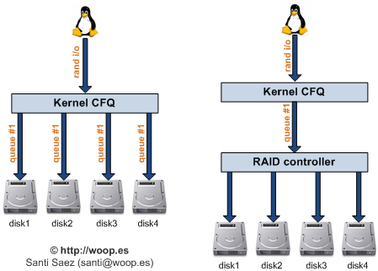
RAID concepts
Hardware RAID versus Software RAID
The hardware-based array manages the RAID subsystem independently from the host and presents to the host only a single disk per RAID array.
An example of a Hardware RAID device would be one that connects to a SCSI controller and presents the RAID arrays as a single SCSI drive. An external RAID system moves all RAID handling "intelligence" into a controller located in the external disk subsystem. The whole subsystem is connected to the host via a normal SCSI controller and appears to the host as a single disk.
RAID Concepts

Slide 90
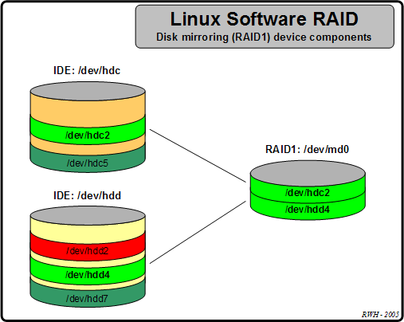
RAID concepts
RAID controllers also come in the form of cards that act like a SCSI controller to the operating system but handle all of the actual drive communications themselves. In these cases, you plug the drives into the RAID controller just like you would a SCSI controller, but then you add them to the RAID controller's configuration, and the operating system never knows the difference
Software RAID
Software RAID implements the various RAID levels in the kernel disk (block device) code. It offers the cheapest possible solution, as expensive disk controller cards or hot-swap chassis [1] are not required. Software RAID also works with cheaper IDE disks as well as SCSI disks. With today's fast CPUs, Software RAID performance can excel against Hardware RAID.
The MD driver in the Linux kernel is an example
of a RAID solution that is completely hardware
independent. The performance of a software-based array
is dependent on the server CPU performance and load.
RAID Concepts

Slide 91
RAID concepts
For those interested in learning more about what Software RAID has to offer, here are the most important features:
Kernel-based configuration
Portability of arrays between Linux machines without reconstruction
Backgrounded array reconstruction using idle system resources
Hot-swappable drive support
Automatic CPU detection to take advantage of certain CPU optimizations
RAID Concepts

Slide 92
Scheduling in Linux

Slide 93
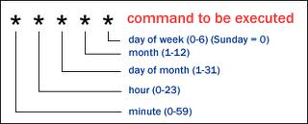
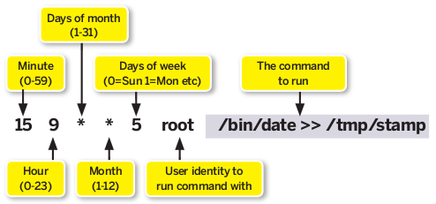
Scheduling options in Linux
Running jobs at regular intervals is managed by the cron facility, which consists of the crond daemon and a set of tables describing what work is to be done and with what frequency. The daemon wakes up every minute and checks the crontabs to determine what needs to be done. Users manage crontabs using the crontab command. The crond daemon is usually started by the init process at system startup
Schedule tasks on Linux using crontab
Cron is a daemon that executes scheduled commands. Cron is started automatically from /etc/init.d on entering multi-user runlevels, The basic usage of cron is to execute a job in a specific time

Slide 94
Scheduling options in Linux
Examples 1: To execute the script: /bin/execute/this/script.sh on every Friday 1AM
0 1 * * 5 /bin/execute/this/script.sh
The script is now being executed when the system clock hits:
1. minute: 0
2. of hour: 1
3. of day of month: * (every day of month)
4. of month: * (every month)
5. and weekday: 5 (=Friday)
Examples 2: To schedule the script to Monday till Friday at 1 AM
0 1 * * 1-5 /bin/execute/this/script.sh
The script is now being executed when the system clock hits:
1. minute: 0
2. of hour: 1
3. of day of month: * (every day of month)
4. of month: * (every month)
5. and weekday: 1-5 (=Monday til Friday)
Job Scheduling

Slide 95
Scheduling options in Linux
Examples 3:
What if you'd want to run something every 10 minutes? Well you could do this:
0,10,20,30,40,50 * * * * /bin/execute/this/script.sh
(OR)
*/10 * * * * /bin/execute/this/script.sh
How to delete Cron-Jobs: We deleted the scheduled jobs by crontab –r or we can edit the /etc/crontab
9.2 Run jobs at specific times :
Sometimes you may need to run a job just once, rather than regularly. For this you use the at command. The commands to be run are read from a file specified with the -f option, or from stdin if -f is not used. The -m option sends mail to the user even if there is no stdout from the command. The -v option displays the time at which the job will run before reading the job. The time is also displayed in the output.
#at -f mycrontest.sh 10pm tomorrow
job 14 at Sun Jul 8 22:00:00 2007
#at -f mycrontest.sh 2:00 tuesday
job 15 at Tue Jul 10 02:00:00 2007
Job Scheduling

Slide 96
Scheduling options in Linux
How to delete scheduled jobs with at:
#atq
16 Wed Jul 11 02:00:00 2007 a ian
17 Sat Jul 14 02:00:00 2007 a ian
14 Sun Jul 8 22:00:00 2007 a ian
15 Tue Jul 10 02:00:00 2007 a ian
#atrm 16 14 15
#atq
17 Sat Jul 14 02:00:00 2007 a ian
Job Scheduling

Slide 97
Basic Networking in Linux

Slide 98
Basic Networking in Linux
Basic Commands to check Network information:
#ping // Sends test packets to a specified server to check if it is responding properly
#ifconfig -a //Display all network interfaces on server, active or inactive.
#ifconfig eth0 192.168.10.12 netmask 255.255.255.0 broadcast 192.168.10.255 //Assigning an IP address
#ifconfig eth0 down //This will take eth0 (assuming the device exists) down
#ifconfig eth0 up //You guessed it. This would take eth0 up and available to receive or send packets.
#netstat //Shows all current network connections.
#netstat –an //Shows all connections to the server, the source and destination ips and ports
#netstat -rn //Shows routing table for all ips bound to the server.
#route -n //Shows routing table for all ips bound to the server.
Linux Network Concepts

Slide 99
Basic Networking in Linux
Nslookup is a program to query Internet domain name servers. Interactive mode allows the user to query name servers for information about various hosts and domains or to print a list of hosts in a domain.
#nslookup cyberciti.biz //To find out an IP address of cyberciti.biz, Forward lookup
Sample outputs:
Server: 127.0.0.1
Address: 127.0.0.1#53
Non-authoritative answer:
Name: cyberciti.biz
Address: 75.126.153.206
#nslookup 75.126.153.206 //You can run reverse ip lookup
Server: 127.0.0.1
Address: 127.0.0.1#53
Non-authoritative answer:
206.153.126.75.in-addr.arpa name = www.cyberciti.biz
Linux Network Concepts

Slide 100
Basic Networking in Linux
Network Configuration Files:
/etc/resolve.conf //List DNS servers for internet domain name resolution.
/etc/hosts //Lists hosts to be resolved locally (not by DNS).
/etc/sysconfig/network //Specify network configuration. eg. Static IP, DHCP, NIS, etc.
/etc/sysconfig/network-scripts/ifcfg-device //Specify TCP network information.
Assign more than one IP address to one Ethernet card:
#ifconfig eth0 XXX.XXX.XXX.XXX netmask 255.255.255.0 broadcast XXX.XXX.XXX.255
#ifconfig eth0:0 192.168.10.12 netmask 255.255.255.0 broadcast 192.168.10.255
#ifconfig eth0:1 192.168.10.14 netmask 255.255.255.0 broadcast 192.168.10.255
#route add -host XXX.XXX.XXX.XXX dev eth0
#route add -host 192.168.10.12 dev eth0
#route add -host 192.168.10.14 dev eth0
Config file: /etc/sysconfig/network-scripts/ifcfg-eth0:0
Linux Network Concepts

Slide 101
Linux Introduction-Day05
Presenters:
Manoj Kanala

Slide 102
LVM (Logical Volume Manager)

Slide 103
About LVM
- Logical volume management provides a higher-level view of the disk storage on a computer system than the traditional view of disks and partitions
- This gives the system administrator much more flexibility in allocating storage to applications and users.
LVM used for:
- Adding and replacing disks without downtimes and services disruption, in combination with hot swapping.
- Allows file systems to be easily resized later as needed.
- Performing consistent backups by taking snapshots of the logical volumes.
- Creating single logical volumes of multiple physical volumes or entire hard disks
Logical Volume Manager

Slide 104
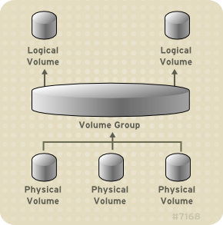
LVM
Logical Volume Manager

Slide 105
Basic LVM Configuration
To Create
To created the physical volume
# pvcreate /dev/sda
To create a volume group
# vgcreate VG00 /dev/sda /dev/sdb
To create logical volume
# lvcreate -L 50G -n /dev/VG00/LV_00 (-L for size)
To Remove
To remove the logical volume
# lvremove /dev/VG00/LV00
To remove the volume group
# vgremove VolGroup00
To remove the physical volumes
# pvremove /dev/sda
Logical Volume Manager

Slide 106
LVM Snapshot
A snapshot volume is a special type of volume that presents all the data that was in the volume at the time the snapshot was created.
A snapshot volume can be as large or a small as you like but it must be large enough to hold all the changes that are likely to happen to the original volume during the lifetime of the snapshot
Snapshot is great for backing up important data that cant be locked due to high availability, traditional backup systems locks data while backups.
To create a LVM snapshot
# lvcreate –L50M -s –n root_snapshot /dev/VG00/root_lv
To mount the snapshot volume (i.e. “root_snapshot”)
# mkdir /mnt/snapshot
# mount /dev/VG00/root_snapshot /mnt/snapshot
# ls -l
To do the backup
# tar -pczf /backups/test_backup.tar.gz /mnt/VG00/test_snapshot
Logical Volume Manager

Slide 107
Basic Trouble shooting

Slide 108
Load Average Issues
- Load Averages differ from CPU percentage in two significant ways
- Its the trend in CPU utilization not only an instantaneous snapshot,
It includes the demand for the CPU not only how much was active
If the load Average is high that means there are more number of processes waiting for CPU , Memory or I/O to be processed.
The next cause for high load is a system that has run out of available RAM and has started to go into swap. Because swap space is usually on a hard drive that is much slower than RAM, when you use up available RAM and go into swap
Trouble Shooting

Slide 109
Load Average
Find the processes which are waiting for CPU or consuming more the CPU. Check if any processes are running any
# top
To see if memory is the culprit behind the high load
# top
# sar –r 2 10
# free –m –t
- To find the processes which are waiting for CPU, do below
# ps –ef | grep D
(D – gives processes which are waiting for I/O or any resources )
Trouble Shooting

Slide 110
Disk Space Issues
To find the root cause behind disk space issues, we need to track down the files consuming more space and recently been added or generated
# du –sh * | grep G | sort –nr
# find /var -type f -mmin -60 (modified)
# find /target_directory -type f -mtime -2 (days)
# df –h
# ls -ltrh
Trouble Shooting

Slide 111
Ping Failed Issues
Try to ping the server
# ping <IP-Address>
Try to login to server using the standard methods
Login to another server, and try to reach the server in question
See if the server has any another interface card to reach
# ssh user@<IP-Address>
Try to telnet the server
# telnet 192.168.242.170
Trouble Shooting

Slide 112
System Rebooted
Check the uptime
# uptime
Check the last logins
# last | less
Check the system logs
# grep -ri syslogd /var/log/
Check the system authentication logs
# tail -250 /var/log/secure
Check the root command history
# su –
# history 90
Trouble Shooting

Slide 113
Summary
We have seen
What is Linux
Gone through the its history
File systems Linux supports
VIM editor
Zipping and archiving
User administration
Patching
Troubleshooting

