Slide 1
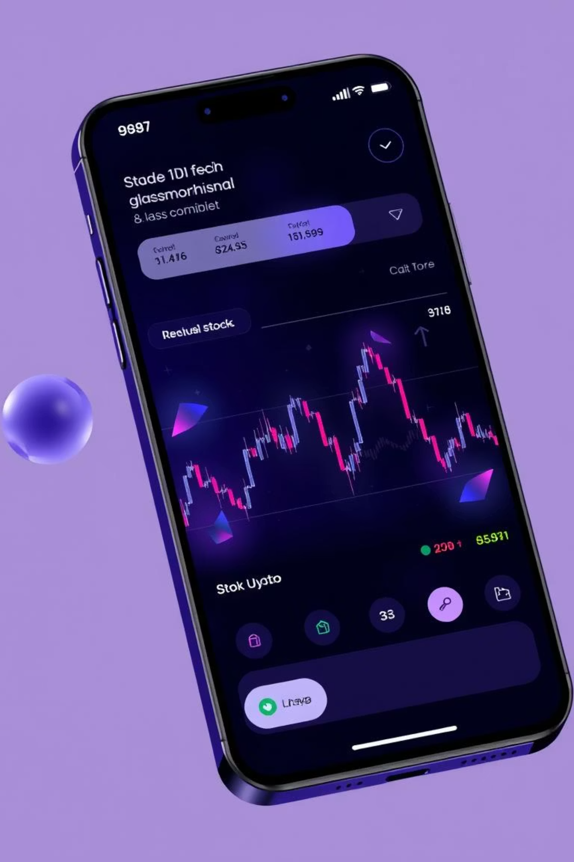
StockIt: Your Advanced Mobile Trading Platform
Welcome to StockIt, a cutting-edge mobile application designed for seamless stock trading. Experience real-time market data, comprehensive portfolio management, and an intuitive, secure platform.
Team Infinity Iterator
By Gamidi Surya Vardhin
(22BDS0114)
By Shashank Shekhar
(22BCE3319)

Slide 2



Our Key Contributions
UI/UX Development (Gamidi Surya Vardhin)
Designed and implemented intuitive user interfaces for onboarding, home, and profile screens. Focused on responsive design for seamless interaction.
Market Features (Shashank Shekhar)
Developed interactive stock detail views with live charts. Created personalized watchlist functionality for efficient stock tracking and management.
System Integration (Shashank Shekhar)
Integrated secure REST APIs for robust data communication. Managed authentication and ensured smooth data flow with comprehensive error handling.

Slide 3



Our Key Contributions
Authentication System (Shashank Shekhar)
Developed secure sign-in and sign-up flows. Managed authentication states and JWT tokens. Ensured robust session handling.
Stock Detail Screen (Gamidi Surya Vardhin)
Built interactive charts with live prices. Displayed company information and multiple timeframes. Delivered comprehensive market data.
Watchlist Management (Gamidi Surya Vardhin)
Created personalized watchlists for stocks. Enabled adding, removing, and live price monitoring. Ensured data persistence and sync.

Slide 4
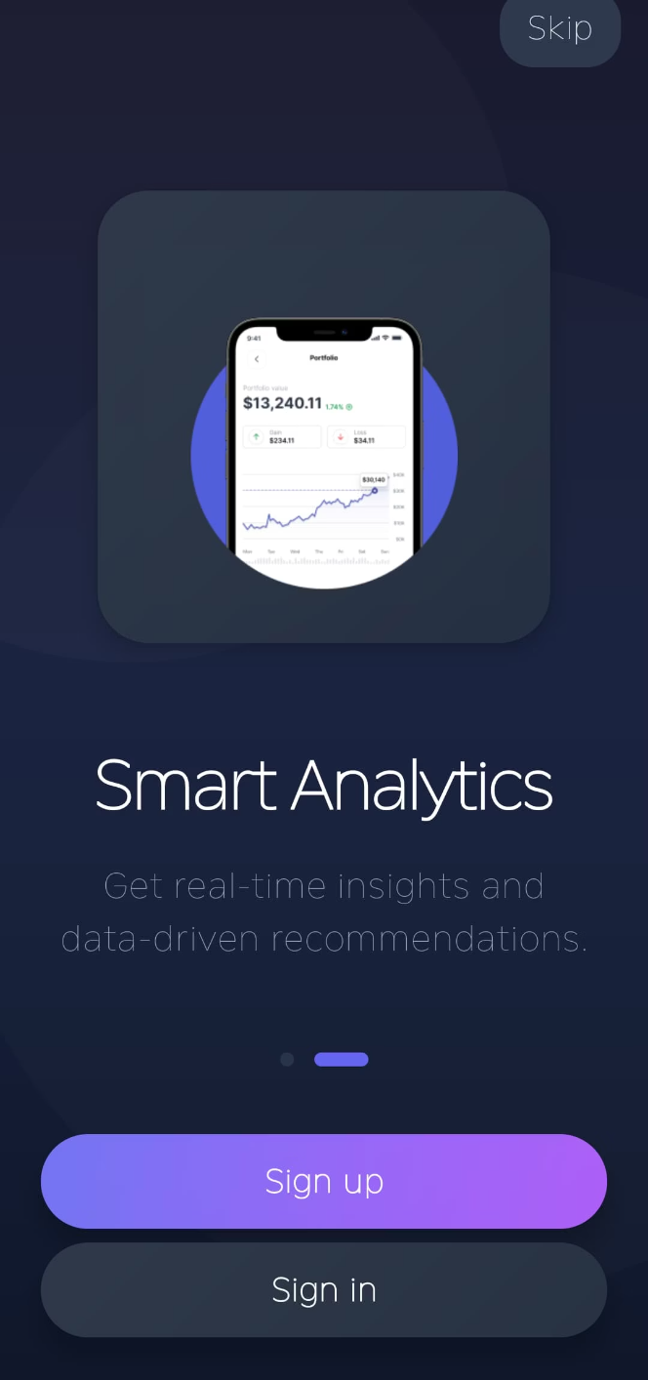
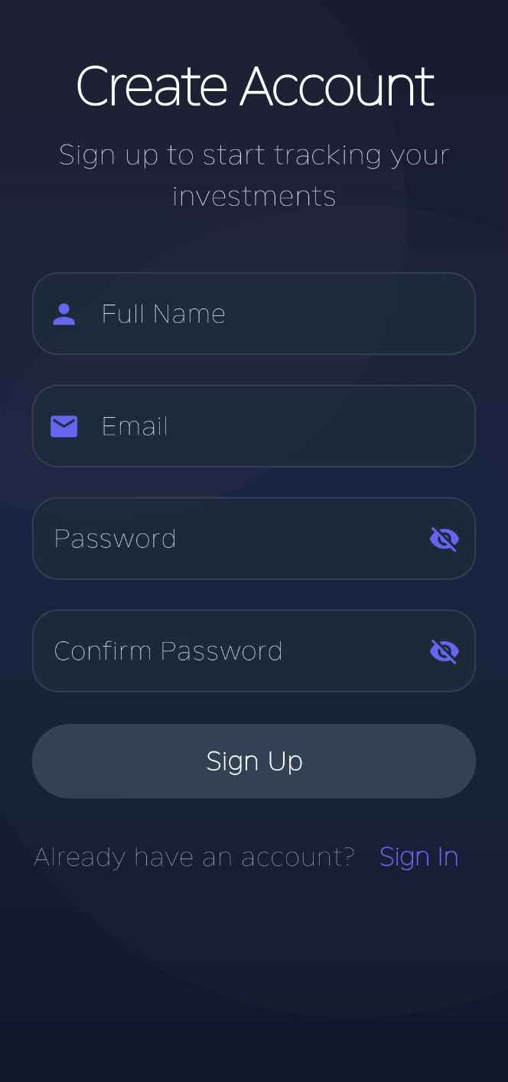
Sleek Design and User Experience
StockIt features a stunning dark-themed interface with modern glassmorphism effects. Enjoy smooth, spring-based animations and a responsive layout that adapts to any screen size.
Modern UI/UX
Elegant dark mode and responsive design.
Smooth Animations
Engaging spring-based transitions.
Accessibility First
Full support for screen readers and semantic descriptions.

Slide 5




Real-Time Market Insights
Stay ahead with live stock prices and interactive charts. Access trending stocks and advanced analytics to make informed decisions, all updated instantly via WebSocket connections.
Live Stock Prices
Interactive Charts
Instant updates for accurate trading.
Multiple timeframes for detailed analysis.
Trending Stocks
Advanced Analytics
Curated lists of top performers.
Technical indicators and market statistics.

Slide 6
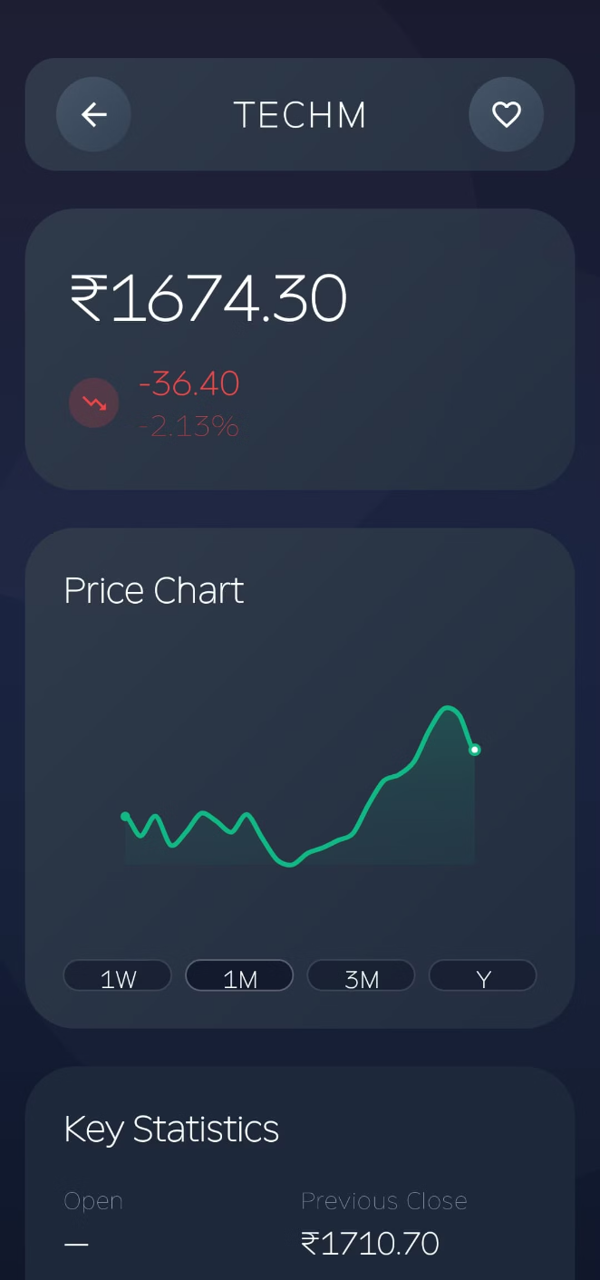
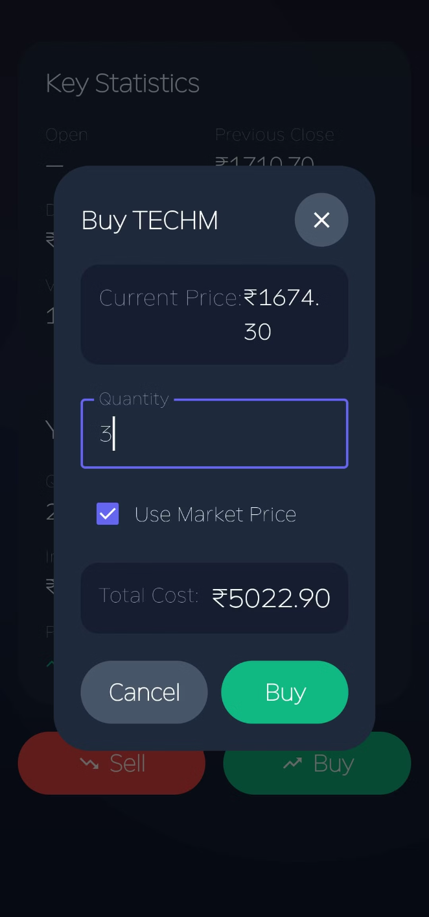



Effortless Portfolio and Trading
Manage your investments with ease. Track real-time portfolio value, detailed holdings, and transaction history. Execute trades seamlessly with market orders and real-time price validation.
Portfolio Overview
Real-time value and P&L tracking.
Holdings Management
Detailed performance metrics.
Performance Analytics
Profit/loss with percentage calculations.

Slide 7
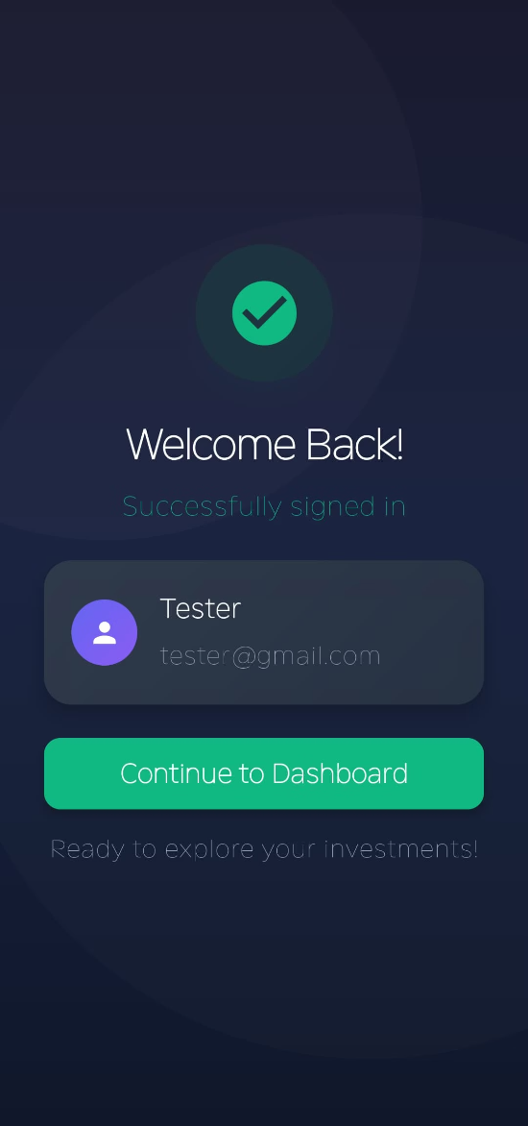
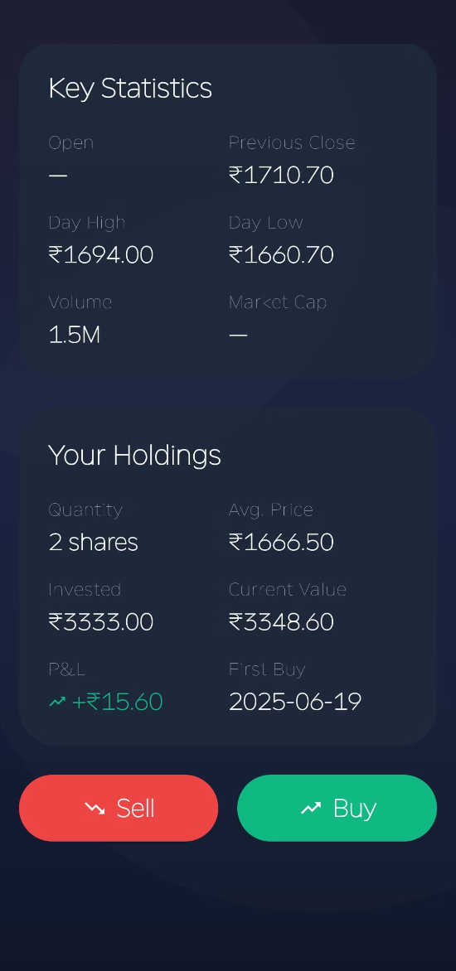
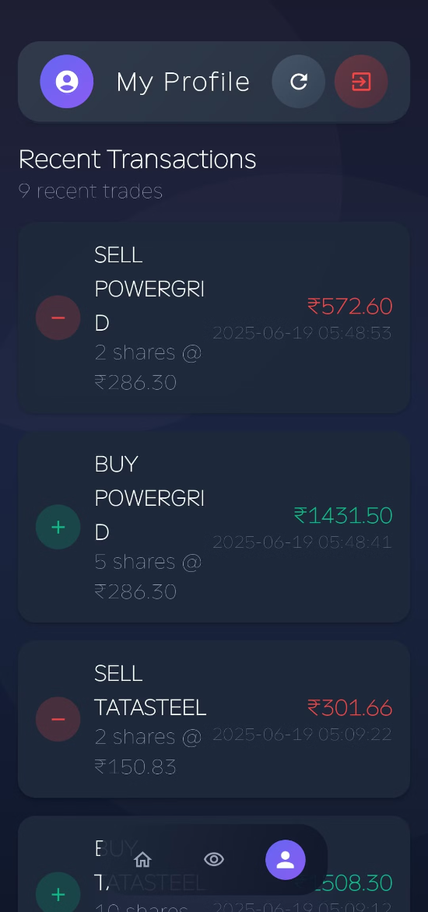
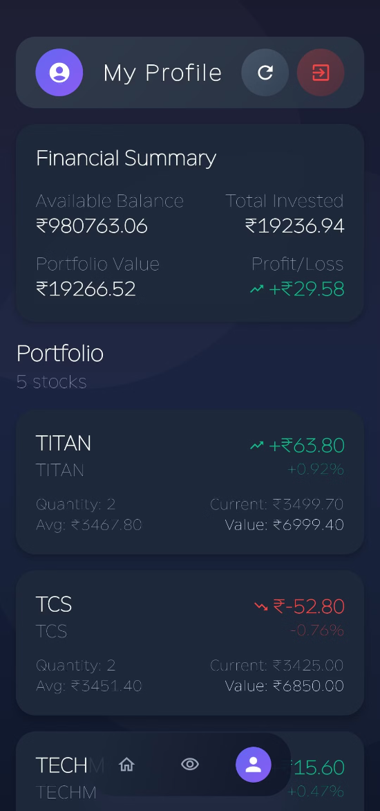
Sign-In Success Screen
Stock Detail & Holdings Screen
Profile - Recent Transactions Screen
Profile - Portfolio Summary Screen
Displays a welcome message after successful login with user info and a "Continue to Dashboard" button.
Shows stock statistics, user holdings, investment value, and P&L with "Buy" and "Sell" action buttons.
Displays available balance, total invested, profit/loss, and a summary of all owned stocks.
Lists recent buy/sell transactions with stock name, quantity, price, and timestamps.

Slide 8

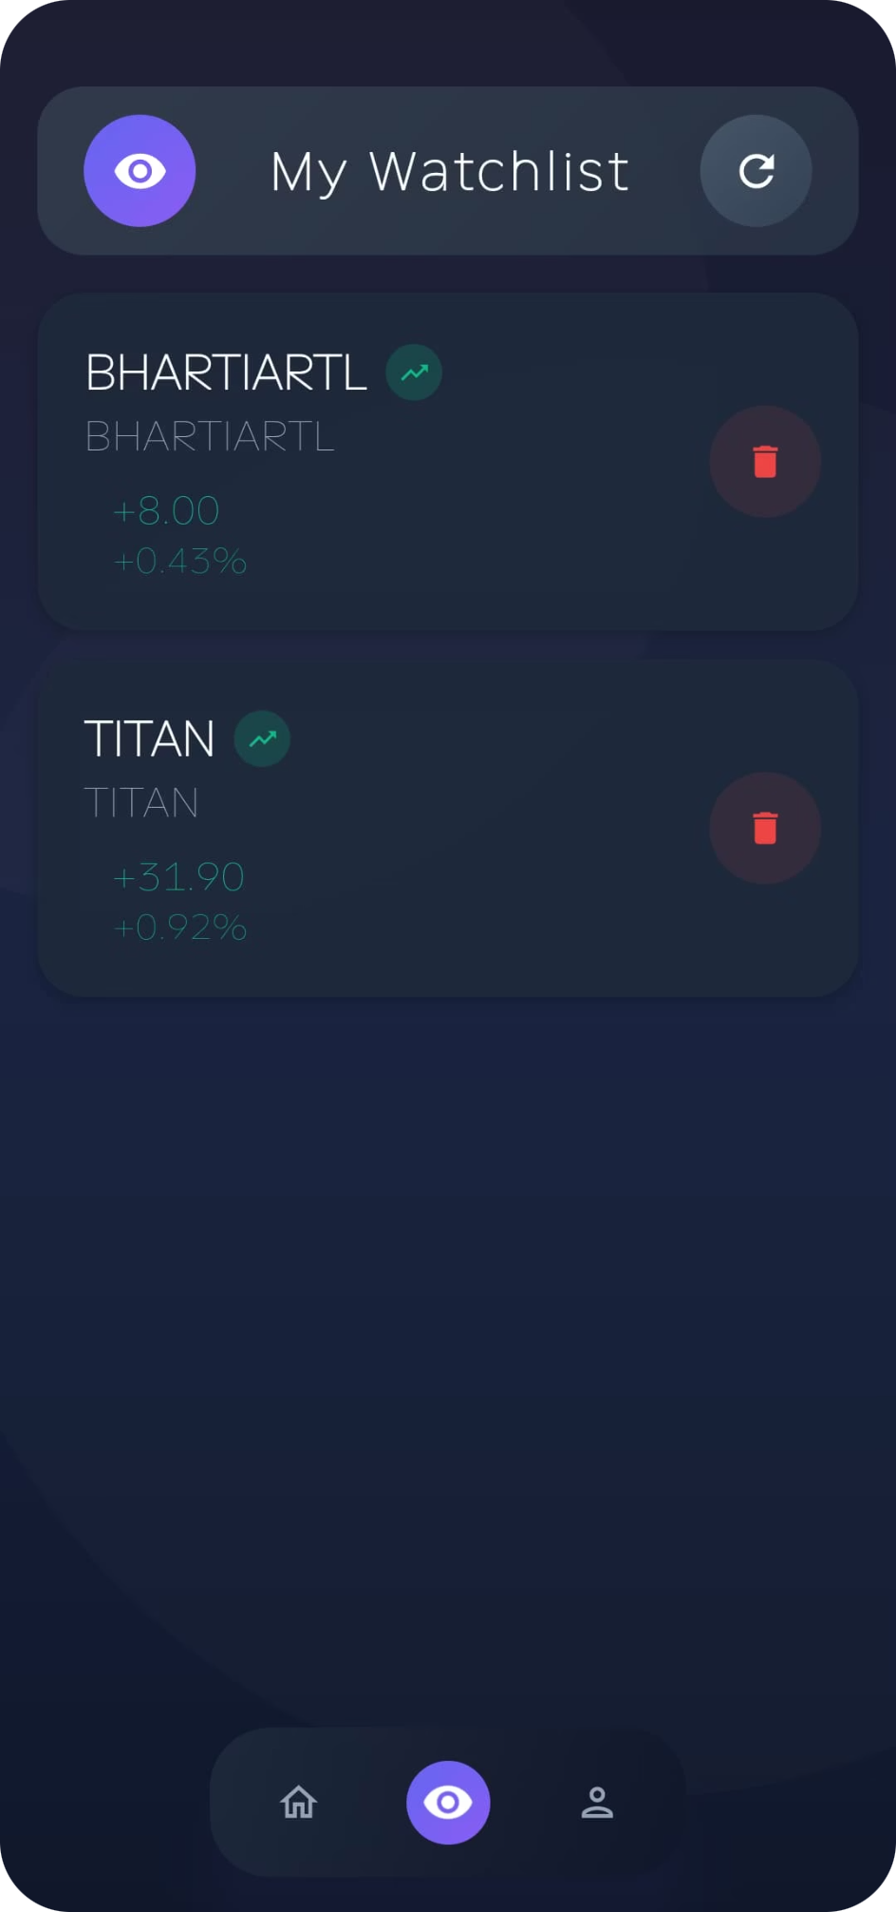



Secure and Smart Watchlist Management
Personalize your trading experience with synchronized watchlists and price alerts. StockIt ensures secure authentication and data encryption for all your financial activities.
Personal Watchlist
Track your favorite stocks.
Price Alerts
Monitor stock movements.
Synchronized Data
Cloud-based watchlist sync.

Slide 9
Robust Architecture and Tech Stack
StockIt is built on MVVM + Clean Architecture principles for maintainable, testable code. It utilizes cutting-edge Android technologies for a smooth and powerful experience.
Frontend Technologies
Networking & Data
Jetpack Compose: Declarative UI
Retrofit/OkHttp: HTTP clients
Material 3: Latest design components
Gson: JSON serialization
Hilt: Dependency injection
Coroutines: Asynchronous ops
StateFlow/Flow: Reactive programming
SharedPreferences: Local storage

Slide 10

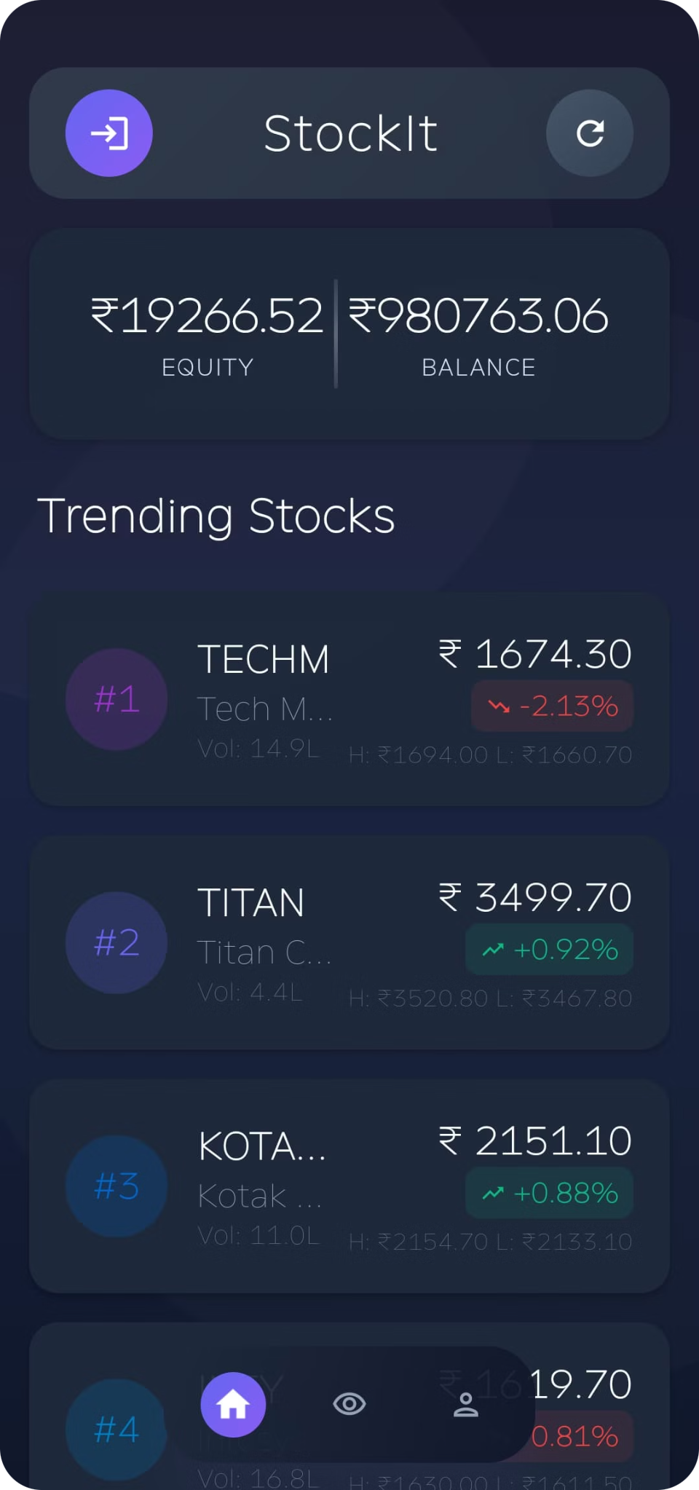
Future Innovations: Roadmap
Our roadmap includes exciting features like advanced analysis, notifications, and biometric authentication. We are constantly enhancing StockIt for a superior user experience.
Advanced Analytics
More technical analysis tools.
Push Notifications
Real-time price alerts.
Biometric Auth
Fingerprint/face unlock.
Offline Support
Local caching for data.
AI-Powered Insights
Smarter trading suggestions.

Slide 11
Thank You
We appreciate your time today. StockIt is designed to empower your financial journey. Download the app to start trading smarter.
GitHub link- https://github.com/khatarnaak-khiladi/Trading-platform/tree/main

