Slide 1



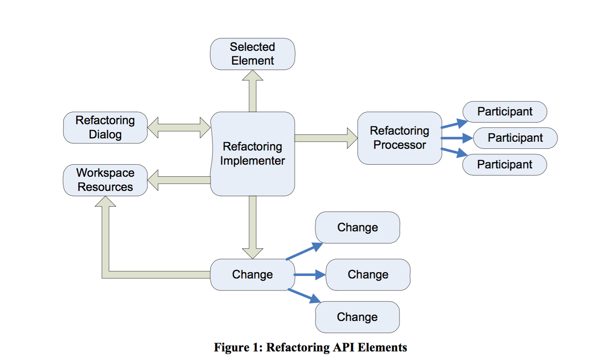
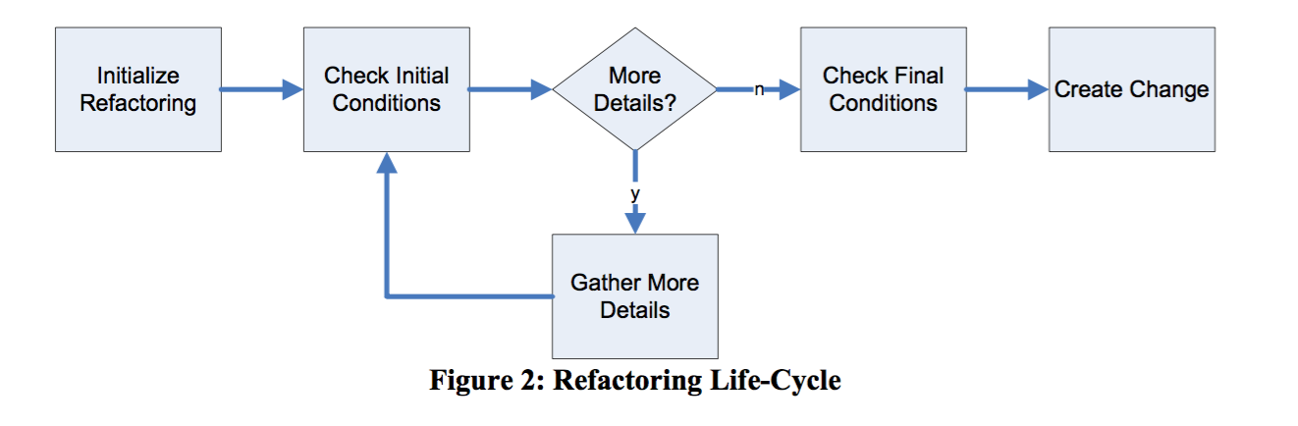
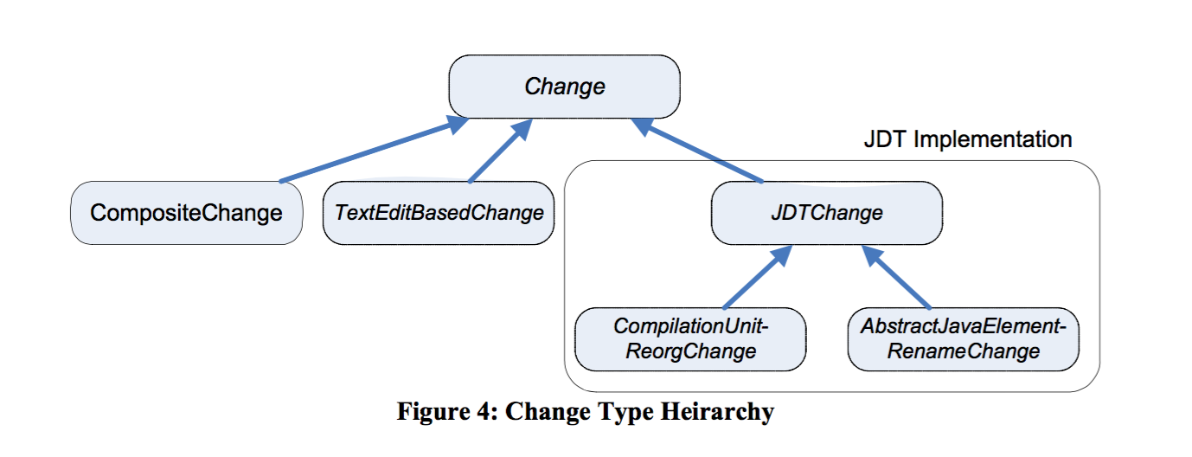
Porting the NetBeans Java 8 Enhanced For Loop Lambda Expression Refactoring to Eclipse Md Arefin Mentor: Dr. Raffi Khatchadourian Computer System Technology, City University of New York
Abstract:
Java 8 is one of the most significant upgrades to Java programming language and framework. This upgrade provided supports for functional programming, a new JavaScript engine, a new APIs for date time manipulation, a new streaming API and so on. There are several new key features of Java 8 that can help make programs easier to read, write, and maintain. Among the new Java 8 features, lambda expressions are touted to be most significant. Lambda expression simplify the development process by facilitating functional programming. Eclipse is one of the most popular IDEs for Java. While JDT UI has incorporated several Java 8 quick-fixes and refactoring's, there are still many features left to be done. For example, NetBeans has a refactoring that converts loops to Lambda expressions. This project is for exploring the porting of such conversion mechanisms in NetBeans to Eclipse. These may be manifested as refactoring and/or quick-fixes. In this project we are working on the Convert to a lambda expression Java 8 refactoring/ quick-fixes.
Examples
Motivation
List<String> list = Arrays.asList({"Moe", "Larry", "Curly"});
Regular Enhance For Loop Conversion:
for (String s : list) System.out.println(s);
Suggested Java 8Lambda expression:
//list.forEach(s -> System.out.println(s));
//or better yet:
list.forEach(System.out::println);
//and it also should work with streams:
list.stream.forEach(System.out::println);
Lambda expression simplify the development process by facilitating functional programming.
Lambda expression provide concise way to represent method interface and also make it easier to iterate through, filter, and extract data from Collection.
Due to java 8 upgrade some programming platform like tomcat, glassfish, groovy base on java need to be upgraded. According to Gyori et al. [1], making such changes manually would require changing approx. 1,700 line of no-commented, non-blank lines of code across approx. 100 files per project, on average. With our plug-in, Eclipse developers would not need to make these changes manually.
Eclipse Refactoring Model:
Eclipse Refactoring Life-Cycle
The API for refactoring provides a process-level abstraction upon which specific refactorings may be built.
Figure 1 shows the elements of this abstraction at a very high level. Here, arrows between elements represent dependencies
Once a refactoring has been initiated, an implementer of that refactoring is used to coordinate condition checking, gathering details about the refactoring, and ultimately producing a series of changes that may be applied to the Eclipse workspace to accomplish the refactoring.
This implementer must extend the abstract class org.eclipse.ltk.core.refactoring.Refactoring. The life-cycle for this class is shown in Figure 2.
IMPLICATION & PRECONDITIONS:
The conversion must be semantics-preserving. That is the behavior of the program prior to the refactoring must match that of after the refactoring.
The for loop must iterate over an instance of an Collection.
The body of the initial for loop must not throw a checked exception.
The body of the initial for loop must not have more than one reference to a local, non-effectively final variable defined outside the loop.
The for loop body must not contain a break , continue statement as these semantics cannot be expressed via a lambda expression.
JDT Type Hierarchy
ACKNOWLEDGMENT:
We would like to thank Google Summer of Code, as well as the Eclipse Foundation, for their funding towards this project
FUTURE RESEARCH:
This is a on-going projects and we will be working on it through out the fall session;
We plan to develop refactorings for Java 8 that do not currently exist in any IDE.
References:
[1] Alex Gyori, Lyle Franklin, Danny Dig “Crossing the Gap from Imperative to Functional Programming through Refactoring” (2013).
[2] Petito, Michael “Eclipse Refactoring”, Clarkson University, EE564 Spring 2007.

