Slide 1
Instance Variables, and Methods
Instance variables belong to a specific instance. Instance methods are invoked by an instance of the class.

Slide 2
Static Variables, Constants, and Methods
Static variables are shared by all the instances of the class. Static methods are not tied to a specific object.
Static constants are final variables shared by all the instances of the class.

Slide 3
Static Variables, Constants, and Methods, cont.
To declare static variables, constants, and methods, use the static modifier.

Slide 4
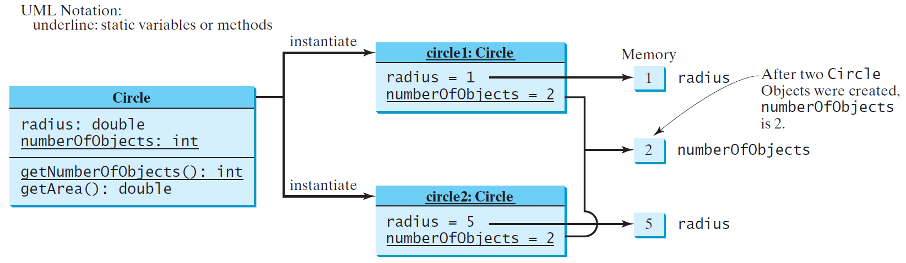
Static Variables, Constants, and Methods, cont.

Slide 5
Example of Using Instance and Class Variables and Method
Objective: Demonstrate the roles of instance and class variables and their uses. This example adds a class variable numberOfObjects to track the number of Circle objects created.

Slide 6
Visibility Modifiers and Accessor/Mutator Methods
By default, the class, variable, or method can be accessed by any class in the same package.
public
The class, data, or method is visible to any class in any package.
private
The data or methods can be accessed only by the declaring class.
The get and set methods are used to read and modify private properties.

Slide 7
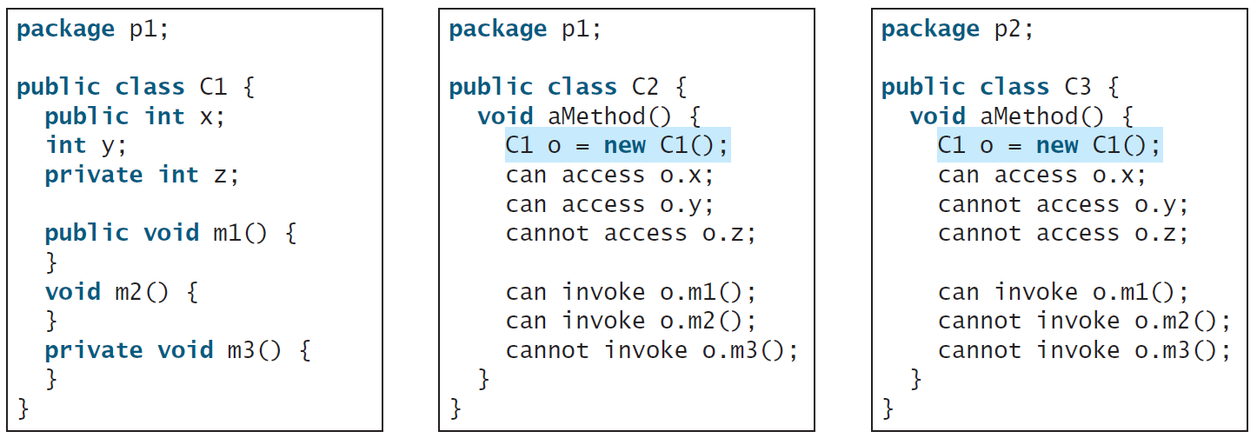
The private modifier restricts access to within a class, the default modifier restricts access to within a package, and the public modifier enables unrestricted access.

Slide 8
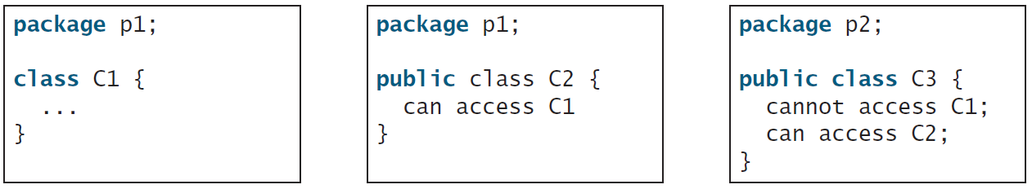
The default modifier on a class restricts access to within a package, and the public modifier enables unrestricted access.

Slide 9
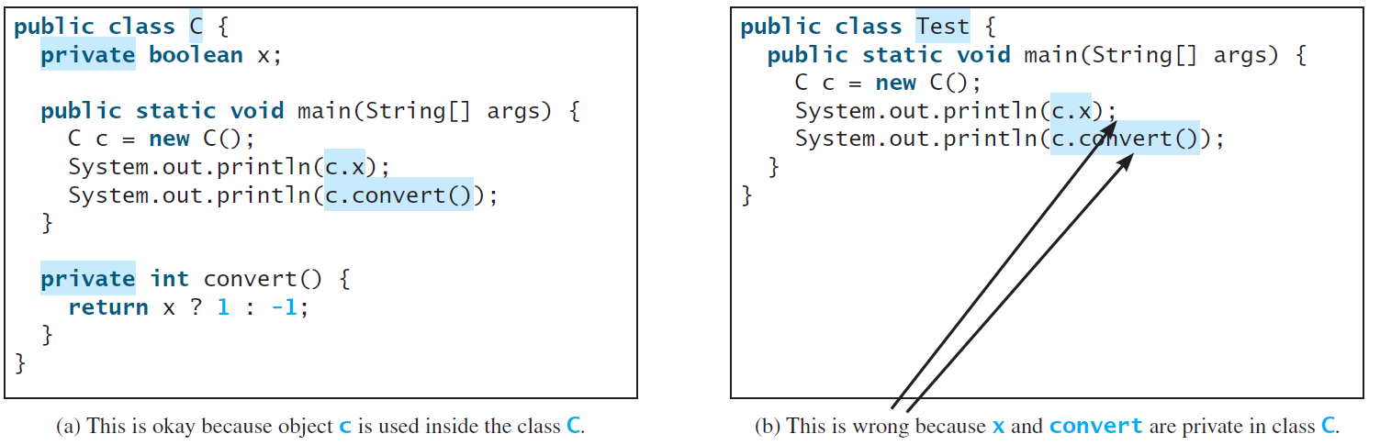
NOTE
An object cannot access its private members, as shown in (b). It is OK, however, if the object is declared in its own class, as shown in (a).

Slide 10
Why Data Fields Should Be private?
To protect data.
To make code easy to maintain.

Slide 11
Example of Data Field Encapsulation

