Slide 1
POWER BI / BANKING ANALYTICS
Banking
Dashboard
DASHBOARD AT A GLANCE
TOTAL LOAN
$139.9M
Loan • Deposits • Customer & Financial KPIs
TOTAL DEPOSIT
$111.49M
TOTAL FEES
$5.17M
01

Slide 2
01 / PROJECT
What this project delivers
A concise banking analytics view built around the supplied dataset and Power BI dashboard.
THE IDEA
ANALYSIS AREAS
Turn banking data into a clear, interactive view of loans, deposits and customer-level financial metrics.
• Loan analysis across banking relationships, income bands and nationality.
• Deposit analysis across bank deposits, savings, checking and foreign currency accounts.
• Summary KPIs for clients, loans, deposits, fees and account balances.
02

Slide 3
02 / DATA
From raw data to analysis
The project combines banking data with derived fields and DAX measures.
01
02
03
04
Banking data
Derived fields
DAX measures
Dashboard
›
›
›
Client, loan, deposit & account fields
Engagement Days • Income Band • Processing Fees
SUM • DISTINCTCOUNT • SUMX • SWITCH • DATEDIFF
Loan • Deposit • Summary • Drill-through
The supplied report documents Engagement Days, Income Band and Processing Fees as derived fields.
03

Slide 4
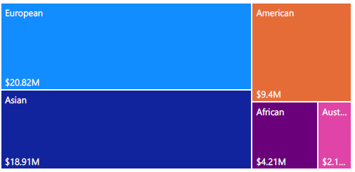
03 / DASHBOARD
The Power BI experience
Interactive pages organize the analysis into a simple navigation flow.
04

Slide 5
04 / KPIS
Key numbers at a glance
TOTAL LOAN
TOTAL DEPOSIT
TOTAL FEES
$139.9M
$111.49M
$5.17M
BANK LOAN
BANK DEPOSIT
BUSINESS LENDING
$55.5M
$60.18M
$83.52M
05

Slide 6
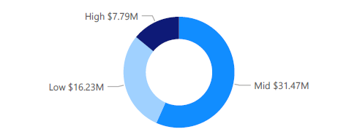
05 / ANALYSIS
What the dashboard shows
Selected findings retained from the supplied presentation.
OBSERVATIONS
Mid income band has the highest bank loan in the shown analysis.
European countries show the highest bank-loan value in the nationality view, while Australian countries show the lowest.
06

Slide 7
FINAL VIEW
Banking Dashboard
PROJECT STACK
A practical Power BI dashboard for exploring banking loans, deposits and customer-level financial metrics.
DATA
Banking client dataset
ANALYSIS
Python EDA
BI
Power BI + DAX
OUTPUT
Interactive dashboard
Thank you
07

