Slide 1

Course Comparison Web App
Internship Project Presentation
Role: Software Development Intern | Duration: Jan 2025 – June 2025
Company Name : The Kiran Academy
GitHub Repo: github.com/khatri-raj/Course-Comparison
github.com/akshay-3596/CompareIT
By
Raj Khatri
Akshay Sonawane
Sahil Surana

Slide 2
Project Overview
Purpose
Comparison Criteria
Help students find the best courses and institutes in Pune.
To reduce time and confusion in course selection by providing
a centralized platform for comparing multiple institutes based
on objective metrics.
Fees
Placement Rate
Student Ratings
Platform Features
Tech Stack
User-friendly interface with course comparison, reviews, and contact form.
Django backend with React (Vite) frontend and MySQL
database.

Slide 3
Key Features
Course Search & Filter
Compare Multiple Courses
Review System
Find courses easily with advanced filtering options.
View and submit reviews after login for authenticity.
Side-by-side comparison based on key metrics.
Contact Form & Authentication
Admin Dashboard
Submit enquiries and secure user registration/login.
Manage courses, reviews, and enquiries efficiently.

Slide 4
Tech Stack
Frontend
Backend
React.js with Vite
Django with Django REST Framework
Tailwind CSS / Bootstrap
MySQL database
Axios for API calls
Postman for API testing
Framer Motion for animations
GitHub and Render for deployment

Slide 5
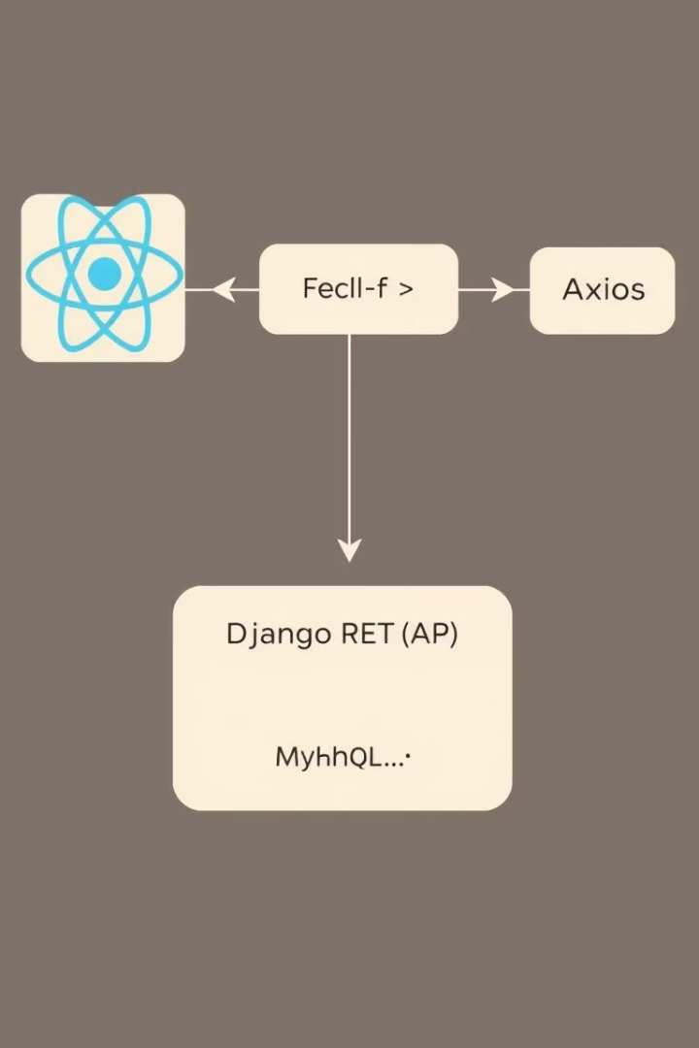




System Architecture
Fetch (API) or Frontend Logic
React Frontend
Handles UI rendering, routing, and animations.
Axios
Facilitates REST API communication with backend.
Django REST API
Django Rest API
MySQL Databse
Manages authentication, courses, reviews, and data logic.
MySQL Database
Stores all persistent data for the app.
LocalStorage caches API responses for faster access.

Slide 6
Implementation Details
Backend (Django)
Frontend (React + Vite)
Models: Course, Review, Enquiry
Components: Home, Course List, Comparison
REST APIs built with DRF
Axios for API data fetching
Django Admin for content management
Loading/error states and animations with Framer Motion

Slide 7
Challenges & Learnings
Challenges
Integrating React with Django backend
Managing app state and API responses
Designing intuitive comparison logic
Learnings
Full-stack development lifecycle insights
REST API integration mastery
React hooks usage and Django models development
Deployment strategies using Render

Slide 8
Conclusion & Future Scope
Current Achievements
Future Enhancements
Effective platform enabling smart course choices in
Pune. Successfully migrated the frontend from
traditional HTML/CSS templates to a modern React
(Vite) application, improving the UI responsiveness,
user experience, and maintainability of the codebase.
AI-powered personalized course recommendations
Expand coverage to more cities and course types
Advanced filters like placement stats and alumni reviews

Slide 9
Thank You!
Feel free to ask questions or explore the project on GitHub.

