Slide 1
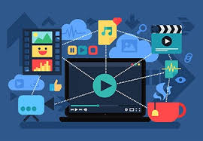
M ULTIMEDIA
Introduction:
Multimedia is the integration of multiple forms of media. This includes text, graphics, audio, video, and animation. It is widely used in various fields to enhance the way information is presented and communicated.

Slide 2
Uses of Multimedia
1. Education: Enhances learning through interactive content. 2. Entertainment: Used in movies, games, and music. 3. Business: Employed in presentations and marketing. 4. Communication: Used in video conferencing and social media. 5. Journalism: Enhances storytelling with images, audio, and video.

Slide 3
Advantages of Multimedia
1. Engages multiple senses for better retention. 2. Makes content more interesting and dynamic. 3. Facilitates interactive learning. 4. Increases accessibility of information. 5. Enhances communication effectiveness.

Slide 4
Conclusion
Multimedia has changed the way we talk to each other, learn new things, and enjoy entertainment. It brings together text, sound, pictures, and videos to make information more interesting and easier to understand. Today, we use multimedia in many areas like online learning, video games, social media, advertising, and even virtual meetings.

