Slide 1
Food Drive
By Bhumika Khatri
Apurva Sawant
Aadesh Randeria

Slide 2
Problem Statement
This application is for an organization which collects leftover food from various sources like individual person, hotels and events.
Distributes this food to the needy by setting up food stalls daily at a particular time at different locations.
Extra food obtained from the sources is stored in the inventory of the organization.
If enough food is not available at one stall, nearby food stalls are contacted, and if extra food is found at the requested stalls, then food is transported to the respective stall.
Food present in the inventory is also tested in the labs for quality purposes. If the food stored does not pass the quality check, then it is sent for decomposition.
Fertilizers obtained from this composting process is given away to farmers.

Slide 3
Approach
Donors – Individual, Hotel & Event
Individual sends food directly to stores while Hotel or Event requests for food pick up to Main Office.
If store lacks sufficient amount of food, they may request nearby stores to send some amount of food.
If there is scarcity of food in nearby stores, they will request Inventory for the food.
Request is sent to Transport which assigns it to the Driver who then delivers the food.
Inventory can request Lab to test the food. If condition of food is bad, lab sends the food for decomposition.

Slide 4
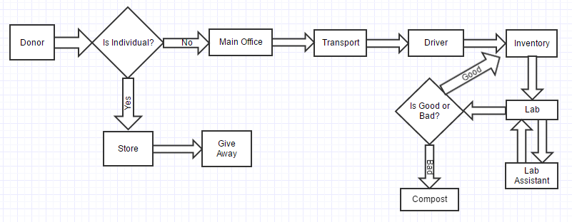
Use Cases

Slide 5
Object Model
Gliffy link: https://www.gliffy.com/go/html5/11587021?app=1b5094b0-6042-11e2-bcfd-0800200c9a66

Slide 6
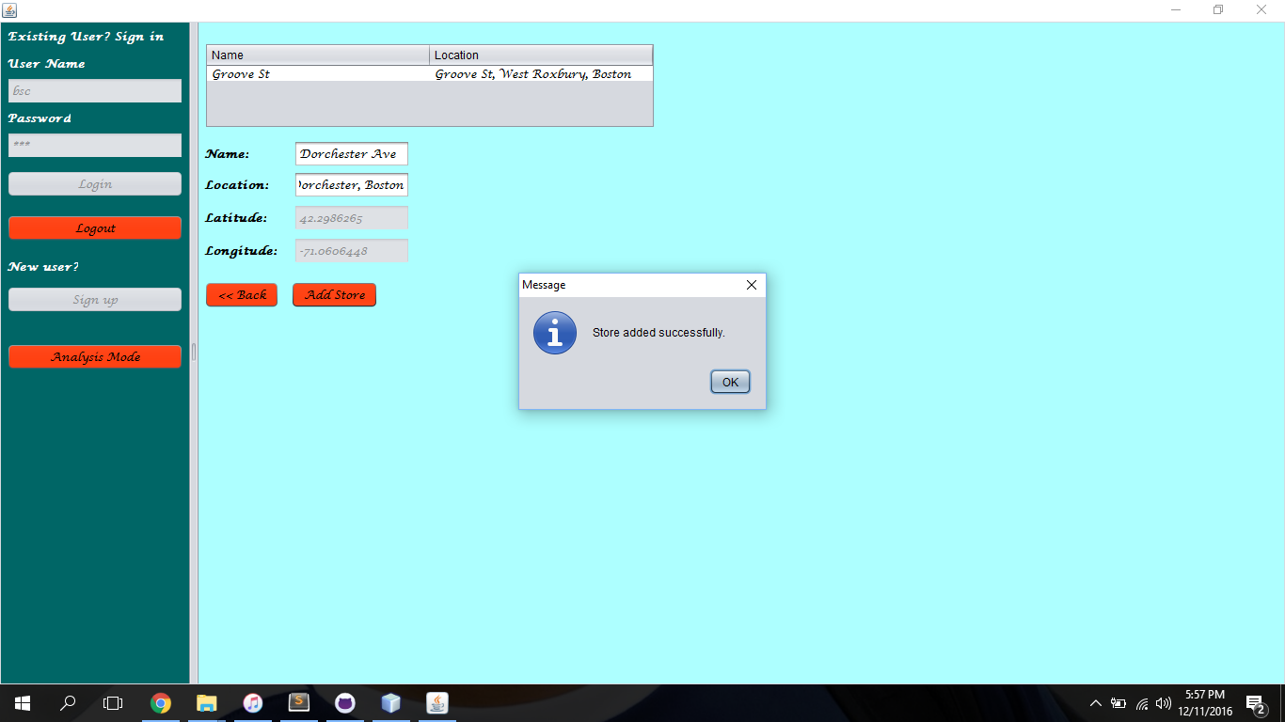
Scenario 1: Real time location information taken

Slide 7
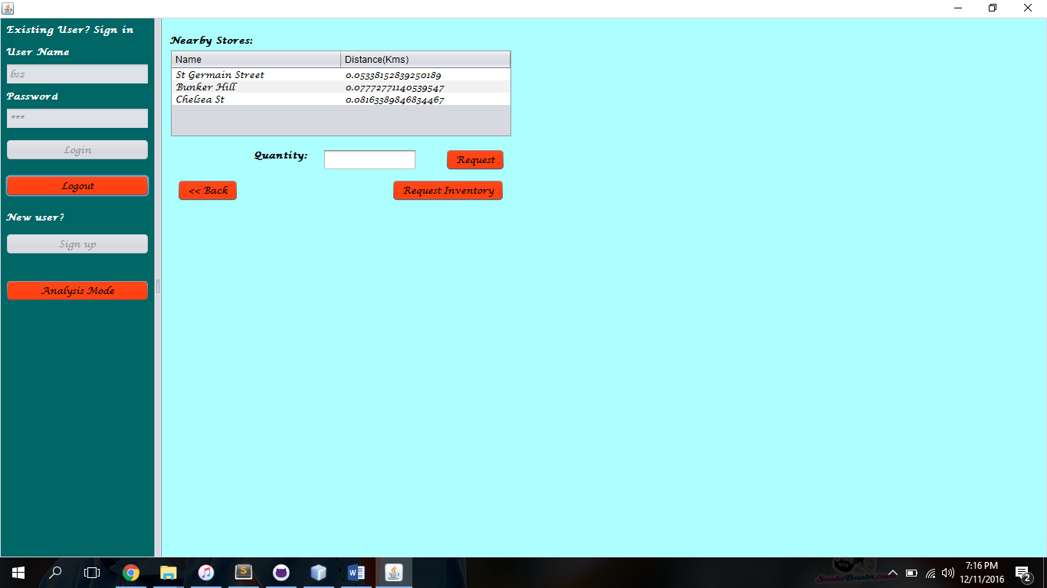
Scenario 2: Display the nearest 3 stores based on its location

Slide 8
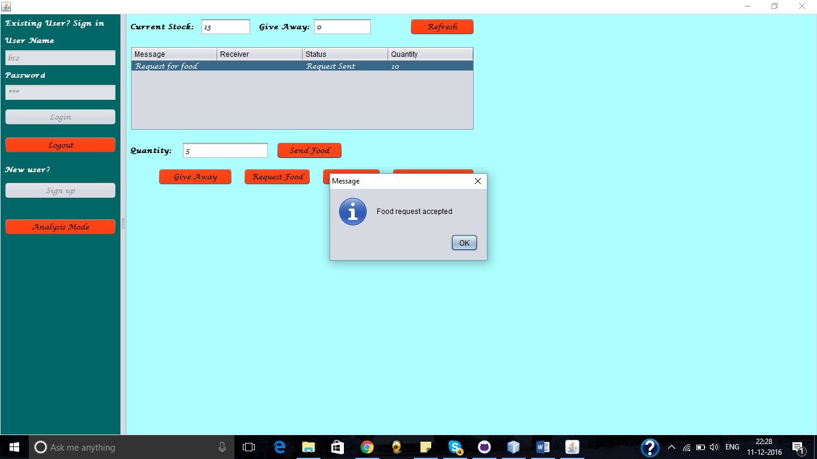
Scenario 3: A store can process a request partially.

Slide 9
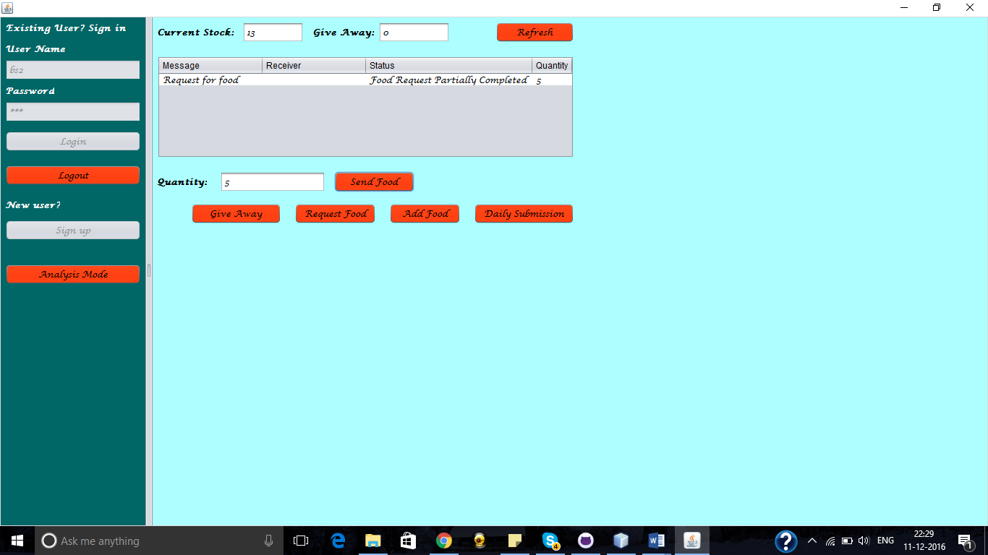
Extension of previous scenario: An another store can process the partially completed request

Slide 10
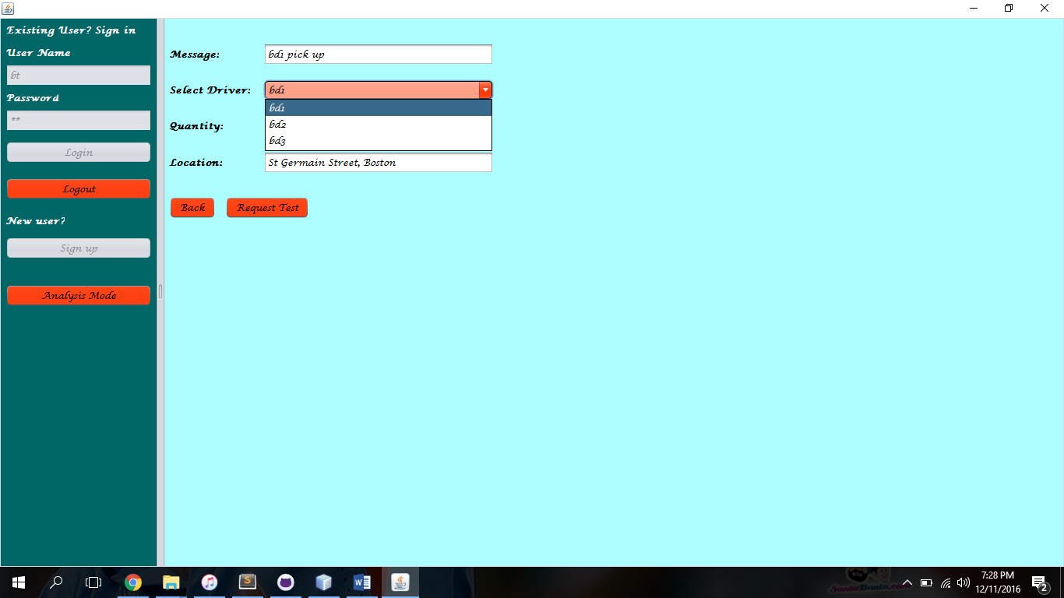
Scenario 4: Transport Manager assigns request to available drivers

Slide 11
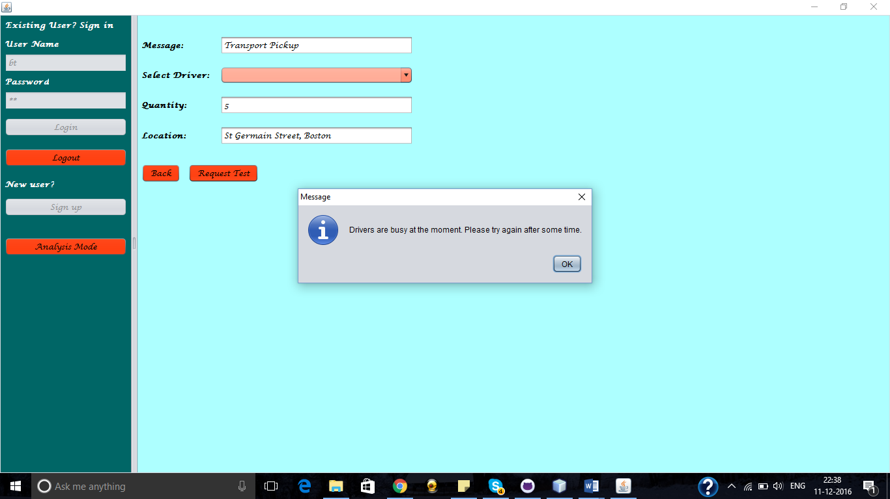
Scenario 5: All drivers are busy

Slide 12
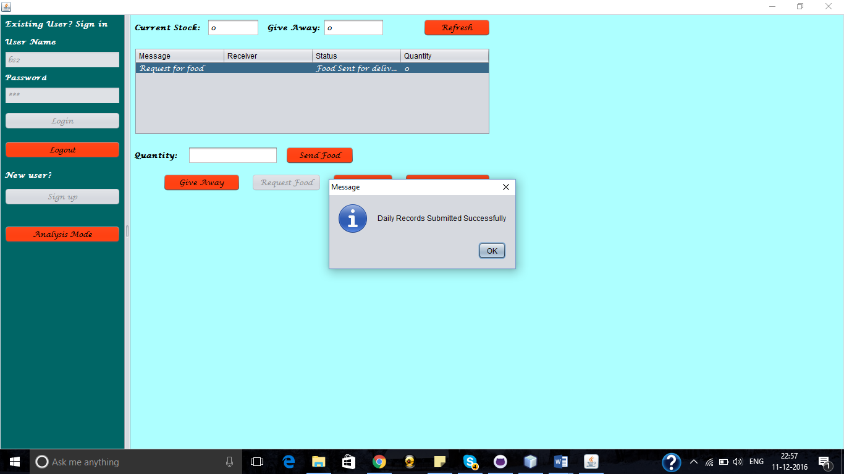
Scenario 6: Submission of daily records

Slide 13
Thank you

