Slide 1




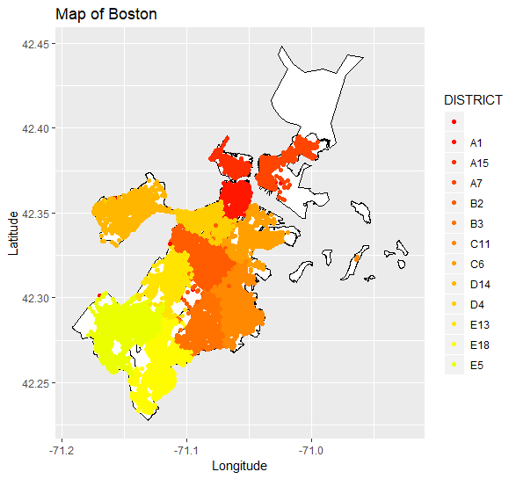
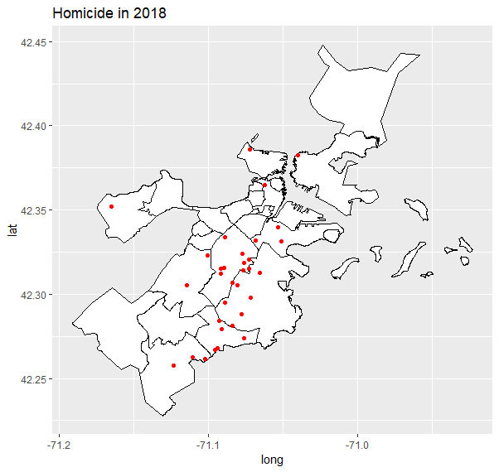
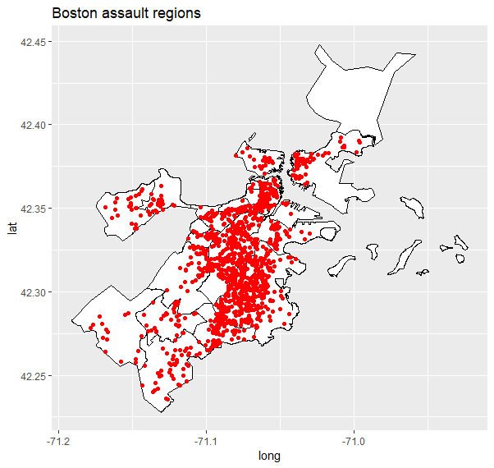
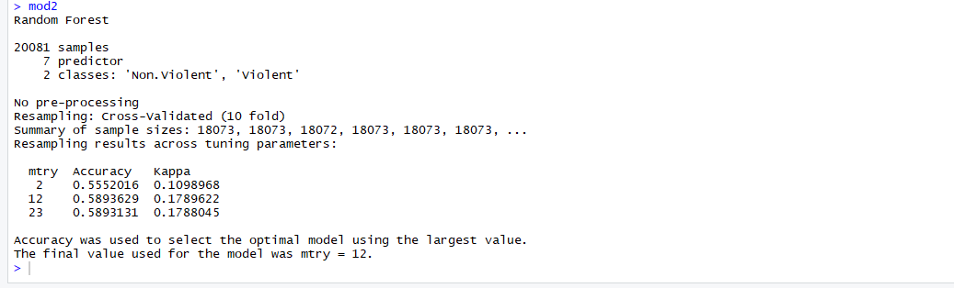
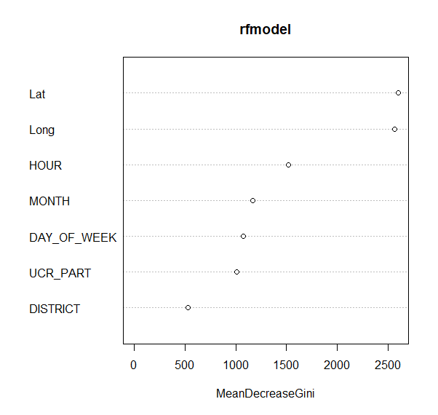
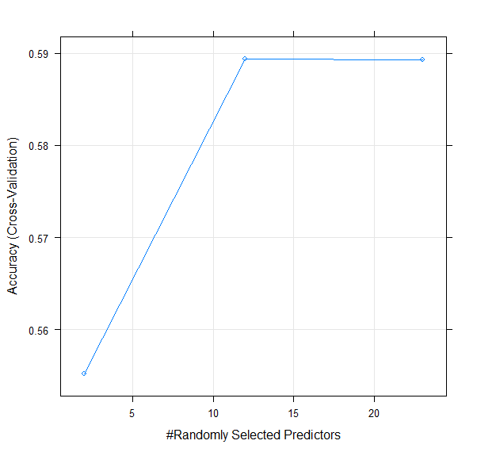
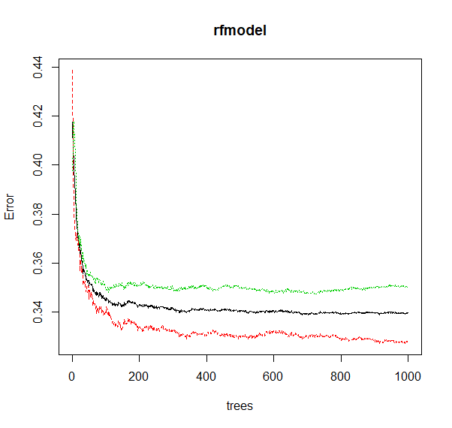
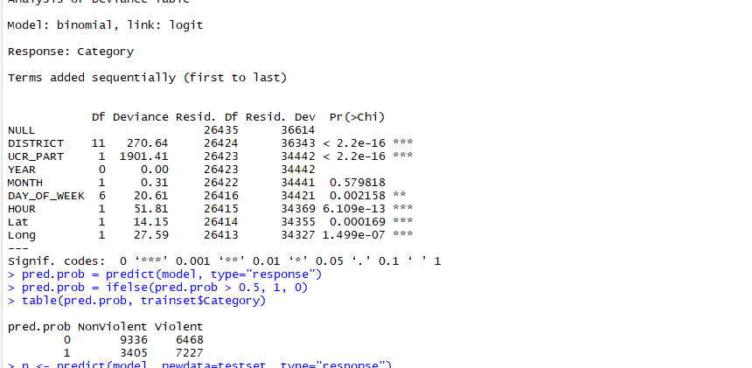
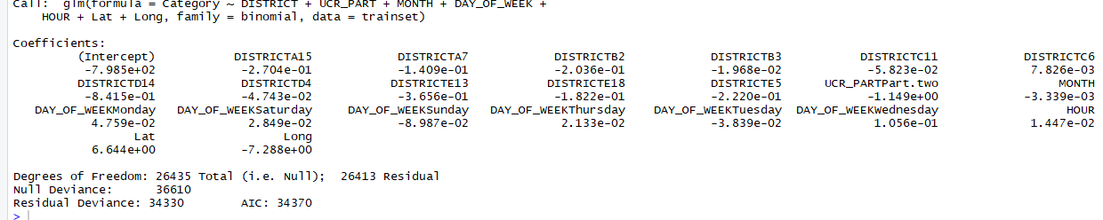
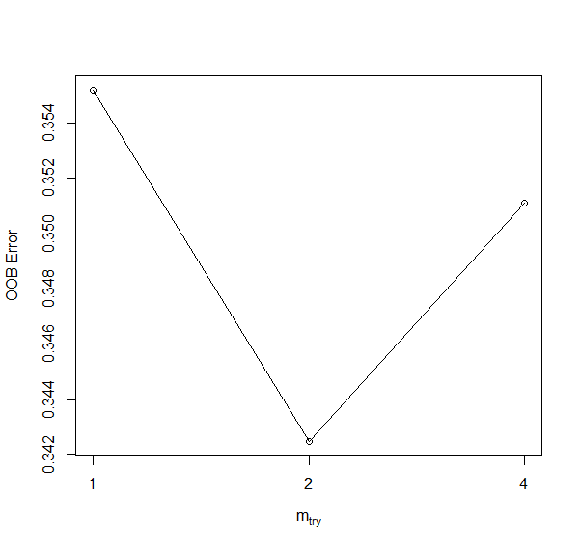
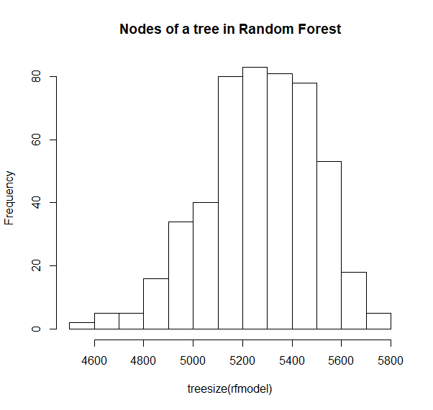
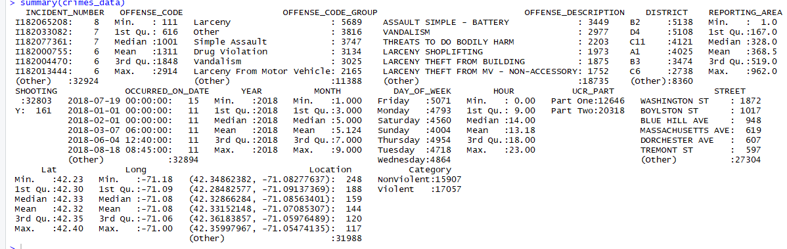
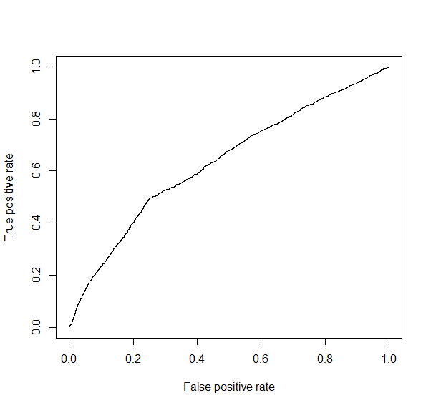
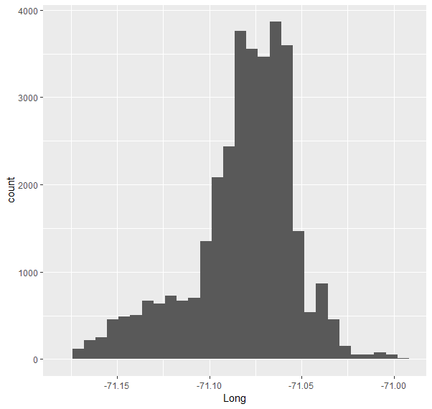
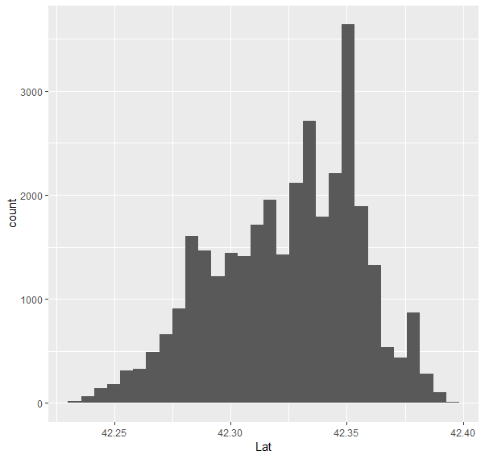
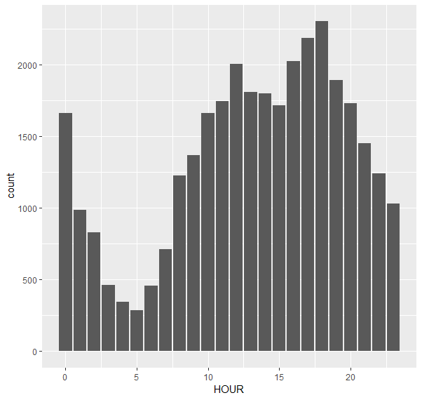
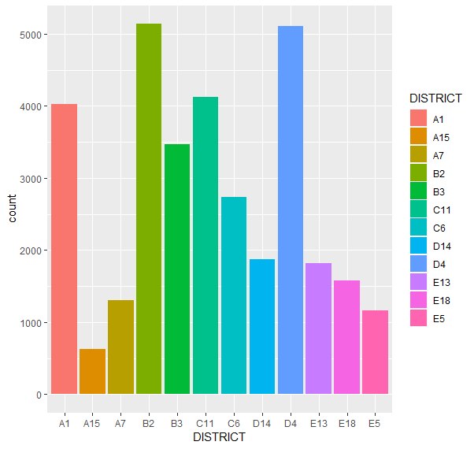
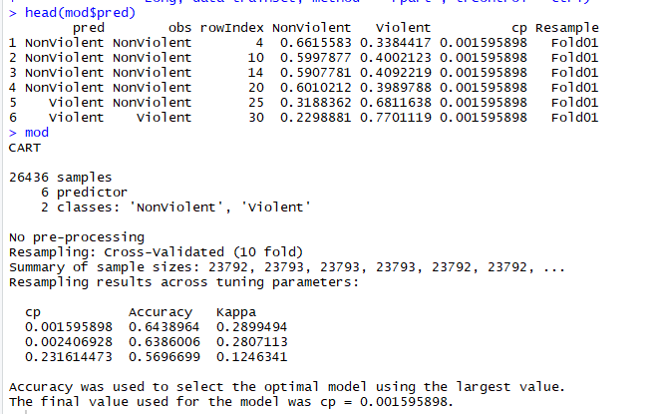
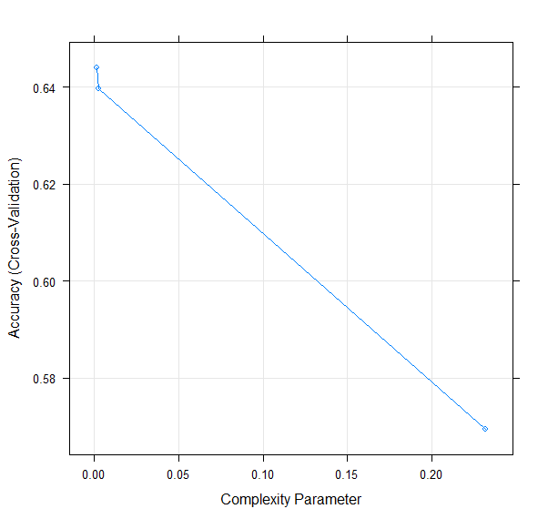
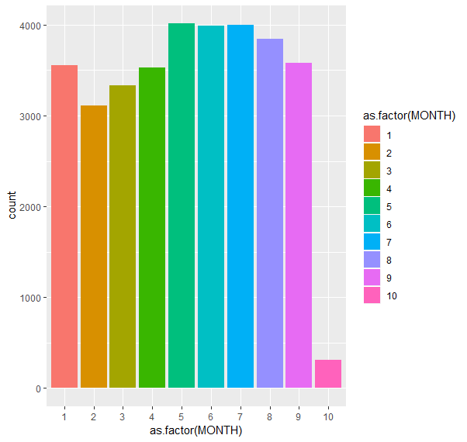
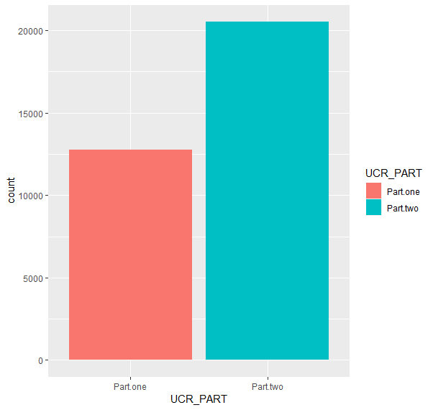
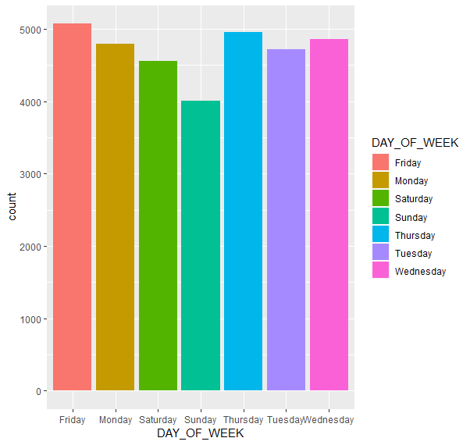
Crime Classification in Boston
^{Yamini Khatri (khatry@rpi.edu)}
Rensselaer Polytechnic Institute 110 8th St., Troy, NY, 12180 United States
ABSTRACT
SPATIAL ANALYSIS
Random Forests analysis and tuning
lower mtry - less correlation between the trees
if you are taking the mtry equal to number of variables then that means each tree is taking the same combination
Gini index shows
how pure the nodes are at the end of each tree without variable
There are certain aspects of human behavior which are hard to perceive and even harder to predict. To dispute that a civilization is reaching its brink of sanity is easy with the uncertainty in limiting crime. It is neither random nor systematic, which makes it pertinent to take a step back and analyze. According to a popular statistics website, “The overall crime rate in Boston is 1% higher than the national average. For every 100,000 people, there are 7.83 daily crimes that occur in Boston. Boston is safer than 14% of the cities in the United States. In Boston you have a 1 in 35 chance of becoming a victim of any crime.”
I will attempt to analyze the information available on location centric data to observe and predict the crimes in Boston according to their volatility.
This work is motivated by the popular Kaggle dataset in classifying crimes in San Francisco which brought interesting results and analysis. Prior to that, there has been extensive research in crime analysis through Data Mining to improve intelligence for bureaus throughout the world.
Geo spatial analysis takes up a whole new field for analysis of regions and creating highly effective visuals. I have tried to implement the visuals of affected areas of Boston to observe which districts are most affected to the violent crimes, and shootings to notice if there is a pattern that reports need to better surveillance for those areas.
MODELS FOR CLASSIFICATION
Logistic Regression to analyze variable importance in binary classification-
THE DATA AND FEATURE SELECTION
The data provided by Boston Police consists of more than 320000 data points from year 2015 to 2018(till October). To stabilize model performance and analysis, I would be focusing on crimes occurred in year 2018 to analyze current trends in crimes occurring in Boston.
There are 17 initial features in the dataset, of which Incident number, Offense code, Offense code group, Offense code description are lined up with Offense code group with 67 levels of categories. Another feature, Occurrence date is all also not relevant because it has been segregated into Hour, Day of week, and rest of the distinct features to be considered namely - District, Longitude, Latitude, UCR. Further, divided into Violent and Non Violent and UCR cleaned to Part One and Two, to normalize dataset.
With this explanation we now know that our feature selection proved to report significant importance and that they can be concluded as statistically significant while in a quest to determine crime category.
CONCLUSION
AUC at 63.5 which is a bit above average it is pertinent to identify if there are better ways to predict this relationship.
The dataset used in this analysis was huge and needed a lot of filtration to produce relevant results. Recursive partitioning was better tuned to rule out error with cross validation with even better results using Offense code group. Random forest was a bit disarrayed and I wouldn’t use it according to my present analysis. I would like to continue with trying out biases and variances connections in future work.
The bias of the presence of UCR Part is still something I would emphasis on, but in my opinion the model gave a very strong indication that Time , Location counts a lot for a crime to occur. It is consistent throughout years, months or days but the distributions say that we can statistically identify which areas are more to what kind of a crime.
Recursive partitioning in trees
The idea of taking recursive trees is dividing efficiently based on maximum information gain.
Using cross validation, accuracy plots are generated to implement 10 fold default cross validation strategy
Poster: MT15A-08
References:
RPI – Rensselaer Polytechnic Institute
TWC – Tetherless World Constellation at Rensselaer Polytechnic Institute
https://towardsdatascience.com/plotting-a-map-of-london-crime-data-using-r-8dcefef1c397
https://cseweb.ucsd.edu/classes/wi17/cse258-a/reports/a075.pdf
https://www.academia.edu/8460155/Plotting_spatial_data_in_R_using_ggplot2
https://ucr.fbi.gov/crime-in-the-u.s/2011/crime-in-the-u.s.-2011/offense-definitions
Acknowledgments:
Prof. Fox has been an invaluable mentor throughout the course, with his help I have taken a step in the right direction begin analytics and see things in a better manner.
Data resource:
Kaggle
Presented for Data Analytics – Fall 2018

