Slide 1
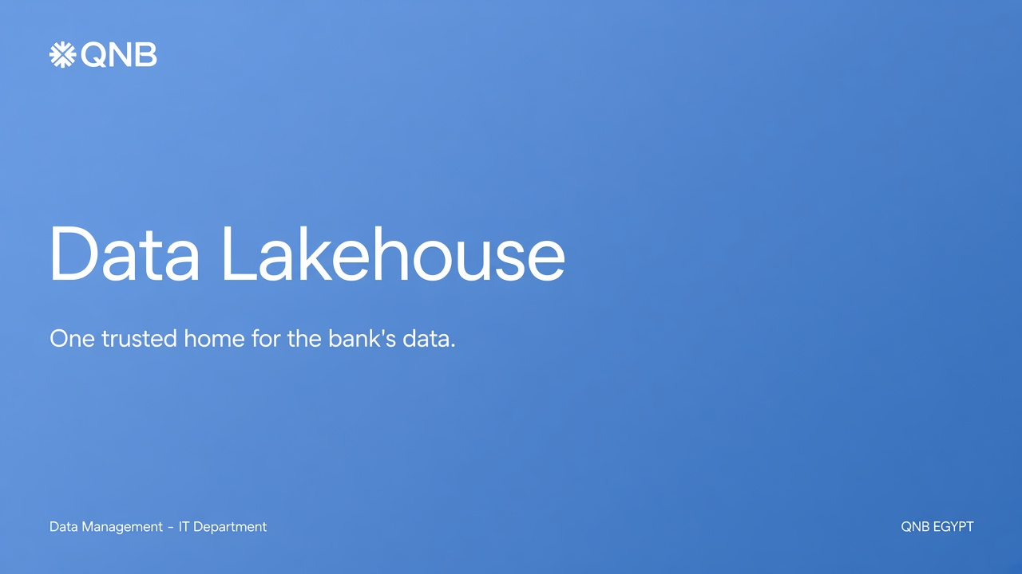
Notes:
COVER — speaking notes
Open by saying this is not a technology fashion presentation. It is a proposal to give the bank one organised home for its data, inside our own data centres, using enterprise tools with vendor support.
Audience mix: senior management, risk, finance, IT, and data teams. Promise: by the end they will know what a lakehouse is, why we need one, how it stays on-premises, and what changes for the business in three waves.

Slide 2
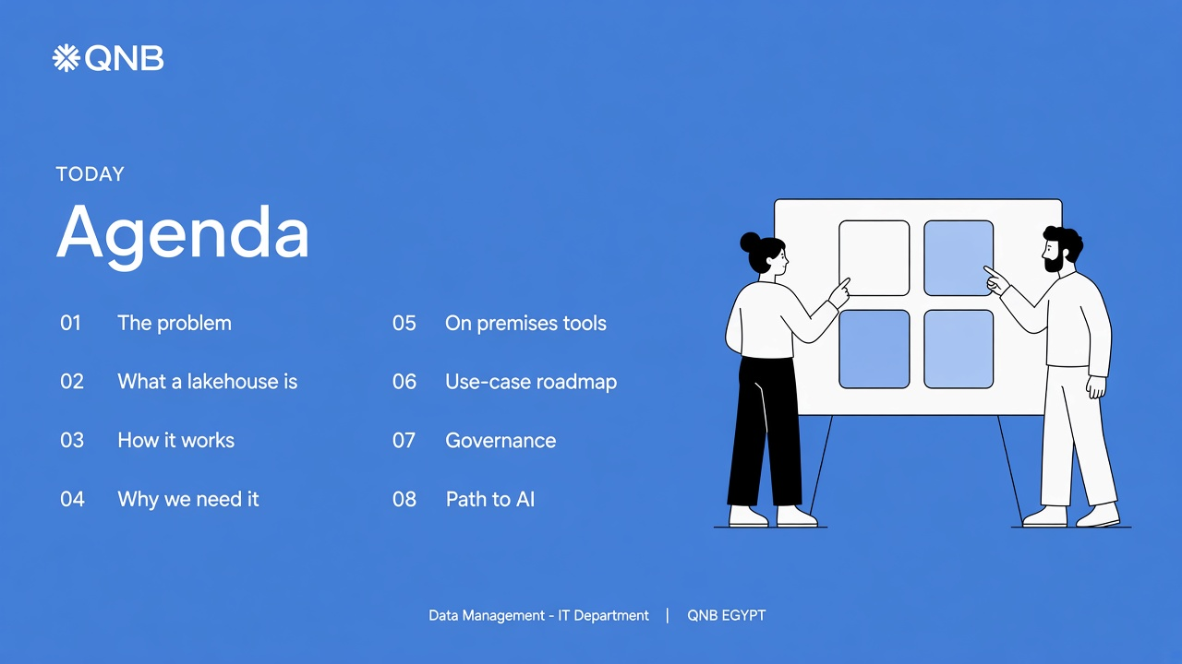
Notes:
AGENDA — speaking notes
Walk the room through the journey: problem → concept → architecture → business case → tools (all on-premises) → roadmap → control → AI.
Decision we want: endorsement to design and stand up an on-premises lakehouse as the bank’s system of record for analytics, reporting, and future AI — with no data leaving our data centres.

Slide 3
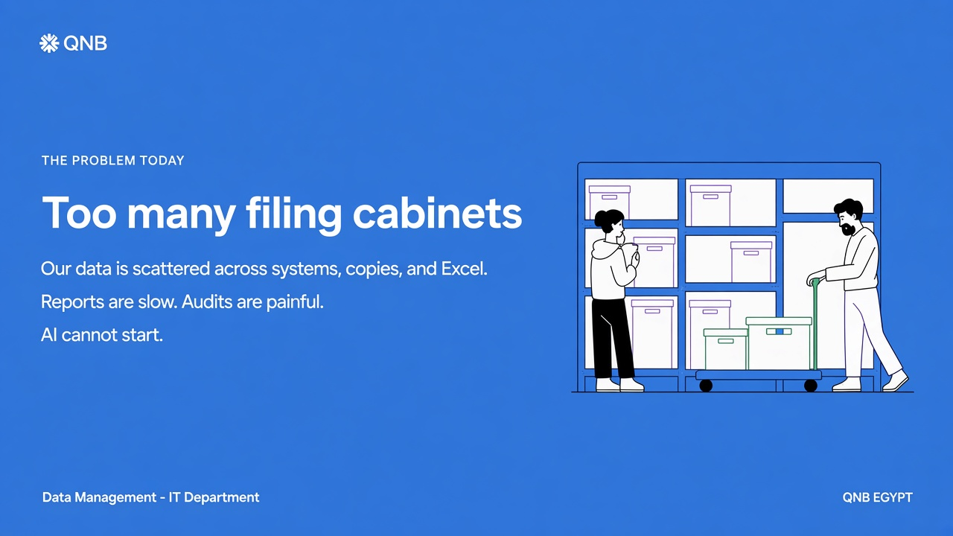
Notes:
THE PROBLEM — speaking notes
Tell it as a story. Today the bank’s data is fragmented: a legacy data warehouse, multiple data marts, core-system extracts, and Excel. Each copy drifts. Finance, Risk, and the business often show different numbers for the “same” KPI.
Consequences:
• Reporting is slow. We spend time reconciling, not deciding.
• Audits and regulatory reviews are painful because lineage is incomplete.
• Customer analytics is incomplete — we do not see one customer across products.
• AI cannot be industrialised on ungoverned copies.
Close: this is not a people problem. It is an architecture problem.

Slide 4
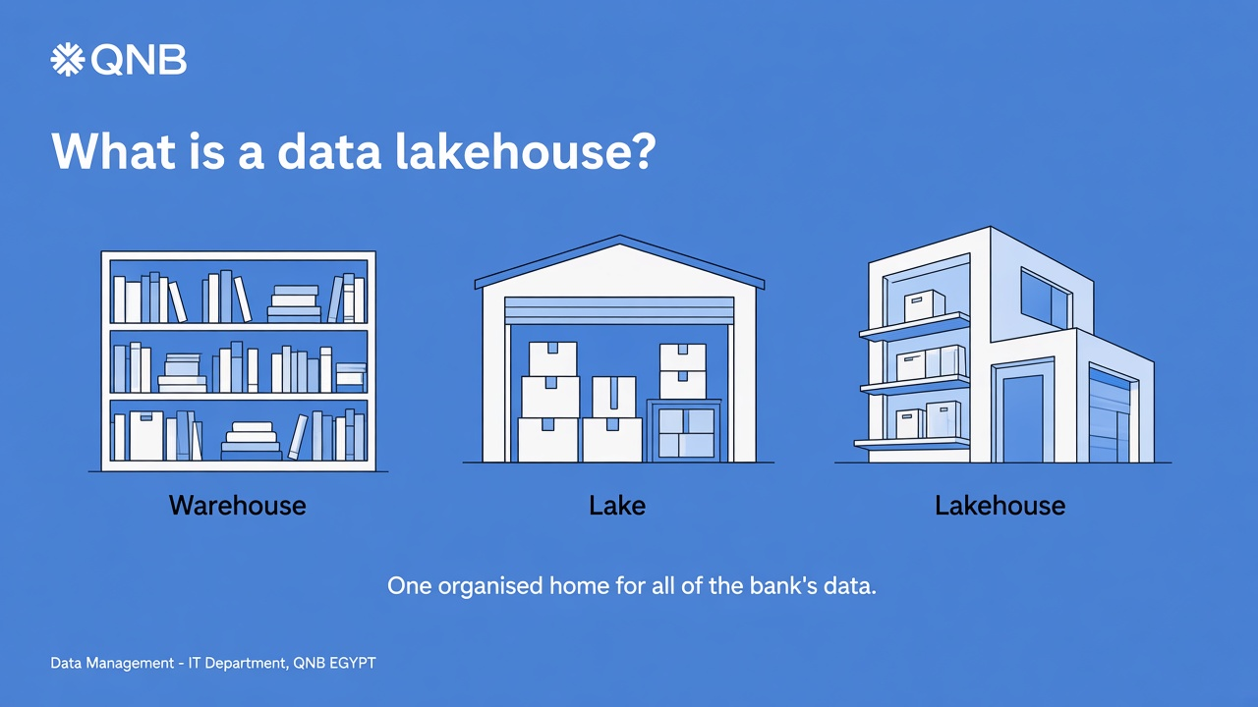
Notes:
WHAT IS A LAKEHOUSE — speaking notes
Warehouse = organised library. Excellent for finance and regulatory reports. Slow to add new kinds of data.
Lake = big storage garage. Economical, but without discipline it becomes a junk pile.
Lakehouse = one building with a garage and a library. Raw material stays in bronze. Clean folders sit in silver. Published reports sit in gold.
One-sentence definition: a single, organised home for all of the bank’s data — economical enough to keep everything, structured enough to trust for reports, risk, and AI.

Slide 5
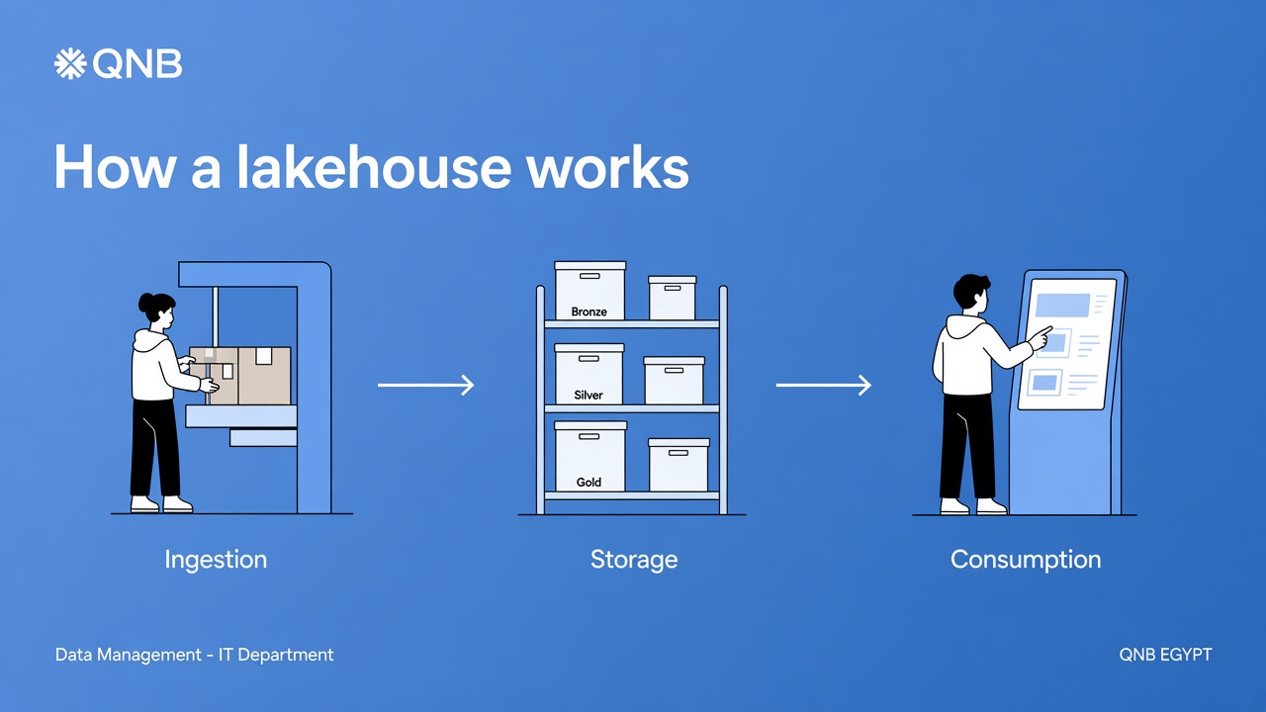
Notes:
HOW IT WORKS — speaking notes
Supermarket analogy: loading dock → stockroom → shelf.
Ingestion: core banking, cards, loans, digital channels, payments, HR, market data.
Storage with bronze / silver / gold:
• Bronze: raw, like a sealed evidence bag.
• Silver: cleaned and joined. “Customer ID” means the same across the bank.
• Gold: business-ready. The IFRS number, the NPL ratio, the customer 360 view.
Consumption: BI packs, risk engines, finance reports, and data science all drink from the same tap.

Slide 6
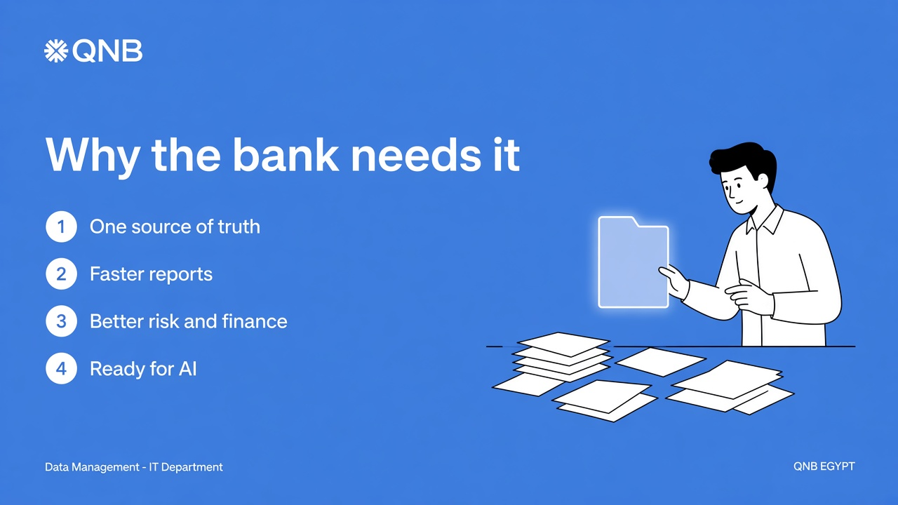
Notes:
WHY WE NEED IT — speaking notes
1. One source of truth — stop competing versions of “the number”.
2. Faster reports — month-end, ALCO, and the regulator.
3. Better risk, finance, and Customer 360.
4. AI on data we can explain, mask, and audit.
Peer banks (public case studies, not a forecast):
• Krungsri Bank: 5× platform performance; faster regulatory reporting.
• Bank Mandiri: processing 7 days → hours; loans 5 days → 1 day.
• Regions Bank: +95% fraud capture, −30% false positives, −50% daily fraud losses.
• Bank Danamon: +300% campaign conversion; −30% fraud incidents.
• Bank BRI: fraud detection from two months to seconds.

Slide 7
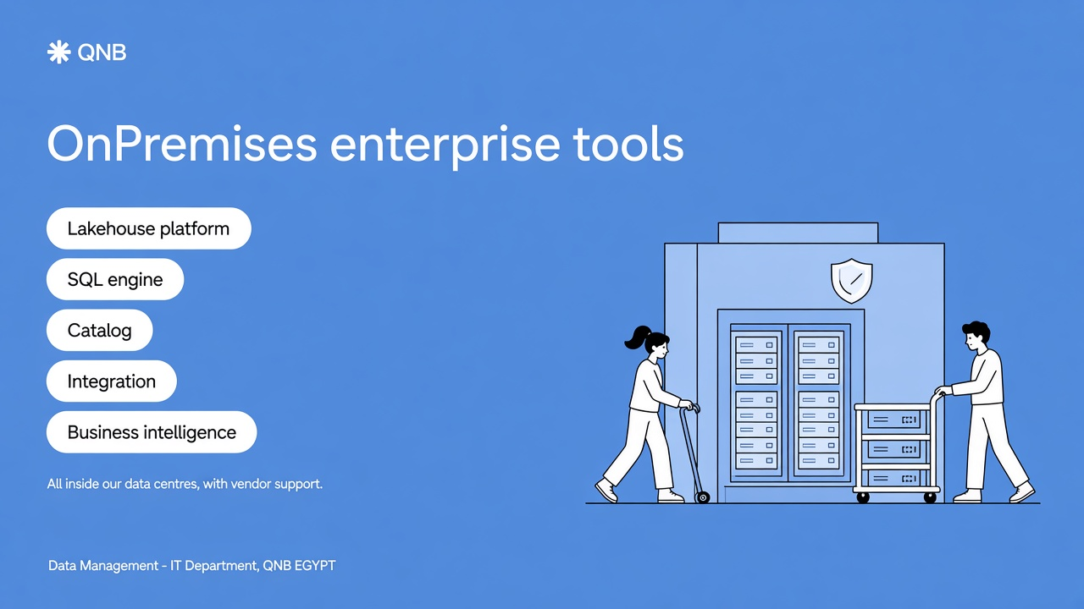
Notes:
ON-PREMISES PLATFORM — speaking notes
Nothing leaves the bank. Commercial products we deploy and harden in our data centres.
1. Lakehouse suite — Cloudera Data Platform or equivalent, installed here.
2. SQL engine — Starburst Enterprise or native enterprise SQL.
3. Catalog/governance — Collibra / Informatica / platform governance.
4. ETL — Informatica PowerCenter or IBM DataStage.
5. BI — Power BI Report Server or Tableau Server, pointed at on-prem gold.
If asked “why not public cloud?”: bank policy is on-premises. This architecture respects that and still gives us a modern lakehouse.

Slide 8
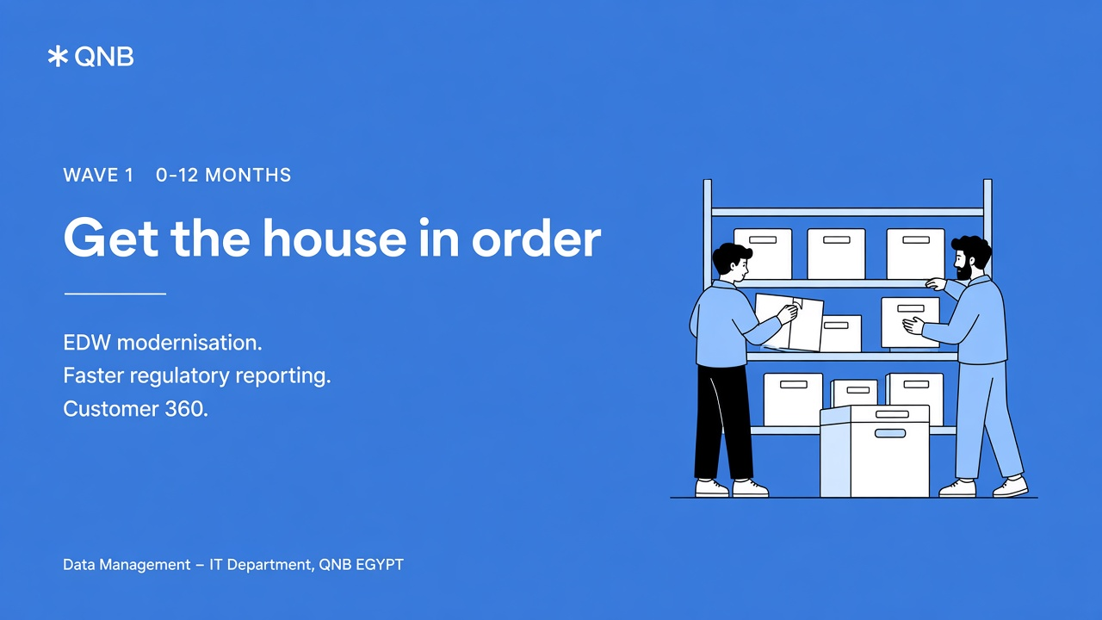
Notes:
WAVE 1 — speaking notes
0–12 months. Deliberately unglamorous. Foundation first.
• EDW modernisation and consolidation — retire duplicate copies.
• Regulatory and financial reporting with lineage.
• Customer 360 and self-service analytics.
What changes: trust the numbers, close the books faster, see the customer as one person.

Slide 9
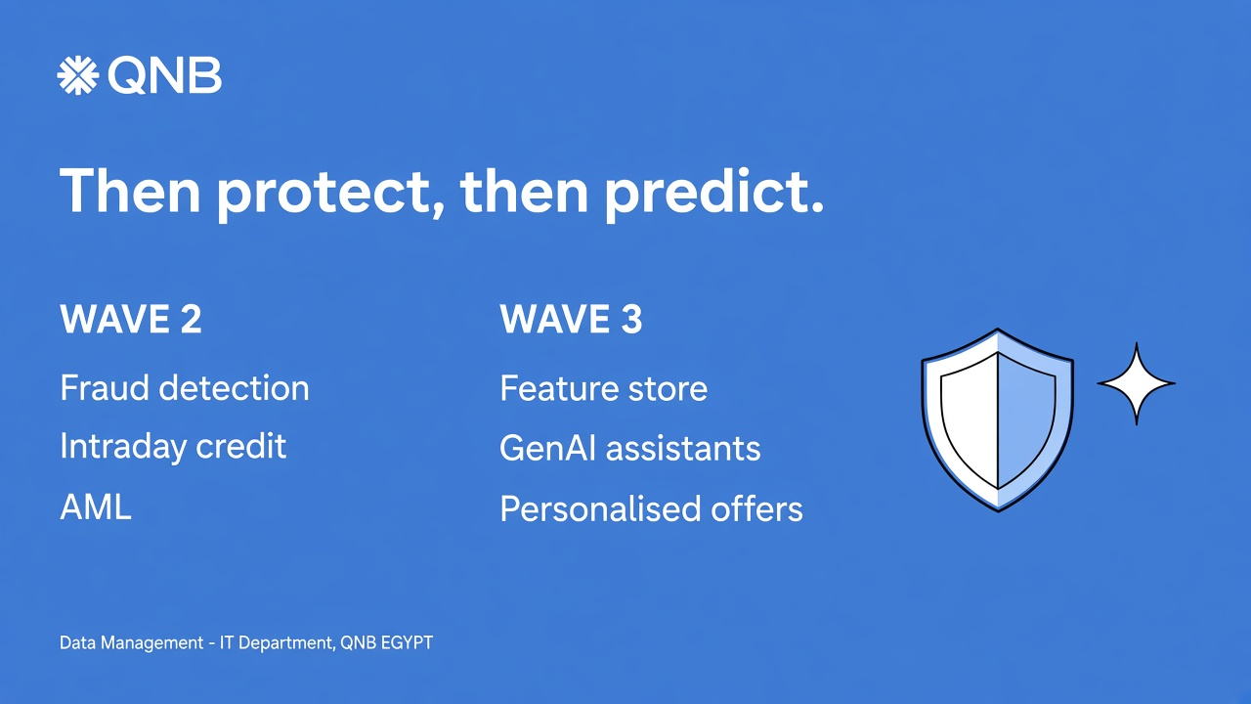
Notes:
WAVES 2 AND 3 — speaking notes
Wave 2 (6–18 months): near-real-time fraud; intraday credit and limits; AML with fewer false positives. Risk and financial-crime teams work from live data.
Wave 3 (12–36 months): feature store and MLOps; GenAI assistants; hyper-personalisation. AI runs on the gold data the bank already trusts.
Do not start Wave 3 at scale until lineage, masking, and the model inventory are working.

Slide 10
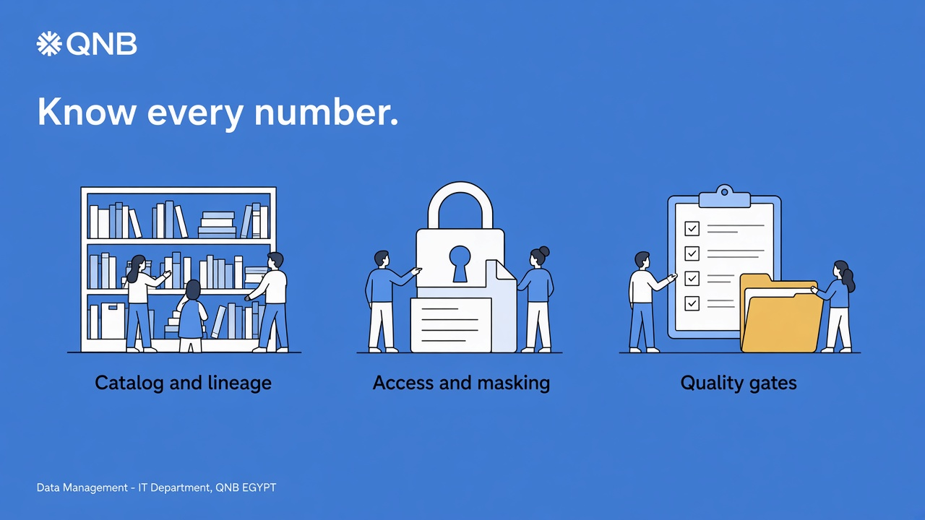
Notes:
GOVERNANCE — speaking notes
A lakehouse without governance is just a bigger garage.
1. Catalog + lineage — when Audit asks “why is NPL 1.4%?”, we show the path.
2. Access + masking — need-to-know. PII masked by default.
3. Quality gates — bronze can be messy; gold cannot.
Operations: separate BI / risk / data-science workloads; cost monitoring; automated pipelines and models.

Slide 11
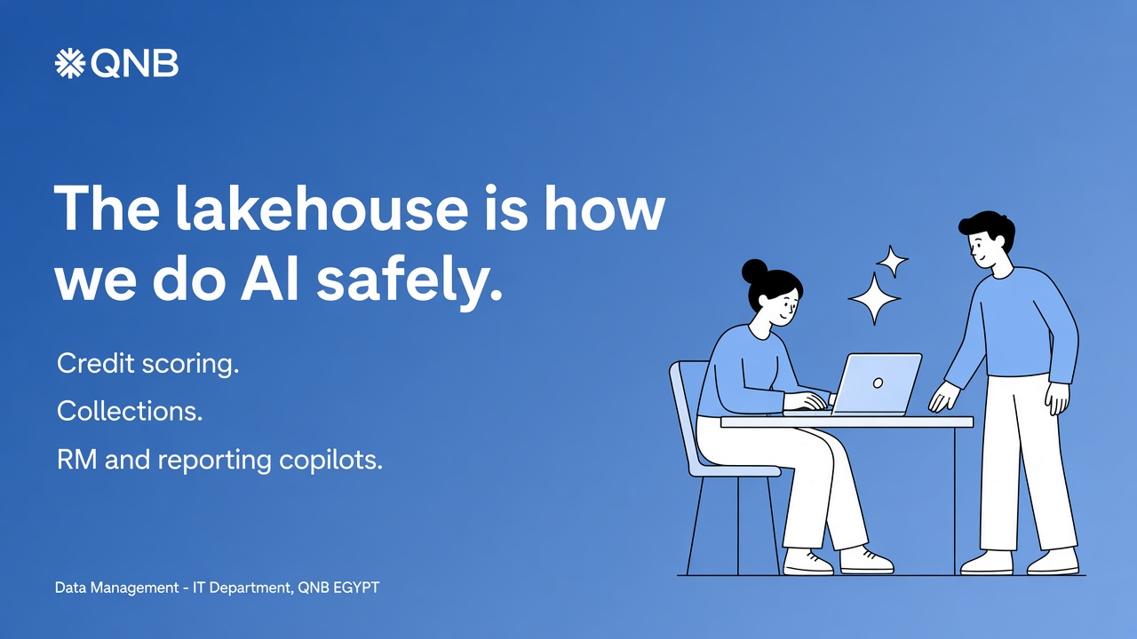
Notes:
AI — speaking notes
The lakehouse is the prerequisite for safe AI.
• Unified governed data — no shadow copies for data science.
• Feature store and model registry — explainable to Risk and Audit.
• GenAI copilot — questions in everyday language, only on allowed gold data.
Examples: credit scoring; collections optimisation; RM briefing and regulatory-pack drafting. A human remains accountable. GenAI never becomes a second source of truth.

Slide 12
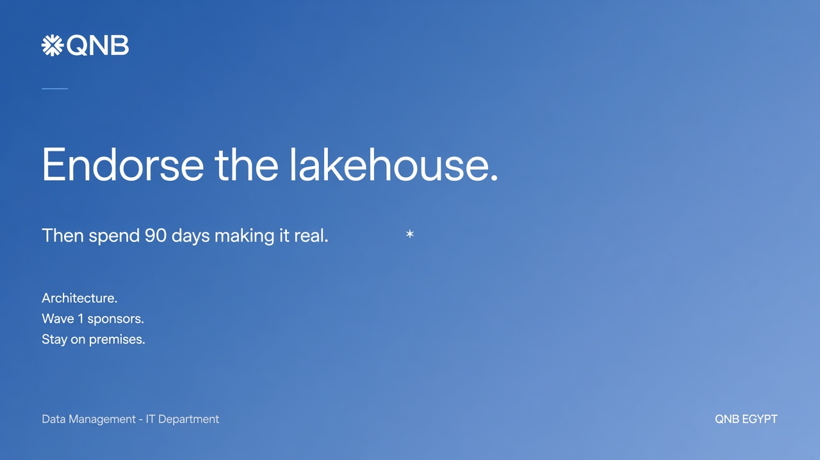
Notes:
CLOSE — speaking notes
Ask for three things, not a blank cheque:
1. Endorse the on-premises lakehouse as the strategic platform.
2. Sponsor Wave 1 with named executives.
3. Keep it in our data centres with enterprise vendors.
Next 90 days: architecture and product shortlist; Finance / Risk / Customer domains; governance working group; investment case.
Close: we do not need another warehouse, another mart, and another Excel. We need one home for the bank’s data — organised, governed, and here.

