Slide 1
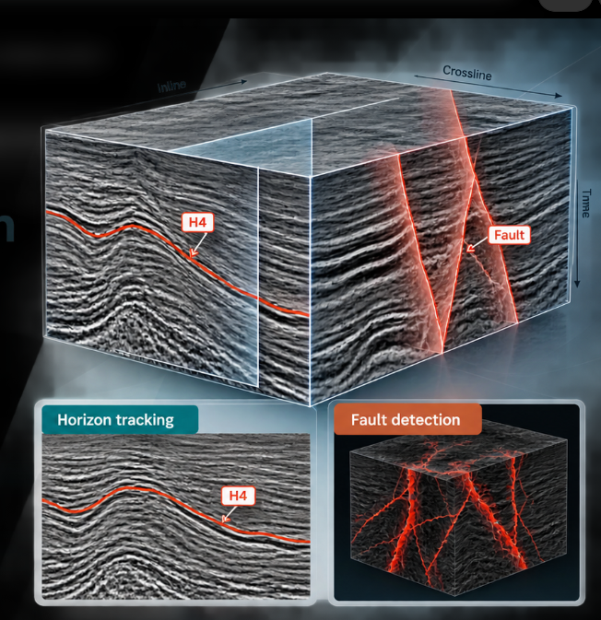
28 OCTOBER 2026 / TECHNICAL REVIEW
Seismic interpretation
experiments
Horizon tracking + Fault detection
Methods tested, measured outcomes, and practical limits
F3 inline 425 / H4 • Thebe full-grid evaluation
Notes:
[Clear, steady opening. Look up.] The work covers two problems in seismic interpretation. First, following one reflection through a seismic section. Second, identifying faults throughout a 3D volume. My starting point was computer science, not geology. So the question was not simply which model scores highest. It was how to read the data, build a baseline, and trust the evaluation. [Pause.] I will show the decisions that mattered.

Slide 2
LEARNING PATH / COMPUTER SCIENCE → SEISMIC INTERPRETATION
Five practical steps, from reading traces to checking reliability
The goal was to make unfamiliar seismic data measurable—not to start with the largest model.
01
02
03
04
05
Understand the data
Build a simple baseline
Use expert evidence
Work in 3D
Test reliability
Traces · samples · axes
›
Seed · amplitude tracking
›
H4 · MAE · convergence
›
128³ voxels · fault masks
›
Real Thebe · seeds · masks
What does one sample represent?
Does it follow a reflector?
Is the curve actually correct?
Can a model find faults?
Will the result hold outside the demo?
Two projects • eight horizon experiments • ten fault experiment families • one evidence-first workflow
SEISMIC INTERPRETATION / TECHNICAL REVIEW
02
Notes:
[Gesture along the five stages.] This was the learning path. First, understand traces, samples and geometry. Then build a simple tracker. Next, compare it with an expert interpretation—not just with a picture that looks reasonable. In the second project, move from one line to millions of 3D voxels, then test how results change across datasets and random seeds. [Emphasize.] The important skill is knowing what each result actually proves.

Slide 3
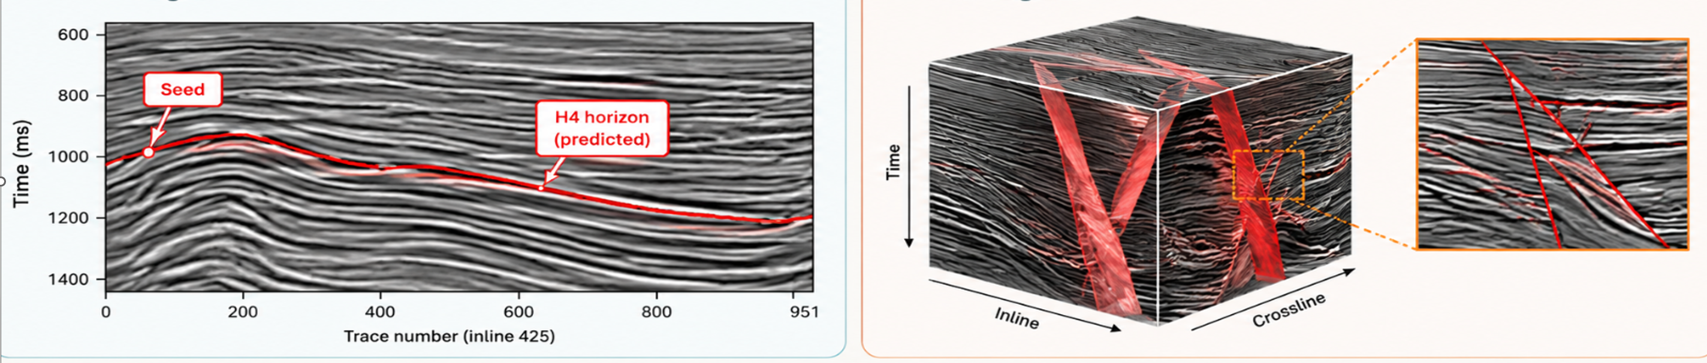
OVERVIEW
Two tasks, two types of evidence
Each result is reported only within its actual benchmark.
01 Horizon tracking
02 Fault detection
Input: F3 inline 425 + one seed
Target: one continuous reflector
Evaluation: expert H4 line, 951 traces
Strongest result: 2.00 ms MAE
Input: 3D seismic patches
Target: fault / non-fault per voxel
Evaluation: labelled synthetic and real data
Strongest full test: Dice 0.5813
Horizon = position along traces • Fault = voxel-level segmentation
SEISMIC INTERPRETATION / TECHNICAL REVIEW
03
Notes:
In horizon tracking, we select one seed point and estimate a time position on each trace. The result is one curved line. In fault detection, we predict whether each 3D voxel is part of a fault. These tasks need different evidence. Horizon tracking is evaluated using mean absolute error, or MAE—lower is better. Fault detection uses overlap and classification metrics such as Dice, precision and recall—higher is generally better. I will not mix their scores.

Slide 4
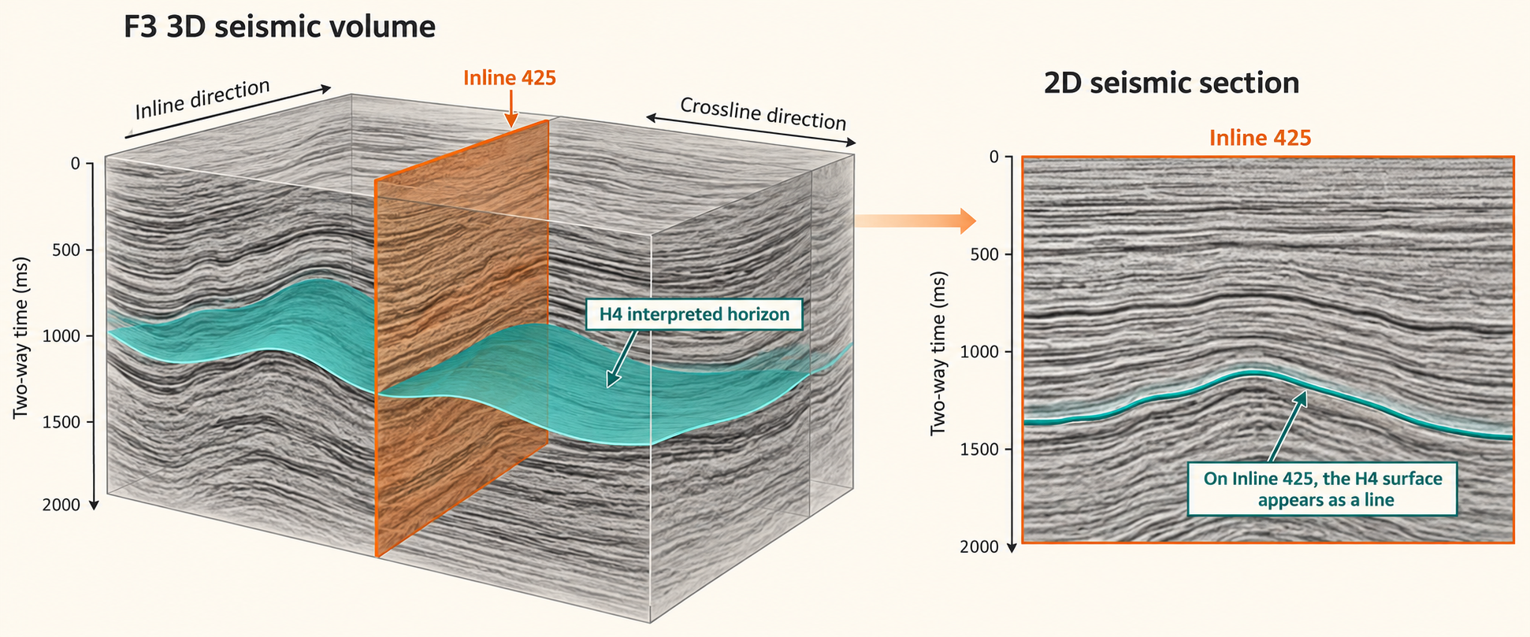

Slide 5
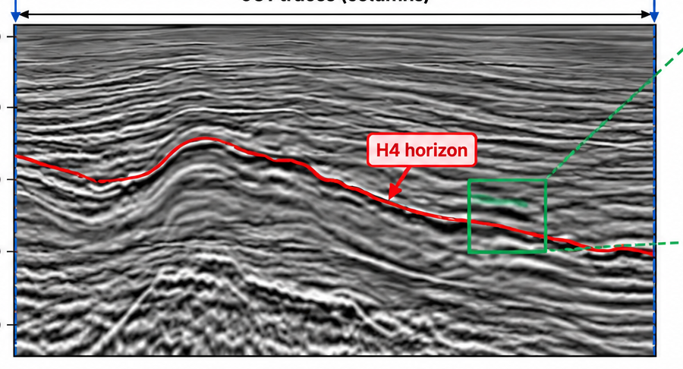
HORIZON / DATA
The prediction is one line across one seismic section
F3 is a 3D survey. Inline 425 is one 2D vertical section; H4 is one expert-traced reflector.
951 × 462
traces × time samples
What the tracker returns
One time position per trace → 951 positions form a curved line.
MHE reads the entire seismic section; expert H4 is held for accuracy scoring.
SEISMIC INTERPRETATION / TECHNICAL REVIEW
04
Notes:
[Point to image.] F3 is the full 3D survey; inline 425 is one vertical section. It has 951 traces, or vertical signal columns, and 462 time samples per trace. H4 is one particular reflection traced by an expert across those columns. It is curved, not a fixed row. The algorithm receives the seismic section and one manually selected seed, and predicts one time value per trace. We use expert H4 to check the prediction afterward. There is no neural-network training here.

Slide 6
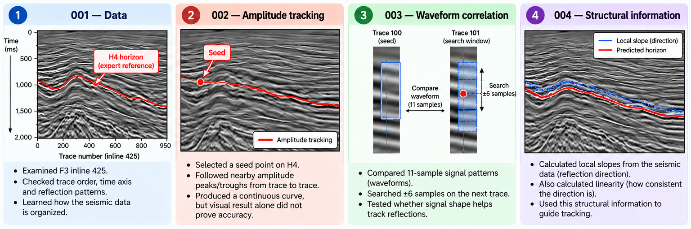
HORIZON / 001–004
Start simple; add local seismic evidence
Conceptual illustrations of the first four experiment stages.
WHY: inspect data + establish simple local evidence • NEXT: common H4 benchmark on 951 traces (005–006) • REF: amplitude, waveform correlation, local slope / linearity
SEISMIC INTERPRETATION / TECHNICAL REVIEW
05
Notes:
The first question was: can a reflection be followed at all? Experiments 001 and 002 checked trace order, time direction and a basic tracker that follows nearby amplitude peaks or troughs. That produced a curve, but did not prove it was the right reflection. So experiment 003 compared the surrounding signal shape: an 11-sample window, searched within plus or minus six samples. Then experiment 004 calculated local slope—how a reflection tilts—from horizontal and vertical amplitude changes. The structure tensor smooths those changes over a neighborhood, using 8 vertical samples and 2 horizontal traces. Those were the tested smoothing settings, not proven optimal values. [Pause.] Better-looking local information still needed an expert benchmark.

Slide 7
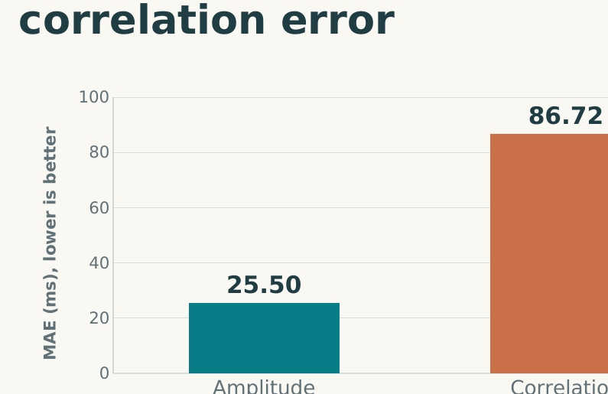
HORIZON / 005–006
A plausible curve can still follow the wrong reflector
Both methods were scored against expert H4 on the same 951 traces.
100.76 ms
Python slope-fit MAE
006 / Converged in 12 iterations
The numerical updates became tiny, but the horizon still differed greatly from H4.
WHY: benchmark plausible curves against expert H4 • NEXT: integrate the official method for a cleaner comparison (007) • REF: 005 common benchmark; 006 slope least-squares
005: correlation did worse than amplitude. 006: solver convergence ≠ geological accuracy.
SEISMIC INTERPRETATION / TECHNICAL REVIEW
07
Notes:
That is exactly what experiment 005 exposed. We reran amplitude and correlation tracking on the same H4 seed and all 951 traces. Amplitude gave 25.50 milliseconds MAE. Correlation gave 86.72. [Pause.] Comparing more signal shape had not helped; similar reflections can still mislead the tracker. Experiment 006 then fitted a horizon using local slopes and least squares. After 12 iterations, its numerical adjustments had nearly stopped, but the MAE was still 100.76 milliseconds. A solver can converge to the wrong geological line. So the next fair question was whether the complete published algorithm, not an approximation, could do better.

Slide 8
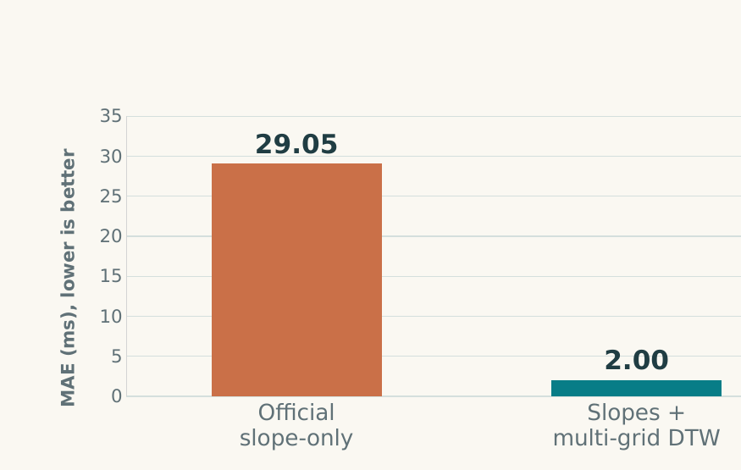
HORIZON / 007
Complete official MHE: 2.00 ms MAE
Wu & Fomel (2018). Same seed and input fields in the official slope-only versus complete comparison.
Integration path
SEG-Y traces → Python preparation
Local slope and linearity fields
Official Jython / Java MHE runner
Convert outputs to ms; compare with H4
WHY: test the complete official method under the same seed / inputs • NEXT: perturb the seed for robustness (008) • REF: Wu & Fomel, 2018
Multi-grid waveform alignment + slopes: 29.05 → 2.00 ms (93.1% lower vs official slope-only).
SEISMIC INTERPRETATION / TECHNICAL REVIEW
08
Notes:
[Slow down for main result.] Experiment 007 integrated the official method by Xinming Wu and Sergey Fomel, published in 2018. Their method combines local slopes with multi-grid waveform correlations. Slopes say how reflections tend to continue; correlations help align corresponding signals when local continuation is unreliable. The integration required preparing SEG-Y trace order, converting the binary data, running the authors’ Java and Jython implementation, and converting output picks back to milliseconds. Within that implementation, slope-only gave 29.05 milliseconds MAE, while the complete method reached 2.00. [Pause.] That is a 93.1 percent reduction against official slope-only, not a claim that the original algorithm was invented here.

Slide 9
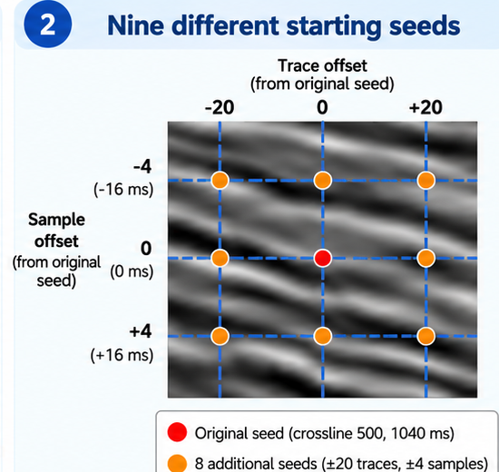
HORIZON / 008
Seed robustness: nine starts, one reference result
The seed is one chosen trace and time location on the reflection.
3 × 3 = 9 starting points
Trace offsets: −20, 0, +20
Sample offsets: −4, 0, +4 (±16 ms)
One original seed + eight nearby alternatives
Nine predictions → median and disagreement
1.85 ms
47 traces excluded. Selected accuracy is not full coverage.
on 904 lowest-spread traces
SEISMIC INTERPRETATION / TECHNICAL REVIEW
09
Notes:
A strong result raises another question: does it depend on choosing exactly the right starting point? Experiment 008 tested a 3-by-3 grid. Three horizontal offsets—minus 20, zero, plus 20 traces—were combined with three vertical offsets—minus 4, zero, plus 4 samples. Three times three is nine: the original seed plus eight nearby alternatives. [Point to grid.] Each produced a horizon. The median prediction still had 2.00 milliseconds MAE. Looking only at the 904 traces with the least disagreement gave 1.85, but excluded 47 traces. So this was a robustness check, not a full-section improvement.

Slide 10
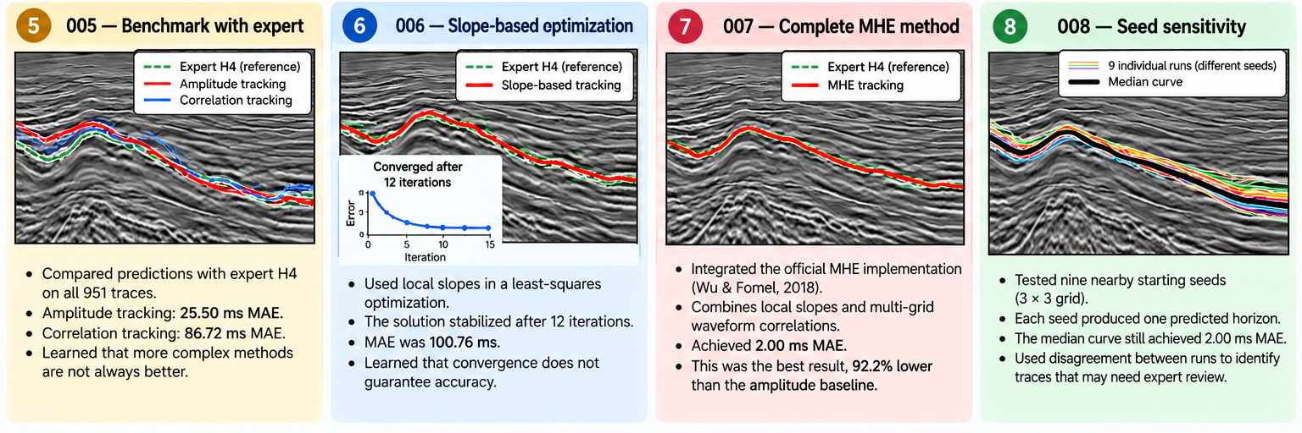
HORIZON / CONCLUSIONS
What the horizon work established
Result and remaining boundaries are kept separate.
Contribution
Limitations
Next validation
Eight documented experiments
Official MHE integration and evaluation
Seed-sensitivity and selective review
Code package delivered for company testing
Single F3 section / H4 horizon
Company accuracy not measured
Test more labelled sections
Collect company overlays and settings
Preserve logs and geometry checks
SEISMIC INTERPRETATION / TECHNICAL REVIEW
10
Notes:
The completed contribution is an integrated and evaluated MHE workflow, a comparison with simpler baselines, and a seed-sensitivity analysis. The code package was delivered for company testing; the mentor reported it ran, but no company accuracy number was provided. The strongest quantitative result therefore remains the F3 H4 benchmark on one 2D section. [Pause.] The next step is more labelled sections, company-specific overlays and a review signal that works without benchmark labels. From a CS perspective, this taught practical seismic geometry, numerical optimization and evidence-based benchmarking.

Slide 11
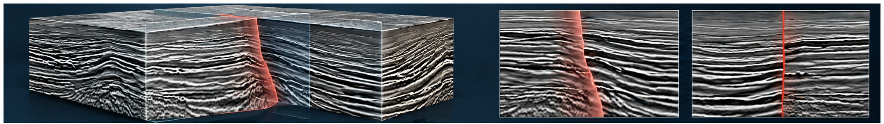
FAULT DETECTION / SETUP
From a seismic cube to a fault mask
Fault detection predicts fault / non-fault for each voxel (one 3D data cell).
What is predicted?
One fault probability for each voxel
(one 3D cell in the seismic cube).
Synthetic
Thebe
Scoring
180 / 20 / 20 cubes; each 128³
9 / 2 / 7 data blocks; real seismic
Exclude missing data; test last
New illustration is conceptual; reported results come from labelled evaluation data.
Dataset and valid-data mask must be fixed before interpreting Dice.
SEISMIC INTERPRETATION / TECHNICAL REVIEW
11
Notes:
[Point to cube.] The second problem is different. A fault can interrupt layers across a 3D seismic volume, so now a model predicts a fault probability at every voxel—a small 3D data cell. We trained on 128-by-128-by-128 patches because full volumes are too large to process as one input under this setup. The synthetic dataset has 180 training, 20 validation and 20 test cubes. The real Thebe data uses nine training, two validation and seven test blocks. We excluded padded and missing regions before scoring. Otherwise, background could dominate the metric.

Slide 12
FAULT DETECTION / DATA SOURCES
Five seismic datasets: origin and label availability
Key distinction: real seismic data does not necessarily include verified fault labels.
DATASET
ORIGIN / SOURCE
DATA TYPE
FAULT ANNOTATIONS
FaultSeg3D
Wu et al. (2019) · UT Austin (USA)
Synthetic 3D
Automatically generated fault masks
Thebe
Thebe Gas Field, Australia · UCD (Ireland)
Real 3D
Expert-interpreted fault labels
Opunake-3D
Taranaki, New Zealand · Crown Minerals
Real 3D
No verified expert fault masks
Kahu-3D
New Zealand · Crown Minerals
Real 3D
No verified expert fault masks
CRACKS
Netherlands F3 · Georgia Tech (USA)
Real 2D
Expert, practitioner & novice labels
Takeaway: Thebe and CRACKS provide human fault labels; Opunake and Kahu need label verification.
SEISMIC INTERPRETATION / TECHNICAL REVIEW
12
Notes:
The datasets have different jobs. FaultSeg3D is synthetic, with automatically generated fault masks; it gives a controlled starting point. Thebe is a real Australian survey with interpreted fault labels, used for training and full-grid evaluation. Opunake and Kahu are real surveys from New Zealand, but we have not verified suitable expert fault masks for this project. CRACKS uses real Netherlands F3 sections with human annotations. [Pause.] Real data is not the same as labelled data. That distinction matters when choosing training and test sets.

Slide 13
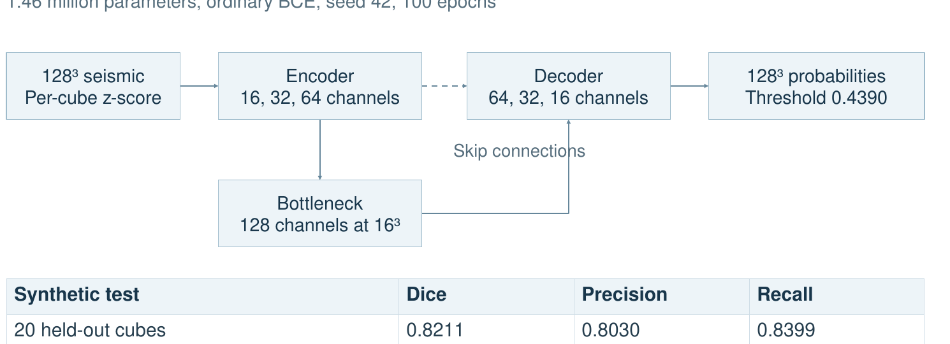
FAULT DETECTION / 01–03
Synthetic baseline and controlled modifications
All three complete runs used the same split, seed 42 and 100-epoch budget.
0.8211
0.8198
0.8266
3D U-Net test Dice
weighted BCE + Dice
attention + CAFT
Small P1 gain (+0.0056); model and loss changed together, so cause cannot be isolated.
WHY: synthetic baseline + controlled modifications • NEXT: zero-shot transfer to Thebe (04–05) • REF: small 3D U-Net; P1 attention + CAFT
SEISMIC INTERPRETATION / TECHNICAL REVIEW
13
Notes:
We started with a small 3D U-Net rather than a very large network. Its synthetic test Dice was 0.8211, giving a baseline. Experiment 02 changed the loss to weighted BCE plus Dice loss, hoping to pay more attention to the sparse fault voxels. The result was 0.8198: no gain. Experiment 03 added attention gates and CAFT, trying to focus the network on relevant patterns and prediction errors. Dice reached 0.8266, a small improvement. But both architecture and loss changed, so we cannot say attention alone caused it. [Pause.] Before making the model bigger, the next useful test was whether it worked on real data.

Slide 14
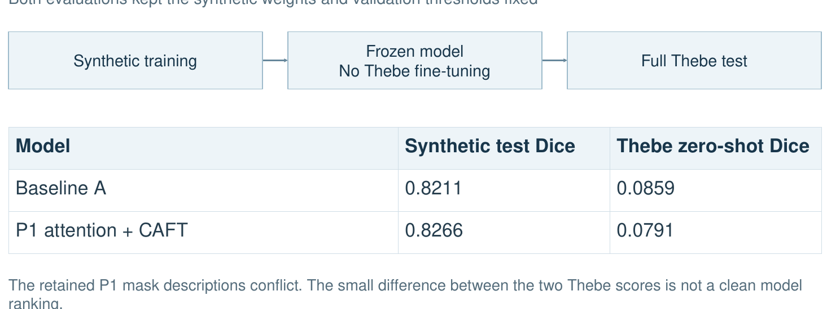
FAULT DETECTION / 04–05
Synthetic models did not transfer well to Thebe
Zero-shot: frozen synthetic weights and thresholds, no training on real Thebe.
0.0859
0.0791
baseline A → Thebe test
P1 → Thebe test*
* P1 mask records conflict; these two Thebe scores are not a clean ranking.
SEISMIC INTERPRETATION / TECHNICAL REVIEW
14
WHY: test domain transfer with no real-data training • NEXT: train directly on labelled Thebe (06) • REF: zero-shot Thebe evaluations
Notes:
We took the two models trained on synthetic data and ran them on Thebe without retraining—that is zero-shot transfer. The baseline fell to 0.0859 Dice and the attention variant to 0.0791. The P1 records also have a mask inconsistency, so that small ranking is not clean. The clear finding is the domain gap: synthetic fault patterns and real seismic data are different. [Emphasize.] A synthetic test score of about 0.82 did not mean a real-world Dice of 0.82. That motivated training on labelled Thebe directly.

Slide 15
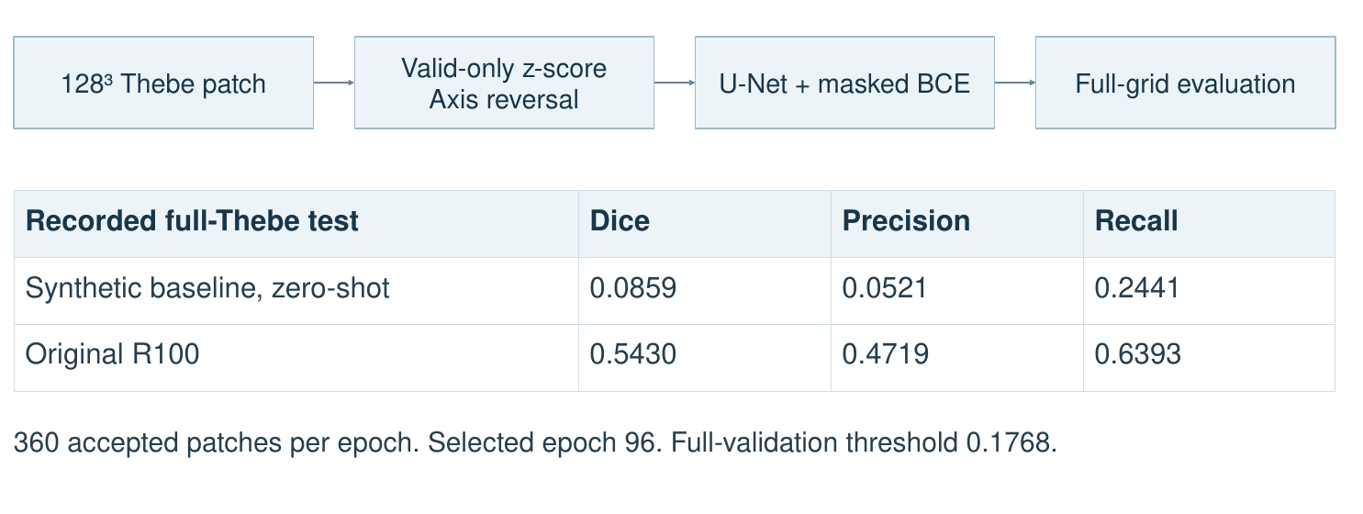
FAULT DETECTION / 06
Training on labelled Thebe changed the result
Real-data 3D U-Net baseline, 128³ patches and 100 epochs.
0.0859
0.5430
synthetic model → Thebe
Thebe-trained R100 test Dice
SEISMIC INTERPRETATION / TECHNICAL REVIEW
15
WHY: test the value of labelled real data • NEXT: measure seed variation, then ensemble (07–08) • REF: R100 Thebe baseline
Notes:
Experiment 06 trained the small 3D U-Net on labelled real Thebe patches, with normalization and a valid-data mask. It used 360 accepted patches per epoch across 100 epochs; the final threshold was chosen from validation data before testing. The full-Thebe test Dice reached 0.5430, compared with 0.0859 for the synthetic-trained baseline. [Pause.] That was the largest measured improvement. It suggested that matching the training data to the real survey mattered more than the small synthetic architectural changes. Next, we checked whether the result was stable across repeated training runs.

Slide 16
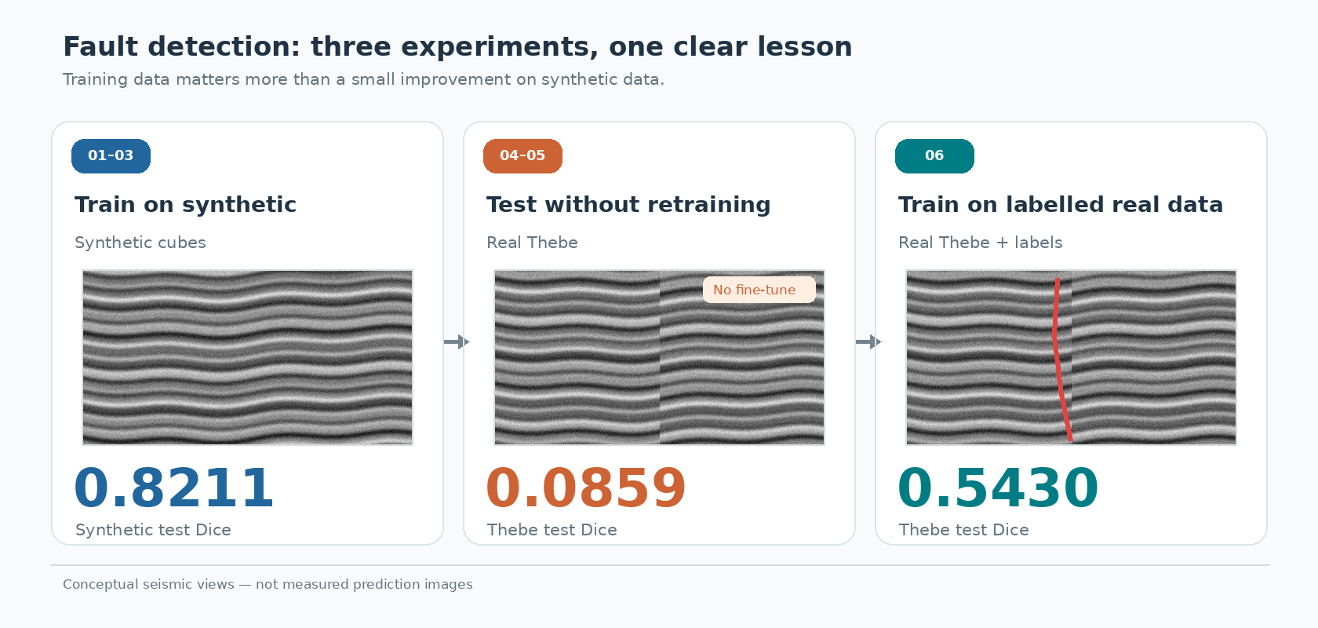

Slide 17
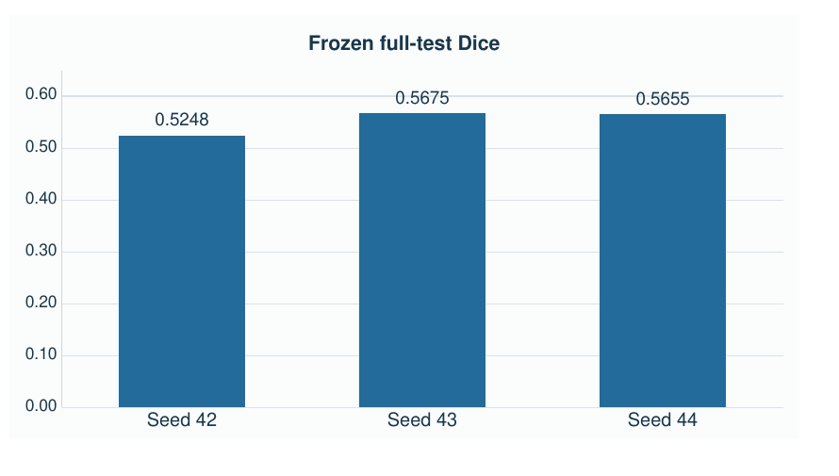
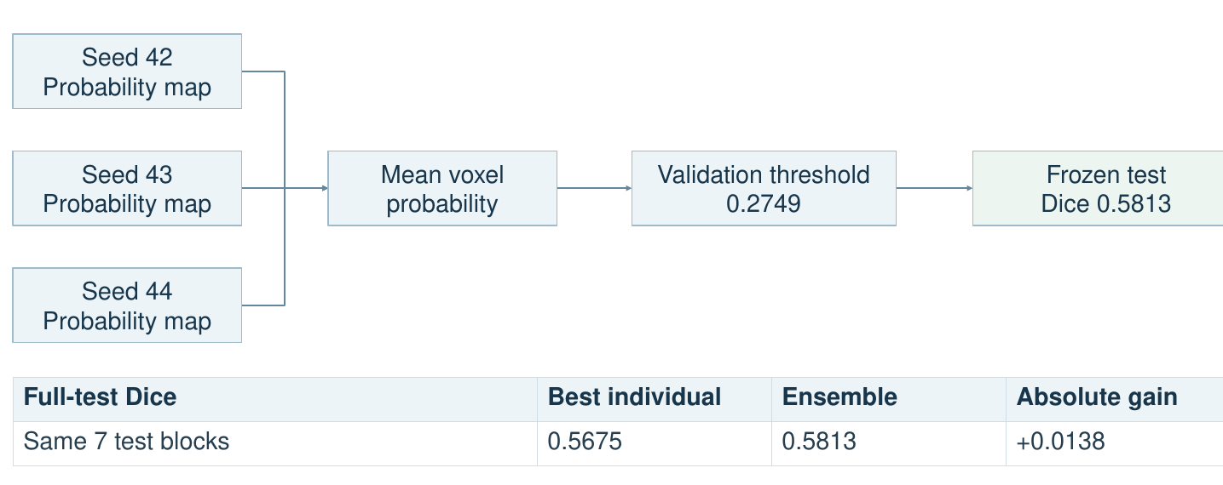
FAULT DETECTION / 07
Repeated seeds and probability averaging
Three clean R100 runs: same procedure, different random initialization.
0.5675
0.5813
best single model test Dice
three-model ensemble test Dice
SEISMIC INTERPRETATION / TECHNICAL REVIEW
16
WHY: quantify seed variation and probability averaging • NEXT: enlarge to a five-model pool (08) • REF: clean R100 three-seed study
Notes:
We repeated the clean R100 training with random seeds 42, 43 and 44. These seeds change initialization and randomized training choices, not the target geology. The test Dice scores ranged from 0.5248 to 0.5675. Then we tried a simple ensemble: each model predicted a fault probability for every voxel, and we averaged the three probabilities before applying a validation-selected threshold. That reached 0.5813 on the same held-out test, above the best single model’s 0.5675. [Pause.] The improvement was modest but measured under a consistent test protocol.

Slide 18
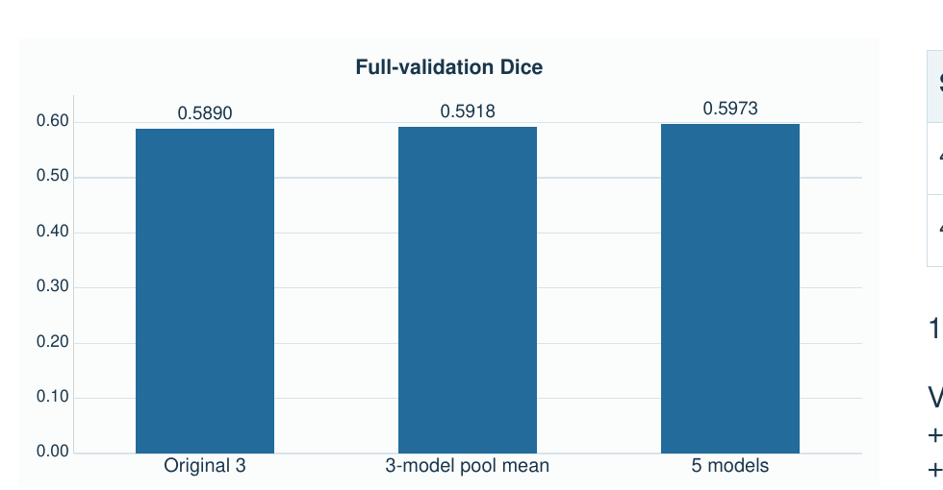
FAULT DETECTION / 08
Five models: promising validation, not a test claim
Seeds 45 and 46 completed 100 epochs; test access remained disabled for this study.
0.5973
five-model validation Dice
Interpretation
Original 3: 0.5890
Five: 0.5973
Gain: +0.00836
No five-model test score
Potential further ensemble gain, but full-test improvement is unconfirmed.
SEISMIC INTERPRETATION / TECHNICAL REVIEW
17
WHY: check whether more models still help • NEXT: keep as validation-only until a frozen test protocol exists • REF: R100 seed-saturation pilot
Notes:
The next question was whether adding more models kept helping. We trained two further random seeds, 45 and 46, then compared three- and five-model averages using validation data. Original three-model validation Dice was about 0.5890. The five-model version reached 0.5973. That is promising, but it is not a five-model test result. We intentionally keep those claims separate: the measured three-model test gain is established; five-model generalization still needs a frozen test evaluation.

Slide 19
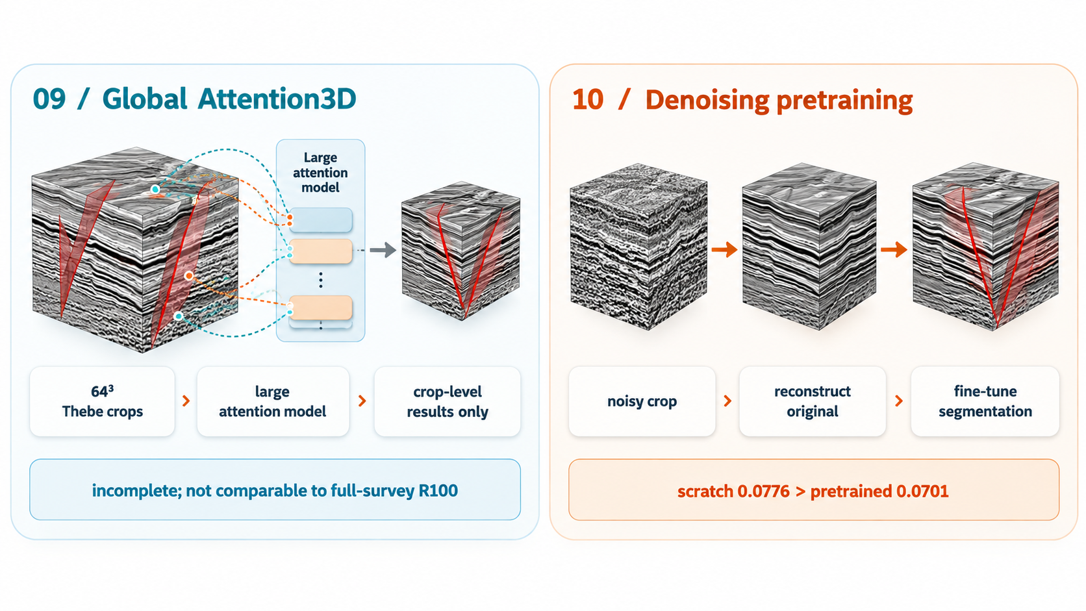
FAULT DETECTION / 09–10
Larger attention and denoising pilots
Useful negative or incomplete evidence; not directly comparable with R100 full-survey Dice.
09 / Global Attention3D
10 / Denoising pretraining
Question: can a larger network capture fault patterns?
Question: can reconstruction teach useful features?
64³ Thebe crops
›
45M-parameter model
›
FP16 / BF16 checks
Noisy field crop
›
Reconstruct original
›
Fine-tune segmentation
Incomplete; crop-only results
Scratch 0.0776 > pretrained 0.0701
No full-survey improvement established; next step = matched evaluation with fixed mask and crops.
SEISMIC INTERPRETATION / TECHNICAL REVIEW
18
Notes:
We also tested two more ambitious ideas. Experiment 09 used a much larger Global Attention3D model with about 45 million parameters, hoping that broader context would reveal fault patterns. The FP16 run later developed non-finite losses; the BF16 version had finite recorded epochs, but completion was not confirmed. These crop scores are not directly comparable with the R100 full test. Experiment 10 asked whether the model could first learn seismic structure by reconstructing a noisy input. Under a short matched training budget, scratch Dice was 0.0776 versus 0.0701 after pretraining. It did not help in that pilot. [Pause.] Complexity alone did not give better evidence.

Slide 20
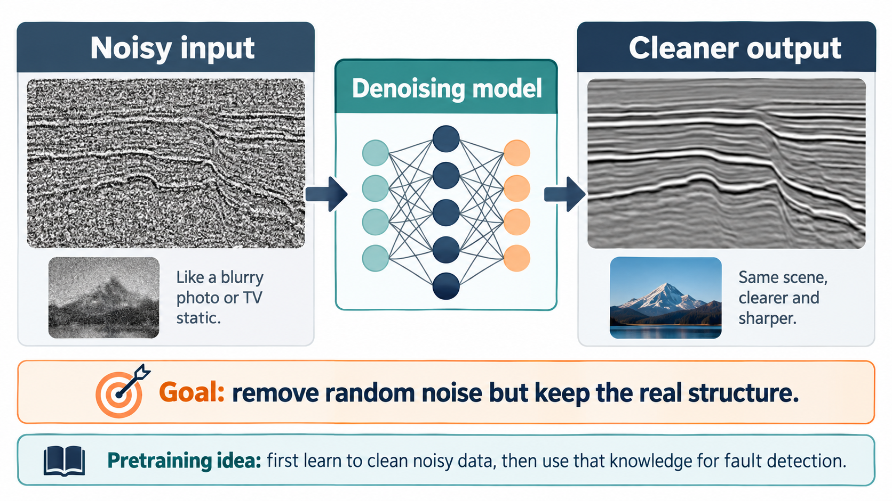
Experiment 10

Slide 21
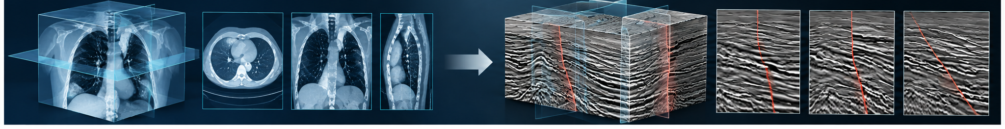
FAULT DETECTION / ADDITIONAL EVALUATIONS
SAM-Med3D : what was actually tested
Additional diagnostic evaluations, separate from the ten run families.
Medical CT → seismic volume?
SAM-Med3D | 3D, but trained for medicine
Frozen on Thebe: Dice 0.0488
Recall 0.9556; precision 0.0250
Many false fault predictions.
Reason for testing SAM: it handles 3D voxels. Finding: a shared data shape does not imply shared fault features.
SEISMIC INTERPRETATION / TECHNICAL REVIEW
19
Notes:
[Point from CT to seismic.] SAM-Med3D is designed for 3D medical scans. We tested it because medical scans and seismic cubes are both volumetric data, and SAM already has a 3D encoder and decoder. But sharing three dimensions does not mean they contain the same patterns. Without retraining on Thebe, SAM achieved only 0.0488 Dice. Its recall was high—0.9556—but precision was just 0.0250, meaning many false fault predictions. Assisted clicks used ground-truth hints, so they are not automatic detection. CRACKS gave another lesson: changing which labels count as valid changes the Dice, even for identical predictions. [Pause.] Model choice and evaluation policy both matter.

Slide 22
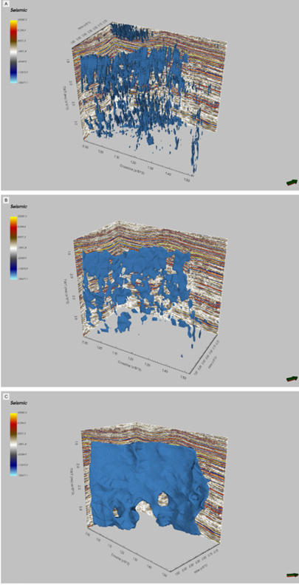
FAULT DETECTION / CONCLUSIONS
Contributions, limits, and next experiments
Evidence to keep: 0.5430 on real-data R100; 0.5813 on the frozen three-model test.
Contribution
Limitations
Next implementation
Synthetic + Thebe evaluation pipeline
Labelled Thebe baseline: 0.5430
Three-model full-test: 0.5813
Repeated seeds + mask-policy audit
One retained Thebe split
P1 transfer mask ambiguity
GPU
Time constraints
Matched Attention3D full-grid test
GPU train + evaluate SAM adapter
Unify evaluation masks
Freeze ensemble protocol before test
CS learning: domain shift • class imbalance • train / validation / test discipline • reproducible model comparison
SEISMIC INTERPRETATION / TECHNICAL REVIEW
20
Notes:
[Slightly slower. Strong finish.] The strongest fault result was not the largest network. It was a small U-Net trained on real labels, followed by repeated-seed probability averaging: 0.5430 and 0.5813 Dice respectively on their recorded test evaluations. We also identified the real limitations: synthetic-to-real transfer, random-seed variation, evaluation masks, incomplete attention runs and untrained SAM adaptation. The next steps are matched full-grid comparisons and carefully frozen tests. Across both projects, the main progress was learning to move from an attractive prediction to a result that can actually be checked. [Pause. Look up.] Thank you.

Slide 23
TECHNICAL BACKUP / Q&A
Reference basis and evidence boundaries
Useful exact references for questions about method source and experiment purpose.
Reference basis
Why each experiment family was run
Horizon: Wu & Fomel (2018), Geophysics — local slopes + multigrid correlations.
FaultSeg3D: Wu et al. (2019) — synthetic seismic / fault masks.
SAM-Med3D: Wang et al. (2023 preprint; 2025 journal) — 3D medical segmentation.
Global Attention3D: adapted supervised experiments; not a complete published-method reproduction.
01–03: synthetic baseline / controlled changes
04–05: domain transfer test
06–08: real-data training + seed / ensemble checks
09–10: larger-model and pretraining pilots
Extra diagnostics: CRACKS label policy, frozen / interactive SAM.
Contribution = integration, benchmarking, controlled comparison, diagnosis, and clear evidence boundaries.
SEISMIC INTERPRETATION / TECHNICAL REVIEW
21
Notes:
Wu & Fomel citation is as reported in the supplied presentation. Do not claim original MHE invention or proprietary-data performance. Source audit noted original MHE and comparative experiments ran under documented settings. Full company accuracy and survey-independent test evaluations were not supplied.
Do not present unless asked; main presentation finishes at slide 20.

Slide 24
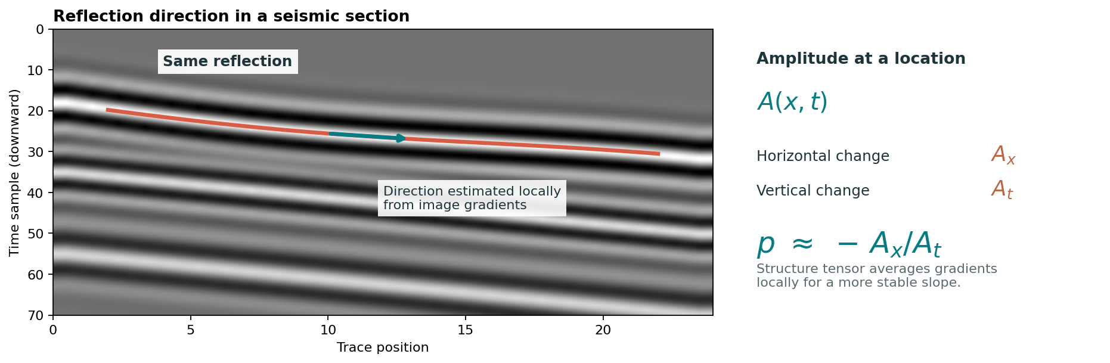
HORIZON + FAULT / METRIC SNAPSHOT
One-slide summary of the scored metrics used in both projects
Keep the evaluation scope fixed when comparing numbers.
Horizon tracking
Fault detection
Exp | Model / scope | MAE | RMSE | ≤8 ms
005 | Amplitude | 25.50 | 37.78 | 44.37%
005 | Correlation | 86.72 | 118.99 | 6.52%
006 | Slope fit | 100.76 | 134.07 | 13.67%
007 | Official slope-only | 29.05 | 43.63 | 45.64%
007 | Full MHE | 2.00 | 2.53 | 98.95%
Exp | Scope | Dice | Prec. | Rec. | PR-AUC
01 | Baseline A synth. | 0.8211 | 0.8030 | 0.8399 | 0.8905
04 | Zero-shot Thebe | 0.0859 | 0.0521 | 0.2441 | 0.0416
06 | R100 Thebe | 0.5430 | 0.4719 | 0.6393 | 0.5698
07 | 3-model ensemble | 0.5813 | 0.5173 | 0.6633 | 0.6203
SAM | Frozen, no prompt | 0.0488 | 0.0250 | 0.9556 | 0.0248
MAE and RMSE ↓ = better horizon timing | Dice, precision, recall and PR-AUC ↑ = better fault classification
SEISMIC INTERPRETATION / TECHNICAL REVIEW
06
Notes:
Here are the metrics used in the two projects. For a horizon, MAE is the average absolute time difference from the expert line. RMSE gives larger mistakes more weight, and the percentage within 8 milliseconds shows the fraction of sufficiently close trace positions under that tolerance. For faults, Dice measures overlap, precision asks how many predicted fault voxels were right, and recall asks how many labelled fault voxels were found. PR-AUC summarizes precision and recall across thresholds. [Pause.] A score without its data and mask can be misleading.

Slide 25
TECHNICAL BACKUP / Q&A
Metric formulas and interpretation
Use this slide if a metric definition is questioned.
Horizon / MAE
Fault / Dice and errors
For each of 951 traces:
|predicted time − expert H4 time|
Average all 951 differences.
Full MHE: 2.00 ms; lower is better.
4 ms sample spacing ≠ 4 ms minimum MAE.
Dice = 2TP / (2TP + FP + FN)
TP: correctly predicted fault voxel
FP: non-fault marked fault
FN: missed real fault
Precision = TP/(TP+FP); recall = TP/(TP+FN).
Validation chooses checkpoints / thresholds. Held-out test reports final results.
SEISMIC INTERPRETATION / TECHNICAL REVIEW
22
Notes:
Horizon 2ms is possible with 4ms sampled input because predicted position may be fractional samples, not proof of 2ms geological resolution. Dice overlap between predicted fault and expert-labelled fault; zero to one. Threshold chosen on validation before frozen test. Never compare Dice on unrelated masks or crop/full-grid populations.
Do not present unless asked; main presentation finishes at slide 20.

