Slide 1


M.Tech Program
Advanced Industry Integrated Programs
Jointly offered by University and LTIMindTree
Review III, 08.10.2026
Evidence-Grounded Supplier Intelligence for Automotive Procurement
Khavin C
251011010
T9972
Knowledge partner | Implementation partner

Slide 2
RESA
Introduction
• Automotive buyers compare supplier cost, quality and delivery.
• Quotations and scorecards support buyer decisions.
• Missing or stale evidence weakens recommendations.
• RESA links requirements to source records.
Buyer Needs
Supplier Evidence
RESA Checks
Supplier Shortlist

Slide 3
RESA
Project Objectives
1. Capture mandatory buyer requirements. | 4. Label evidence as satisfied, violated or insufficient.
2. Link evidence to supplier and component. | 5. Rank eligible suppliers with source references.
3. Check numeric limits and evidence dates. | 6. Compare RESA with retrieval and ranking baselines.
Eligible
Rank suppliers
Needs Review
Missing /
stale evidence
Excluded
Hard limit failed

Slide 4
RESA
Core Modules
Evidence Capture
Records supplier IDs, source references and dates
RESA Alignment
Links each requirement to supplier evidence
Requirement Checks
Compares supplier values with buyer limits
Supplier Ranking
Scores eligible suppliers using buyer priorities
Freshness Checks
Flags missing records and outdated evidence
Cited Explanations
Shows reasons and supporting source records
Capture
Match
Check
Score
Explain
Review

Slide 5
RESA
Problem Statement
A supplier ranking can overlook mandatory limits or rely on incomplete evidence. Buyers need to see whether each supplier meets the requirement and which record supports the decision.
Buyer Request
Missing Evidence
Unchecked Rank
Weak Decision
Every recommendation needs requirement-specific evidence.

Slide 6
RESA
RESA Workflow
Buyer Request
Requirements
Supplier Evidence
Freshness Check
Limit Checks
RESA Alignment
State
Eligible
Rank with evidence
Needs Review
Missing or stale evidence
Excluded
Mandatory limit failed

Slide 7
RESA
Approach, Algorithms, and Tools
Approach:
• Match supplier and part IDs
• Check limits and evidence dates
• Assign one of three evidence states
• Rank eligible suppliers with citations
Ranking logic
Ranking:
Eligible suppliers only: 25% quality + 20% price + 20% delivery + 20% reliability + 15% evidence coverage − 15% risk.
Tools
Used: React, JavaScript, CSV / JSON,
FastAPI, Qdrant, Ollama
Llama 3.1 8B, Nomic embeddings, BM25

Slide 8
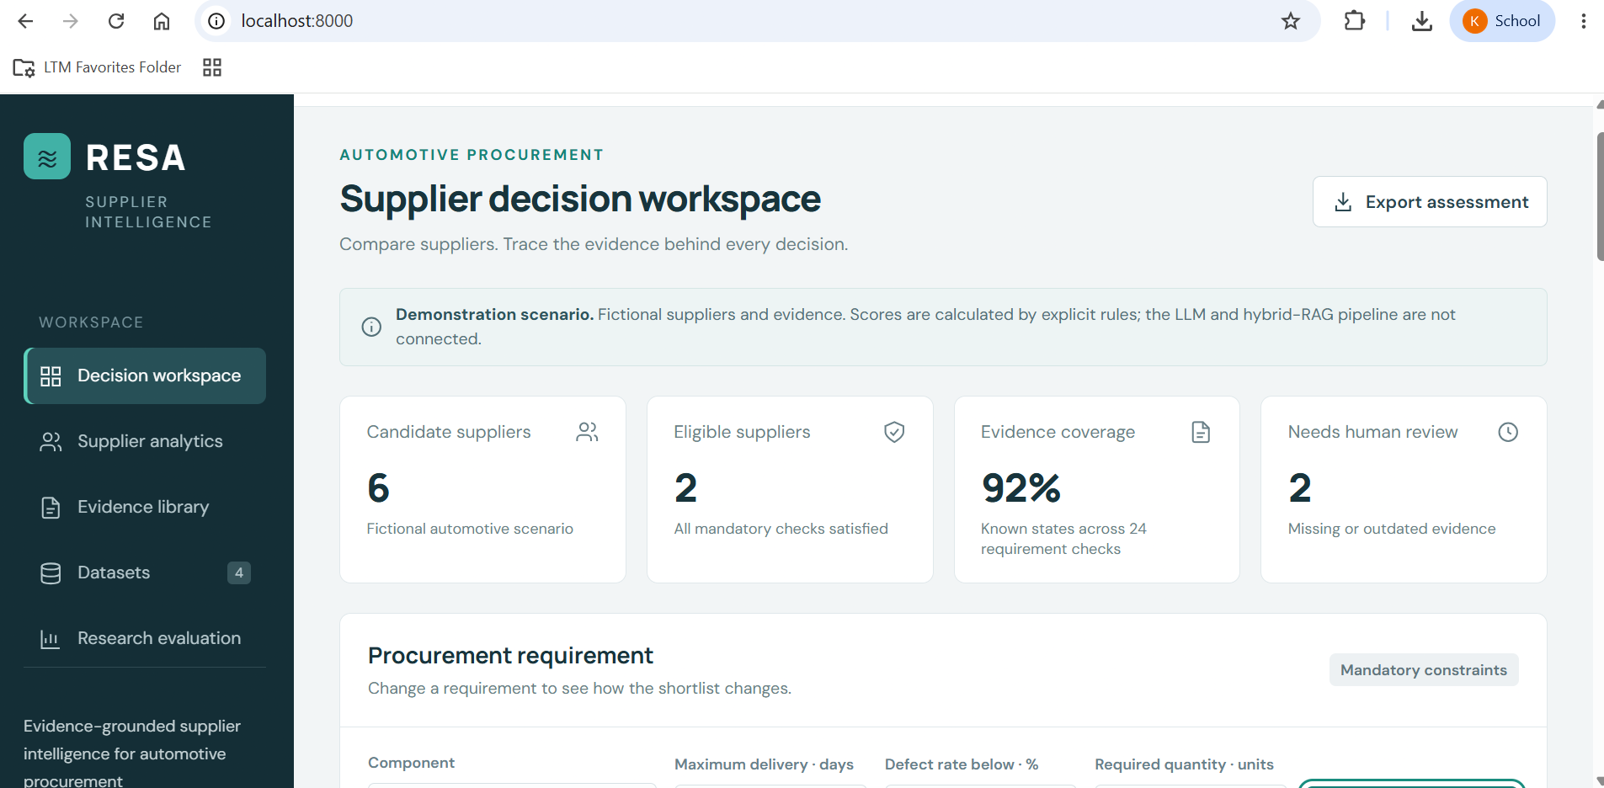
RESA
Application demonstration

Slide 9
RESA
Controlled Evaluation Results
6 Demo Suppliers
12 quotations
18 scorecards
2 / 6
Suppliers eligible in the default scenario
2 / 6
Suppliers excluded for failed requirements
Scenario
Synthetic records for controlled checks
2 / 6
Suppliers need review for missing or stale evidence
RESA
Checks evidence before ranking
This separates eligible, review and excluded suppliers in a given scenario.

Slide 10
RESA
Conclusion
• RESA links buyer requirements to supplier-specific evidence.
• Mandatory checks separate eligible suppliers from review and exclusion cases.
• The prototype ranks eligible suppliers and displays source references, missing evidence and stale records.
• Research evaluation will compare RESA with retrieval and ranking baselines.
Supplier recommendations with inspectable evidence.

Slide 11
RESA
Limitations and Future Work
Limitations
Small synthetic supplier evaluation set
Public sources lack shared supplier IDs
Document retrieval and LLM features remain planned
No independent ranking benchmark yet
Future work
Build an annotated automotive supplier benchmark
Integrate hybrid retrieval and cited explanations
Test claim support and evidence-state accuracy
Compare baselines, ablations and response time

Slide 12
MemPoisonGuard
Acknowledgement
I sincerely thank Ms. Indumathi K, Professor, Department of Information Technology, Rajalakshmi Engineering College, for her valuable guidance and support throughout this project.
I also extend my sincere gratitude to Dr. Ganesa Ramachandran Arunachalam, L&T EduTech, Chennai, and all the classroom teachers and faculty members for their guidance, teaching, encouragement, and support.
Thank You
Questions and Discussion

Slide 13
RESA
Reference
[1] ShahriarKabir, “Procurement KPI Analysis Dataset,” Kaggle.
[2] GraphDatasetHub, “Supply Chain Dataset,” automotive sample.
[3] ManmohanBuildsProducts, “Auto Parts Search Benchmark,” Hugging Face.
[4] RESA prototype: synthetic supplier data and functional validation suite.
[5]Joshi, Singh, Parashar & Singh (2026). A Multi-Agent Large Language Model Framework for Intelligent Vendor Evaluation and Risk-Aware Procurement Decisions.

Slide 14
M.Tech Program
Advanced Industry Integrated Programs
Jointly offered by University and LTIMindTree
Review III, 08.10.2026
MedTrace AI: Medical Device Complaint Investigation Platform
Khavin C
251011010
T9972
Knowledge partner | Implementation partner

Slide 15
MedTrace AI
Introduction
Medical device complaints need a traceable investigation of reported failures and harm.
Incomplete narratives make device identification and evidence review difficult.
Investigators compare past complaints, recall records and regulatory requirements.
MedTrace AI combines complaint analysis and supporting evidence in one workspace.
The system supports infusion-pump investigations with qualified human review.
New Complaint
Evidence Retrieval
Priority Review
Investigation Report

Slide 16
MedTrace AI
Project Objectives
1. Extract device details and reported failure information from complaints. | 4. Explain investigation priority using visible risk factors.
2. Retrieve similar complaints from FDA MAUDE reports. | 5. Retrieve relevant regulatory passages with source citations.
3. Identify recurring patterns and possible recall links. | 6. Save investigation evidence and generate a report for human review.
Complaint:
Facts and Gaps
AI:
Evidence and Priority
Investigator:
Review and Decide

Slide 17
MedTrace AI
Core Modules
Complaint Understanding
Extracts device details, failure indicators and reported harm.
Explainable Investigation Priority
Shows the factors behind each priority recommendation.
Historical Case Retrieval
Finds related FDA reports and retains source references.
Regulatory Evidence Retrieval
Retrieves relevant passages with dated source citations.
Trend and Recall Analysis
Shows recurring problems and candidate recall matches.
Investigation Report Workspace
Stores findings and generates reports for qualified review.
Intake
Extract
Retrieve
Assess
Review
Report

Slide 18
MedTrace AI
Problem Statement
• Complaint narratives often omit essential device and event details.
• Manual searches across reports and recalls slow evidence collection.
• Similar reports can describe the same failure using different terms.
• Priority decisions need explicit reasons and traceable supporting evidence.
• MedTrace AI links complaint facts, historical evidence and regulatory sources.
Incomplete Narrative
Manual Evidence Search
Unclear Failure Patterns
Delayed Investigation
Limited Evidence Traceability

Slide 19
MedTrace AI
MedTrace AI Workflow
1. Enter a complaint and available device identifiers.
2. Extract reported facts and highlight missing details.
3. Retrieve similar FDA reports and related evidence.
4. Check recurring patterns and possible recall links.
5. Explain priority and retrieve regulatory passages.
6. Save the investigation report for qualified review.
Complaint Input
Extract Facts
Similar Reports
Trends and Recalls
Priority + Regulation
Human Review
The investigator verifies evidence and makes the final decision.

Slide 20
MedTrace AI
Approach, Algorithms, and Tools
Approach: Rules extract complaint facts and evidence spans. TF-IDF and semantic search retrieve related reports. Trend analysis identifies recurring issues and recall candidates. Visible rules explain priority. Regulatory retrieval supplies cited passages for the investigation report.
Tools:
Python, FastAPI, Streamlit, SQLite, SQLAlchemy
pandas, scikit-learn, Sentence Transformers, FAISS, Plotly
LangGraph, LangChain and regulatory evidence retrieval
Streamlit Dashboard
FastAPI Backend
SQLite Database
Retrieval + Evidence

Slide 21
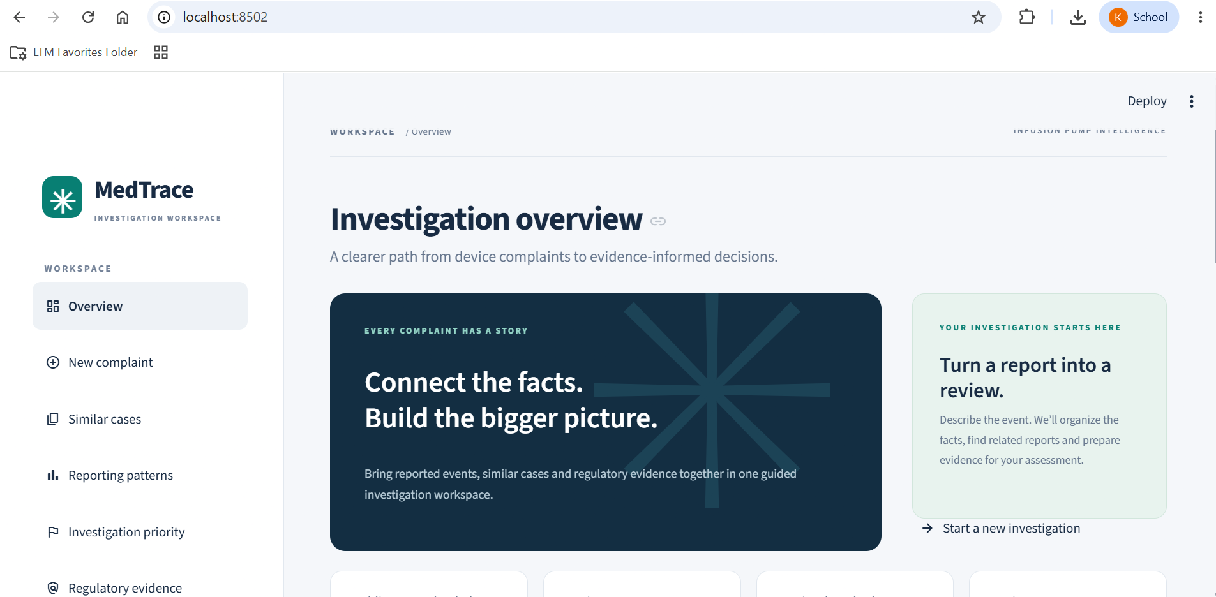
Application demonstration

Slide 22
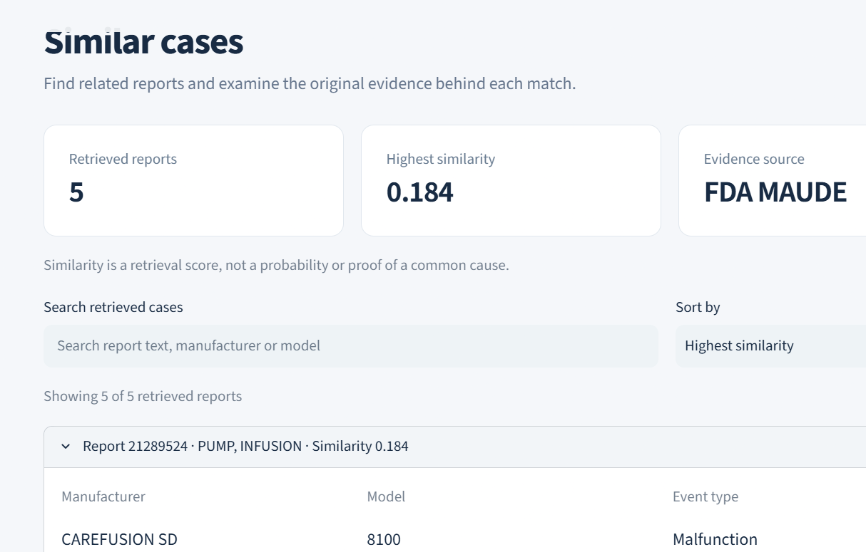
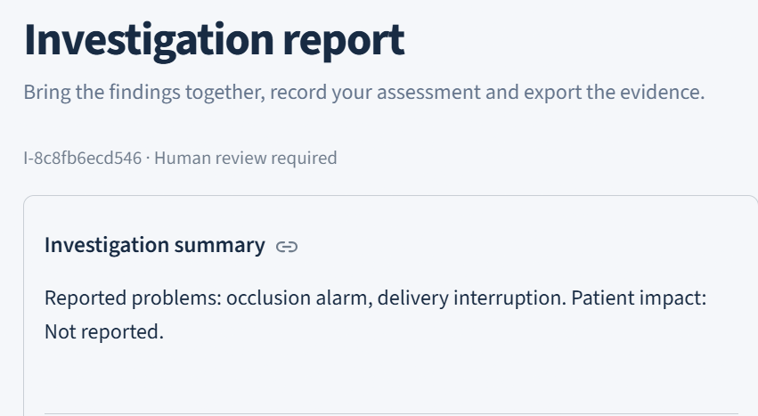
Findings and Results: Complaint Investigator
Extracted device details, failure indicators and reported harm from complaint narratives.
Highlighted missing information requiring investigator follow-up.
Retrieved similar FDA MAUDE reports to support investigation.
Displayed recurring complaint patterns and potential recall matches.
Presented investigation priority with clear supporting factors.

Slide 23
MedTrace AI
Validation Summary
18 Passed
Automated Tests
Automated Test Suite 18 automated tests passed. | Evidence Retrieval Similar FDA reports and regulatory passages retrieved.
Application Workflow FastAPI and Streamlit workflow tested. | Investigation Storage SQLite stores investigation records. Source references remain linked to evidence.
Workflow Orchestration Sequential and LangGraph execution checked.
Source References
Evidence Traceability
FastAPI + Streamlit
Workflow Validation
Validation covers software workflows and evidence retrieval. Qualified review remains essential for regulatory decisions.

Slide 24
MedTrace AI
Conclusion
• MedTrace AI brings medical device complaint investigation into one workflow.
• Complaint extraction highlights reported facts and missing information.
• Historical reports and recall candidates support evidence review.
• Visible priority factors and cited regulatory passages explain recommendations.
• Stored investigations preserve evidence for qualified human decisions.
MedTrace AI supports traceable investigation from complaint intake to human review.

Slide 25
MedTrace AI
Limitations and Future Work
Limitations
Public reports contain missing values, duplicates and reporting bias.
Similarity and recall matches require investigator verification.
Report counts do not establish incidence or device failure rates.
Regulatory interpretation and final decisions require qualified review.
Future work
Extend coverage to additional medical device categories.
Expand the corpus with expert-reviewed investigation labels.
Evaluate retrieval and classification across diverse failure types.
Integrate manufacturer quality systems and controlled production access.

Slide 26
MedTrace AI
Reference
FDA. MAUDE medical device adverse event reports. www.accessdata.fda.gov
FDA. Device Event and Recall API documentation. open.fda.gov/apis/device/
eCFR. 21 CFR Part 803: Medical Device Reporting. www.ecfr.gov
Sentence Transformers. Semantic search documentation. www.sbert.net
FAISS. Similarity search documentation. faiss.ai

