Slide 1


M.Tech Program
Advanced Industry Integrated Programs
Jointly offered by University and LTIMindTree
Review III, 08.10.2026
MedTrace AI: Medical Device Complaint Investigation Platform
Khavin C
251011010
T9972
Knowledge partner | Implementation partner

Slide 2
MedTrace AI
Introduction
Medical device complaints need a traceable investigation of reported failures and harm.
Incomplete narratives make device identification and evidence review difficult.
Investigators compare past complaints, recall records and regulatory requirements.
MedTrace AI combines complaint analysis and supporting evidence in one workspace.
The system supports infusion-pump investigations with qualified human review.
New Complaint
Evidence Retrieval
Priority Review
Investigation Report

Slide 3
MedTrace AI
Project Objectives
1. Extract device details and reported failure information from complaints. | 4. Explain investigation priority using visible risk factors.
2. Retrieve similar complaints from FDA MAUDE reports. | 5. Retrieve relevant regulatory passages with source citations.
3. Identify recurring patterns and possible recall links. | 6. Save investigation evidence and generate a report for human review.
Complaint:
Facts and Gaps
AI:
Evidence and Priority
Investigator:
Review and Decide

Slide 4
MedTrace AI
Core Modules
Complaint Understanding
Extracts device details, failure indicators and reported harm.
Explainable Investigation Priority
Shows the factors behind each priority recommendation.
Historical Case Retrieval
Finds related FDA reports and retains source references.
Regulatory Evidence Retrieval
Retrieves relevant passages with dated source citations.
Trend and Recall Analysis
Shows recurring problems and candidate recall matches.
Investigation Report Workspace
Stores findings and generates reports for qualified review.
Intake
Extract
Retrieve
Assess
Review
Report

Slide 5
MedTrace AI
Problem Statement
• Complaint narratives often omit essential device and event details.
• Manual searches across reports and recalls slow evidence collection.
• Similar reports can describe the same failure using different terms.
• Priority decisions need explicit reasons and traceable supporting evidence.
• MedTrace AI links complaint facts, historical evidence and regulatory sources.
Incomplete Narrative
Manual Evidence Search
Unclear Failure Patterns
Delayed Investigation
Limited Evidence Traceability

Slide 6
MedTrace AI
MedTrace AI Workflow
1. Enter a complaint and available device identifiers.
2. Extract reported facts and highlight missing details.
3. Retrieve similar FDA reports and related evidence.
4. Check recurring patterns and possible recall links.
5. Explain priority and retrieve regulatory passages.
6. Save the investigation report for qualified review.
Complaint Input
Extract Facts
Similar Reports
Trends and Recalls
Priority + Regulation
Human Review
The investigator verifies evidence and makes the final decision.

Slide 7
MedTrace AI
Approach, Algorithms, and Tools
Approach: Rules extract complaint facts and evidence spans. TF-IDF and semantic search retrieve related reports. Trend analysis identifies recurring issues and recall candidates. Visible rules explain priority. Regulatory retrieval supplies cited passages for the investigation report.
Tools:
Python, FastAPI, Streamlit, SQLite, SQLAlchemy
pandas, scikit-learn, Sentence Transformers, FAISS, Plotly
LangGraph, LangChain and regulatory evidence retrieval
Streamlit Dashboard
FastAPI Backend
SQLite Database
Retrieval + Evidence

Slide 8
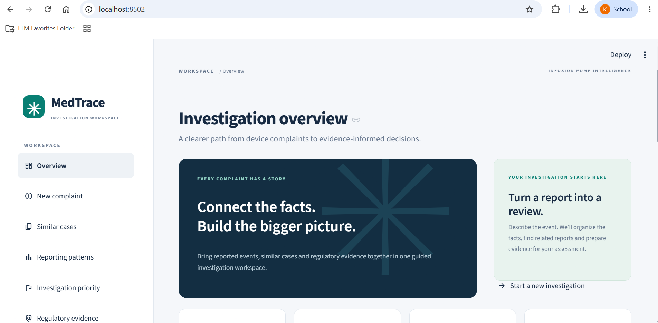
Application demonstration

Slide 9
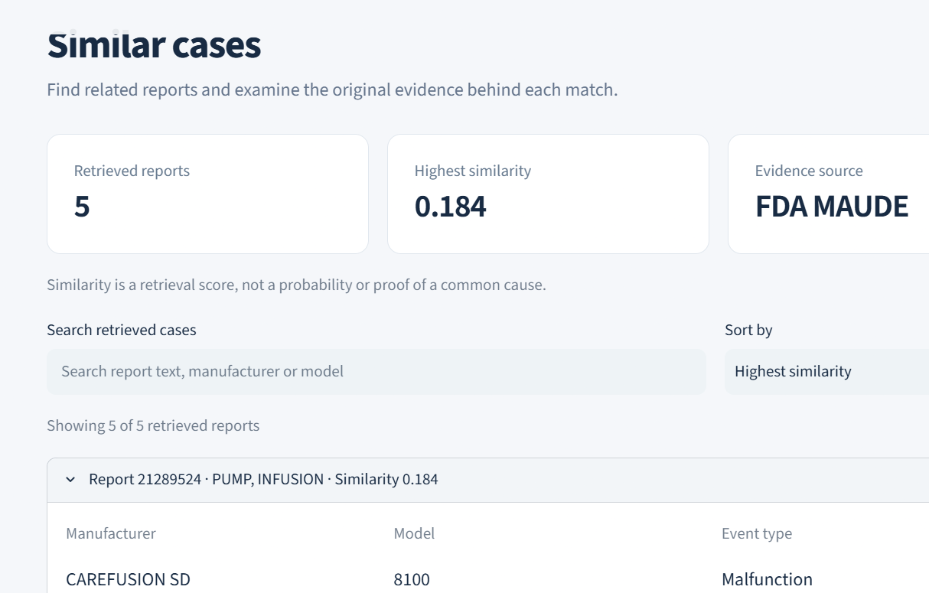
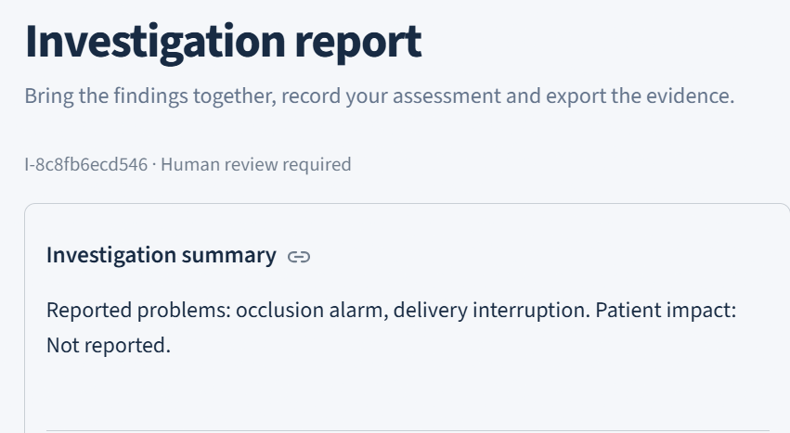
Findings and Results: Complaint Investigator
Extracted device details, failure indicators and reported harm from complaint narratives.
Highlighted missing information requiring investigator follow-up.
Retrieved similar FDA MAUDE reports to support investigation.
Displayed recurring complaint patterns and potential recall matches.
Presented investigation priority with clear supporting factors.

Slide 10
MedTrace AI
Validation Summary
18 Passed
Automated Tests
Automated Test Suite 18 automated tests passed. | Evidence Retrieval Similar FDA reports and regulatory passages retrieved.
Application Workflow FastAPI and Streamlit workflow tested. | Investigation Storage SQLite stores investigation records. Source references remain linked to evidence.
Workflow Orchestration Sequential and LangGraph execution checked.
Source References
Evidence Traceability
FastAPI + Streamlit
Workflow Validation
Validation covers software workflows and evidence retrieval. Qualified review remains essential for regulatory decisions.

Slide 11
MedTrace AI
Conclusion
• MedTrace AI brings medical device complaint investigation into one workflow.
• Complaint extraction highlights reported facts and missing information.
• Historical reports and recall candidates support evidence review.
• Visible priority factors and cited regulatory passages explain recommendations.
• Stored investigations preserve evidence for qualified human decisions.
MedTrace AI supports traceable investigation from complaint intake to human review.

Slide 12
MedTrace AI
Limitations and Future Work
Limitations
Public reports contain missing values, duplicates and reporting bias.
Similarity and recall matches require investigator verification.
Report counts do not establish incidence or device failure rates.
Regulatory interpretation and final decisions require qualified review.
Future work
Extend coverage to additional medical device categories.
Expand the corpus with expert-reviewed investigation labels.
Evaluate retrieval and classification across diverse failure types.
Integrate manufacturer quality systems and controlled production access.

Slide 13
MedTrace AI
Reference
FDA. MAUDE medical device adverse event reports. www.accessdata.fda.gov
FDA. Device Event and Recall API documentation. open.fda.gov/apis/device/
eCFR. 21 CFR Part 803: Medical Device Reporting. www.ecfr.gov
Sentence Transformers. Semantic search documentation. www.sbert.net
FAISS. Similarity search documentation. faiss.ai

