Slide 1


M.Tech Program
Advanced Industry Integrated Programs
Jointly offered by University and LTIMindTree
Review III, 08.10.2026
Evidence-Grounded Supplier Intelligence for Automotive Procurement
Khavin C
251011010
T9972
Knowledge partner | Implementation partner

Slide 2
RESA
Introduction
• Automotive buyers compare supplier cost, quality and delivery.
• Quotations and scorecards support buyer decisions.
• Missing or stale evidence weakens recommendations.
• RESA links requirements to source records.
Buyer Needs
Supplier Evidence
RESA Checks
Supplier Shortlist

Slide 3
RESA
Project Objectives
1. Capture mandatory buyer requirements. | 4. Label evidence as satisfied, violated or insufficient.
2. Link evidence to supplier and component. | 5. Rank eligible suppliers with source references.
3. Check numeric limits and evidence dates. | 6. Compare RESA with retrieval and ranking baselines.
Eligible
Rank suppliers
Needs Review
Missing /
stale evidence
Excluded
Hard limit failed

Slide 4
RESA
Core Modules
Evidence Capture
Records supplier IDs, source references and dates
RESA Alignment
Links each requirement to supplier evidence
Requirement Checks
Compares supplier values with buyer limits
Supplier Ranking
Scores eligible suppliers using buyer priorities
Freshness Checks
Flags missing records and outdated evidence
Cited Explanations
Shows reasons and supporting source records
Capture
Match
Check
Score
Explain
Review

Slide 5
RESA
Problem Statement
A supplier ranking can overlook mandatory limits or rely on incomplete evidence. Buyers need to see whether each supplier meets the requirement and which record supports the decision.
Buyer Request
Missing Evidence
Unchecked Rank
Weak Decision
Every recommendation needs requirement-specific evidence.

Slide 6
RESA
RESA Workflow
Buyer Request
Requirements
Supplier Evidence
Freshness Check
Limit Checks
RESA Alignment
State
Eligible
Rank with evidence
Needs Review
Missing or stale evidence
Excluded
Mandatory limit failed

Slide 7
RESA
Approach, Algorithms, and Tools
Approach:
• Match supplier and part IDs
• Check limits and evidence dates
• Assign one of three evidence states
• Rank eligible suppliers with citations
Ranking logic
Ranking:
Eligible suppliers only: 25% quality + 20% price + 20% delivery + 20% reliability + 15% evidence coverage − 15% risk.
Tools
Used: React, JavaScript, CSV / JSON,
FastAPI, Qdrant, Ollama
Llama 3.1 8B, Nomic embeddings, BM25

Slide 8
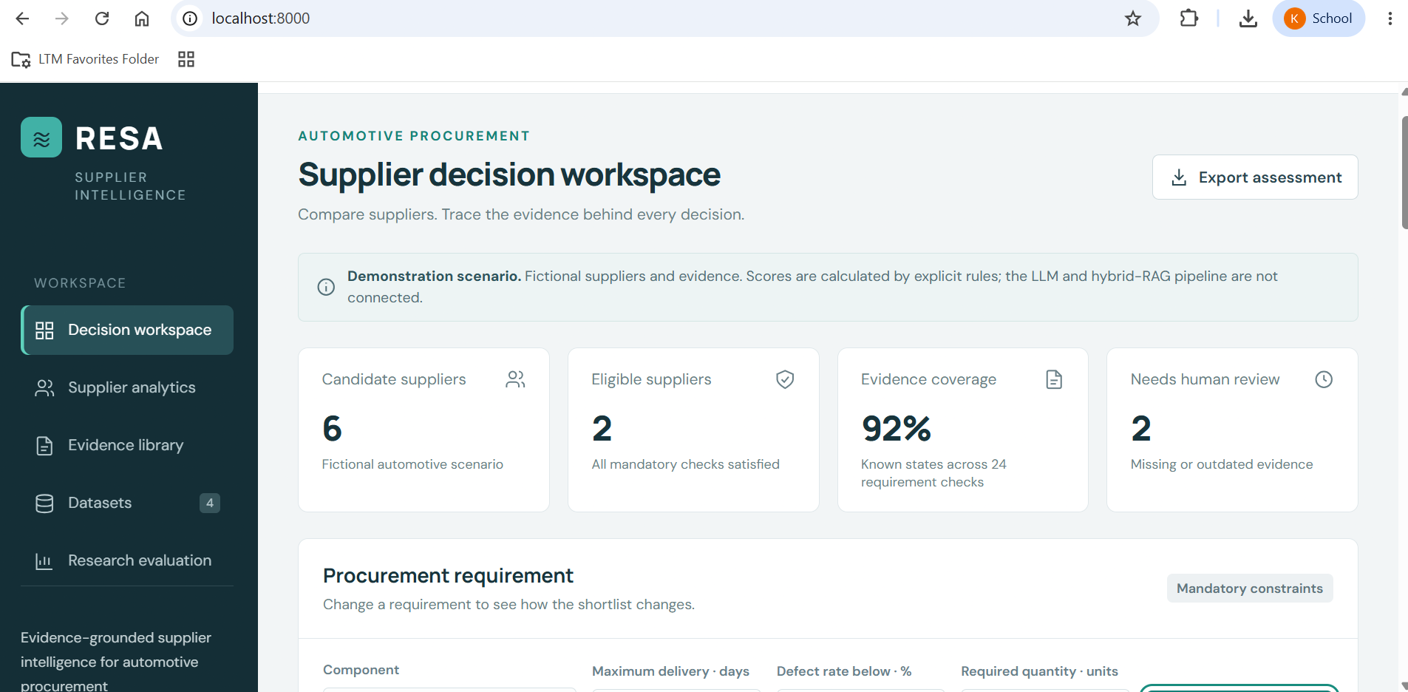
RESA
Application demonstration

Slide 9
RESA
Controlled Evaluation Results
6 Demo Suppliers
12 quotations
18 scorecards
2 / 6
Suppliers eligible in the default scenario
2 / 6
Suppliers excluded for failed requirements
Scenario
Synthetic records for controlled checks
2 / 6
Suppliers need review for missing or stale evidence
RESA
Checks evidence before ranking
This separates eligible, review and excluded suppliers in a given scenario.

Slide 10
RESA
Conclusion
• RESA links buyer requirements to supplier-specific evidence.
• Mandatory checks separate eligible suppliers from review and exclusion cases.
• The prototype ranks eligible suppliers and displays source references, missing evidence and stale records.
• Research evaluation will compare RESA with retrieval and ranking baselines.
Supplier recommendations with inspectable evidence.

Slide 11
RESA
Limitations and Future Work
Limitations
Small synthetic supplier evaluation set
Public sources lack shared supplier IDs
Document retrieval and LLM features remain planned
No independent ranking benchmark yet
Future work
Build an annotated automotive supplier benchmark
Integrate hybrid retrieval and cited explanations
Test claim support and evidence-state accuracy
Compare baselines, ablations and response time

Slide 12
MemPoisonGuard
Acknowledgement
I sincerely thank Ms. Indumathi K, Professor, Department of Information Technology, Rajalakshmi Engineering College, for her valuable guidance and support throughout this project.
I also extend my sincere gratitude to Dr. Ganesa Ramachandran Arunachalam, L&T EduTech, Chennai, and all the classroom teachers and faculty members for their guidance, teaching, encouragement, and support.
Thank You
Questions and Discussion

Slide 13
RESA
Reference
[1] ShahriarKabir, “Procurement KPI Analysis Dataset,” Kaggle.
[2] GraphDatasetHub, “Supply Chain Dataset,” automotive sample.
[3] ManmohanBuildsProducts, “Auto Parts Search Benchmark,” Hugging Face.
[4] RESA prototype: synthetic supplier data and functional validation suite.
[5]Joshi, Singh, Parashar & Singh (2026). A Multi-Agent Large Language Model Framework for Intelligent Vendor Evaluation and Risk-Aware Procurement Decisions.

