Slide 1


M.Tech Program
Advanced Industry Integrated Programs
Jointly offered by University and LTIMindTree
Review 2
28-09-2026
MedTrace AI: Medical Device Complaint
Investigation and Regulatory Decision Support
Khavin C
251011010
REC (2025–2027)
Knowledge partner | Implementation partner
Notes:
Cover layout, text styling, background and partner logos are retained from the supplied Review 2 template. Student name: Khavin C. Registration number: 251011010. No unverified T-code is assigned.

Slide 2
MedTrace AI
Introduction
Medical-device complaints require traceable investigation
Narratives often lack clear device and event details
Investigators review past reports, recalls and regulations
MedTrace AI brings this evidence into one workflow
Initial focus: infusion pumps; final decisions stay human
Notes:
MedTrace AI is B2B investigator decision support. The implementation begins with infusion pumps and real public FDA evidence. It does not determine causality or MDR reportability automatically.

Slide 3
MedTrace AI
Objective
Extract device details, failure indicators and reported harm
Retrieve similar complaints from real FDA MAUDE data
Analyse recurring patterns and possible recall links
Explain investigation priority using visible factors
Retrieve regulatory passages with sources and dates
Generate an evidence-backed draft for human review

Slide 4
MedTrace AI
Core Module
  Evidence-Based Complaint Investigation:
  Accept a new infusion-pump complaint
  Extract facts and highlight missing information
  Retrieve related FDA report narratives
  Check patterns and candidate recall matches
  Explain priority and cite regulatory passages
  Save the investigation for qualified review
New Complaint
Reported Facts
Historical Evidence
Priority + Regulation
Investigator Review

Slide 5
MedTrace AI
Methodology
Complaint Input
Clean Text + Extract Facts
Retrieve Similar Cases
Trends + Recall Check
Human Review
Evidence-Based Draft
Regulatory Retrieval
Explainable Priority
Evaluation plan
Baseline vs. transformer classification
Human judgments for retrieval and citation support
Macro F1, precision@5 and investigation time
Notes:
The default system uses rule extraction, TF-IDF and extractive regulatory retrieval without a paid LLM. Classification/retrieval research metrics remain pending reviewed labels. The proposed comparative evaluation is not a completed result.

Slide 6
MedTrace AI
Data preprocessing & EDA
FDA MAUDE: 280 real reports in the working sample
Research target: 20,000–100,000 records, 2021–2025
Filter infusion-pump product code and receipt date
Join raw FDA files using MDR_REPORT_KEY
Clean text; retain missing values and source links
Deduplicate records before retrieval and evaluation
EDA: report counts, problem types, manufacturers and missing fields
Also included: 100 recall records and 72 regulatory text chunks
Sample patterns are descriptive; they do not estimate incidence.
Notes:
Source details: openFDA device/event; device/enforcement; device/classification; official eCFR Part 803 and 820.35. The 280-record sample covers selected 2025 reports. The intended 2021–2025 research corpus was not downloaded fully. URLs: https://open.fda.gov/apis/device/event/ ; https://open.fda.gov/apis/device/enforcement/ ; https://www.ecfr.gov/current/title-21/chapter-I/subchapter-H/part-803 ; https://www.ecfr.gov/current/title-21/chapter-I/subchapter-H/part-820/subpart-B/section-820.35 .

Slide 7
MedTrace AI
Approach/Algorithms/Tools
Methods:
Tools:
Rule extraction with evidence spans
TF-IDF case-retrieval baseline
Sentence Transformers + FAISS*
BERT / RoBERTa comparison*
Transparent priority; XGBoost / SHAP*
Source-linked regulatory RAG
Python | pandas | scikit-learn
FastAPI | Streamlit | Plotly
SQLite / PostgreSQL*
LangGraph | LangChain*
Transformers | FAISS | SHAP*
* Advanced paths are implemented; model training and optional deployment require activation and evaluation.

Slide 8
MedTrace AI
Project plan/ Mile stones Progress
Milestone | Status
FDA sample and source provenance | Completed
Text cleaning and rule extraction | Tested
TF-IDF retrieval and sample trends | Tested
Priority rules and regulatory evidence | Tested
API, SQLite and Streamlit workflow | Tested
LangGraph and FAISS numeric test | Tested
BERT / RoBERTa and SHAP code | Training pending
Larger corpus and reviewed labels | Pending
Docker and PostgreSQL deployment | Not yet tested
Verified demonstration:
18 automated tests passed
Dashboard workflow tested
5 similar FDA reports retrieved
4 regulatory passages retrieved
No model accuracy claimed
Notes:
Evidence: MedTrace_AI/docs/VALIDATION.md and reports/sample_reports/demo_stages.json. Example input describes delivery interruption and an occlusion alarm. It returns 5 cases, 4 regulatory passages and priority 20/100. The score is an unvalidated project rubric, not an FDA risk class. No trained-model accuracy has been claimed.

Slide 9
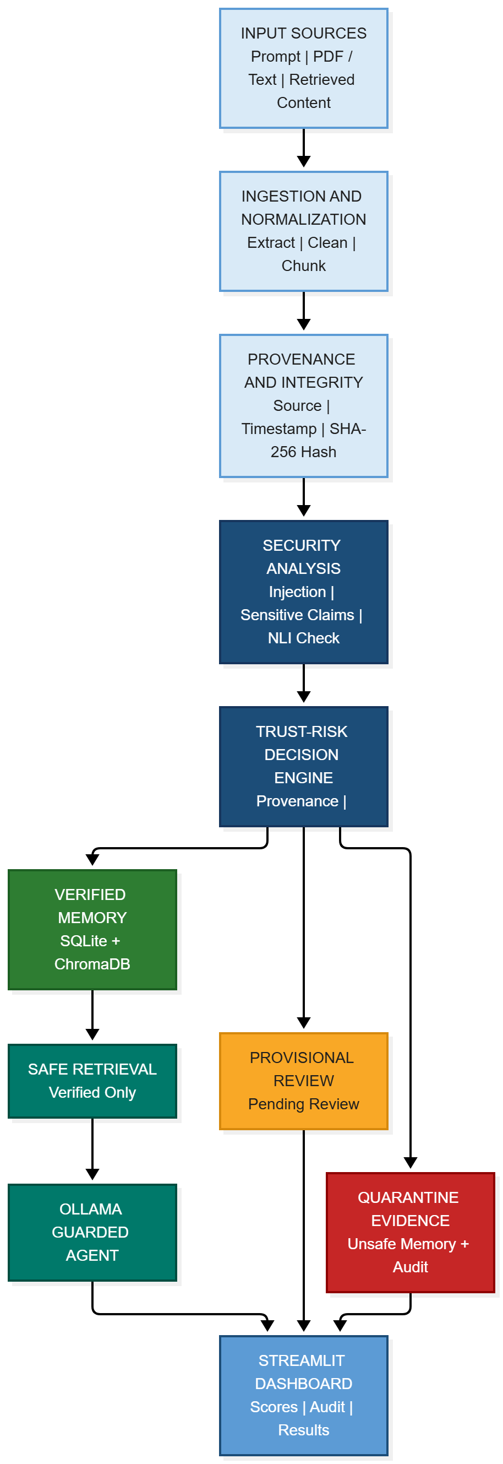
MedTrace AI
Pipeline structure
New complaint
Narrative + available device identifiers
Complaint understanding
Extract facts; record missing information
FDA MAUDE
TF-IDF / semantic search*
Historical evidence
Similar reports + trends + recall candidates
FDA recall records
Candidate matches only
Regulatory sources
Dated CFR passages / RAG
Priority and synthesis
Visible rule factors + cited regulatory passages
Investigation report
Stored evidence → qualified human review
Investigation store
SQLite / PostgreSQL*
Sequential / LangGraph orchestration • FastAPI + Streamlit • * Optional advanced configuration

