Slide 1
Indoor Navigation System Using Augmented Reality Team no - 10
Team Members: Project Guide:
1. Khavyaa S 813817205020 Mrs. M. Padma Priya M.E.,
2. Nilani P 813817205029 Department of Information
3. Shanmathi S 813817205049 Technology

Slide 2
Augmented Reality
Augmented Reality = Real World + Virtual Layer
Computer-generated enhancement of real-world environment with information or objects
Interactive experience in real-time
Applications in many areas like
Medical
Entertainment
Engineering Design
Navigation

Slide 3
Objective
To provide an interactive navigation application, within large buildings using cameras and other built-in sensors mounted on our smartphones.
Motivation
Need for clear visual indicators to create an appealing and convenient experience for the users to navigate inside buildings.

Slide 4
Abstract
For the most part of navigation, we rely on GPS technology to find our way outside buildings.
But when it comes to indoor navigation, GPS fails as it uses satellite signals which cannot penetrate through the walls of the buildings.
With Indoor Navigation System, people can locate other people or objects inside a building, or navigate to a Point-of-Interest inside the building.
An Augmented Reality based Indoor Navigation System uses cameras on our smartphones to navigate within large buildings.

Slide 5
Literature Survey
1. Bluetooth-based Indoor Navigation Mobile System
Author : Adam Satan
Publisher and Year : IEEE, 2018
Advantage : Bluetooth signal accuracy
Limitation : Cost of installation and number of devices
2. The Indoor Navigation Using Mapping Technique Based On Signal Strength Difference
Author : Jirapat Sangthong
Publisher and Year : IEEE, 2018
Advantage : Signal Strength
Limitation : Requires the installation of devices

Slide 6
3. A Geocoding Framework for Indoor Navigation based on the QR Code
Author : Ying Zhuang, Yuhao Kang, Lina Huang, Zhixiang Fang
Publisher and Year : IEEE, 2018
Advantage : QR-code
Limitation : Not suitable for complex buildings – rendered in 2D
4. Indoor Navigation System Using Visual Positioning System with Augmented Reality
Author : Ravinder Yadav, Vandit Jain, Himanika Chugh, Prasenjit Banerjee
Publisher and Year : 2018 International Conference on Automation and Computational Engineering
Advantage : Visual elements to navigate to the destination
Limitation : Dependent on markers that need to be permanent.

Slide 7
Proposed System
We propose an interactive indoor navigation system which uses augmented reality. AR is used to overlap the computer generated 3D directional graphics on the absolute view of indoor habitat.
The camera on our smartphones, detects markers from the surrounding environment.
The detected maker location will become input to the route planner module.
Once route planner receives the current position then the navigation system guides us to the desired destination within the building with AR elements.

Slide 8
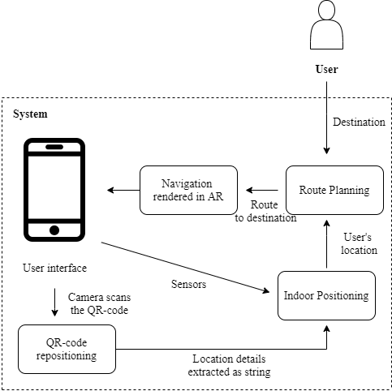
Proposed System Architecture

Slide 9
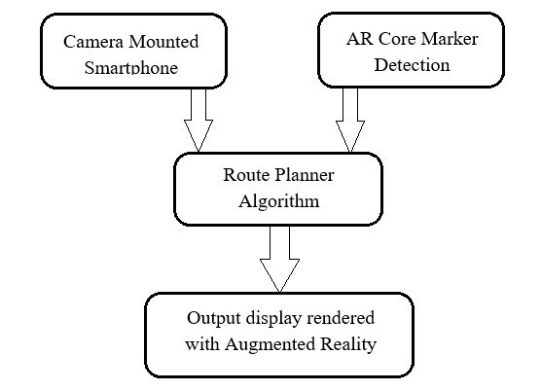
Modular Architecture

Slide 10
Modules and its Description
Map Localization: A floor plan of the indoor space is mapped with the building and the mappable areas are identified from it. Various points-of-interest are then located in the building as the destinations. The mappable area is then covered in-person with the smartphone camera.
QR-code Repositioning: Location information of points-of-interest inside the building are encoded into QR codes using libraries provided by AR Core. These are then placed inside the building. The markers inside the building and the indoor map are mapped using SDKs provided by the AR Core. This gives the exact location of the user in the building.

Slide 11
Modules and its Description Contd…
Navigation Algorithm: Users can scan the QR code/any marker which contains location information. After the detection of the marker, the user’s current location extracted from it along with the destination are sent to the algorithm. The algorithm then calculates the optimal path to the destination.
Route in Augmented Reality: The route is rendered in the smartphone in real-time using Augmented Reality (computer-generated augmentations) elements. The AR elements keep generating the route till the point of destination.

Slide 12
Methodology
Map Localization – SLAM
QR-code Repositioning – Library in ARCore
Navigation – NavMesh Components
AR View

Slide 13
Advantages
Cost effective – No need for any beacons or access points installation
Less messy – Beacons or Access Points need to be installed in huge numbers for greater accuracy and also in a particular architecture. This creates more mess.
Less confusion – 3D maps create an immersive experience as opposed to 2D maps which tend to create confusion while navigating
Interactive user experience – Computer generated AR elements lead the way to our destination, along with additional markers for point-of-interests

Slide 14
Conclusion
As navigation inside buildings such as hospitals, shopping malls, offices, etc. become more complex, the need for indoor navigation system increases.
AR based Indoor Navigation makes navigation inside buildings possible and also improves the user experience.
AR can take us to our destinations much faster and also with less perplexity.

Slide 15
References
Adam Satan (2018) – Bluetooth-based Indoor Navigation Mobile System, IEEE, 2018 19th International Carpathian Control Conference (ICCC)
Austin Corotan, Jianna Jian Zhang Irgen-Gioro (2019) - An Indoor Navigation Robot Using Augmented Reality, IEEE, 2019 5th International Conference on Control, Automation and Robotics (ICCAR)
Georg Gerstweiler (2018) - Guiding People in Complex Indoor Environments Using Augmented Reality, 2018 IEEE Conference on Virtual Reality and 3D User Interfaces 18-22 March, Reutlingen, Germany
Grinyak V., Devyatisilnyi A., Shurygin A. (2019) - Accuracy of Indoor Navigation with Bluetooth Beacons, 2019 International Multi-Conference on Industrial Engineering and Modern Technologies

Slide 16
References
Gupta, A., Bhatia, K., Gupta, K., & Vardhan, M. (2018). A Comparative Study of Marker-Based and Marker-Less Indoor Navigation in Augmented Reality, International Research Journal of Engineering and Technology (IRJET), 2018
Jirapat Sangthong (2018) – The Indoor Navigation Using Mapping Technique Based on Signal Strength Difference, IEEE, The 21st International Symposium on Wireless Personal Multimedia Communications (WPMC- 2018)
Ravinder Yadav, Vandit Jain, Himanika Chugh & Prasenjit Banerjee (2018) - Indoor Navigation System Using Visual Positioning System with Augmented Reality, IEEE, 2018 International Conference on Automation and Computational Engineering (ICACE)
Ying Zhuang, Yuhao Kang, Lina Huang, Zhixiang Fang (2018) - A Geocoding Framework for Indoor Navigation based on the QR Code, IEEE, 2018 Ubiquitous Positioning, Indoor Navigation and Location-Based Services (UPINLBS)

Slide 17
Thank You

