Slide 1
Team Members: M.Usama Amjad M.Talha Saeed M.Kashir khan Azfer Asif
Semester Project : Restaurant Management System
Submitted to : Sir Muhammad Sufyan

Slide 2
Restaurant Management System

Slide 3
Table of Contents
Project Goal
Project Analysis
Project Features
Users of our System
Functional Requirements
Roles Association
Use Case

Slide 4
Project Goal
Our main goal of this project is to create such a restaurant management software which will save time of both customer and restaurant management team.
It helps you to run business with much more efficiently
This project which give excellence on controlling the restaurant order and customer satisfaction

Slide 5
Project Analysis
Login option
Food items,prize,food selection & order option
Order flow & cash counter
Order receiving acknowledgment
Bill receiving system

Slide 6
Roles Association
Restaurant Manager

Slide 7
Project Features
Point of sale system.
Show order details.
Employee Registration

Slide 8
Functional Requirements
Login
Manage Users
Manage Orders
Manage Menu

Slide 9
 | PROJECT TIMELINE FOR RESTURANT MANAGEMENT SYSTEM
 |  |  |  |  |  | April 1 – June 29, 2022
 |  |  |  |  |  | w1 | w2 | w3 | w4 | w5 | w6 | w7 | w8 | w9 | w10 | w11 | w12
 | Project Research
 | Creation of SRS & UML
 | Changes in SRS
 | Approval of SRS
 | Start working on Frontend
 | Identify Problem
 | Changes in Frontend
 | Creation of Database
 | Connection with Frontend
 | Testing
 | Quality Assurance
 | Finalize the Project

Slide 10
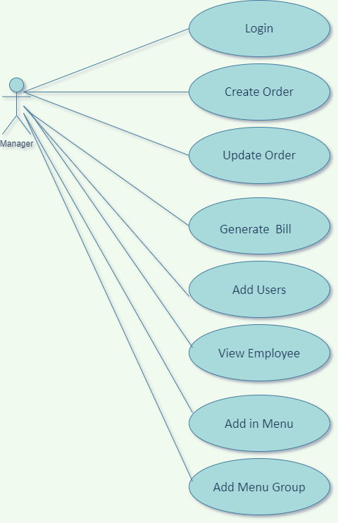
Use Case

