Slide 1


PAID ADS & SOCIAL MEDIA PORTFOLIO
Khawaja Saim
Turning attention
into measurable
growth.
Paid Ads & Social Media Specialist
Based in Lahore. Open to global projects.
khawajasaim.github.io/Khawaja-Saim
2026
Notes:
Sources: original Khawaja Saim Paid Ads Portfolio Final v8 and user-approved portfolio website content. This conversation confirms 59 TrendElite orders and five additional advertising campaigns. Decorative Meta, apparel, home decor and skincare imagery is illustrative, not campaign proof.

Slide 2
01 / SELECTED RESULTS
Results that
lead the story
PKR
1.65M+
Paid revenue across campaigns
57x
25x
59
50K+
Best reported ROAS
Second recruitment campaign
Confirmed ecommerce orders
Organic content views
Selected recruitment, app acquisition, ecommerce and B2B campaigns
KHAWAJA SAIM
02
Notes:
Sources: original Khawaja Saim Paid Ads Portfolio Final v8 and user-approved portfolio website content. This conversation confirms 59 TrendElite orders and five additional advertising campaigns. Decorative Meta, apparel, home decor and skincare imagery is illustrative, not campaign proof.

Slide 3
02 / THE HIRING / PAKISTAN
57x
Recruitment
lead generation
The approach
Reported return on ad spend
IT audience segmentation, lookalikes and Meta Instant Forms. Tested ad copy, creative and form questions.
PKR 9K
PKR 520K
63
Ad spend
Attributed revenue
Leads generated
KHAWAJA SAIM
03
Notes:
Sources: original Khawaja Saim Paid Ads Portfolio Final v8 and user-approved portfolio website content. This conversation confirms 59 TrendElite orders and five additional advertising campaigns. Decorative Meta, apparel, home decor and skincare imagery is illustrative, not campaign proof.

Slide 4
03 / THE HIRING / MAY 2026
A second campaign.
A 25x return.
12-day Meta lead generation test
62
PKR 323
Leads generated
Cost per lead
Execution
Audience segmentation, warm retargeting, lookalikes and Instant Forms. Tested creative to scale qualified inquiries.
2,400% ROI
KHAWAJA SAIM
04
Notes:
Sources: original Khawaja Saim Paid Ads Portfolio Final v8 and user-approved portfolio website content. This conversation confirms 59 TrendElite orders and five additional advertising campaigns. Decorative Meta, apparel, home decor and skincare imagery is illustrative, not campaign proof.

Slide 5
04 / TROTS TUTOR / UNITED KINGDOM
A smarter
channel choice
$0.36
1.86%
Click-through rate
26,506
Average cost per click
Impressions
Shifted acquisition emphasis from Meta to Google App Campaigns
KHAWAJA SAIM
05
Notes:
Sources: original Khawaja Saim Paid Ads Portfolio Final v8 and user-approved portfolio website content. This conversation confirms 59 TrendElite orders and five additional advertising campaigns. Decorative Meta, apparel, home decor and skincare imagery is illustrative, not campaign proof.

Slide 6
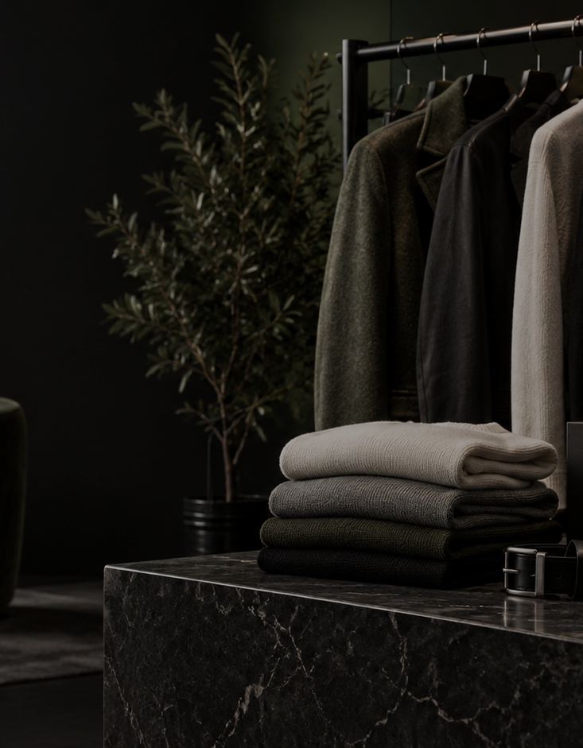
05 / TRENDELITE / ECOMMERCE
05 / TRENDELITE / ECOMMERCE
59
Confirmed orders
PKR 3K
PKR 30K
Ad spend
Revenue
Product-focused creative, audience testing and purchase-intent messaging
Illustrative apparel imagery
KHAWAJA SAIM
KHAWAJA SAIM
06
06
Notes:
Sources: original Khawaja Saim Paid Ads Portfolio Final v8 and user-approved portfolio website content. This conversation confirms 59 TrendElite orders and five additional advertising campaigns. Decorative Meta, apparel, home decor and skincare imagery is illustrative, not campaign proof.

Slide 7
06 / 360 FACEVISION
B2B lead generation
9
PKR 289
Cost per lead
1.58%
Leads in three days
Click-through rate
Facial recognition technology, paid lead generation and campaign monitoring
KHAWAJA SAIM
07
Notes:
Sources: original Khawaja Saim Paid Ads Portfolio Final v8 and user-approved portfolio website content. This conversation confirms 59 TrendElite orders and five additional advertising campaigns. Decorative Meta, apparel, home decor and skincare imagery is illustrative, not campaign proof.

Slide 8
07 / BRAND & ORGANIC WORK
More work.
Across the
buyer journey.
Coder Crew
1,200+ organic followers, SEO and inbound support
IPPBX
USA telecom brand and recruitment content
The Ad Logic
SaaS / MarTech brand authority and beta-user support
VeeOutsource
Technology, telecom, SaaS and staffing
Remote staffing content, higher inquiries in two months
KHAWAJA SAIM
08
Notes:
Sources: original Khawaja Saim Paid Ads Portfolio Final v8 and user-approved portfolio website content. This conversation confirms 59 TrendElite orders and five additional advertising campaigns. Decorative Meta, apparel, home decor and skincare imagery is illustrative, not campaign proof.

Slide 9
08 / ADDITIONAL ADVERTISING EXPERIENCE
UK, USA and ecommerce
01
UK business
Ran a paid advertising campaign for a UK business.
02
Second UK business
Ran another paid advertising campaign for a UK business.
03
USA B2B
Ran a campaign targeting a business audience in the USA.
04
Ecommerce business
Ran paid ads promoting ecommerce products.
05
Second ecommerce business
Ran paid advertising for another ecommerce business.
KHAWAJA SAIM
09
Notes:
Sources: original Khawaja Saim Paid Ads Portfolio Final v8 and user-approved portfolio website content. This conversation confirms 59 TrendElite orders and five additional advertising campaigns. Decorative Meta, apparel, home decor and skincare imagery is illustrative, not campaign proof.

Slide 10
09 / CLIENT WORK AT ZAM STUDIOS
UAE and Pakistan client work
UAE
UAE
PAKISTAN
Shift 2 Fresh
Consumer brand
Apparel brand
Social planning and content calendars. Meta lead generation, audience targeting and campaign monitoring.
Organic social and community engagement. Buyer-query handling and Meta product-sales support.
Content calendars for T-shirts and apparel. Product messaging, Meta Ads and creative/audience adjustments.
Lead generation
Organic + paid
Ecommerce
KHAWAJA SAIM
10
Notes:
Sources: original Khawaja Saim Paid Ads Portfolio Final v8 and user-approved portfolio website content. This conversation confirms 59 TrendElite orders and five additional advertising campaigns. Decorative Meta, apparel, home decor and skincare imagery is illustrative, not campaign proof.

Slide 11
10 / EXPERTISE
Built around
your goals
Paid advertising
Social media strategy
Meta and Google campaigns. Audience strategy, creative testing and conversion tracking.
Content planning, community engagement and performance analysis.
SEO
AI automation
Keyword research, on-page optimisation and off-page work.
Lead qualification, voice agents, follow-up and appointment booking.
KHAWAJA SAIM
11
Notes:
Sources: original Khawaja Saim Paid Ads Portfolio Final v8 and user-approved portfolio website content. This conversation confirms 59 TrendElite orders and five additional advertising campaigns. Decorative Meta, apparel, home decor and skincare imagery is illustrative, not campaign proof.

Slide 12
11 / BEHIND THE WORK
Five years.
One connected
approach.
Khawaja Saim Sohail
Based in Lahore, Pakistan. I connect paid advertising, social media and SEO with the full customer journey.
Khawaja Saim
KHAWAJA SAIM
12
Notes:
Sources: original Khawaja Saim Paid Ads Portfolio Final v8 and user-approved portfolio website content. This conversation confirms 59 TrendElite orders and five additional advertising campaigns. Decorative Meta, apparel, home decor and skincare imagery is illustrative, not campaign proof.

Slide 13
12 / THE GROWTH SYSTEM
Attention is
the beginning.
01 Attention
Content creates relevance, familiarity and demand.
02 Acquisition
Ads connect the offer with the right audience.
03 Conversion
The campaign continues through acquisition, conversion and follow-up.
Forms and landing pages reduce friction.
04 Automation
Workflows support response speed and handoffs.
05 Growth
Budget follows the combinations that work.
KHAWAJA SAIM
13
Notes:
Sources: original Khawaja Saim Paid Ads Portfolio Final v8 and user-approved portfolio website content. This conversation confirms 59 TrendElite orders and five additional advertising campaigns. Decorative Meta, apparel, home decor and skincare imagery is illustrative, not campaign proof.

Slide 14
13 / AI AUTOMATION
The system after the lead
Faster
follow-through.
Lead capture
Collect context from a form, ad or inbound inquiry.
AI qualification
Gather useful details and route the inquiry.
Follow-up and booking
Practical workflows that support a clear customer journey.
Support responses, availability and reminders.
CRM and human handoff
Keep the next action visible to the team.
KHAWAJA SAIM
14
Notes:
Sources: original Khawaja Saim Paid Ads Portfolio Final v8 and user-approved portfolio website content. This conversation confirms 59 TrendElite orders and five additional advertising campaigns. Decorative Meta, apparel, home decor and skincare imagery is illustrative, not campaign proof.

Slide 15
14 / WORKING TOOLKIT
Tools behind
the outcome.
Campaigns
Measurement
Automation
Content
Meta Ads Manager
Google Ads
Google Analytics
Google Tag Manager
n8n
AI voice agents
CRM systems
Canva
CapCut
The tool follows the job
KHAWAJA SAIM
15
Notes:
Sources: original Khawaja Saim Paid Ads Portfolio Final v8 and user-approved portfolio website content. This conversation confirms 59 TrendElite orders and five additional advertising campaigns. Decorative Meta, apparel, home decor and skincare imagery is illustrative, not campaign proof.

Slide 16

15 / INDEPENDENT CONCEPT / US HOME DECOR
15 / INDEPENDENT CONCEPT / US HOME DECOR
Morrow
& Pine
Paid acquisition strategy
Meta and TikTok for discovery. Google Search and Shopping for purchase intent.
Product context, reviews, dimensions, shipping clarity and bundles support conversion.
Independent concept, no historical results claimed
KHAWAJA SAIM
KHAWAJA SAIM
16
16
Notes:
Sources: original Khawaja Saim Paid Ads Portfolio Final v8 and user-approved portfolio website content. This conversation confirms 59 TrendElite orders and five additional advertising campaigns. Decorative Meta, apparel, home decor and skincare imagery is illustrative, not campaign proof.

Slide 17
16 / MORROW & PINE / TESTING PLAN
An acquisition blueprint
01
02
03
04
Discovery
Intent
Conversion
Scale
Room transformations, product demonstrations and creator-style hooks.
Category search terms, product feeds and focused landing pages.
Retargeting, reviews, shipping clarity and checkout confidence.
Move budget based on purchase economics and creative response.
Measurement: Meta Pixel + CAPI, GA4, Google Ads and TikTok Pixel
Success measures: CAC, purchase CVR, ROAS, AOV and new-customer revenue
KHAWAJA SAIM
17
Notes:
Sources: original Khawaja Saim Paid Ads Portfolio Final v8 and user-approved portfolio website content. This conversation confirms 59 TrendElite orders and five additional advertising campaigns. Decorative Meta, apparel, home decor and skincare imagery is illustrative, not campaign proof. Independent concept project. No simulated campaign results.

Slide 18

17 / INDEPENDENT CONCEPT / USA SKINCARE
17 / INDEPENDENT CONCEPT / USA SKINCARE
Glow
Theory
A TikTok-first
creative strategy
Routine-based UGC, texture demonstrations and native creator videos. Spark Ads amplify strong creator posts.
Independent concept. No historical results claimed.
KHAWAJA SAIM
KHAWAJA SAIM
18
18
Notes:
Sources: original Khawaja Saim Paid Ads Portfolio Final v8 and user-approved portfolio website content. This conversation confirms 59 TrendElite orders and five additional advertising campaigns. Decorative Meta, apparel, home decor and skincare imagery is illustrative, not campaign proof.

Slide 19
18 / GLOW THEORY / CREATIVE TESTING
The creative
is the test.
Problem hook
Pain-led opener with a product-texture demonstration.
Routine and proof
Creator voiceover, routine and close-up product use.
Campaign structure
US prospecting, warm retargeting and multiple hooks.
Decision framework
Review watch quality and purchase intent. Refresh angles as fatigue grows.
Hook rate, 6-second view rate, CTR, CPA, CVR and ROAS
KHAWAJA SAIM
19
Notes:
Sources: original Khawaja Saim Paid Ads Portfolio Final v8 and user-approved portfolio website content. This conversation confirms 59 TrendElite orders and five additional advertising campaigns. Decorative Meta, apparel, home decor and skincare imagery is illustrative, not campaign proof. Independent concept project. Strategy and testing framework only.

Slide 20
19 / WORKING PRINCIPLES
The decisions behind the work
Data before decisions
Channel flexibility
Campaign and audience data guide where budget and effort go.
Choose platforms around the business objective and campaign response.
Economics first
Creative quality
Review acquisition cost, conversion rate, revenue and ROAS.
Test messages and formats that help the audience understand the offer.
KHAWAJA SAIM
20
Notes:
Sources: original Khawaja Saim Paid Ads Portfolio Final v8 and user-approved portfolio website content. This conversation confirms 59 TrendElite orders and five additional advertising campaigns. Decorative Meta, apparel, home decor and skincare imagery is illustrative, not campaign proof.

Slide 21
20 / LET’S WORK TOGETHER
Your next
growth campaign
starts here.
Paid ads, social media, SEO and practical AI automation
khawajas245@gmail.com
Khawaja Saim
+92 304 4828634
KHAWAJA SAIM
21
Notes:
Sources: original Khawaja Saim Paid Ads Portfolio Final v8 and user-approved portfolio website content. This conversation confirms 59 TrendElite orders and five additional advertising campaigns. Decorative Meta, apparel, home decor and skincare imagery is illustrative, not campaign proof.

