Slide 1

Multi-Factor Authentication
MFA
By: Khawar Amin

Slide 2

Outline
What is MFA?
Importance of MFA.
Need of MFA.
How MFA Works.
Benefits of MFA.
Future of MFA.
Top Vendors of MFA.
Conclusion.

Slide 3
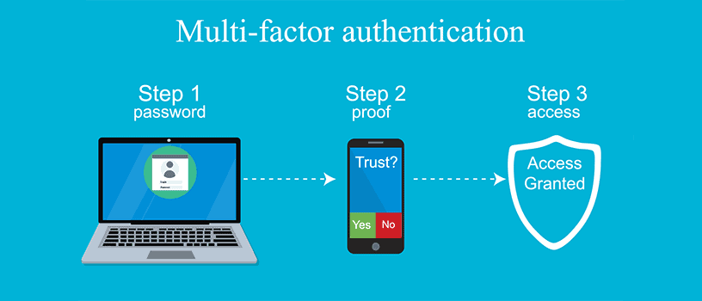
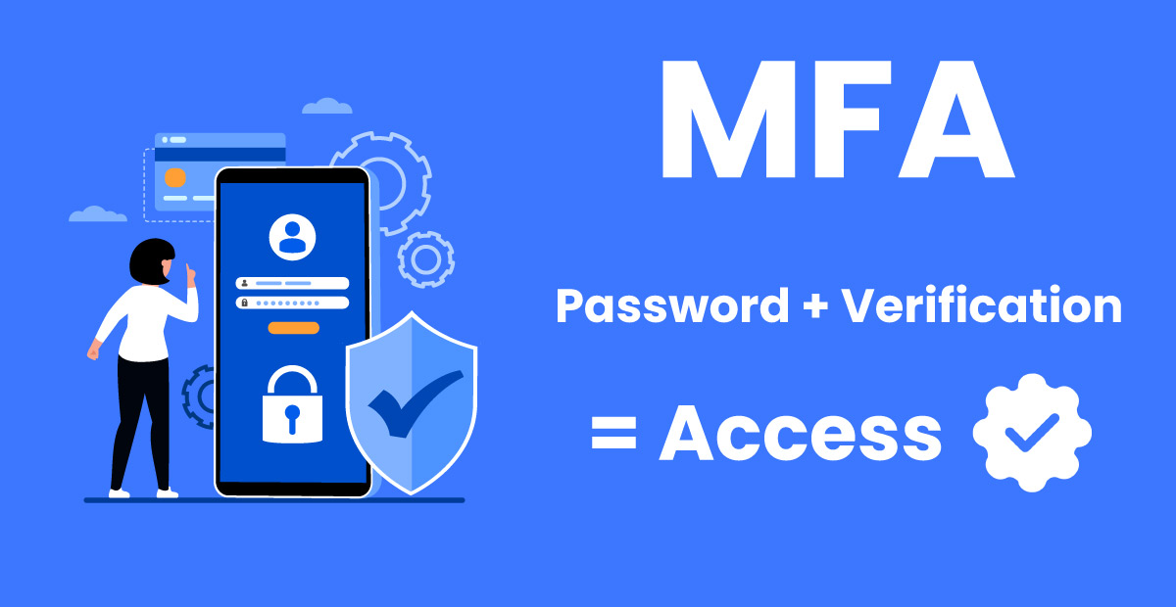
What is MFA?
Multi-Factor Authentication (MFA) is a security process that requires users to provide two or more verification factors to gain access to a system, application, or account. Rather than relying solely on a password, MFA adds additional layers of security by combining something the user knows (like a password), something the user has (like a smartphone or hardware token), and something the user is (like a fingerprint or facial recognition).

Slide 4
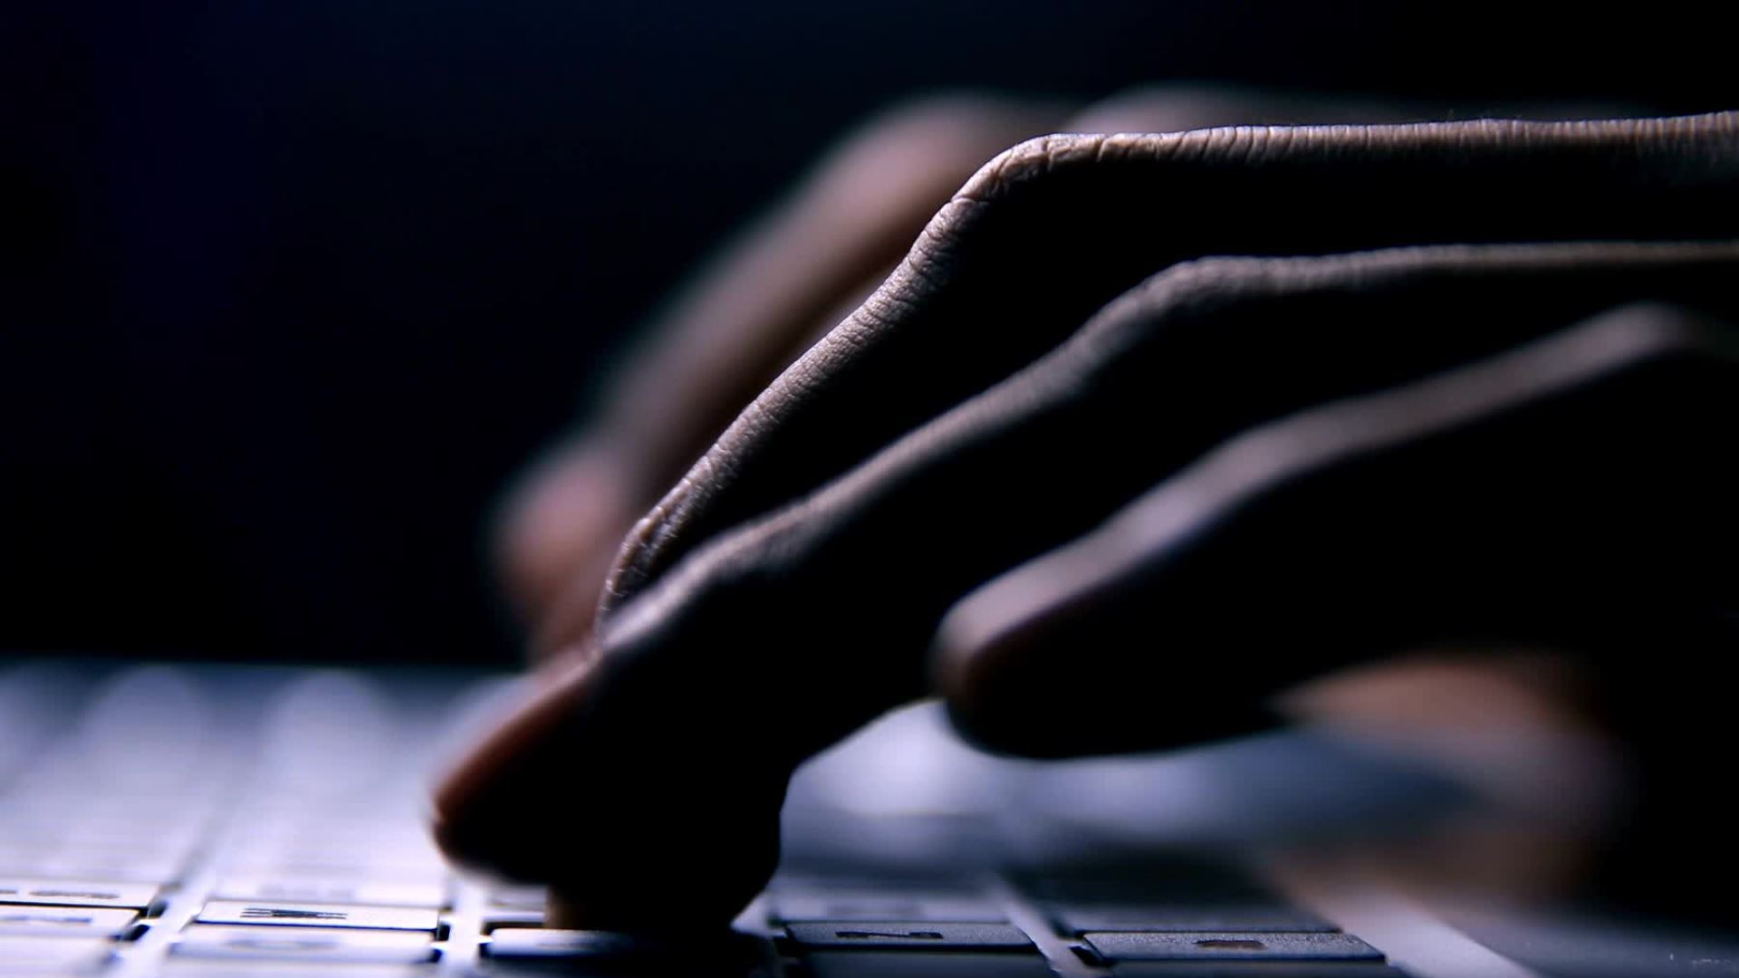
Importance of MFA?
MFA has great importance in cyber industry because we cannot only rely on passwords or pins for our device or account security. Nowadays even complex passwords and pins can we easily cracked. MFA is very important component due to...
Enhanced Security: MFA adds layers of protection beyond passwords, reducing the risk of unauthorized access and defending against common attacks like phishing and brute-force.
Regulatory Compliance: MFA helps meet security standards required by regulations like GDPR and HIPAA, avoiding legal penalties and ensuring best practices.
Reducing Fraud: MFA lowers the risk of identity theft and fraud by requiring multiple verification factors, protecting sensitive data and transactions.
Remote Work Protection: MFA secures remote access to corporate networks, ensuring safe login from various locations and devices.

Slide 5
Need for MFA?
Only Passwords and Pins are not enough that's why need for MFA emerged due to following reasons.
Weakness of Passwords: Passwords alone are often insufficient for security, as they can be easily stolen through phishing, brute-force attacks, or data breaches. MFA provides additional layers of protection to secure accounts.
Increasing Cyber Threats: The rise in cyberattacks, including sophisticated hacking techniques, requires stronger defenses. MFA helps mitigate risks by requiring multiple forms of authentication.
Preventing Unauthorized Access: With MFA, even if a password is compromised, the attacker still needs additional verification, making it much harder to gain unauthorized access to sensitive information.
Compliance with Security Standards: Many industries must comply with regulations that mandate MFA, such as GDPR, HIPAA, and PCI-DSS, to protect sensitive data and avoid legal consequences.

Slide 6
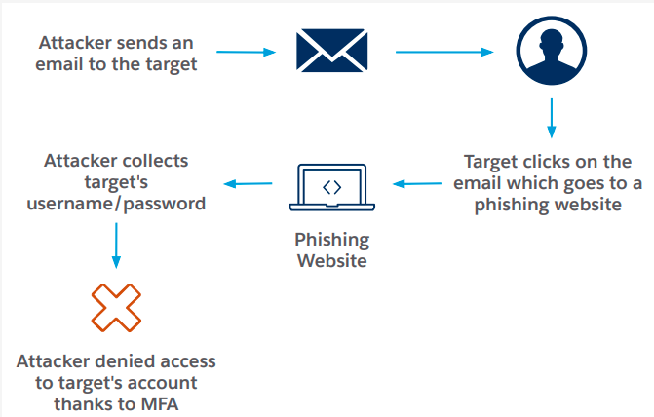
Need for MFA?
Protecting Sensitive Data: MFA is essential for safeguarding sensitive information like financial records, healthcare data, and intellectual property, reducing the risk of costly data breaches.
Adapting to Remote Work: As remote work becomes more common, MFA is crucial for securing access to corporate networks and resources, ensuring that only authorized users can log in from various locations.
Mitigating Human Error: Since users can fall for phishing or social engineering attacks, MFA provides an additional security layer that can prevent breaches even when passwords are compromised.
Building Trust and Reputation: Organizations that implement MFA demonstrate a commitment to security, which can enhance customer trust and protect their reputation in the market.

Slide 7
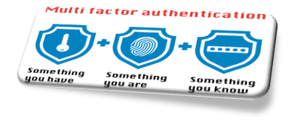
How MFA Works?
MFA secures access by requiring two or more verification factors:
Authentication Factors:
Something You Know: A password or PIN.
Something You Have: A smartphone, hardware token, or smart card.
Something You Are: Biometric data like fingerprints or facial recognition.
Process:
Step 1: Enter your password.
Step 2: Provide a second factor, like a one-time code or fingerprint.
Step 3: Access is granted only after both factors are verified.
Common Methods:
SMS-based codes, authenticator apps, or hardware tokens.
MFA strengthens security by adding layers of verification beyond just a password.

Slide 8
Benefits of MFA
MFA provides an extra layer of protection beyond passwords, making it significantly harder for unauthorized users.
It helps defend against phishing, keyloggers, and brute-force attacks.
MFA helps organizations meet regulatory requirements.
By requiring multiple forms of verification, MFA minimizes the risk of identity theft and fraudulent activities.
MFA helps for protecting remote access to corporate systems and data.
MFA adds an additional layer of security that can prevent breaches caused by user mistakes, such as falling for phishing scams.
Implementing MFA demonstrates a commitment to security, enhancing customer trust and protecting an organization’s reputation.

Slide 9
Benefits of MFA
MFA provides an extra layer of protection beyond passwords, making it significantly harder for unauthorized users.
It helps defend against phishing, keyloggers, and brute-force attacks.
MFA helps organizations meet regulatory requirements.
By requiring multiple forms of verification, MFA minimizes the risk of identity theft and fraudulent activities.
MFA helps for protecting remote access to corporate systems and data.
MFA adds an additional layer of security that can prevent breaches caused by user mistakes, such as falling for phishing scams.
Implementing MFA demonstrates a commitment to security, enhancing customer trust and protecting an organization’s reputation.

Slide 10
Future of MFA
The shift towards passwordless solutions, such as biometric verification and hardware tokens, aims to enhance security and user convenience by eliminating the need for traditional passwords.
Leveraging artificial intelligence and machine learning, adaptive authentication assesses the risk level of each login attempt and adjusts the MFA requirements accordingly.
Innovations in biometric technologies, such as facial recognition and voice authentication, are becoming more sophisticated and reliable, offering more secure and user-friendly authentication methods.
MFA is increasingly being integrated into Zero Trust security architectures, where continuous verification of users and devices is required, regardless of their location.
Advancements in multi-factor solutions will likely include more seamless and secure methods of verification, such as integration with IoT devices and more advanced cryptographic techniques.
Future MFA solutions are expected to prioritize user experience, balancing security with ease of use to encourage widespread adoption and reduce friction for end-users.

Slide 11
Top Venders of MFA
Google Authenticator: Includes MFA options through Google Authenticator and security keys.
Microsoft(Azure Active Directory): Supports a range of methods including SMS, voice calls, mobile app notifications, and biometric authentication.
Okta: Offers a comprehensive MFA solution with options for SMS, email, biometrics, and mobile apps.
Duo Security (Cisco): Features a user-friendly MFA solution with support for push notifications, SMS, and hardware tokens.
Auth0: Offers flexible MFA solutions with support for SMS, email, push notifications, and various third-party authenticators.
OneLogin: Support a wide range of methods like, Mobilephone authenticators app, biometrics factors and SMS.

Slide 12
Conclusion:
In summary, Multi-Factor Authentication (MFA) is crucial for enhancing security by requiring multiple forms of verification beyond just passwords. It significantly reduces the risk of unauthorized access, helps meet regulatory requirements, and protects sensitive information. As cyber threats evolve, MFA continues to adapt, providing essential protection and fostering trust in an increasingly digital world.
Thank You

