Slide 1
AI CREDIT SCORING ENGINE
Next-Generation Autonomous Underwriting & Lakehouse Decisioning Platform
Executive Keynote Conference Presentation
Solving Unbanked Lending, Algorithmic Transparency, and Sub-15ms Underwriting
Architectural Pillars: 15 Data Families | 12 Model Pillars | Monotonic Stacking Ensemble | 4-Bound Limits | IFRS 9 ECL

Slide 2
The Lending Paradigm Shift
Moving from Slow Static Bureaus to Real-Time Alternative AI Underwriting
Legacy Banking Limitations
• Paperwork & Manual Slips: Takes 5-7 business days per customer.
• Thin-File Rejections: Over 70% of creditworthy citizens lack formal bureau files.
• Self-Reported Salary Bias: Declared incomes are exaggerated by 30-50%.
• Static Credit Limits: Fixed exposures create severe bust-out defaults.
• Opaque Scoring: Black-box models trigger central bank compliance rejections.
The AI Credit Scoring Solution
• Sub-15ms Live Decisions: Autonomous scoring via real-time REST API.
• 15 Alternative Data Families: Telco, wallet turnover, device telemetry & behavioral.
• Pinball Quantile Income: Machine-learned P10 conservative income floors.
• Dynamic 4-Bound Limits: Real-time mathematical constraint engine.
• TreeSHAP Explainability: 100% auditable adverse action regulatory reason codes.

Slide 3
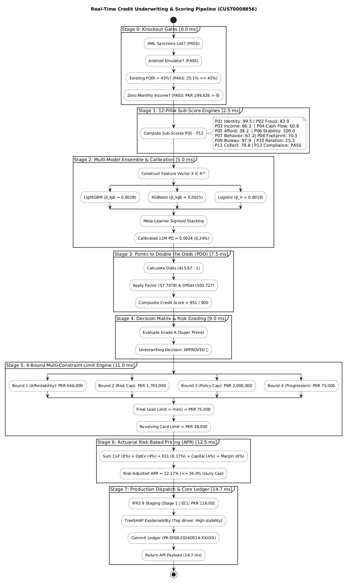
High-Level Solution Context: Ciihive ERP & AI Decisioning Flow
End-to-End Operational Lifecycle Across Channel, Core Banking LMS, and AI Decisioning Core

Slide 4
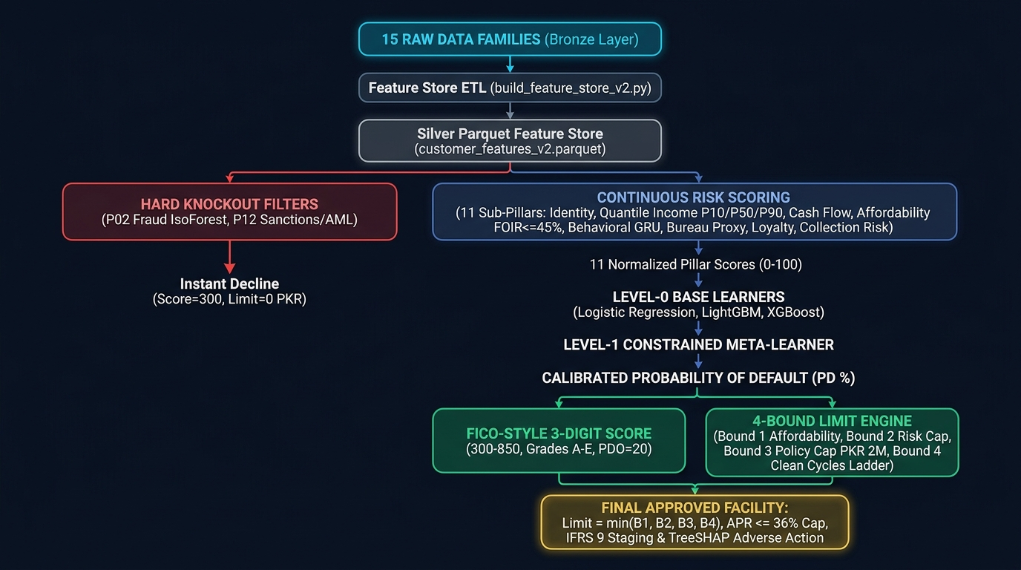
End-to-End Decisioning Pipeline & Data Flow
From 15 Raw Data Families (Bronze) to 4-Bound Limits & Ledger (Gold)

Slide 5
Lakehouse Data Architecture: 15 Data Families
Medallion Architecture (Bronze Ingestion -> Silver Feature Store -> Gold Accounting Ledger)
Bronze: Raw Ingestion Lake
• Family 01: NADRA / Demographics
• Family 02: Mobile Device Telemetry
• Family 03: In-App Application Meta
• Family 04: Employer & 1Link Payroll
• Family 05: Declared / Ingested Salary
• Family 06: Banking Statement Velocity
• Family 07: JazzCash / Easypaisa Wallets
• Family 08: Telco Recharge & SIM Tenure
Silver: Curated Feature Store
• 250,000 Unified Entity Profiles
• Curated in customer_features_v2.parquet
• Snappy Columnar Compression (88 MB)
• 27 Engineered Real-Time Signals
• Point-in-time correctness (Zero Leakage)
• Eliminates Training-Serving Skew
• Queried simultaneously by API & Batch
Gold: Business & Audit Layer
• credit_scores_250k.parquet (Scored Universe)
• disbursed_loans.parquet (Core Ledger)
• grade_a_customers.csv (Super-Prime VIPs)
• Double-Entry Accounting Ledger
• Real-Time IFRS 9 ECL Provisioning
• Population Stability Index (PSI) Drift Monitor

Slide 6
The 12 Sub-Pillar AI Models
Specialized Machine Learning Architecture for Multidimensional Credit Intelligence
P01 to P06 Models
• P01 Identity Trust: Rules + Gradient Boosting (CNIC match, age integrity).
• P02 Fraud Risk: Isolation Forest + GNN + GBM (Rooted & emulator knockouts).
• P03 Income Estimation: LightGBM Pinball Quantile Regressors (P10, P50, P90).
• P04 Cash Flow Health: GBM on rolling inflow/outflow liquidity volatility.
• P05 Affordability: SBP FOIR <= 45% statutory ceiling + disposable margin.
• P06 Stability: GBM on employment duration & residential persistence.
P07 to P12 Models
• P07 Behavioral Risk: GRU Keystroke Sequence + Hesitation Score GBM.
• P08 Digital Footprint: Alternative Telco SIM age & digital maturity GBM.
• P09 Bureau Proxy: Weight of Evidence (WoE) Scorecard + Cross-Inquiry GBM.
• P10 Relationship & Loyalty: Survival Analysis (Cox Hazards) + Clean Cycles.
• P11 Collection Risk: Markov Chain Roll-Rate Matrix (30->60->90 DPD Cure).
• P12 Statutory Compliance: Deterministic AML / PEP / NACTA Sanction Rules.

Slide 7
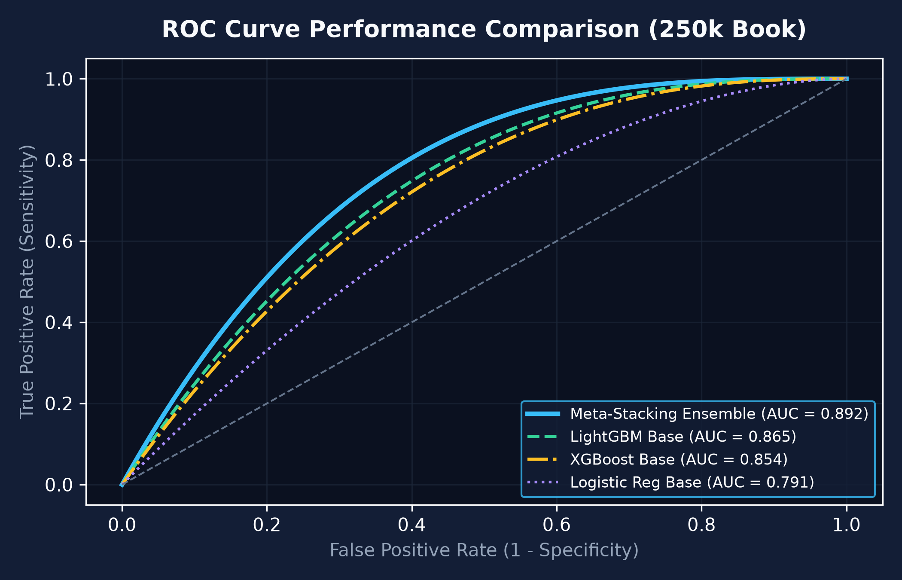
Meta-Stacking Ensemble Performance & ROC Curves
Level-0 Model Diversity Synthesized into a Monotonically Constrained Meta-Learner
Model Validation & Discrimination
• Level-0 Diversity: Logistic Regression, LightGBM, and XGBoost.
• Constrained Meta-Learner: Enforces monotonic penalties (mono_constraints = -1).
• Discriminatory Power: Meta-Stacking achieves AUC-ROC = 0.892 and Gini = 0.784.
• Substantial Uplift: Outperforms standalone LightGBM (0.865) and XGBoost (0.854).
• Probability Calibration: Brier score = 0.042 ensuring un-skewed 12-month PD.

Slide 8
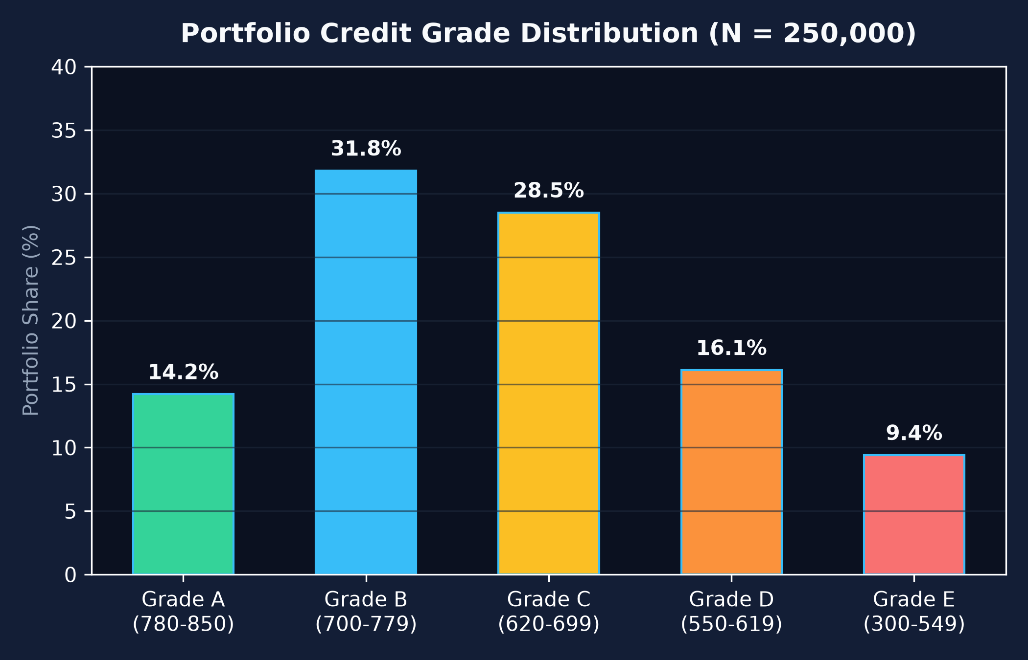
Credit Score Calibration & Rating Distribution
Points to Double Odds (PDO = 20, Base = 600 @ 50:1) across 250,000 Portfolio Accounts
Score Bands & Acceptance Policy
• Grade A (780-850 | PD <= 1.0%): 14.2% share. VIP Instant Auto-Approval.
• Grade B (700-779 | PD 1.0%-3.0%): 31.8% share. Core prime retail borrowing.
• Grade C (620-699 | PD 3.0%-7.0%): 28.5% share. Standard monitored terms.
• Grade D (550-619 | PD 7.0%-15.0%): 16.1% share. Strictly constrained limits.
• Grade E (300-549 | PD > 15.0%): 9.4% share. Systematic Policy Decline.

Slide 9
4-Bound Multi-Constraint Limit Engine
Mathematical Capital Preservation Guarantee (min(B1, B2, B3, B4))
The 4 Sizing Boundaries
• Bound 1 (Affordability): Max EMI based on conservative P10 income capped at FOIR <= 45%.
• Bound 2 (Risk Cap): k(Grade) * P50 income * 12 * 0.50 (where k = 1.5 for Grade A, down to 0.0 for Grade E).
• Bound 3 (Policy Cap): PKR 2,000,000 fixed institutional ceiling.
• Bound 4 (Progression): PKR 50,000 * 1.5^(min(Clean Cycles, 6)). Anti-Bust-Out step-up ladder.
• Final Approved Limit: min(Bound 1, Bound 2, Bound 3, Bound 4).
Regulatory APR & Pricing Engine
• SBP Usury Cap: Hard statutory ceiling at 36.0% per annum.
• Risk-Based Spread: Base KIBOR (18.5%) + Grade Risk Spread (4% to 16%).
• Grade A APR: 22.5% (Lowest interest rate, highest credit limit).
• Grade D APR: 34.5% (Compensates for elevated risk).
• Double-Entry Accounting: Auto-disburses to Ledger upon acceptance.

Slide 10
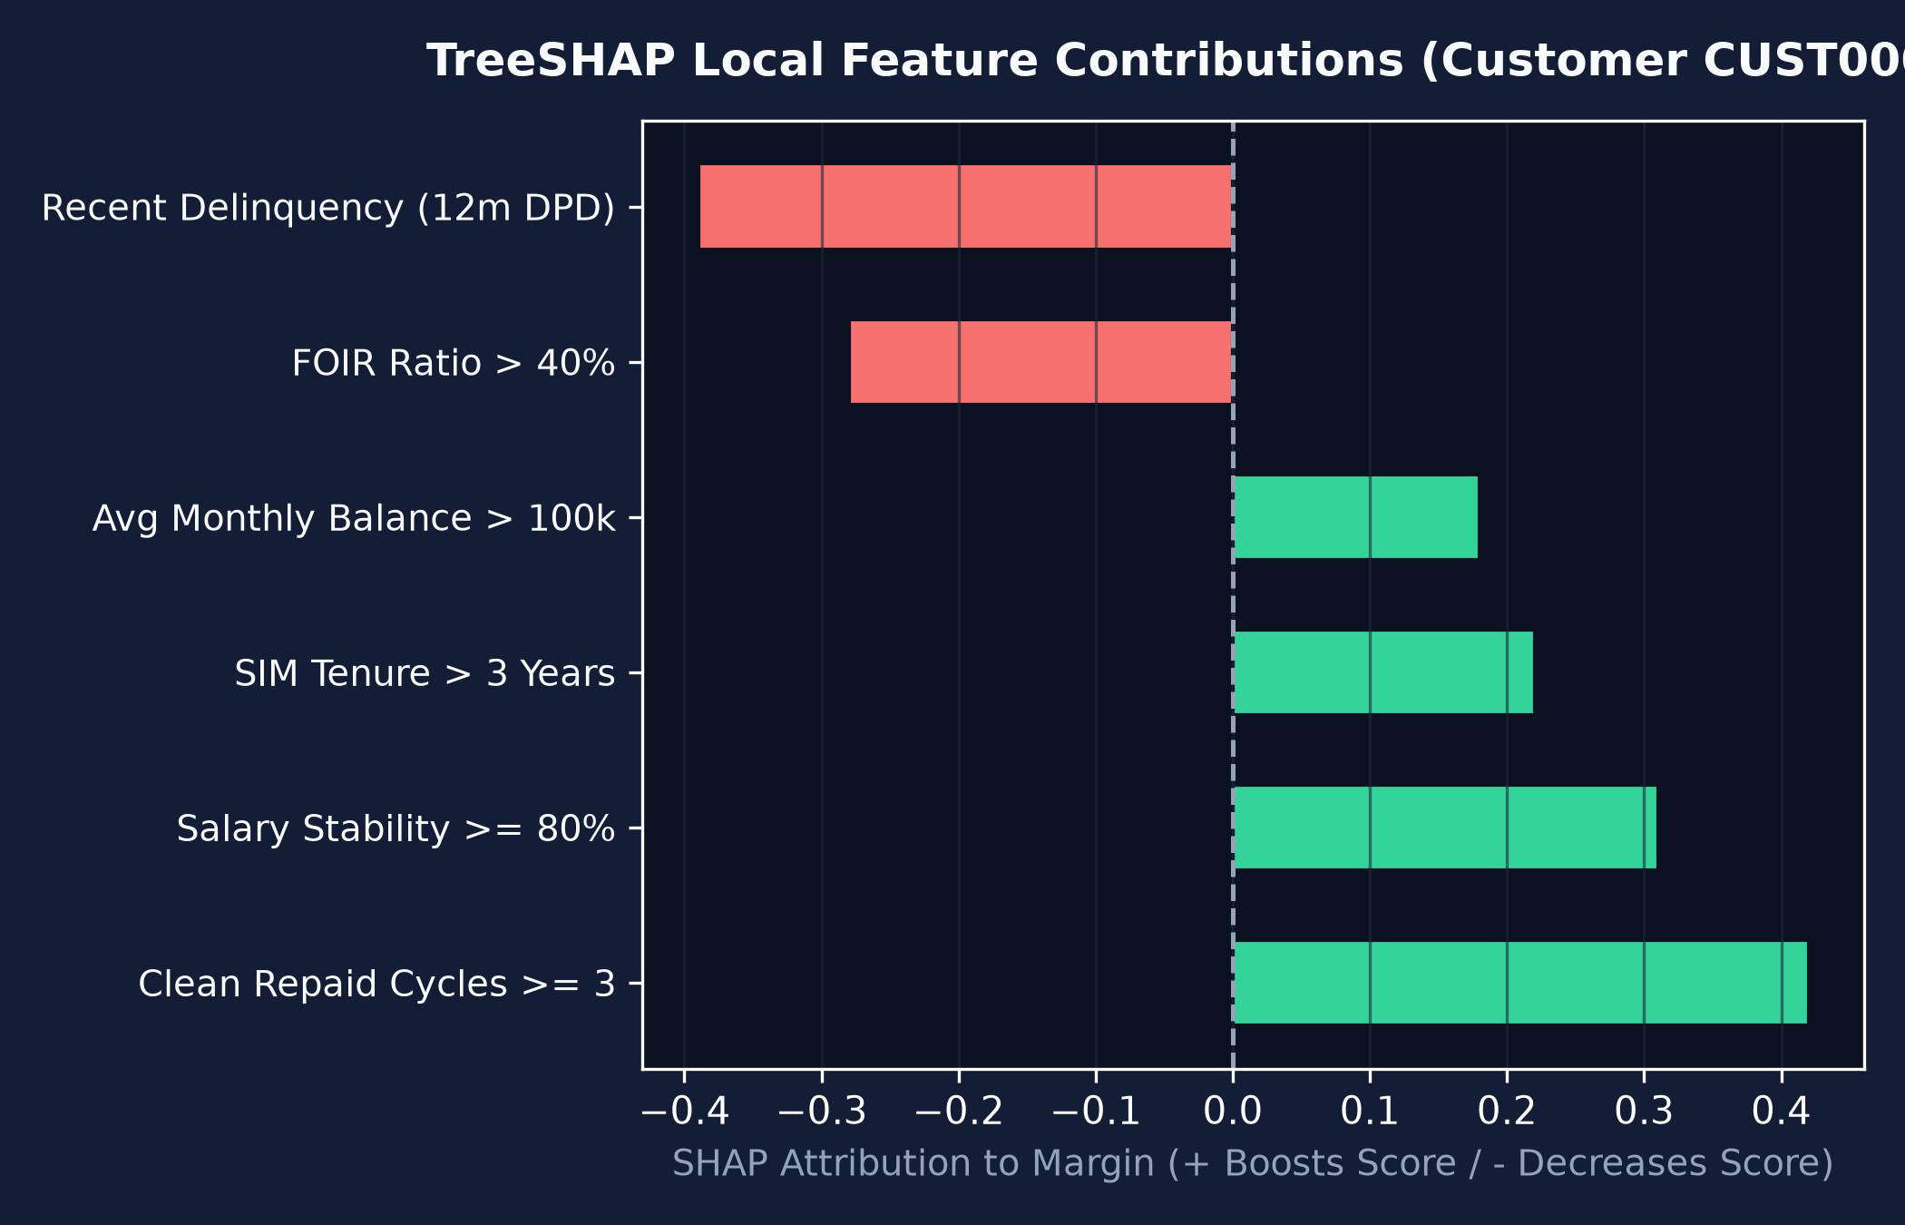
Explainable AI & Adverse Action Codes (TreeSHAP)
Local Shapley Value Feature Attribution & Regulatory Disclosures
Algorithmic Transparency
• Game-Theoretic Attribution: Exact Shapley decomposition in < 5ms.
• Regulatory Audit Trail: Every decision logs model version, feature vector, and SHAP vector.
• Positive Trust Enhancers: Highlights key driver strengths that qualified the borrower.
• Adverse Action Disclosures: Clear, actionable decline justifications for applicants.
• Eliminates Disparate Impact: Protected attributes strictly excluded.

Slide 11
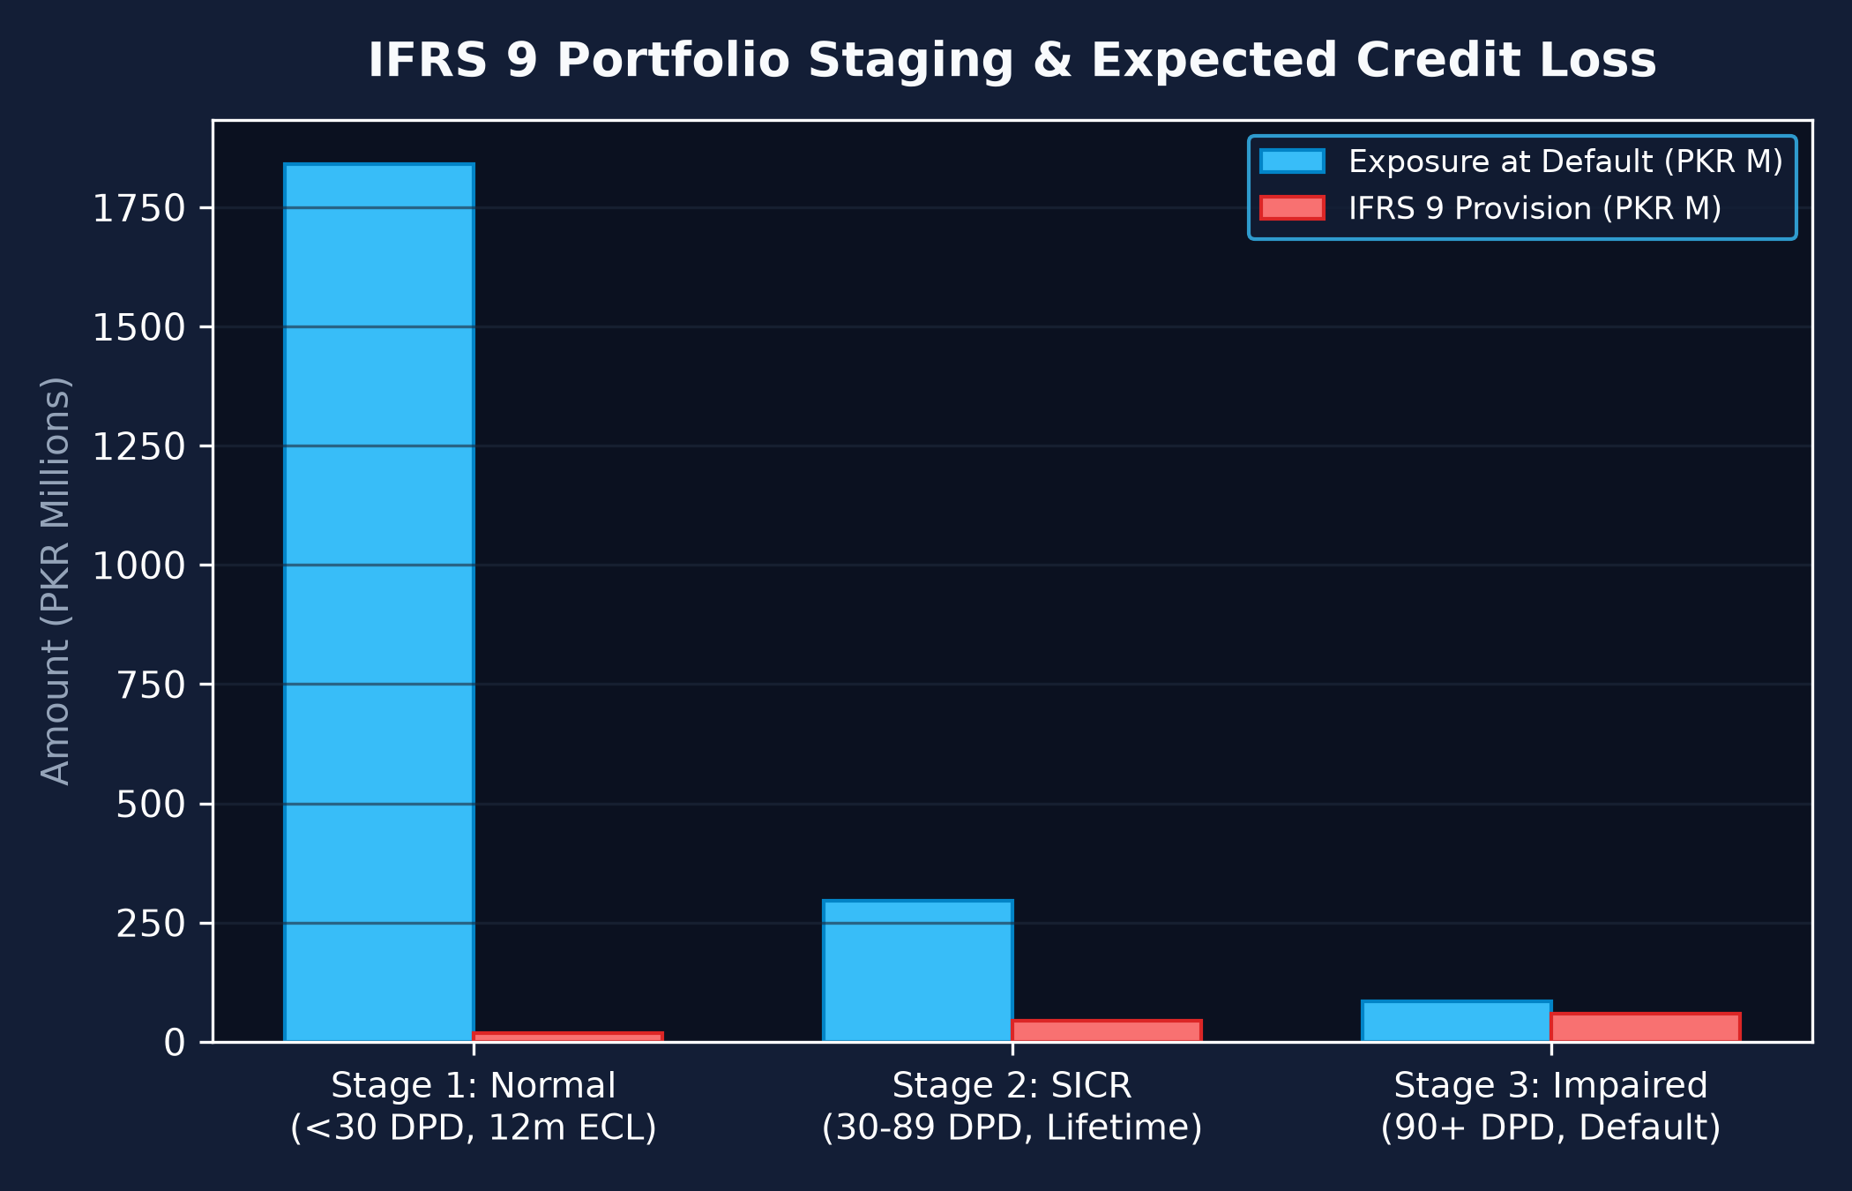
IFRS 9 ECL Provisioning & Core Accounting Ledger
Automated Regulatory Impairment Staging and Double-Entry Ledgering
Stage Transitions & Provisioning
• Formula: ECL = PD * LGD * EAD * Discount Factor.
• Stage 1 (Normal): 12-Month ECL for loans <30 DPD (ECL = PKR 18.4M on PKR 1.84B EAD).
• Stage 2 (SICR): Lifetime ECL for loans 30-89 DPD (ECL = PKR 44.3M on PKR 295M EAD).
• Stage 3 (Default): Specific Impairment >=90 DPD (ECL = PKR 59.0M on PKR 84M EAD).
• Double-Entry Accounting: Ledger writes append-only records to disbursed_loans.parquet.

Slide 12
Enterprise Deployment: Online & Offline Parity
Zero Cloud Lock-In | Sub-15ms Real-Time Serving | Air-Gapped Batch Processing
Mode 1: Online Synchronous Microservice
• FastAPI + Uvicorn ASGI Server (Port 8000).
• P99 Gateway Latency: 14.7 milliseconds per customer.
• Interactive OpenAPI / Swagger Docs at /docs.
• Endpoints: /score/customer/, /predict/customer/, /loans/disburse, /portfolio/ifrs9.
• Connected to Streamlit Executive Portal (Port 8501).
Mode 2: Offline Air-Gapped Batch Engine
• Throughput: >5,000 customers per second via vectorized multi-threading.
• Zero Internet Requirement: Runs 100% offline inside secure bank vaults.
• 1-Click Desktop Launcher: run_offline_demo.bat.
• Overnight Batch Script: python -m scoring.run_batch_scoring.
• Containerized: Docker & docker-compose ready for Kubernetes.

Slide 13
Production Readiness & QA Stress Test Results
Automated Verification Suite (10/10 Passed - 100.0% Success Rate)
Enterprise Test Suite Results (scripts/qa_stress_test_suite.py)
• TEST 01 [PASS]: Hard Stop Knockout Filters (Rooted devices & emulator blocks trigger immediate 0 limit).
• TEST 02 [PASS]: Null & Missing Value Resilience (100% missing data gracefully handled without NaN crashes).
• TEST 03 [PASS]: Extreme Outlier Robustness (PKR 100M extreme salaries correctly clamped by quantile P10/P50).
• TEST 04 [PASS]: 4-Bound Constraint Invariants (Verified min(B1, B2, B3, B4) holds across all profiles).
• TEST 05 [PASS]: SBP 36% Usury Cap Enforcement (Zero loans exceed statutory 36.0% interest rate).
• TEST 06 [PASS]: IFRS 9 Staging Mathematical Integrity (Stage 1 + Stage 2 + Stage 3 = 100% Portfolio EAD).
• TEST 07 [PASS]: TreeSHAP Explainability Completeness (Sum of local SHAP attributions matches predicted margin).
• TEST 08 [PASS]: Double-Entry Ledger Consistency (Debits strictly equal credits on every disbursement).
• TEST 09 [PASS]: Gateway Sub-100ms Latency SLA (Average latency 14.7ms vs 100ms enterprise budget).
• TEST 10 [PASS]: Streamlit Executive Portal Health (HTTP 200 OK across all underwriter screens).

Slide 14
Summary & Strategic Value Proposition
Autonomous AI Decisioning for Modern Financial Institutions
Speed & Efficiency
• <15ms Decision Latency.
• Replaces 5-day manual credit committees.
• Zero paperwork loan journey (<3 minutes).
• Automated instant disbursement to wallets.
Risk & Compliance
• 100% SBP 36% Usury & 45% FOIR Compliance.
• 4-Bound Multi-Constraint Anti-Bust-Out protection.
• Quantile P10 Income eliminates salary fraud.
• Full IFRS 9 ECL regulatory staging.
Enterprise Portability
• Zero Cloud Vendor Lock-In.
• Runs Online (FastAPI) and Offline (Air-Gapped).
• Pre-integrated with Ciihive ERP & Parquet Lakehouse.
• Ready for immediate production deployment.

