Slide 1

CFG
INTRODUCTION TO
DATABASES & SQL PROGRAMMING LANGUAGE
PROJECT PRESENTATION
ALBINA KHAYBULLINA

Slide 2
Child Management System for a Day Nursery
The idea of the project is to create a database for a day nursery that allows storing and managing information about children, their parents, groups, staff, children's visiting schedules, an attendance log, as well as prices for attendance.
PROJECT IDEA

Slide 3
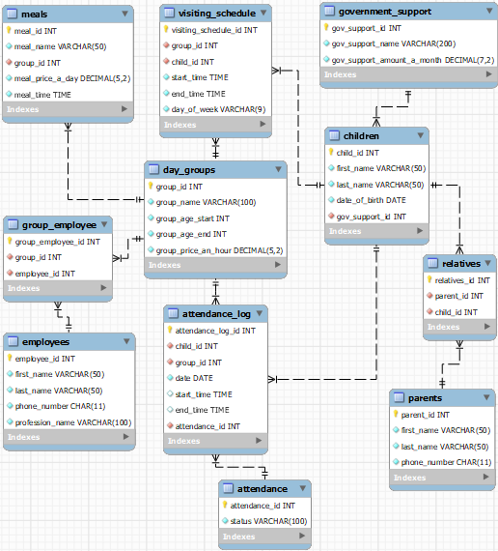
MODULE 1: HTML
Enhanced entity–relationship
(EER) diagram

Slide 4
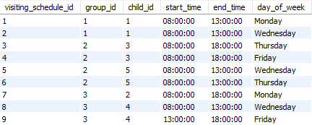
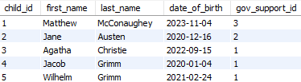
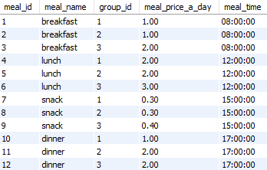
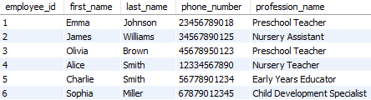

QUERY:
ATTENDANCE LOG
EXAMPLES OF THE TABLES

Slide 5
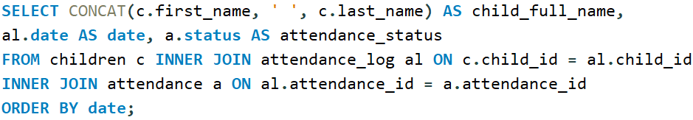
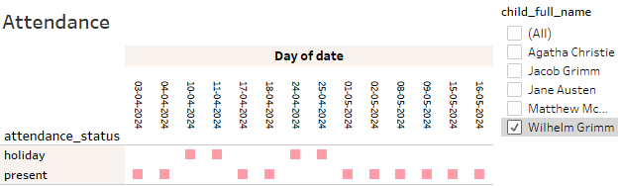
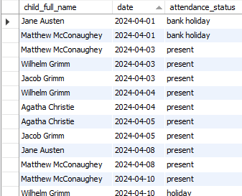
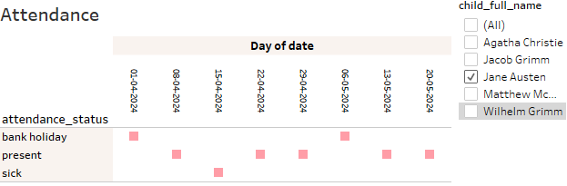
QUERY EXAMPLE:
ATTENDANCE LOG
The query provides information about the attendance log in a user-friendly form
The attendance log of Wilhelm
The attendance log of Jane

Slide 6
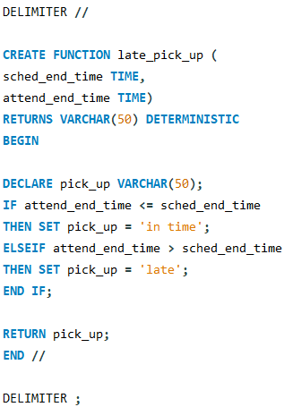
Stored function: a body of code
Function “late_pick_up” takes two parameters: scheduled pick up time and real pick up time of a child and returns “in time” or “late” depending on the result of the “if” clause

Slide 7
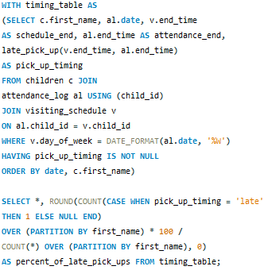
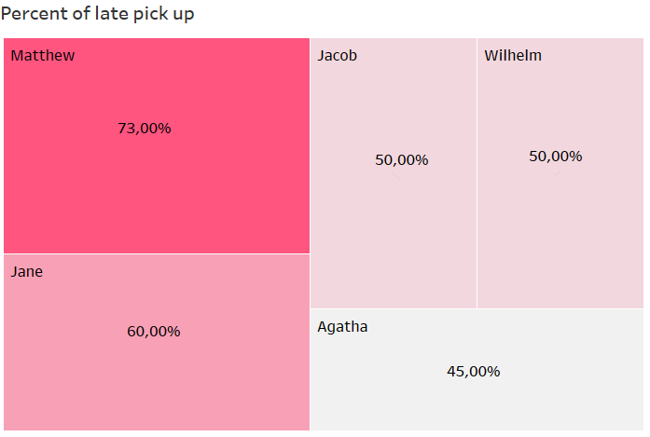
Stored function: application within a query
Find out how often parents picked up their children later than scheduled

Slide 8
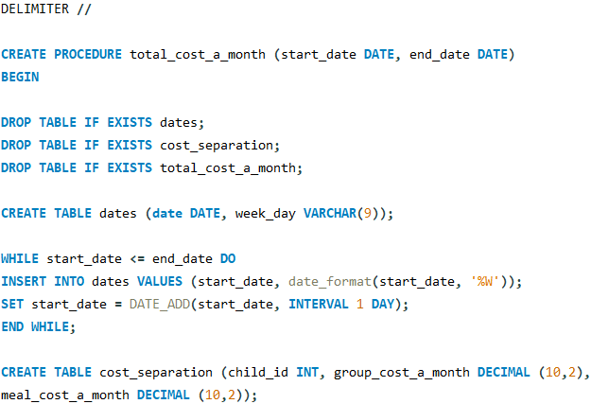
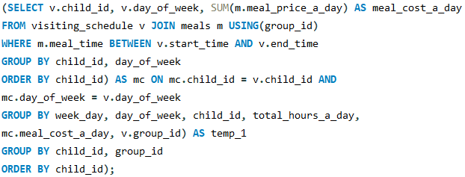
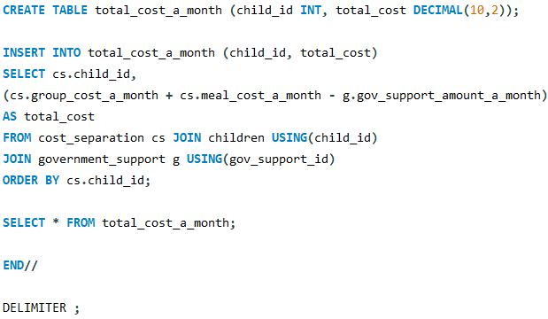
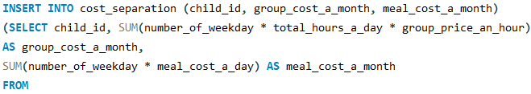
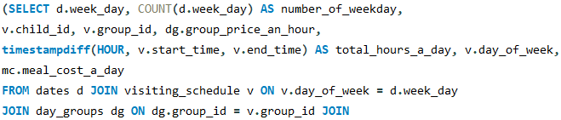
Stored procedure: a body of code
Procedure “total_cost_a_month “ takes two parameters: the start of a period and the end of a period and calculates total cost for the next month's attendance

Slide 9
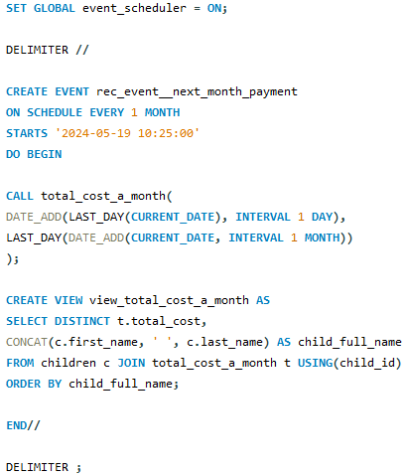
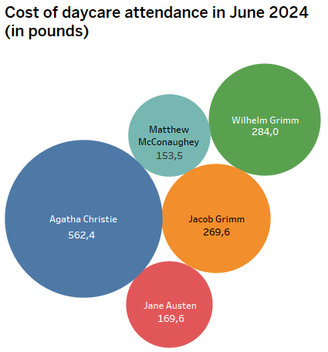
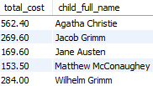
Stored procedure: application within an EVENT
Event “rec_event__next_month_payment” automatically creates a view with the cost of attendance for next month's payment on the given date and time of each month

Slide 10
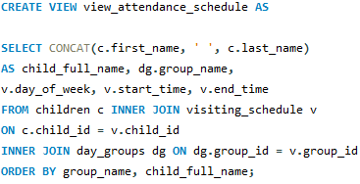
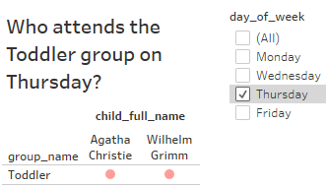
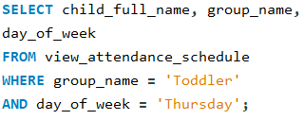
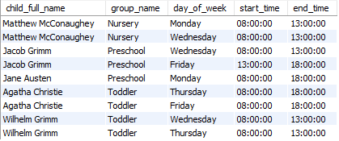
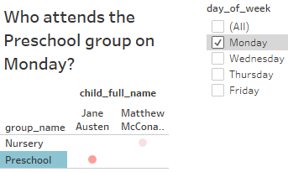
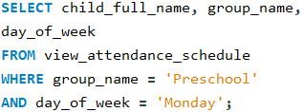
View: attendance schedule for children
body of code
The view “view_attendance_schedule” creates a user-friendly attendance schedule for each child, intended for the staff of the nursery.
full display of the view

Slide 11
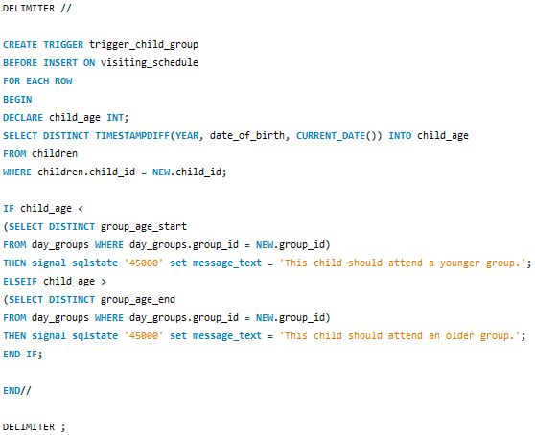
Trigger: check the group for a child before inserting data into the "visiting_schedule" table
Trigger “trigger_child_group” prevents inserting data into the "visiting_schedule" table if the child’s age doesn’t match the group’s age range

Slide 12
Trigger: check the group for a child before inserting data into the "visiting_schedule" table
Toddler group
Matthew (6 months)
Toddler group
Jacob (4 years)
Preschool group
Jacob (4 years)

Slide 13
Child Management System for a Day Nursery
EVENT
automatically creates a view with the cost of attendance for the next month on a monthly
basis
STORED FUNCTION
estimates whether children were picked up on time
“NURSERY”
DATABASE
STORED PROCEDURE
calculates the total cost for next month's attendance
TRIGGER
checks the group for a child before inserting data into the database
VIEW
the attendance schedule for children in a user-friendly form

Slide 14
THANK YOU!

