Slide 1

Predicting Readmission of Diabetes Patients
Kyle Hayes, Kaleb Nyquist

Slide 2
Background
30.3 million people (9.4% of US population) diabetic
4 in 10 diabetic adults describe health as “poor to fair”- 3 times the rate of non-diabetic adults.
25% of hospital admissions are diabetic
Hospitalization costs in 2012: $124 billion

Slide 3

Can we predict repeat hospitalization?
Image Source: http://www.starmulticare.com/home-health-care-services/post-hospitalization/

Slide 4
Data
Diabetes 130-US hospitals for years 1999-2008 Data Set (https://archive.ics.uci.edu/ml/datasets/diabetes+130-us+hospitals+for+years+1999-2008)
Inpatient encounters, diabetic patients
Length of stay: one to 14 days

Slide 5
Model Measurement:
Measure the number of correct “readmission” predictions divided by total actual readmissions (Recall)
False “no readmission” predictions are the most harmful

Slide 6
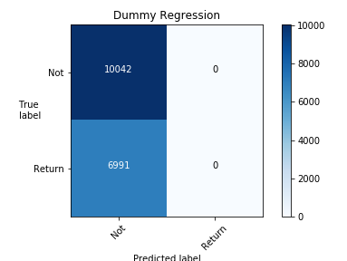
Dummy Model:
Recall: 0

Slide 7
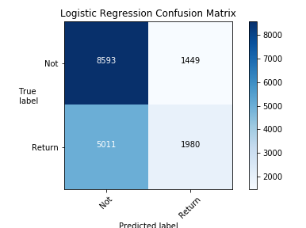
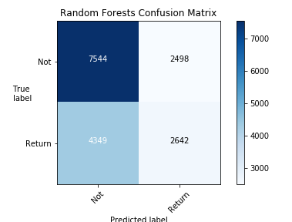
Non-boosted models
Logistic Regression: 0.283
Random Forests: 0.378

Slide 8
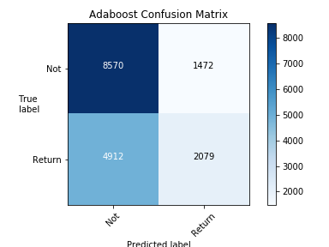
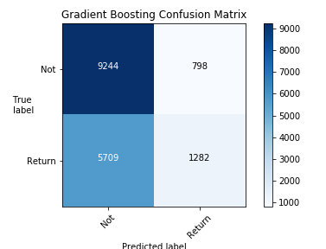
Boosted Models
AdaBoost: 0.297
Gradient Boosting: 0.183

Slide 9
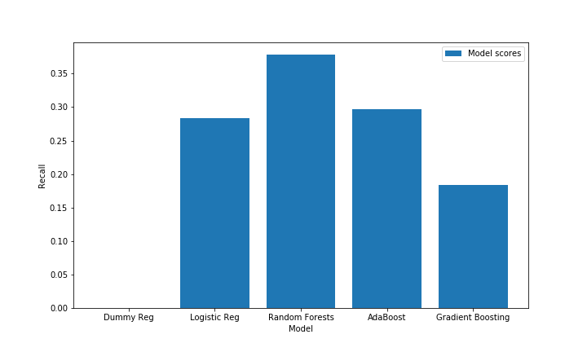
Model Comparison
Notes:
Dummy,
Decision Tree,
Random Forest,
Logistic Regression,
K-Nearest Neighbors
XGBoost

Slide 10
Conclusion
Random forests is best at predicting readmissions using predicted readmissions / total readmissions as measurement
Prediction capabilities are low, model will need improvement

Slide 11
Next Steps and Recommendations
Determine if we can study only subsamples with HbA1c and/or glucose tests
Look at whether readmission is within 30 days
Remember that a lack of readmission does not mean a lack of need.

Slide 12
Sources
Diabetes Research Institute (https://www.diabetesresearch.org/diabetes-statistics)
Hospital Readmission of Patients With Diabetes (https://link.springer.com/article/10.1007/s11892-018-0989-1)

