Slide 1

Trigger Warning:
Blocking Offensive
Online Comments
Kyle Hayes
Credit: Pxhere.com

Slide 2
This presentation will address:
Comment remover problems
Comment detector criteria
Data exploration
Results
Recommendations

Slide 3
Offensive Comment Removal
510,000 Facebook comments per minute (Forbes 2018/5/21)
50% of businesses use online communities (Greenbook Research Industry Trends, 2015)
37% of Americans have been harassed online (USA Today, 2019/2/13)
Average comment moderator: 900 per day (Buzzfeed, 2019/3/4)

Slide 4
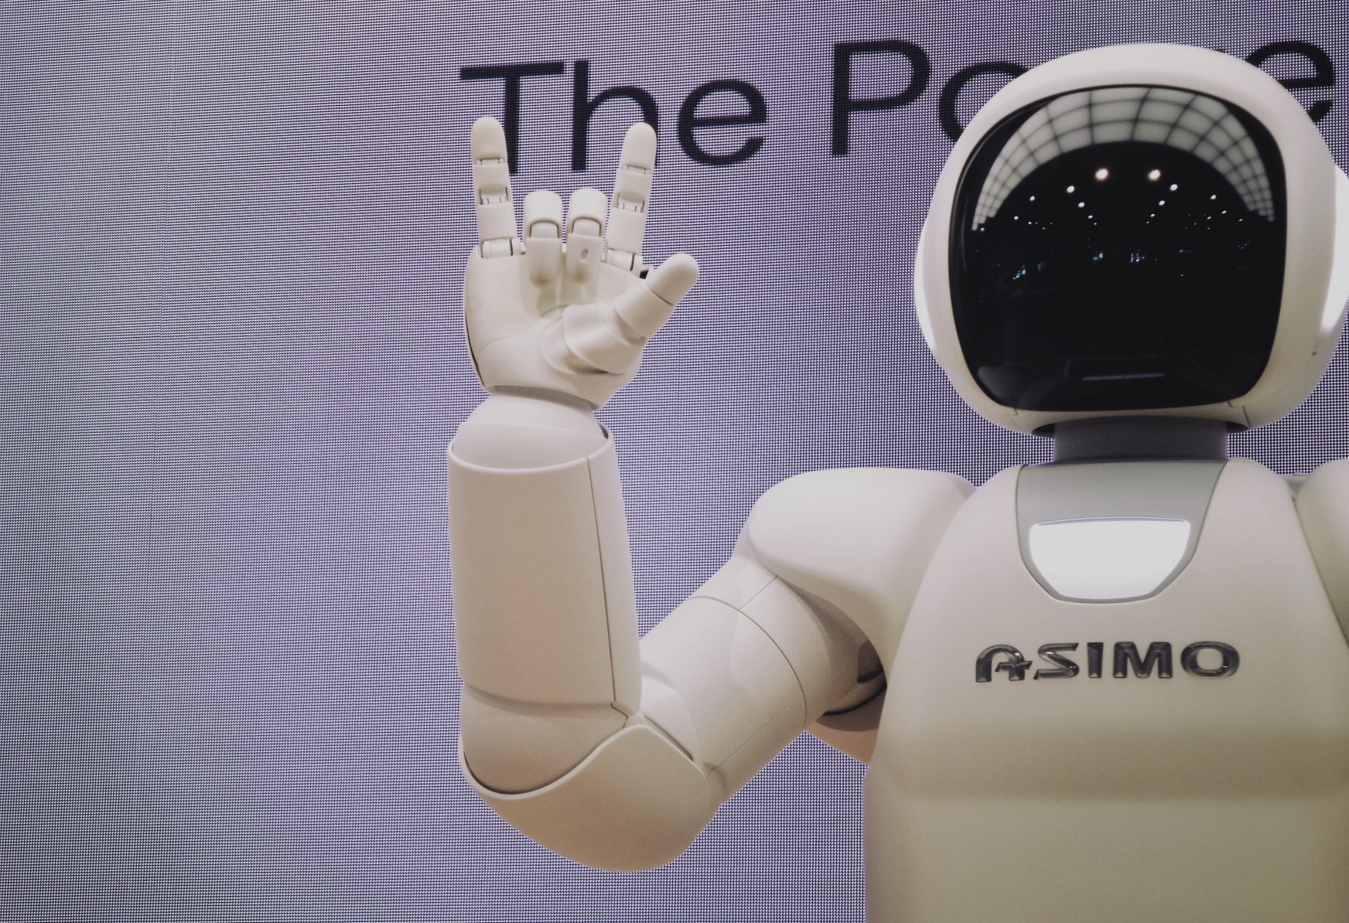
AI and hate speech: what could possibly go wrong?
Credit: Unsplash.com

Slide 5
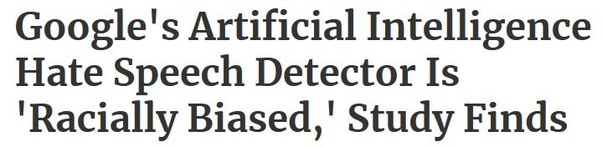

Oh, right.
2x more likely to flag African-Americans posters (Forbes, 2019/8/13)
Speech about groups v. hate speech
Nuance-free
Credit: BlutGruppe

Slide 6


Ideal detector:
Shouldn’t:
Should:
Be ‘color-blind’
Measure only correct assignations
Err on the ‘block’ side
Notice ‘group’ content
Measure incorrect assignations
Minimize incorrect blocks

Slide 7
Cost Function
Good message allowed
0 points
Good message Banned
4 points
Bad message Banned
-1 points
Bad message allowed
1 points

Slide 8
Data Exploration:
Google Jigsaw: AI and Online Harassment
400,000 Quora comments
Annotated toxicity and ‘group’ subject labels

Slide 9
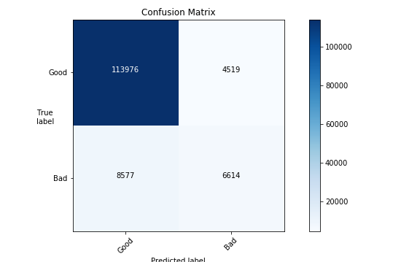
No group classification
Correct bans: 6614
Good comments banned: 4519
Bad comments missed: 8577
Score: 20,039

Slide 10
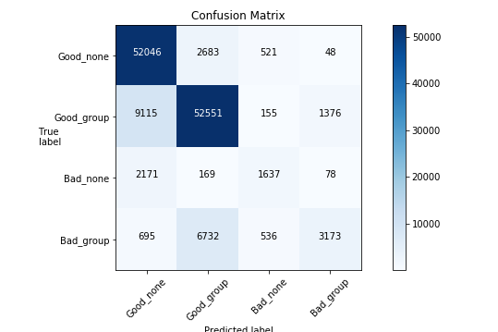
Results
Grouped
Grouped (simplified)
Good comments banned: 53.5% less
Bad comments missed: 13.9% more
Correct bans: 18% less
Score: 12,743

Slide 11
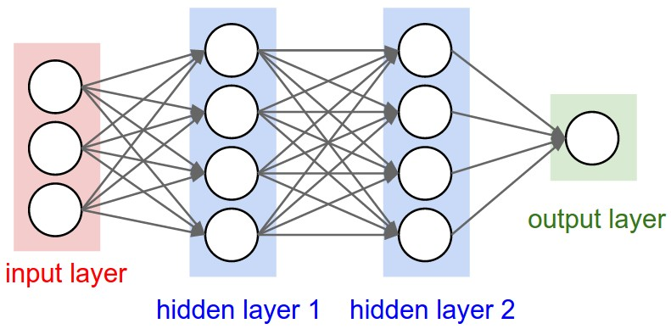
Deep Learning Network
Bad?
We sure?
“Pizza”
Yup,
bad.
“You’re nice!”
“(*Something
just awful*)”

Slide 12
Problems with classification:
Not Toxic:
Toxic:
“This nation is afflicted with an epidemic of Black-on-White… violence… unreported by the mainstream media.”
“(I don’t see) racial discrimination in favor of black people... Do you have any studies that don't include cherry-picked items?“

Slide 13
Problems with classification:
Not a group comment
Group comment
“I think Native Americans should get a pass for being suspicious of… this government.”
“Haha [sic] you guys are a bunch of losers.”

Slide 14
Findings
Offensive speech categorization decreases false bans significantly
Deep learning decreases levels of false bans
Anti-group speech is harder to recognize and to correctly classify

Slide 15
Recommendations
Use together with human process
Introduce Convolutional Neural Network
Use unsupervised learning to investigate incorrect assignments
Use diverse group of annotators to better define offensiveness

