Slide 1

“Microsoft Studios”:
Should Microsoft Enter the Movie Business?
G. Haws & K. Hayes

Slide 2

Questions:
What is the “problem” definition?
What is the scope of work?
Which partners are ideal?
Where should Microsoft focus subsequent efforts?
Should Microsoft emulate others?

Slide 3
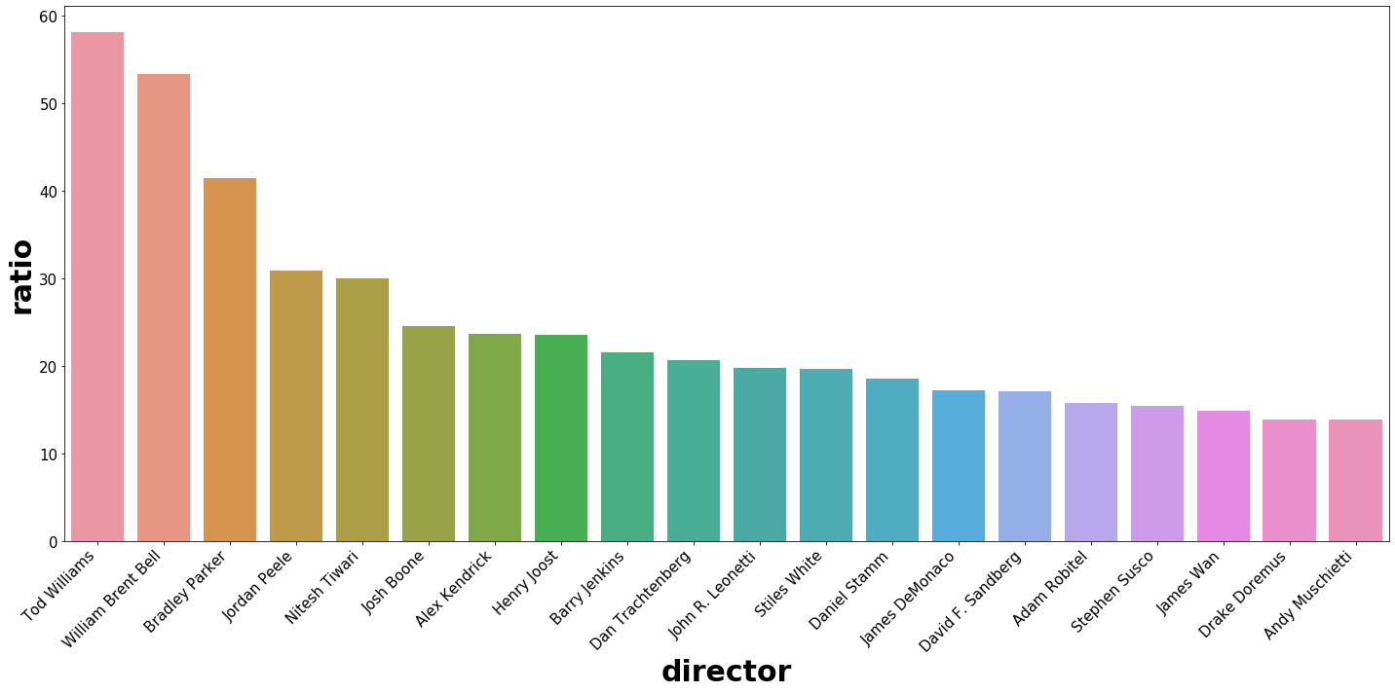
xROI by Director

Slide 4
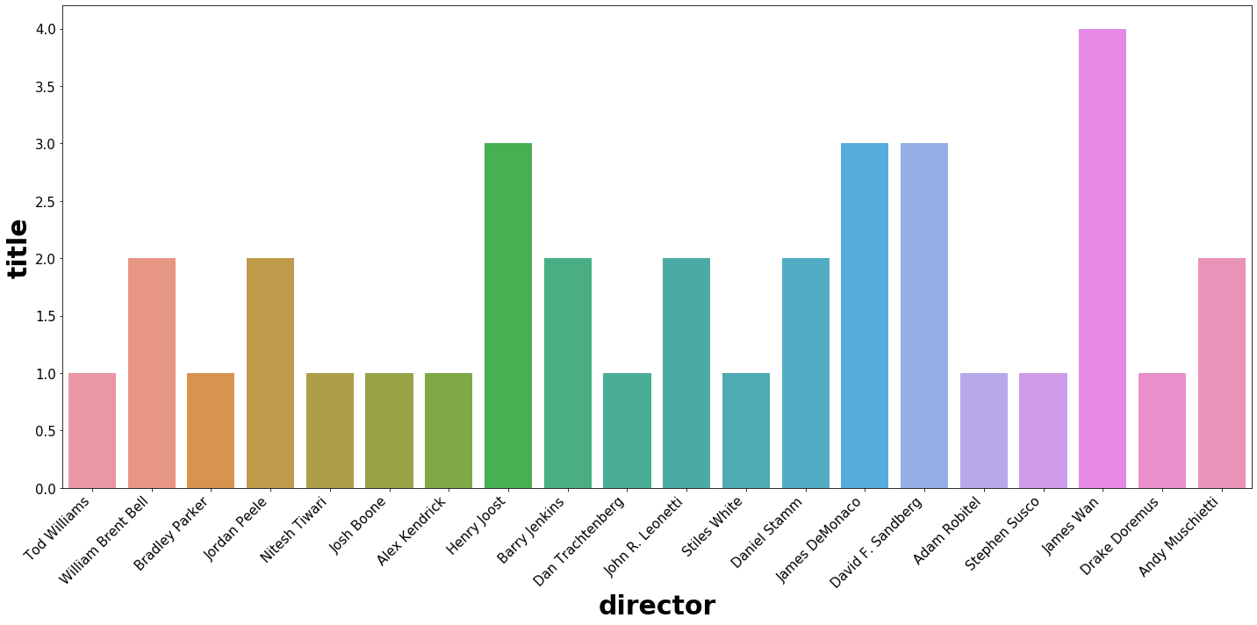
Director Track Record

Slide 5
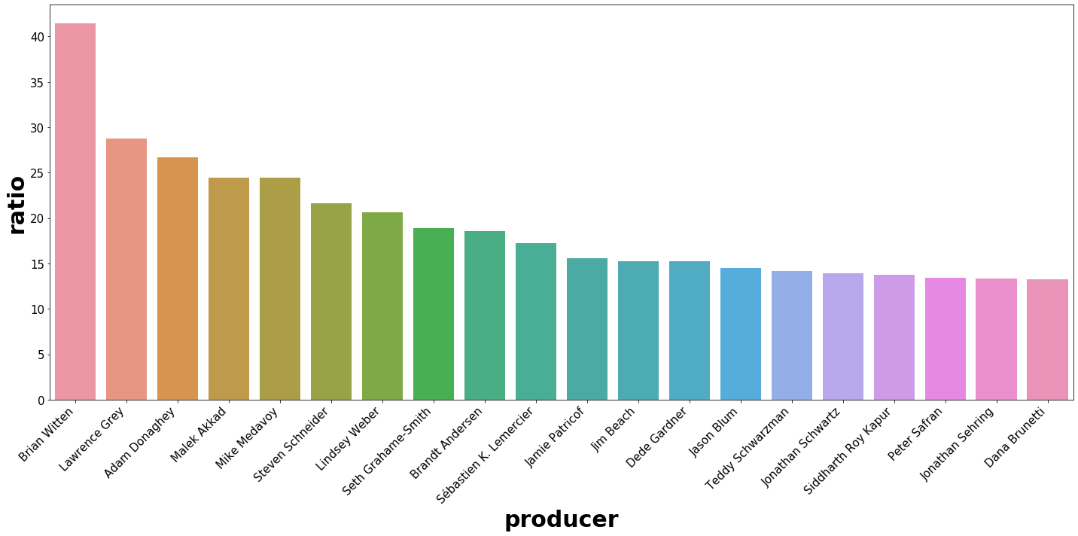
xROI Multiple by Producer

Slide 6
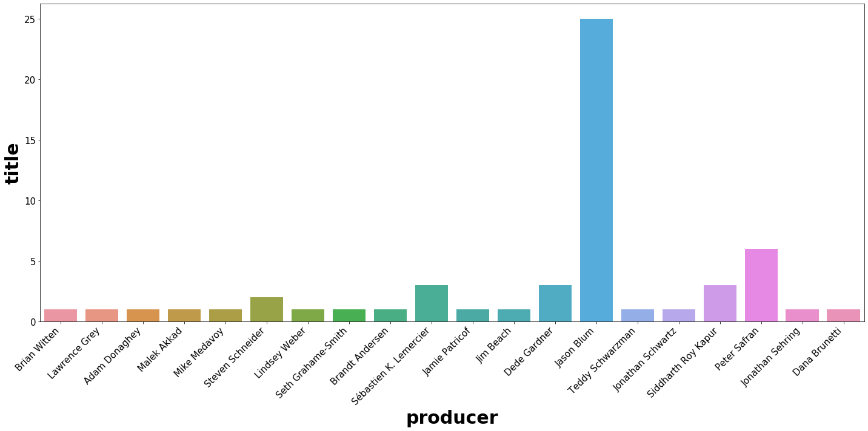
Producer Track Record

Slide 7
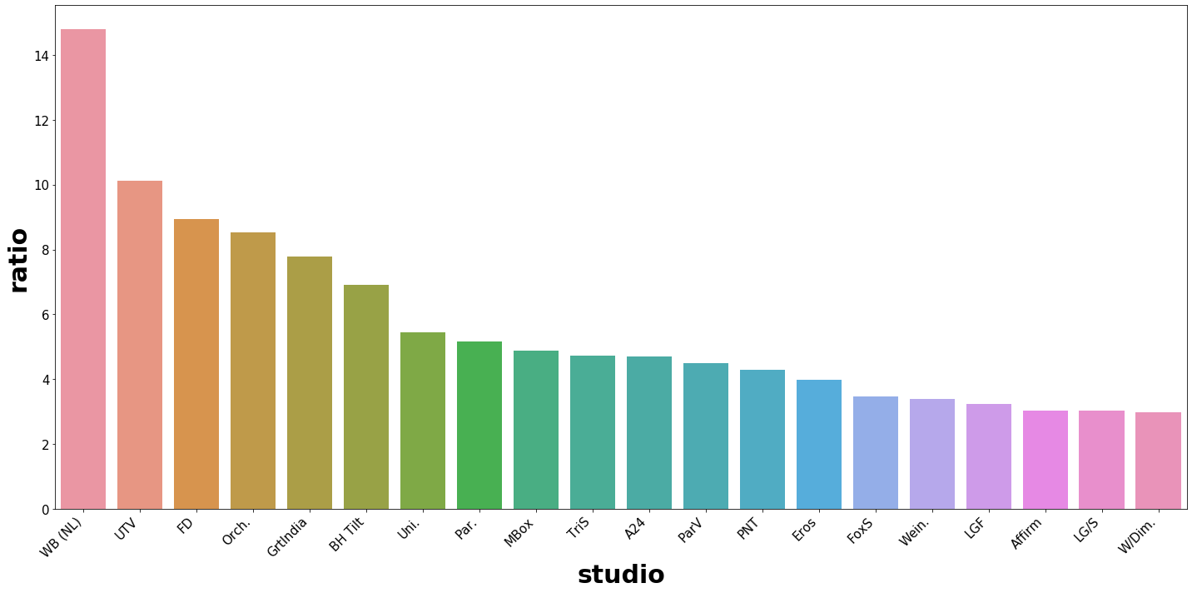
Top Studios: xROI Multiple

Slide 8
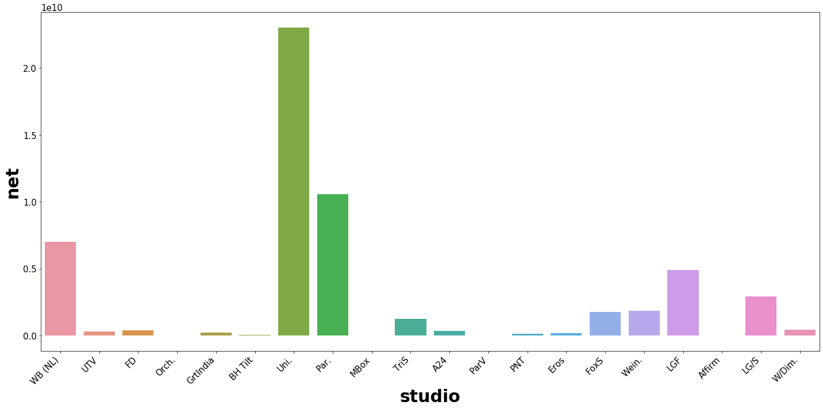
Top Studios: Cumulative Net Profit

