Slide 1


Slide 2
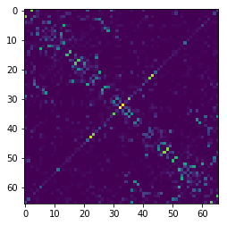
Predicted Structural Matrix

Slide 3
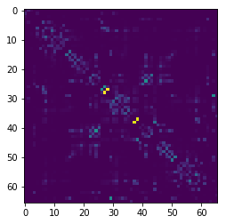
Actual Structural Matrix

Slide 4
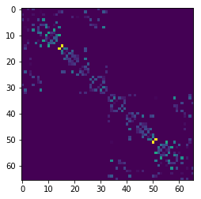
Actual Structural Matrix (Surface)

Slide 5
Actual
Predicted
Correlation: 0.4985

Slide 6
Actual (Surface)
Predicted
Correlation: 0.5426

Slide 7
Actual (Surface)
Actual
Predicted

Slide 8
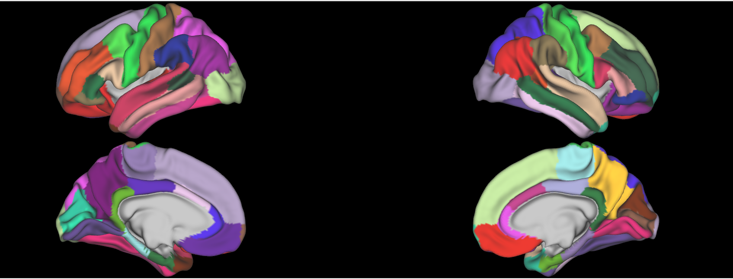
Brain Regions

Slide 9
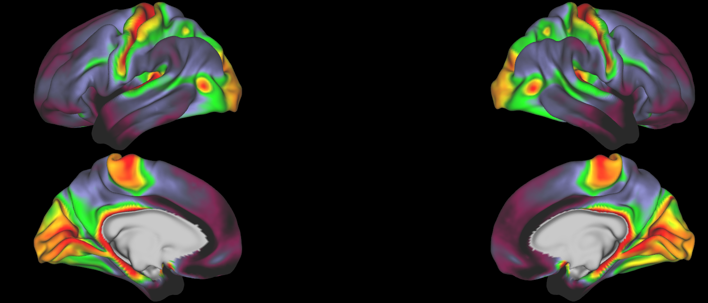
Myelin Map

Slide 10
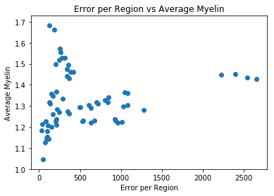

Slide 11
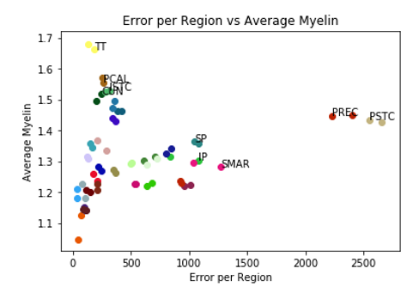
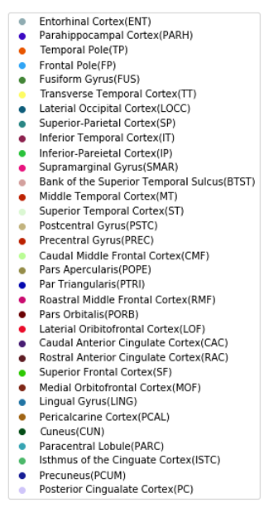

Slide 12
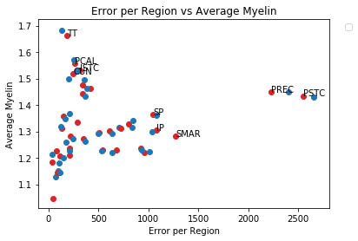
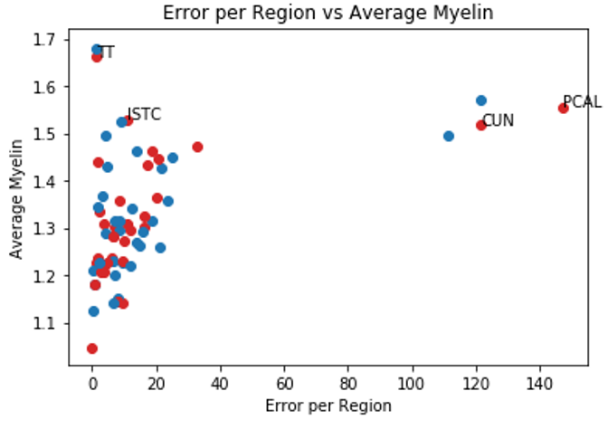

Structural (Surface)
Structural

