Slide 1
Data analysis for a panel of three immunoassays utilizing the gplot2 package (R programming language)
By
Katarzyna Haynesworth

Slide 2
Background
Data graphs for a panel of three immunoassays
NOTE: Data used in this exercise are artificial and did not come from a real-life lab bench experiment
Testing Conditions:
Three assays (Assay-1, Assay-2, & Assay-3)
Tested on three sample matrices
EDTA plasma
Heparin plasma
Serum
Cerebrospinal fluid (CSF)
Compared two assay formats (one-step and two-step)
Evaluation at the level of raw data (ECL = electrochemiluminescence) and transformed data (Concentration in pg/ml)

Slide 3
Data Summary
> head(Assay_Data)
# A tibble: 6 x 5 Assay Measure Assay_Format Sample Measurement
<chr> <chr> <chr> <chr> <dbl>
1 Assay-1 ECL 2-Step EDTA Plasma 931.
2 Assay-1 ECL 2-Step EDTA Plasma 1080.
3 Assay-1 ECL 2-Step EDTA Plasma 845.
4 Assay-1 ECL 2-Step EDTA Plasma 1163.
5 Assay-1 ECL 2-Step EDTA Plasma 2528.
6 Assay-1 ECL 2-Step EDTA Plasma 3162.
> tail(Assay_Data)
# A tibble: 6 x 5 Assay Measure
Assay_Format Sample Measurement
<chr> <chr> <chr> <chr> <dbl>
1 Assay-3 Concentration pg/mL 1-Step CSF 8192. 2 Assay-3 Concentration pg/mL 1-Step CSF 7808. 3 Assay-3 Concentration pg/mL 1-Step CSF 2257. 4 Assay-3 Concentration pg/mL 1-Step CSF 5359. 5 Assay-3 Concentration pg/mL 1-Step CSF 8401. 6 Assay-3 Concentration pg/mL 1-Step CSF 4893.
> str(Assay_Data)
Classes ‘tbl_df’, ‘tbl’ and 'data.frame': 480 obs. of 5 variables:
$ Assay : chr "Assay-1" "Assay-1" "Assay-1" "Assay-1" ...
$ Measure : chr "ECL" "ECL" "ECL" "ECL" ...
$ Assay_Format: chr "2-Step" "2-Step" "2-Step" "2-Step" ...
$ Sample : chr "EDTA Plasma" "EDTA Plasma" "EDTA Plasma" "EDTA Plasma" ...
$ Measurement : num 931 1080 845 1163 2528 ...

Slide 4
Assay-1
# Assay-1
ggplot(subset(Assay_Data, Assay =="Assay-1")) +
geom_boxplot (aes(Assay_Format, Measurement, colour = Sample))+
facet_wrap(Measure~Sample, ncol = 4,scales = "free")+
ggtitle("Assay-1") +
theme(plot.title = element_text(lineheight=.8, face="bold",hjust = 0.5 ))+
labs(x = "Assay Format", y = "")

Slide 5
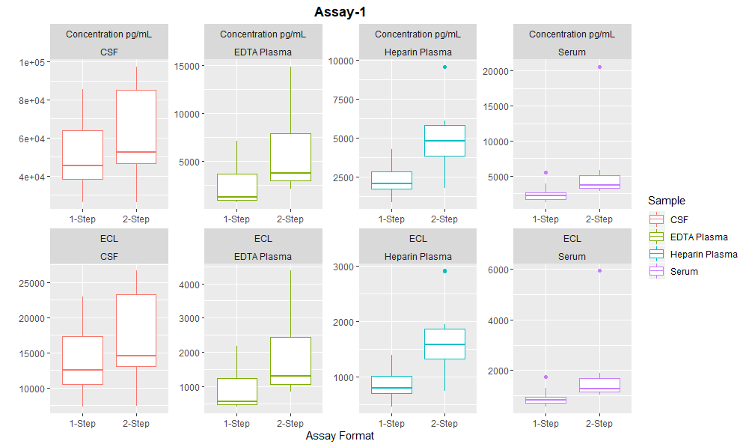

Slide 6
Assay-2
# Assay-2
ggplot(subset(Assay_Data, Assay =="Assay-2")) +
geom_boxplot (aes(Assay_Format, Measurement, colour = Sample))+
facet_wrap(Measure~Sample, ncol = 4,scales = "free")+
ggtitle("Assay-2") +
theme(plot.title = element_text(lineheight=.8, face="bold",hjust = 0.5 ))+
labs(x = "Assay Format", y = "")

Slide 7
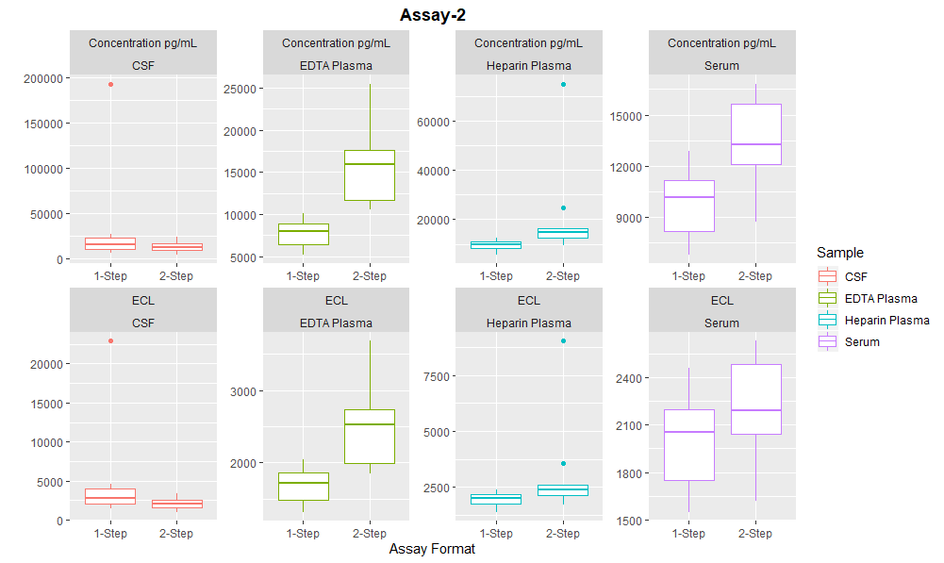

Slide 8
Assay-3
# Assay-3
ggplot(subset(Assay_Data, Assay =="Assay-3")) +
geom_boxplot (aes(Assay_Format, Measurement, colour = Sample))+
facet_wrap(Measure~Sample, ncol = 4,scales = "free")+
ggtitle("Assay-3") +
theme(plot.title = element_text(lineheight=.8, face="bold",hjust = 0.5 ))+
labs(x = "Assay Format", y = "")

Slide 9
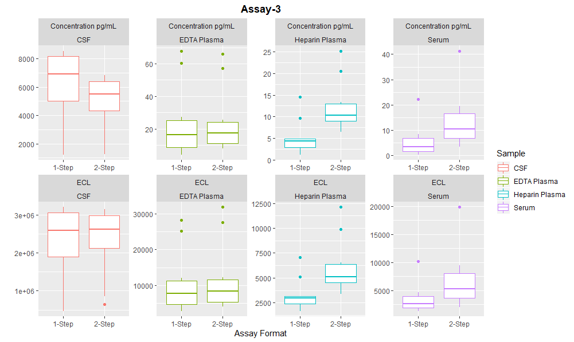

Slide 10
Concentration (pg/ml) Comparison
# All Assays in Terms of Concentration pg/mL
ggplot(subset(Assay_Data, Measure == "Concentration pg/mL")) +
geom_boxplot (aes(Assay_Format, Measurement, colour = Sample))+
facet_wrap(Assay~Sample, ncol = 4,scales = "free")+
ggtitle("Concentration (pg/mL) Comparison for 1-Step vs. 2-Step") +
theme(plot.title = element_text(lineheight=.8, face="bold",hjust = 0.5 ))+
labs(x = "Assay Format", y = "Concentration pg/mL")

Slide 11
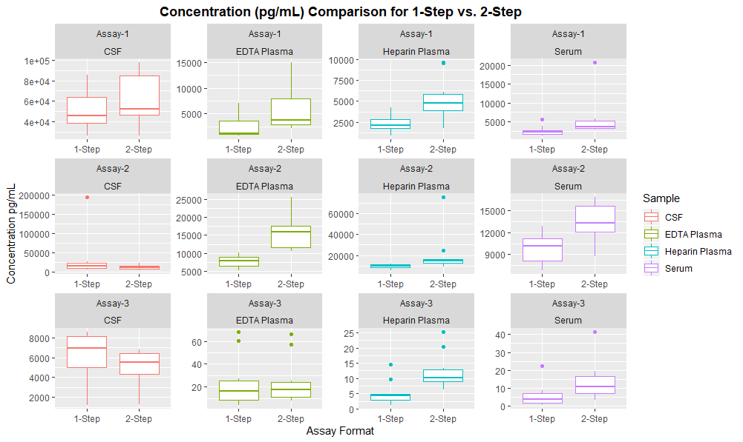

Slide 12
Raw Data (ECL) Comparison
# All Assays in Terms of ECL
ggplot(subset(Assay_Data,Measure == "ECL")) +
geom_boxplot (aes(Assay_Format, Measurement, colour = Sample))+
facet_wrap(Assay~Sample, ncol = 4,scales = "free")+
ggtitle("ECL Comparison for 1-Step vs. 2-Step") +
theme(plot.title = element_text(lineheight=.8, face="bold",hjust = 0.5 ))+
labs(x = "Assay Format", y = "Average ECL")

Slide 13
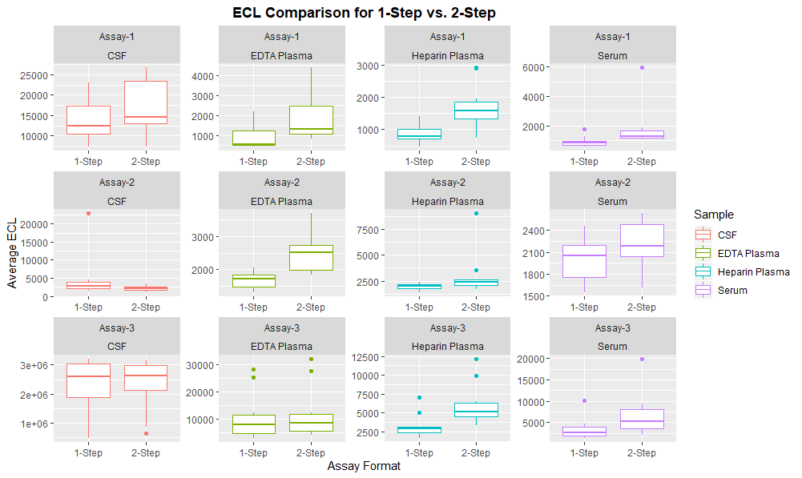

Slide 14
CSF Comparison
# CSF Data Comparison
ggplot(subset(Assay_Data,Sample =="CSF" )) +
geom_boxplot (aes(Assay_Format, Measurement, colour = Assay))+
facet_wrap(Assay~Measure, ncol = 2,scales = "free")+
ggtitle("CSF Data") +
theme(plot.title = element_text(lineheight=.8, face="bold",hjust = 0.5 ))+
labs(x = "Assay Format", y = "")

Slide 15
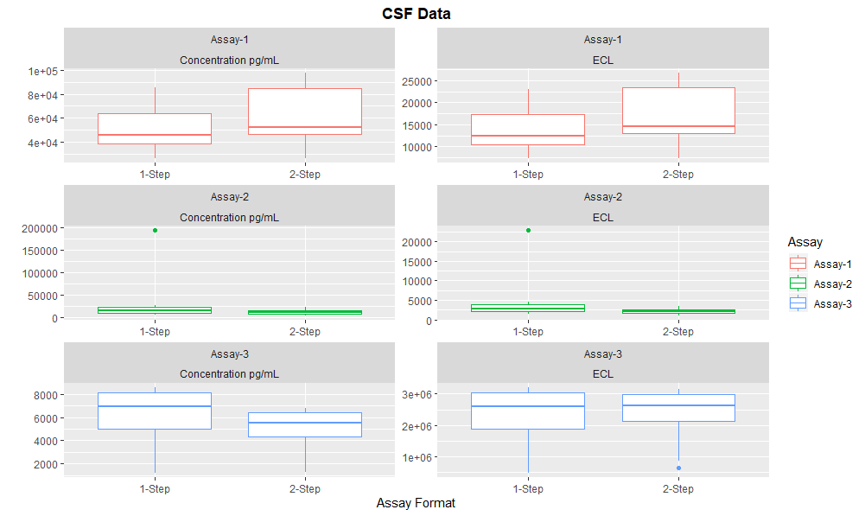

Slide 16
Serum Comparison
# Serum Data Comparison
ggplot(subset(Assay_Data,Sample =="Serum" )) +
geom_boxplot (aes(Assay_Format, Measurement, colour = Assay))+
facet_wrap(Assay~Measure, ncol = 2,scales = "free")+
ggtitle("Serum Data") +
theme(plot.title = element_text(lineheight=.8, face="bold",hjust = 0.5 ))+
labs(x = "Assay Format", y = "")

Slide 17
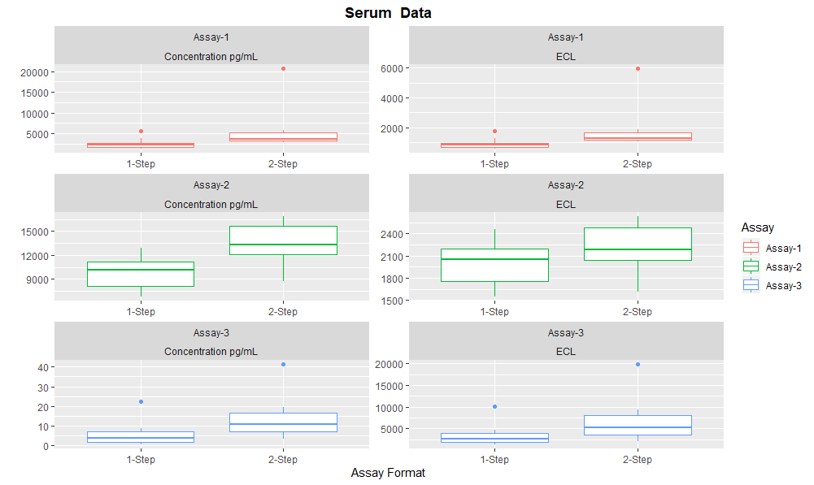

Slide 18
EDTA Plasma Comparison
# EDTA Plasma Data Comparison
ggplot(subset(Assay_Data,Sample =="EDTA Plasma" )) +
geom_boxplot (aes(Assay_Format, Measurement, colour = Assay))+
facet_wrap(Assay~Measure, ncol = 2,scales = "free")+
ggtitle("EDTA Plasma Data") +
theme(plot.title = element_text(lineheight=.8, face="bold",hjust = 0.5 ))+
labs(x = "Assay Format", y = "")

Slide 19
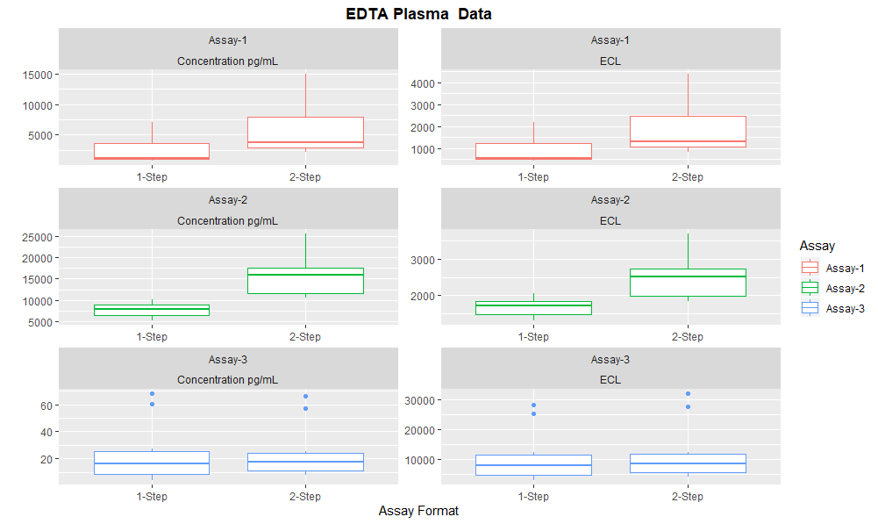

Slide 20
Heparin Plasma Comparison
# Heparin Plasma Data Comparison
ggplot(subset(Assay_Data,Sample =="Heparin Plasma" )) +
geom_boxplot (aes(Assay_Format, Measurement, colour = Assay))+
facet_wrap(Assay~Measure, ncol = 2,scales = "free")+
ggtitle("Heparin Plasma Data") +
theme(plot.title = element_text(lineheight=.8, face="bold",hjust = 0.5 ))+
labs(x = "Assay Format", y = "")

Slide 21
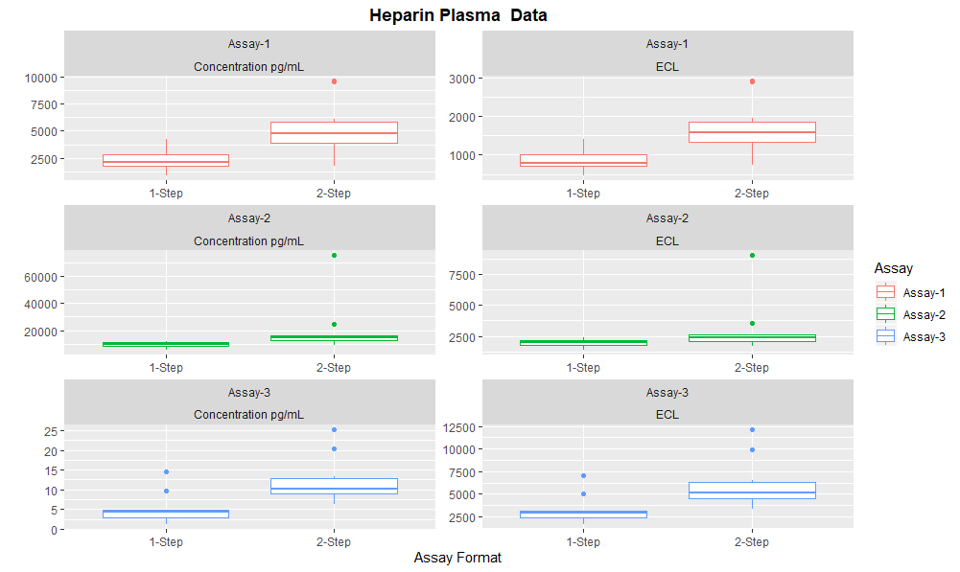

Slide 22
Thank You!

