Slide 1
Neural Lattice Search for Domain Adaptation in Machine Translation
Huda Khayrallah, Gaurav Kumar
Kevin Duh, Matt Post, Philipp Koehn
This talk was presented at JHU CLSP seminar
November 17, 2017
It is based on this paper:
http://aclweb.org/anthology/I17-2004
bib:
http://aclweb.org/anthology/I17-2004.bib
Notes:
This talk includes both an introduction to MT for non experts, as well as a description of the paper

Slide 2
Neural Lattice Search for Domain Adaptation in Machine Translation
Huda Khayrallah, Gaurav Kumar
Kevin Duh, Matt Post, Philipp Koehn

Slide 3
Outline
Machine Translation
Phrase Based MT
Neural MT
MT metrics
Domain Adaptation
Neural Lattice Search for Domain Adaptation in Machine Translation

Slide 4
Machine Translation
(in ~20 min)
Huda Khayrallah
17 November 2017
Notes:
Focus on what you need to know for the 2nd part of the talk

Slide 5
Machine Translation
Source
Target
le chat est doux
the cat is soft
MT

Slide 6
Goals:
Adequacy & Fluency
Notes:
Adequacy: Does the output convey the same meaning as the input sentence? Is part of the message lost, added, or distorted?
Fluency: Is the output representative of the target language? This involves both grammatical correctness and idiomatic word choices.

Slide 7
What kind of data do we have?
Parallel Text
Monolingual Text
Source
Target
Target
le chat est noir the cat is black
le chien est doux the dog is soft
le chat et le chien courent the cat and dog run
Notes:
Main data for MT is parallel text. These are documents translated sentence by sentence, but we don’t know exactly how the words correspond
*most* people don’t naturally generate parallel text
Also, we have a lot more monolingual text. Because that is much cheaper.

Slide 8
What kind of systems do we build?
Phrase-based MT
Neural MT
Notes:
PBMT: ~14 years, trusted in production systems
NMT: recently becoming practical

Slide 9
Phrase-Based MT
Source is segmented in to ‘phrases’
Phrases translated into target language
Phrases are reordered
[Koehn et al. 2003]
Notes:
phrases = groups of words

Slide 10

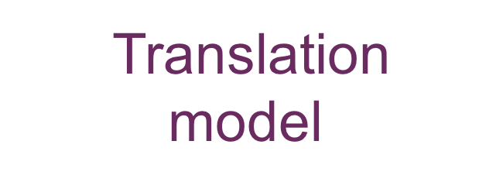
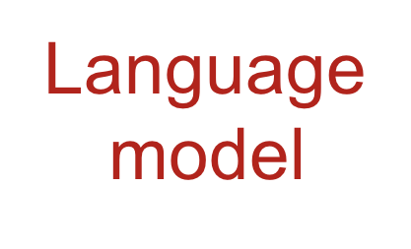
Phrase-Based MT
$$P\left(target | source\right)$$
$$\sim P\left(source | target\right) P(target)$$
Translation
model
Language
model
Source
Target
Target
Notes:
We want to find the highest probability target sentence given the source
We can beak this up using Bayes’ rule
And these divide up nicely:
FLUENCY & ADAQCY

Slide 11
Translation Model
Notes:
This is tasked with adequacy

Slide 12
Word Alignment
the black cat
le chat noir
the dog is soft
le chien est doux
Notes:
Begin with a uniform distribution, update parameters based on counts using EM

Slide 13
Word Alignment
the black cat
le chat noir
the dog is soft
le chien est doux
Notes:
First signal might be determiners…

Slide 14
Word Alignment
the black cat
le chat noir
the dog is soft
le chien est doux
Notes:
Other common words

Slide 15
Word Alignment
the black cat
le chat noir
the dog is soft
le chien est doux

Slide 16
Word Alignment
the black cat
le chat noir
the dog is soft
le chien est doux
Notes:
Last slide with lines…

Slide 17
Word Alignment
the black cat
le chat noir
the dog is soft
le chien est doux

Slide 18
Phrase Extraction
the black cat
le chat noir
the dog is soft
le chien est doux
Notes:
we then use heuristic methods to extract phrases from alignment pairs
These all also have probabilities

Slide 19

Language Model
$$P\left(the cat is soft\right)>P(the cat are soft)$$
$$P\left(the cat is soft\right)>P(the cat soft is)$$
n-gram $(n=5)$
Notes:
FLUENCY: Is the output representative of the target language?
Word choice
word order
n=5 sentence -- length longer
limited context will come in handy later

Slide 20
Decoding
le | chat | est | doux
the | cat | is | soft
a | cat is |  | sweet
 | cats | are
 | cats are
Notes:
Now we can begin the process of translation, which is called decoding Begin with the sentence
Divide it up into phrases, which we translate using the extracted phrase probabilities
noisy – automatic

Slide 21
Decoding
le | chat | est | doux
the | cat | is | soft
a | cat is |  | sweet
 | cats | are
 | cats are
soft
cat
is
the
cat is
soft
soft
cat
is
Notes:
Now we begin the search process
As we do this, we will be scoring each hypothesis with both the phrase translation probabilities, as well as the LM probabilities
Begin with our first node, which branches out to several more possibilities. high branching factor.
*Note that we do not have to translate the words in order. *
boxes at the top, to keep track of which words we have translated. CALLED COVERAGE VECTORS This allows us to make sure we translate each word. and only ONCE
But we can recombine! if they have identical histories. And b/c ngram history
We combine states that have the same histories

Slide 22
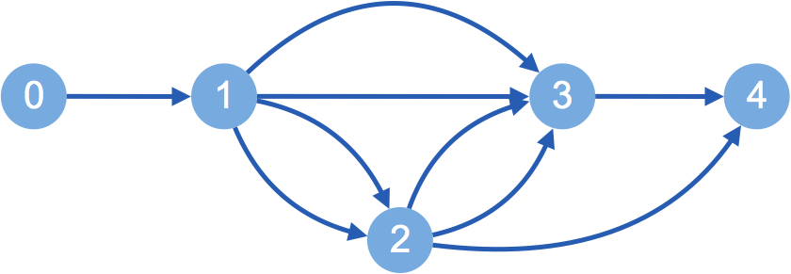
cat is
the
cats are
soft
cats
is
cat
are
soft
Notes:
In this example lattice at the bottom, we use unigram this is called a lattice any questions about PBMT? “in this toy ex. Unigram lm two paths recombine if they have the same coverage vector. **highlight the recombination/ where it happens, in the graphs– note that the two sentences are identical

Slide 23
Neural MT
Each word is represented as a vector
Recurrent neural net encoder and decoder
Notes:
building up one popular architecture

Slide 24
Neural MT
[Sutskever et al. 2015]
le
chat
est
doux
Notes:
Words
Map them to embeddings
Generate a hidden state,
Then each hidden state is generated based on the embedding also previous hidden state
Once we get to the end, the entire sentence is encoded in this hidden state.
This architecture is called an encoder, b/c it encodes the content of the sentence

Slide 25
Neural MT
the
cat
is
soft
[Sutskever et al. 2015]
le
chat
est
doux
Notes:
Produce a hidden state, then a single word embedding based on that, then vocab look up
Each hidden state then depends on the previous hidden state, the previous output word, and the final hidden state of the encoder
decoding at test time, training works in a similar way, but you backpropagate the loss

Slide 26
Neural MT
(bidirectional)
[Schuster & Paliwal 1997]
le
chat
est
doux
Notes:
Why only include information from the previous words?
Make it bidrectional
But, now what embedding do we use as the context? Last one? Fist one? Why not use them all?

Slide 27
Neural MT
(with attention)
the
cat
is
soft
[Bahdanau et al. 2015]
le
chat
est
doux
Notes:
instead of using a single state, lets take a weighted average
Decoder words in a similar way, but now we are conditioning on this weighted average of the hidden states
exact weights are something the model will learn, but we hole it will pay 'attention' to relevant information
this is called NMT with attention
and is the closes NMT has to alignment, but nothing is forcing it to explicitly translate all words

Slide 28
Differences
Explicit translation for each phrase
PBMT
5-gram history
Soft ‘alignment’
NMT
Full sentence history
Fluency?
Adequacy?
Notes:
5-gram LM history Examples where NMT over generates, under generates, makes things up Not forced to pay “attention” to every word can just drop words
even in very low resource settings, the output looks like very nice English (but might be completely off topic)
Different strengths and weaknesses, what if we want to combine them?
before i move on, is anyone confused about how these work?

Slide 29
n-best rescoring
Translations
Source
PBMT
Notes:
Start with source sentence
Use PBMT to generate n translations (for this talk n=500)
highest probability sentence, next highest, etc

Slide 30
n-best rescoring
Scores
Translations
NMT
Source
Notes:
Then we take the source and translations, and use the NMT system to get a score,
This represents how good of a translation the NMT thinks the sentence is
This is straightforward once you have a NMT system
Then pick the sentence with the highest NMT score
This is one way to combine MT systems. We will discuss another in the 2nd part of this talk

Slide 31
MT Metrics
Metric should be:
Meaningful
Correct
Consistent
Low Cost
Useable for tuning
Notes:
Meaningful: score should give intuitive interpretation of translation quality (correlated with humans?)
Correct: metric must rank better systems higher
Consistent: repeated use of metric should give same results
Low cost: reduce time and money spent on carrying out evaluation,
Tunable: automatically optimize system performance towards metric

Slide 32
Why not WER?
WER ≈ Edit Distance
Does not account for reordering
Exact match is not a great goal
Should the Ice Bucket Challenge be forbidden?
This "ice bucket" could be banned then?
Now are they going to ban the ice bucket?
Notes:
my main answer to that is that translation is not linear if someone were transcribing my speech right now, you could do so word by word.
if 2 of you were to transcribe my speech right now, I would hope to get very similar results
Exact match is not a great goal:
All ‘correct’

Slide 33

BLEU
Weighted n-grams precision
Between 0 and 1
(often scaled to be 0-100)
Higher is better
Imperfect…
But… not bad
$$min\left(1,\frac{output length}{reference length}\right){\left(\prod_{i=1}^{4}{{precision}_{i}}\right)}^{\frac{1}{4}}$$
Notes:
Problems with bleu:
Ignore relevance of words: punctuation counts the same as core content
Operate on local level (do not consider overall grammaticality of the sentence or sentence meaning)
absolute value of Scores are meaningless (scores very test-set specific) pros:
Correlated with human judgement
Easy to run
easy to tune
Widely used

Slide 34

How much text do we need?
[Koehn & Knowles 2017]
BLEU
Corpus size (English words)
Notes:
English-Spanish --
X axis is…
Y axis is..
3 lines are …
10million
100 million

Slide 35


Where does parallel text come from?
Notes:
not a lot of parallel text is produced
Biggest sources are EU parliament, UN

Slide 36
Would it not be beneficial, in the short term, following the Rotterdam model, to inspect according to a points system in which, for example, account is taken of the ship's age, whether it is single or double-hulled or whether it sails under a flag of convenience.
Notes:
Sentence from:
http://www.statmt.org/europarl/
/home/pkoehn/statmt/data/wmt15/training/europarl-v7.de-en.en

Slide 37



What do we want to translate?

Slide 38

Notes:
Tweet from: https://twitter.com/ritzwillis/status/901687498732175360

Slide 39
Developmental toxicity, including dose-dependent delayed foetal ossification and possible teratogenic effects, were observed in rats at doses resulting in subtherapeutic exposures (based on AUC) and in rabbits at doses resulting in exposures 3 and 11 times the mean steady-state AUC at the maximum recommended clinical dose.
Notes:
Sentence from:
http://opus.nlpl.eu/EMEA.php
/exp/hkhayrallah/whale17/domain_adapt/data/raw/emea-test.en

Slide 40
Annual growth in prices came in at 10.9 per cent, more than double the gain of the 12 months to August 2013, but the gains were not evenly spread across
the country
Notes:
Sentence from:
Newstest 2015 de-en reference
http://www.statmt.org/wmt15/translation-task.html
/home/pkoehn/statmt/data/wmt16/dev/newstest2015-deen-ref.en.sgm

Slide 41
Domain adaptation:
When train and test differ

Slide 42
Domain adaptation (in practice):
Large amount of out-of-domain data
Small amount of in-domain data

Slide 43
Neural Lattice Search for Domain Adaptation in Machine Translation
Huda Khayrallah, Gaurav Kumar
Kevin Duh, Matt Post, Philipp Koehn
Notes:
I will pause here for any clarifying questions before moving on.
This is joint work with Gaurav, Kevin, Matt and Philipp. this work will be presented at IJCNLP next week. Gaurav gave talk on preliminary results last spring

Slide 44
combine
adequacy of PBMT
with
fluency of NMT
Notes:
With the goal of to improving performance in DA

Slide 45
use PBMT
to constrain the search space
of NMT
Notes:
This is going to prevent NMT from going rouge, and producing content unrelated to the source, while still allowing the NMT system to select between hypotheses

Slide 46
Source
die brötchen sind warm
bread is
PBMT
the
buns are
warm
buns
is
warm
bread
are

Slide 47
Source
Target
die brötchen sind warm
Neural
Lattice Search
the buns are warm
bread is
the
buns are
warm
buns
is
warm
bread
are
Notes:
use NMT to search through the lattice and score different paths.

Slide 48
die brötchen sind warm
bread is
the
buns are
warm
buns
is
warm
bread
are
Notes:
We want to score the paths in this lattice, to search for the best one
We are going to use the NMT system to to score the partial hypothesis

Slide 49

die brötchen sind warm
bread is
bread is
warm
the
warm
the
buns are
buns are
buns
buns
is
is
warm
are
warm
bread
are
bread
0
1
2
3
end
Notes:
Start with the first node

Slide 50
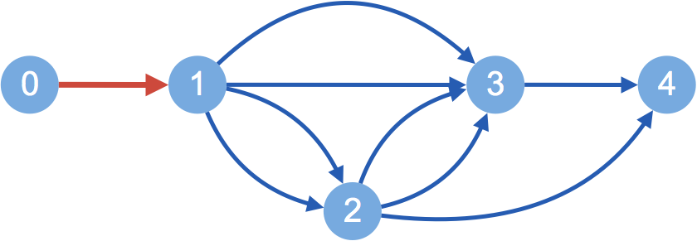

die brötchen sind warm
bread is
the
buns are
warm
buns
is
warm
bread
are
the
0
1
2
3
end
Notes:
Then expand along the path in red
Keeping track of the NMT score, along with the output so far, and the hidden state. This will allow us to continue evaluating the hypothesis when we pop it off the stack
We have expanded all paths out of the 0th node, so we will consider the item in stack 1

Slide 51
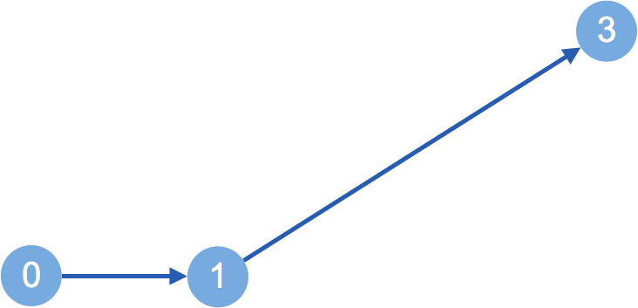
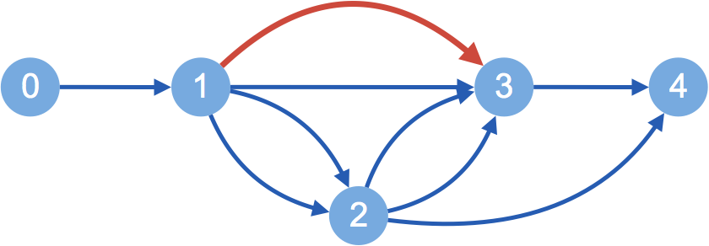
die brötchen sind warm
bread is
the
buns are
warm
bread is
buns
is
warm
bread
are
the
0
1
2
3
end
Notes:
Since this path has two words, our hypothesis is now 3 words long, and we will move it to stack 3, so we can continue keeping track of the lengths of each hypothesis

Slide 52
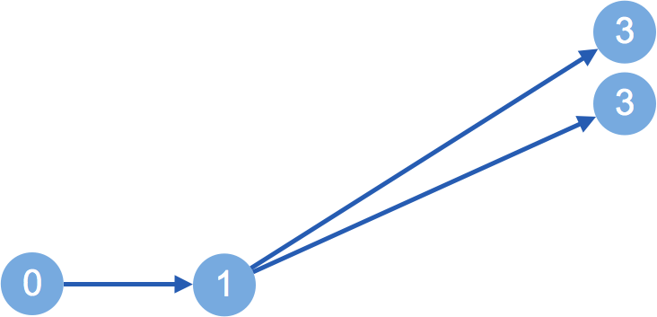
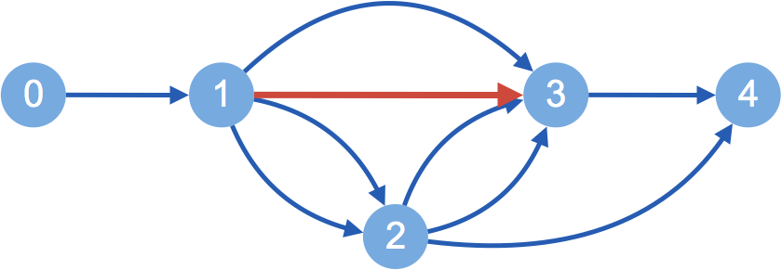
die brötchen sind warm
bread is
the
buns are
warm
bread is
buns
is
warm
buns are
bread
are
the
0
1
2
3
end

Slide 53
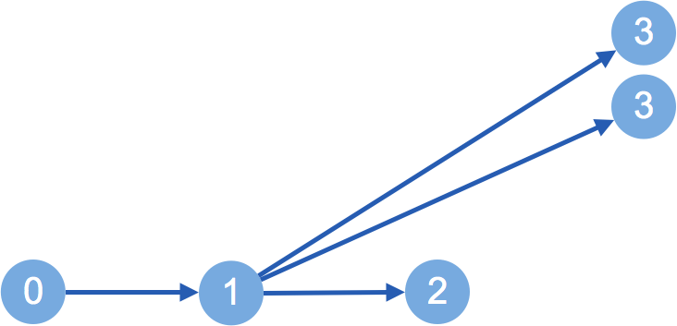
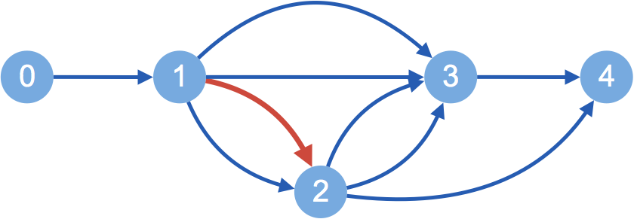
die brötchen sind warm
bread is
the
buns are
warm
bread is
buns
is
warm
buns are
bread
are
the
buns
0
1
2
3
end

Slide 54
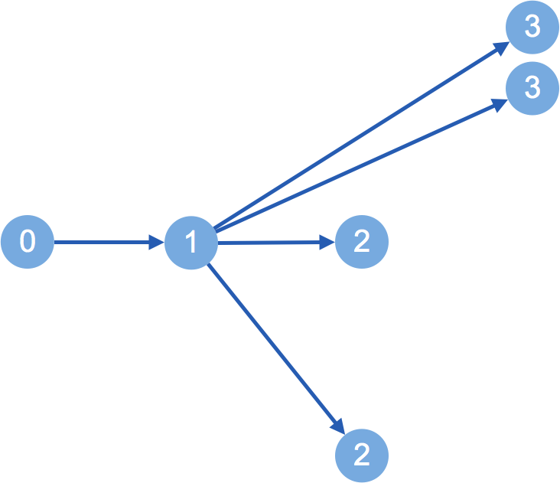
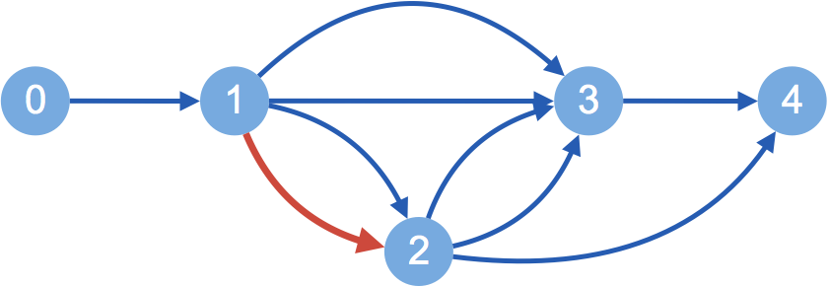
die brötchen sind warm
bread is
the
buns are
warm
bread is
buns
is
warm
buns are
bread
are
the
buns
bread
0
1
2
3
end

Slide 55
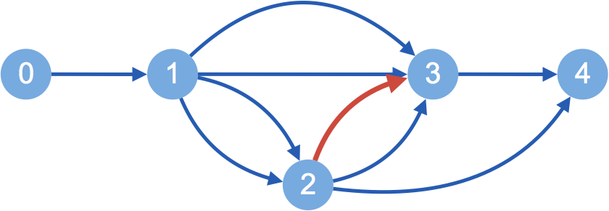
die brötchen sind warm
bread is
bread is
warm
the
warm
the
buns are
buns are
bread is
buns
buns
is
is
warm
buns are
are
warm
bread
are
bread
the
buns
bread
0
1
2
3
end
Notes:
Expand this, but in the lattice this represents 2 recombined paths!
But we cant do that, b/c NMT needs the whole sentence history

Slide 56
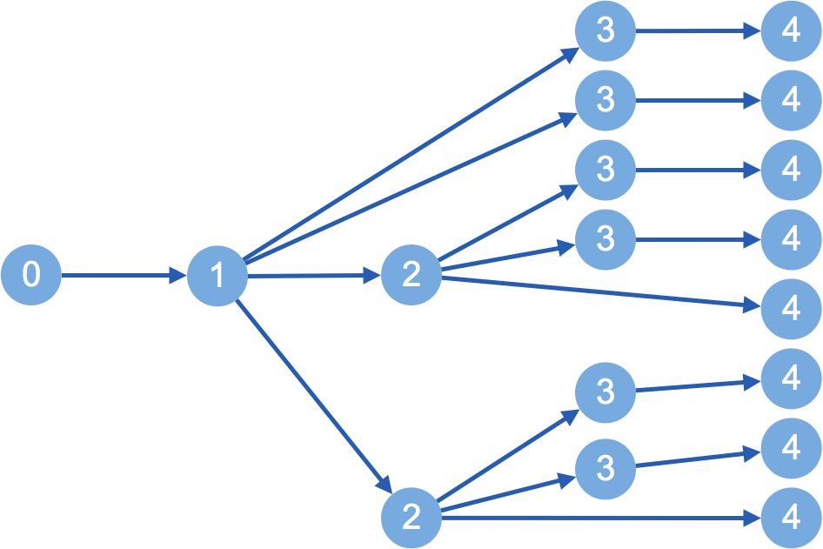
die brötchen sind warm
warm
bread is
the
buns are
warm
bread is
warm
buns
is
warm
buns are
bread
are
warm
is
warm
the
are
buns
warm
warm
bread
is
warm
are
warm
0
1
2
3
end
Notes:
So…. We have to expand all the paths But… since we organized them into stacks based on the number of target words produced
compare translations of the same length
We cap the size of each stack
and limit the number of hypotheses we expand
In practice we use a pretty small beam ~10 worked well

Slide 57
Experiments

Slide 58
Setting: Domain adaptation
IT, Medical, Koran, Subtitles
PBMT outperforms NMT
parliamentary proceedings (WMT)
NMT outperforms PBMT
Small in-domain
Large out-of-domain
Notes:
GERMAN - ENLGISH
when trained and tested on the same domain, pbmt tends to outperform NMT
We focus on domain adaption since this is a situation in which NMT has struggled, the vocabulary mismatch often causes strange sentences to be generated
these fall under the adequacy category, and might be somewhere where limiting the hypothesis space to more adequate candidates might help

Slide 59
How much text do we have?
Medical
IT
Subtitles
&
WMT
Koran
[Koehn & Knowles 2017]
BLEU
Corpus size (English words)
Notes:
English-Spanish
performance differs across languages, domains
numbers don’t compare directly, especially b/c we have the additional challenge of domain adaptation

Slide 60
Setting: Domain adaptation
NMT
 | in-domain | out-of-domain
in-domain
out-of-domain
PBMT
Notes:
we have two systems and two data types for each, so this leaves us with 4 possible experiment setups

Slide 61
IT Results
+5.0
BLEU

Slide 62
Results
+5.0
+0.2
+1.6
+0.4
BLEU
Notes:
n-best rescoring does not always beat SMT
lattice does!

Slide 63
Conclusion
Lattice search > n-best rescoring
Use in-domain PBMT to constrain search space
NMT can be in- or out-of-domain
Code:
github.com/khayrallah/nematus-lattice-search

Slide 64
Thanks!
This material is based upon work supported in part by the Defense Advanced Research Projects Agency (DARPA) under Contract No. HR0011-15-C-0113.
Any opinions, findings and conclusions or recommendations expressed in this material are those of the authors and do not necessarily reflect the views of the Defense Advanced Research Projects Agency (DARPA).

Slide 65
Neural Lattice Search for Domain Adaptation in Machine Translation
Huda Khayrallah, Gaurav Kumar
Kevin Duh, Matt Post, Philipp Koehn
{huda, gkumar, kevinduh, post, phi}@cs.jhu.edu
code:
github.com/khayrallah/nematus-lattice-search

Slide 69

BLEU
$$min\left(1,\frac{output length}{reference length}\right){\left(\prod_{i=1}^{4}{{precision}_{i}}\right)}^{\frac{1}{4}}$$

Slide 70
Corpus Sizes
Corpus | Words | Sentences | W/S
Medical | 14,301,472 | 1,104,752 | 13
IT | 3,041,677 | 337,817 | 9
Koran | 9,848,539 | 480,421 | 21
Subtitles | 114,371,754 | 13,873,398 | 8
EuroParl | 113,165,079 | 4,562,102 | 25

Slide 71
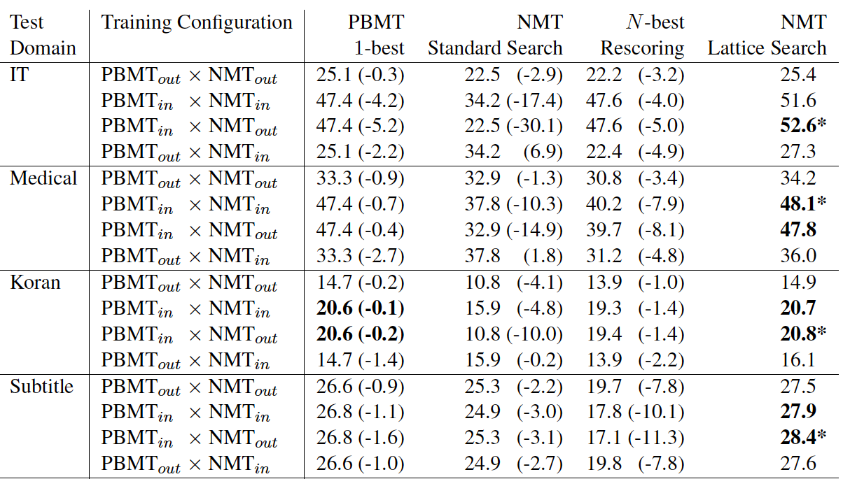

Slide 72
Source | Versionsinformationen ausgeben und beenden
Reference | output version information and exit
PBMT | Spend version information and end
NMT | Spend and end versionary information
lattice | Print version information and exit
Notes:
German - English
IT DA set
Data condition: out x out

Slide 73
IT Baselines
BLEU
Notes:
two phrase based and two neural MT systems
both trained on in and out of domain data evaluated on the same IT data set
EVEN THOUGH the out of domain PBMT is much stronger
NMT outperformed PBMT on WMT

Slide 74
Results
+4.2
+0.7
+1.1
+0.1
BLEU
Notes:
NMT is in domain

Slide 75
Stack Based Decoding
Stacks based on number of target words translated
Keep track of:
Score
Current lattice node
Current neural state
incoming arc
length
Notes:
so, we are comparing scores of partial translations that all have the same length
with this information, when we pop an item off the stack, we have all we need to score the hypothesis

Slide 76
die brötchen sind warm the buns are warm
bread is
the
buns are
warm
buns
is
are
warm
bread
Notes:
Walk though lattice, reading out paths, keep best ones
search over this lattice using a NMT system challenges:
this lattice represents recombination of SMT states, due to 5-gram. but NMT uses the full history. Therefore, for NMT this expands exponentially into a tree.
prune the lattices
throw away the PBMT scores

Slide 77

Phrase-Based MT
$$P\left(target | source\right)$$
$$=P\left(source | target\right) P(target)$$

