Slide 1
Neural Lattice Search for Domain Adaptation in Machine Translation
Huda Khayrallah, Gaurav Kumar
Kevin Duh, Matt Post, Philipp Koehn
This talk was presented at IJCNLP 2017
It is based on this paper:
http://aclweb.org/anthology/I17-2004
bib:
http://aclweb.org/anthology/I17-2004.bib

Slide 2
Neural Lattice Search for Domain Adaptation in Machine Translation
Huda Khayrallah, Gaurav Kumar
Kevin Duh, Matt Post, Philipp Koehn

Slide 3
combine
adequacy of PBMT
with
fluency of NMT
Notes:
With the goal of to improving performance in DA

Slide 4
use PBMT
to constrain the search space
of NMT
Notes:
This is going to prevent NMT from going rouge, and producing content unrelated to the source, while still allowing the NMT system to select between hypotheses
One option would be to rescore an N-best list produced by PBMT with NMT. The method I am presenting today is a better preforming alternative

Slide 5
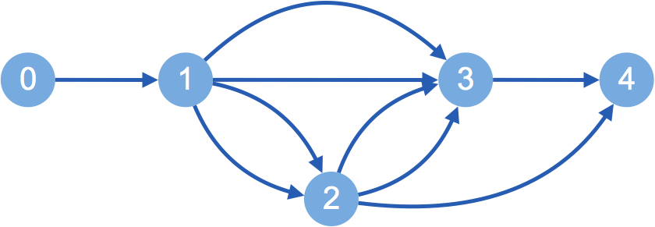
Source
Lattice
die brötchen sind warm
bread is
PBMT
the
buns are
warm
buns
is
warm
bread
are

Slide 6
Source
Target
die brötchen sind warm
Neural
Lattice Search
the buns are warm
Lattice
bread is
the
buns are
warm
buns
is
warm
bread
are
Notes:
use NMT to search through the lattice and score different paths.
and choose the highest scoring path

Slide 7
die brötchen sind warm the buns are warm
bread is
the
buns are
warm
buns
is
are
warm
bread
Notes:
because PBMT uses n-gram LM we can recombine states (in this toy example I am assuming a unigram LM)

Slide 8
die brötchen sind warm
bread is
the
buns are
warm
buns
is
warm
bread
are
Notes:
We want to score the paths in this lattice, to search for the best one
We are going to use the NMT system to to score the paths based on the partial hypothesis as well as the source sentence

Slide 9

die brötchen sind warm
bread is
the
buns are
warm
buns
is
warm
bread
are
0
1
2
3
4
Notes:
Start with the first node.
As we go, we will place items in stacks according to the number of target words produced. Since in NMT we cannot explicitly trace how many source words have been translated as we can in PBMT, we will have to do any pruning based on target words produced

Slide 10
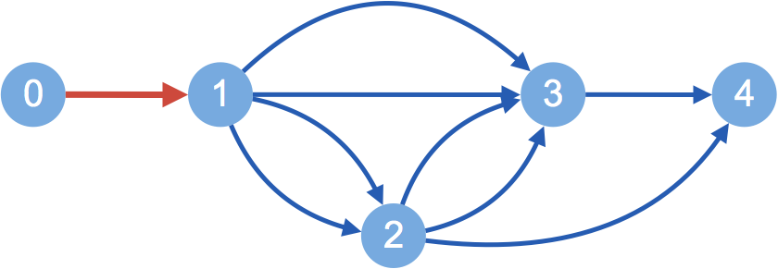

die brötchen sind warm
bread is
the
buns are
warm
buns
is
warm
bread
are
the
0
1
2
3
4
Notes:
Then expand along the path in red
Keeping track of the NMT score, along with the output so far, and the hidden state. This will allow us to continue evaluating the hypothesis when we pop it off the stack
We have expanded all paths out of the 0th node, so we will consider the item in stack 1

Slide 11
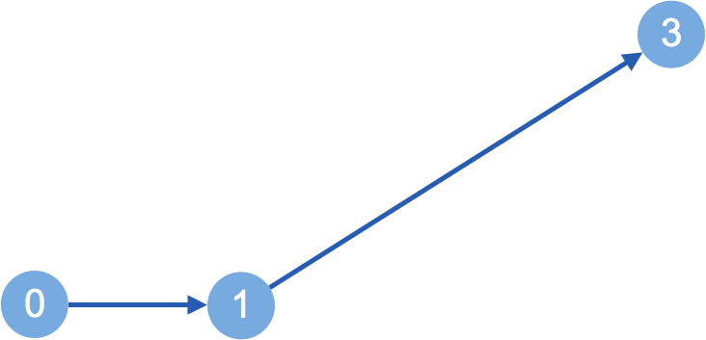
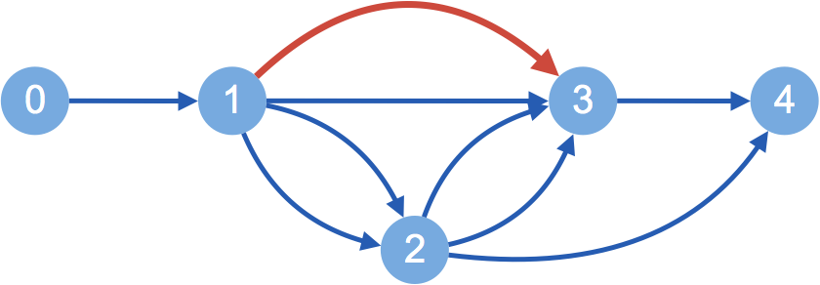
die brötchen sind warm
bread is
the
buns are
warm
bread is
buns
is
warm
bread
are
the
0
1
2
3
4
Notes:
Since this path has two words, our hypothesis is now 3 words long, and we will move it to stack 3, so we can continue keeping track of the lengths of each hypothesis

Slide 12
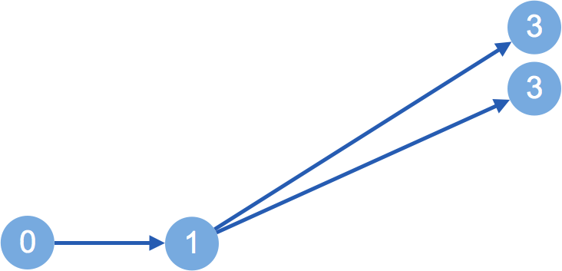
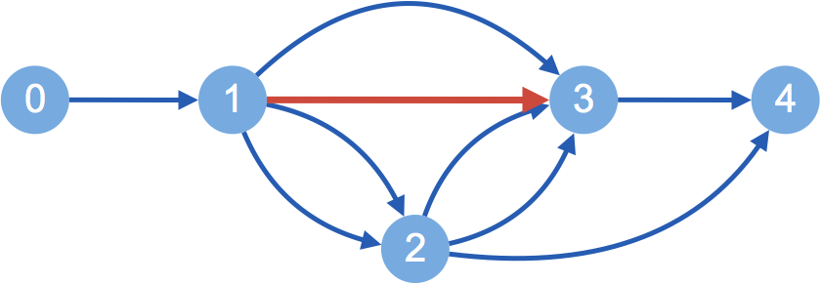
die brötchen sind warm
bread is
the
buns are
warm
bread is
buns
is
warm
buns are
bread
are
the
0
1
2
3
4

Slide 13
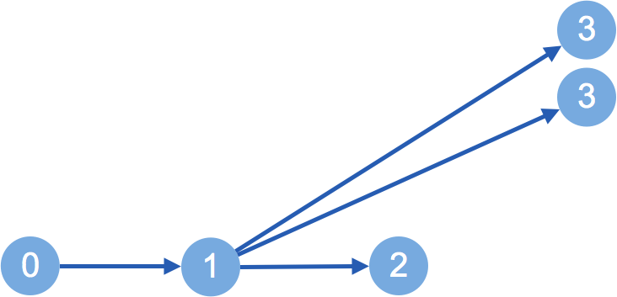
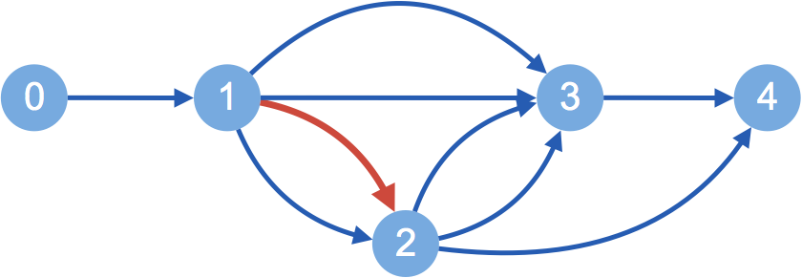
die brötchen sind warm
bread is
the
buns are
warm
bread is
buns
is
warm
buns are
bread
are
the
buns
0
1
2
3
4

Slide 14
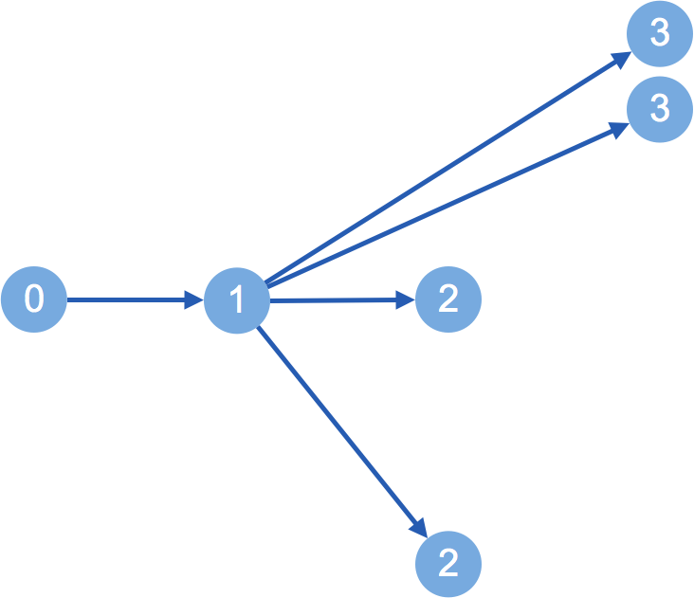
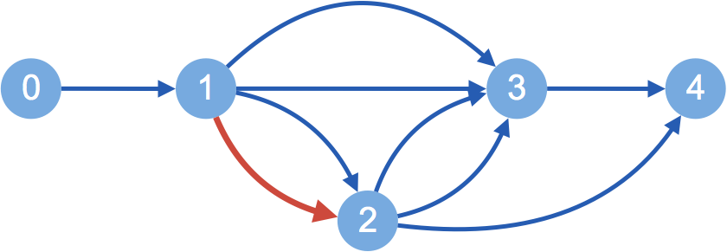
die brötchen sind warm
bread is
the
buns are
warm
bread is
buns
is
warm
buns are
bread
are
the
buns
bread
0
1
2
3
4

Slide 15
die brötchen sind warm
bread is
the
buns are
warm
bread is
buns
is
warm
buns are
bread
are
the
buns
bread
0
1
2
3
4
Notes:
Expand this, but in the lattice this represents 2 recombined paths!
But we cant do that, b/c NMT needs the whole sentence history. this is going to increase our search space

Slide 16
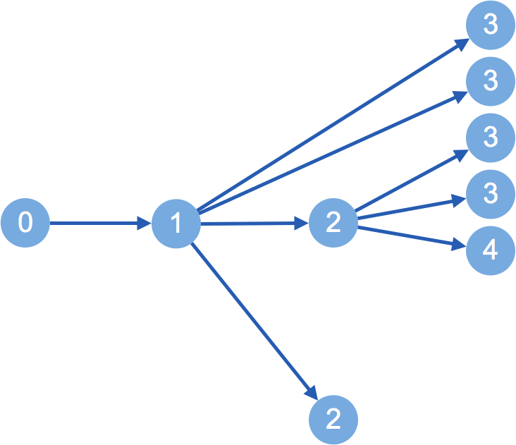
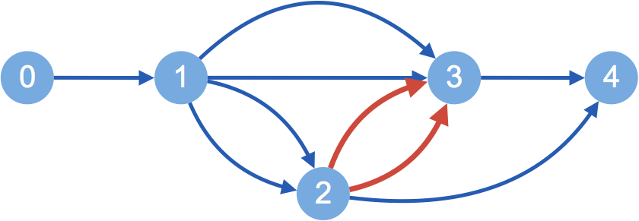
die brötchen sind warm
bread is
the
buns are
warm
bread is
buns
is
warm
buns are
bread
are
is
the
are
buns
warm
bread
0
1
2
3
4
Notes:
So…. We have to expand the paths separately

Slide 17
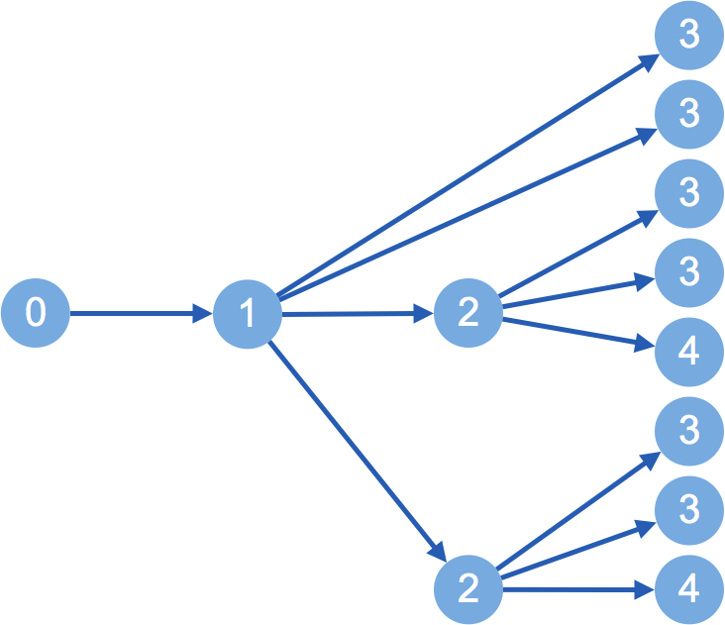
die brötchen sind warm
bread is
the
buns are
warm
bread is
buns
is
warm
buns are
bread
are
is
the
are
buns
warm
bread
is
are
warm
0
1
2
3
4

Slide 18
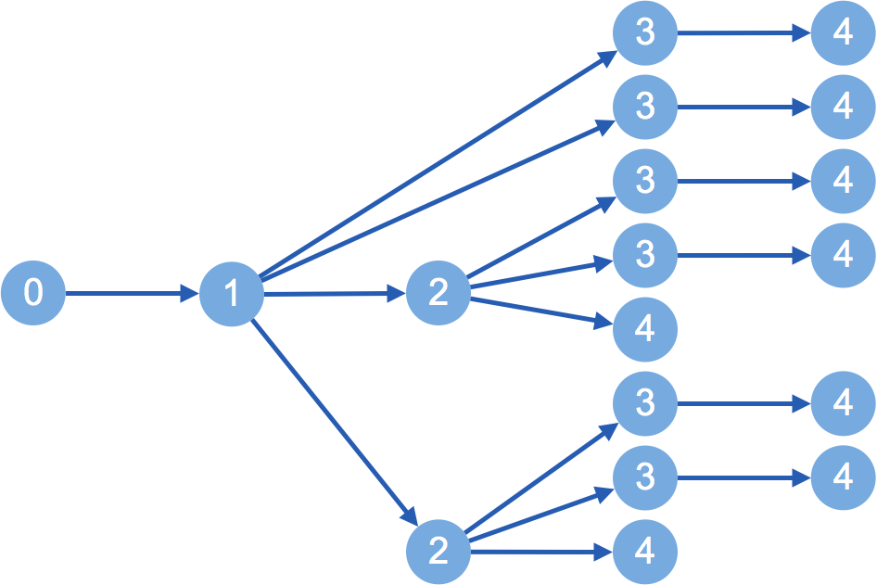
die brötchen sind warm
warm
bread is
the
buns are
warm
bread is
warm
buns
is
warm
buns are
bread
are
warm
is
warm
the
are
buns
warm
warm
bread
is
warm
are
warm
0
1
2
3
4
Notes:
So…. We have to expand all the paths But… since we organized them into stacks based on the number of target words produced
compare hypotheses of the same length
We cap the size of each stack
and limit the number of hypotheses we expand
In practice we use a pretty small beam ~10 worked well

Slide 19
Experiments

Slide 20
Setting: Domain adaptation
IT, Medical, Koran, Subtitles
PBMT outperforms NMT
parliamentary proceedings (WMT)
NMT outperforms PBMT
Small in-domain
Large out-of-domain
Notes:
GERMAN - ENLGISH
when trained and tested on the same domain, pbmt tends to outperform NMT
We focus on domain adaptation since this is a situation in which NMT has struggled, the vocabulary mismatch often causes strange sentences to be generated
these fall under the adequacy category, and might be somewhere where limiting the hypothesis space to more adequate candidates might help

Slide 21
Setting: Domain adaptation
NMT
 | in-domain | out-of-domain
in-domain
out-of-domain
PBMT

Slide 22
IT Results
+5.0
BLEU
Notes:
nbest -- use PBMT to generate a 500 best list, find the best one using the NMT
+5 over nbest

Slide 23
Results
+5.0
+0.2
+1.6
BLEU
+0.4
Notes:
n-best rescoring does not always beat SMT
lattice does!

Slide 24
Conclusion
Lattice search > n-best rescoring
Use in-domain PBMT to constrain search space
NMT can be in- or out-of-domain
Code:
github.com/khayrallah/nematus-lattice-search

Slide 25
Thanks!
This material is based upon work supported in part by the Defense Advanced Research Projects Agency (DARPA) under Contract No. HR0011-15-C-0113.
Any opinions, findings and conclusions or recommendations expressed in this material are those of the authors and do not necessarily reflect the views of the Defense Advanced Research Projects Agency (DARPA).

Slide 26
Neural Lattice Search for Domain Adaptation in Machine Translation
Huda Khayrallah, Gaurav Kumar
Kevin Duh, Matt Post, Philipp Koehn
{huda, gkumar, kevinduh, post, phi}@cs.jhu.edu
code:
github.com/khayrallah/nematus-lattice-search
Notes:
This talk was presented at IJCNLP 2017
It is based on this paper:

Slide 30
Corpus Sizes
Corpus | Words | Sentences | W/S
Medical | 14,301,472 | 1,104,752 | 13
IT | 3,041,677 | 337,817 | 9
Koran | 9,848,539 | 480,421 | 21
Subtitles | 114,371,754 | 13,873,398 | 8
EuroParl | 113,165,079 | 4,562,102 | 25

Slide 31
How much text do we have?
Medical
IT
Subtitles
&
WMT
BLEU
Koran
[Koehn & Knowles 2017]
Corpus size (English words)
Notes:
English-Spanish
Performance differs across languages, domains
Numbers don't compare directly, especially because we have the additional challenge of domain adaptation

Slide 32
Corpus Sizes

Slide 33
IT Baselines
BLEU
Notes:
two phrase based and two neural MT systems
both trained on in and out of domain data evaluated on the same IT data set
EVEN THOUGH the out of domain PBMT is much stronger
NMT outperformed PBMT on WMT

Slide 34
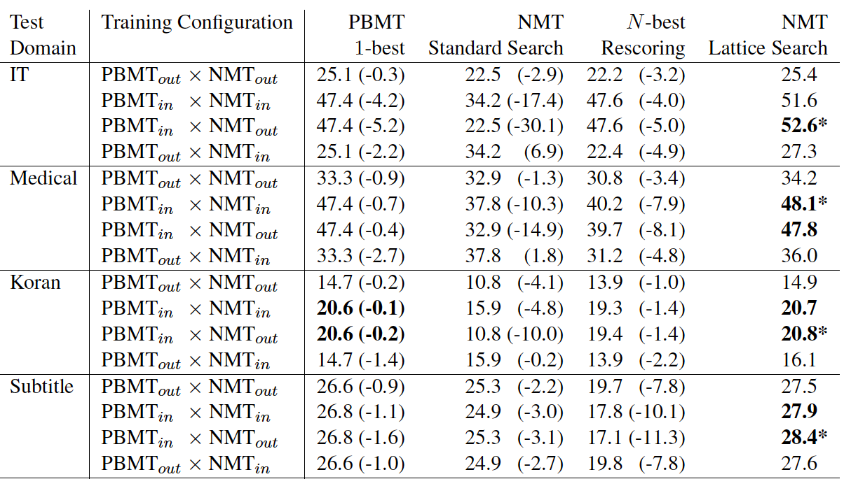

Slide 35
Source | Versionsinformationen ausgeben und beenden
Reference | output version information and exit
PBMT | Spend version information and end
NMT | Spend and end versionary information
lattice | Print version information and exit
Notes:
German - English
IT DA set
Data condition: out x out
Maybe cut this?

Slide 36

Results
+4.2
+0.7
+1.1
+0.1
BLEU
Notes:
NMT is in domain

Slide 37
Stack Based Decoding
Stacks based on number of target words translated
Keep track of:
Score
Current lattice node
Current neural state
incoming arc
length
Notes:
so, we are comparing scores of partial translations that all have the same length
with this information, when we pop an item off the stack, we have all we need to score the hypothesis

