Slide 1
Continued Training Algorithms
This talk was presented at the final presentation for 2018 JHU SCALE workshop
on Domain adaptation in Machine Translation
These slides were presented by Huda Khayrallah;
the full presentation can be found here:
cs.jhu.edu/~kevinduh/t/scale2018/slides/

Slide 2
Continued Training Algorithms
Huda Khayrallah
SCALE Readout
August 9, 2018
Notes:
Presenting on behalf of the team

Slide 3
Wasch
dir
die
Hände

Slide 4
Embedding
Source
Wasch
dir
die
Hände

Slide 5
Encoder
Embedding
Source
Wasch
dir
die
Hände

Slide 6
Decoder
Encoder
Embedding
Source
Wasch
dir
die
Hände

Slide 7
Wash
Softmax
Decoder
Encoder
Embedding
Source
Wasch
dir
die
Hände

Slide 8
Wash
Embedding
Target
Softmax
Decoder
Encoder
Embedding
Source
Wasch
dir
die
Hände

Slide 9
Wash
Embedding
Target
Softmax
Decoder
Encoder
Embedding
Source
Wasch
dir
die
Hände

Slide 10
Wash
your
hands
Embedding
Target
Softmax
Decoder
[Bahdanau et al. 2015]
Encoder
Embedding
Source
Wasch
dir
die
Hände
Notes:
Many toolkits to do this, we use the open source project Sockeye NMT,
with in house modifications that are being pushed back

Slide 11
MT Training
Notes:
RU-- EN patents

Slide 12
General Domain NMT
General Domain
NMT Model
50m General Domain
sentence pairs
Notes:
subtitles, UN, etc

Slide 13
General Domain NMT
Errors due to domain mismatch
General Domain
NMT Model
дверной замок повышенной степени защищенности от взлома Human: door lock with increased degree of security against burglary
System: door security door security door

Slide 14
In-Domain NMT
In-Domain
NMT Model
30k In-Domain
sentence pairs
Notes:
1000x smaller

Slide 15
In-Domain NMT
Errors due to lack of data
In-Domain
NMT Model
дверной замок повышенной степени защищенности от взлома Human: door lock with increased degree of security against burglary
System: door lock for a high degree of protection against coke

Slide 16
Domain Adaptation
Notes:
data we want to translate differs from the vast majority of training data

Slide 17
Continued Training
Random Initialized NMT Model
General Domain
NMT
Model
Continued Training
NMT
Model
30k In-domain
sentence pairs
50M General Domain sentence pairs
Notes:
ct model in purple has seen both the in and general domain data
could throw it all together, but there is way more general domain data, and this works much better in practice

Slide 18
Continued Training
Improved
performance!
Random Initialized NMT Model
General Domain
NMT
Model
Continued Training
NMT
Model
дверной замок повышенной степени защищенности от взлома Human: door lock with increased degree of security against burglary
System: door lock with increased penetration protection

Slide 19
Results

Slide 20

BLEU
Weighted n-gram precision
Between 0 and 1
(often scaled to be 0-100)
Higher is better
Imperfect…
But… cheap & correlates with humans
$$min\left(1,\frac{output length}{reference length}\right){\left(\prod_{i=1}^{4}{{precision}_{i}}\right)}^{\frac{1}{4}}$$
Notes:
Unlike ASR or OCR – no one right answer
Problems with bleu:
Ignore relevance of words: punctuation counts the same as core content
Operate on local level (do not consider overall grammaticality of the sentence or sentence meaning)
absolute value of Scores are meaningless (scores very test-set specific)
Important to note that humans not 100% pros:
Correlated with human judgement
Easy to run
easy to tune
Widely used
we built thousands of MT systems this summer; millions of lines translated; impossible to score all by linguists

Slide 21

Russian Patent
+ 9.3
BLEU
Notes:
In this talk we always translate into English

Slide 22
Patent Results
+0.4
+3.5
+10.1
BLEU
+1.8
Notes:
Ko-en using 1 million subtitles. To translate patents
~~say after showing purple bars~~
DE-EN is huge:
30million general
Almost a million in domain
**Domain adaptation is hard because it is a low resource problem... if we had infinite data in the domain we want this would not be a problem

Slide 23
Patent Results
+0.4
+3.5
+7.2
BLEU
+1.8
Notes:
really highlights the problem of DA
generic system might be great, but might be ill matched to the domain we care about

Slide 24
TED Results
+5.3
+5.8
+6.6
+5.7
BLEU
+4.2
+2.8
Notes:
compared to patent where just in domain did well, here in domain tends to do less well
-- better match between the domains
large gains across the board from running CT

Slide 25
TED Results
+1.4
+1.1
+6.6
+0.0
BLEU
-1.6
-0.7
Notes:
Farsi we do better on General Domain
TED training data might be in online A

Slide 26
How much data do we need?

Slide 27
Patent
BLEU
Notes:
ZERO IS NOT ZERO DATA JUST general domain

Slide 28
Patent
BLEU

Slide 29
Patent
BLEU
Notes:
2000 as validation
Don’t all have the same starting point
even if you just annotate 4k sentences in domain, it is worthwhile
But there is no way you could train an NMT system on just 2000 sentences from scratch

Slide 30
TED
BLEU

Slide 31
Human Evaluation

Slide 32
Source | Output 1 | Output 2 | Ranking
等 了 十个月， 我 终于 见到 了 他 - 将近 一年 啊。 | waiting for 10, i finally met him- nearly a year . | after 10 months, i finally saw him- nearly a year. | Output 2 is better
这 就是 免费 的 代价 。 | that's the price of free. | that's the cost of free. | Output 1 is better
我 是 说 ， 我 已经 够 紧张 的 了 | i mean, i'm nervous enough. | i mean, i'm nervous enough. | Both translations are about the same

Slide 33
Continued Training vs General
Notes:
TED!!!!
AR 83>=
Ko 92>=
Zh 77 >=

Slide 34
Keyword Search
Notes:
NMT is known to fail in some unfortunate ways
dropping important words or substituting two rare words
fluency vs adequacy
Simple KWS of NER
ENGLISH Side of TED

Slide 35
Farsi TED talk NER MicroAvg F1
F1
Notes:
paul annotated
exact match

Slide 36
TED talk NER MicroAvg F1
F1
Notes:
we tend to do better
General SMT >> General NMT
NMT bad at rare words

Slide 37
Research Directions

Slide 38
Analysis of Continued Training
Accepted at EMNLP workshop on
Analyzing and Interpreting Neural Networks for NLP
Brian Thompson, Huda Khayrallah, Antonios Anastasopoulos, Arya McCarthy, Kevin Duh, Rebecca Marvin, Paul McNamee, Jeremy Gwinnup, Tim Anderson and Philipp Koehn
Notes:
talked about good results
better understand the system so we can improve upon it

Slide 39
Wash
your
hands
Embedding
Target
Softmax
Decoder
Encoder
Embedding
Source
Wasch
dir
die
Hände
Notes:
motivated by vision + speech
gains by only training component of the model
general desire to better understand the model
and understand what components are important for CT

Slide 40
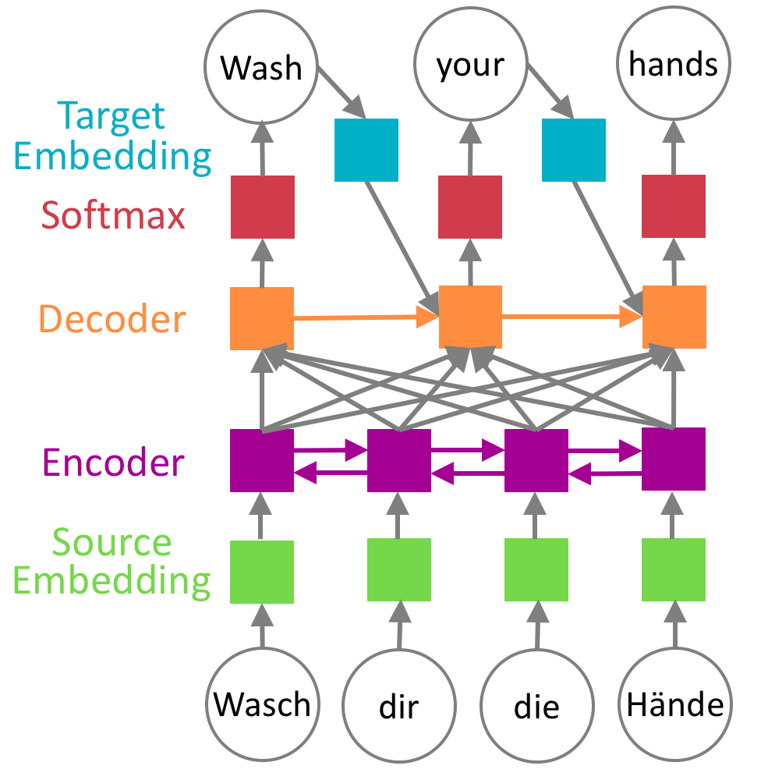
Selective Training of Components
BLEU
Notes:
Russian – English Patents

Slide 41
Selective Training of Components
BLEU
Notes:
Russian – English Patents
Freeze all but one
surprisingly robust so we tried a more extreme case
In domain was 26.9

Slide 42
Selective Training of Components
BLEU
Notes:
Russian – English Patents
Freeze all but one
surprisingly robust so we tried a more extreme case
In domain was 26.9

Slide 43
Selective Training of Components
BLEU
Notes:
Russian – English Patents
Freeze all but one
surprisingly robust so we tried a more extreme case
In domain was 26.9

Slide 45
Extra Slides

Slide 46
Wash
your
hands
Embedding
Target
Softmax
Decoder
Encoder
Embedding
Source
Wasch
dir
die
Hände

Slide 47
Wash
your
hands
Embedding
Target
Softmax
Decoder
Encoder
Embedding
Source
Wasch
dir
die
Hände

Slide 48
Hyperparameters
Model architecture
num_embed="512:512"
rnn_num_hidden=512
rnn_attention_type="dot"
num_layers=2
rnn_cell_type="lstm"
Regularization
embed_dropout=0.0
rnn_dropout=0.1
label_smoothing=0.1
Vocabulary
BPE on Source and Target
num_words=30k:30k
word_min_count="1:1"
max_seq_len="100:100”
Training configuration
batch_size=4096
optimizer=adam
initial_learning_rate=0.0003
learning_rate_reduce_factor=0.7
loss="cross-entropy”
checkpoint_frequency=4000
Notes:
One of the contributions of scale is this generic recipe that works well across domains and languages

Slide 49
Alternate MT explanation

Slide 50
Case Study
Our office needs to translate a lot of Russian patents.
We have a few translators, but they can only process a small fraction of our data.
We would like to use machine translation find the most interesting documents and let our translators focus on those.
We know neural machine translation has state-of-the-art performance, so we decide to build a Neural system…

Slide 51
MT training
General Domain Data
General Domain
NMT Model
Notes:
Explain the general setup of this chart
On the left we have our training data
These are parallel sentences that are translations of each other
Then we create on a model on the right

Slide 52
MT training
In-domain
Data
In-Domain
NMT Model
Notes:
easier to find large amount of general domain data

Slide 53
MT training
General
Domain Data
Mixed
Domain NMT Model
In-domain Data
Notes:
downside: imbalanced classes

Slide 54
MT training
In-domain
Data
General Domain
NMT Model
Continued-Training
NMT Model

Slide 55
MT training
General Domain
NMT Model
50M General Domain sentence pairs
Notes:
Open subtitles, ParaCrawl, Common Crawl, News Commentary, Wiki Headlines, UN parallel corpus
note: windscreen = British for windshield glazing: installing windows

Slide 56
Continued Training
Continue training on in-domain data
Train on general domain data
Random Initialized NMT Model
General Domain
NMT
Model
Domain Adapted
NMT
Model
Notes:
Parameters are random

Slide 57
General Domain NMT
General Domain
NMT Model
50M General Domain sentence pairs
Notes:
parallel text
subtitles, UN,web, ect

Slide 58
General Domain NMT
Errors due to domain mismatch
General Domain
NMT Model
дверной замок повышенной степени защищенности от взлома Human: door lock with increased degree of security against burglary
System: door security door security door

Slide 59
Keyword Search

Slide 60
Keyword Search (sort of)
Extrinsic measure of MT Output quality based on ability to retrieve (i.e., match) words or phrases
[Insert cartoon]

Slide 61
Human assigned categories
Keyword venture capitalist, zero gravity, hydrogen
Sentiment fantastic, messy, bad, happy
Person Heidi, Chris, Leonardo da Vinci, Aristotle
Organization Toyota, UNESCO, Ikea, Swedish Army
Geo-Political Entity Egypt, San Francisco, Haiti
Location Arctic, Africa, hospital, ER, lobby
Date Friday, 1980s, last March, today
Temporal Expression 4:00 am, 30-second, six weeks
Numeric Expression 20 percent, 27 kilometers, one-fifth, two nurses

Slide 62
This metric is pessimistic
Inexact matches count as failure
Tokenization issues exacerbate measures
70 year old vs. 70-year-old
Alternative (very acceptable) translations can count as failure

Slide 63
Results

Slide 64
Russian Patent
+ 10.1
BLEU
Notes:
In this talk we always translate into English

Slide 65
Russian Patent
+7.2
BLEU

Slide 66
Patent Results
+11.3
+9.8
+7.2
+4.6
BLEU
Notes:
highlights the problem of DA...

Slide 67
TED Results
+1.4
+1.1
+7.0
+0.0
-0.6
-0.7
BLEU
Notes:
online is better than SMT
ted more similar to generic trans than patent
we expect a generic model to do well

Slide 68
Patent Results
+0.4
+3.5
+7.2
BLEU
+1.8
Notes:
Ko=en using 1 million subtitles

Slide 69
TED Results
+1.4
+1.1
+6.6
+0.0
BLEU
+1.6
-0.7

Slide 70
TED results
 | Training data | Ar | De | Fa | Ko | Ru | Zh
SMT | General Domain | 24.0 | 31.0 | 13.9 | 6.7 | 25.0 | 15.2
 | Mixed Domain | 27.8 | 31.9 | 18.2 | 10.7 | 25.7 | 16.1
NMT | General Domain | 29.6 | 34.6 | 22.2 | 11.6 | 23.4 | 15.9
 | In Domain (TED) | 27.4 | 32.3 | 21.3 | 14.4 | 22.9 | 16.2
 | Mixed Domain | --- | 35.6 | --- | --- | 24.5 | 17.8
 | Continued Training | 35.4 | 39.9 | 27.9 | 17.2 | 28.6 | 20.4
 | Microsoft Translator | 34.3 | 38.5 | 20.9 | 17.9 | 28.6 | 21.0

Slide 71
Patent results
 | Training data | De | Ko | Ru | Zh
SMT | General Domain | 26.6 | 2.4 | 21.4 | 13.7
 | Mixed Domain | 50.6 | 21.7 | 29.0 | 29.8
NMT | General Domain | 36.0 | 2.7 | 23.4 | 12.6
 | In Domain (TED) | 61.9 | 29.9 | 26.9 | 40.2
 | Mixed Domain | 58.4 | --- | 27.7 | 33.7
 | Continued Training | 62.3 | 31.7 | 37.0 | 43.7
 | Microsoft Translator | 51.0 | 27.1 | 29.8 | 33.9

Slide 72
Patent
BLEU

Slide 73
TED
BLEU
Notes:
Note that these all start with different amounts of data

Slide 74
TED
BLEU
Notes:
TED is simmilar to Europarl and subitlies

Slide 75
TED
BLEU
Notes:
Note that these all start with different amounts of data

Slide 76
Human Eval

Slide 77
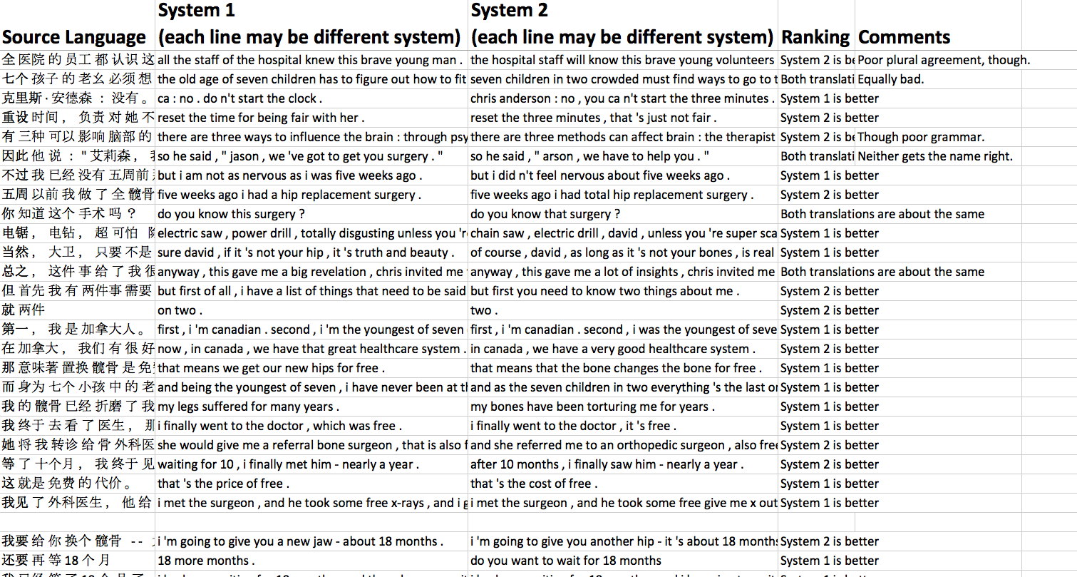
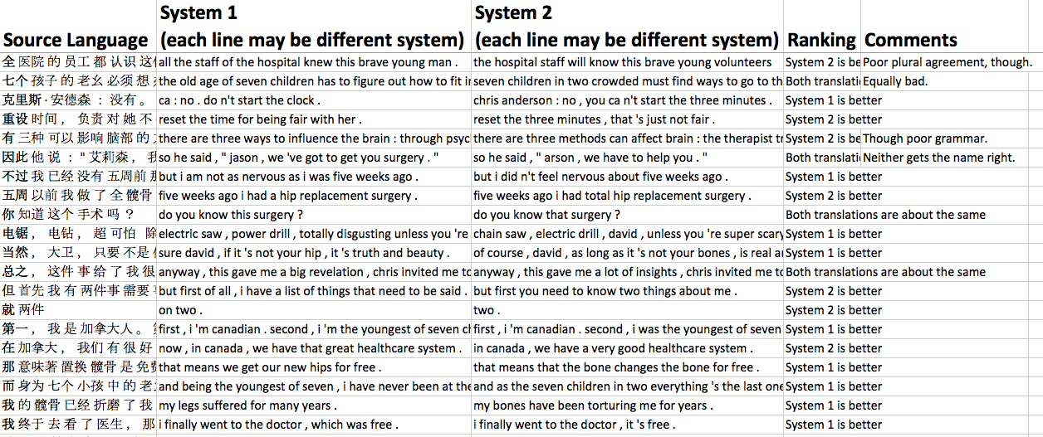
Notes:
TED

Slide 78
Continued Training vs General
Notes:
TED!!!!

Slide 79
Continued Training vs Human

Slide 80
Continued Training vs General
Notes:
Ko=en using 1 million subtitles

Slide 81
Continued Training vs Human
Notes:
Need to redo colors etc
Ko=en using 1 million subtitles

Slide 82
Human Evaluation
Trends similar across three languages
System differences consistent with BLEU
Human reference (unsurprisingly) better

Slide 83
Research Extensions

Slide 84
Parameter Freezing
BLEU
Notes:
Russian – English Patents
Freeze one

Slide 85
Parameter Freezing
BLEU
Notes:
Russian – English Patents
Freeze all but one

Slide 86
Parameter Freezing
BLEU
Notes:
Russian – English Patents
Freeze all but one

Slide 87
Selective Training
BLEU
Notes:
Russian – English Patents
Freeze one

Slide 88
Selective Training of Components
BLEU
Notes:
Russian – English Patents
Freeze all but one
surprisingly robust so we tried a more extreme case

Slide 89
Selective Training
BLEU
Notes:
Russian – English Patents
Freeze all but one
surprisingly robust so we tried a more extreme case

Slide 90
Selective Training
BLEU
Notes:
Russian – English Patents
Freeze all but one

Slide 91
Selective Training
BLEU
Notes:
Russian – English Patents
Freeze one
Don't see gains, but no part of the network is the bottleneck
You can get most of the way with just training a single component
NMT MODEL IS V. robust
gains with adapting one part of the model
great for when you don't have parallel text

Slide 92
Data Sizes

Slide 93
Datasets
# sentence/segment pairs
 | Ar-En | De-En | Fa-En | Ko-En | Ru-En | Zh-En
Large GeneralDomain | 49M Subtitle, UN, LDC | 28M Subtitle, WMT | 6M Subtitle | 1M Subtitle | 51M Subtitle, WMT | 36M Subtitle,WMT
TED Talks | 175k | 152k | 114k | 164k | 180k | 170k
Patent (WIPO) |  | 821k |  | 81k | 39k | 154k
in-domain sets
Goal: Improve test results on TED/Patent using both
Large General Domain and some In-Domain data

Slide 94
Data
Training data | Arabic | German | Farsi | Korean | Russian | Chinese
General Domain | 49M Subtitle, UN, LDC | 28M Subtitle, WMT | 6M Subtitle | 1M Subtitle | 51M Subtitle, WMT | 36M Subtitle, WMT
TED | 175k | 152k | 114k | 164k | 180k | 170k
Patent | --- | 821k | --- | 81k | 39k | 154k

Slide 95
TED Data
Training data | Arabic | German | Farsi | Korean | Russian | Chinese
General Domain | 49M Subtitle, UN, LDC | 28M Subtitle, WMT | 6M Subtitle | 1M Subtitle | 51M Subtitle, WMT | 36M Subtitle, WMT
In Domain (TED) | 175k | 152k | 114k | 164k | 180k | 170k
So, um... she 's kidding...
Resumption of the session
The European Union supports humanitarian action.
Allison Hunt: My three minutes hasn't started yet, has it?

Slide 96
Patent Data
Training data | German | Korean | Russian | Chinese
General Domain | 28M Subtitle, WMT | 1M Subtitle | 51M Subtitle, WMT | 36M Subtitle, WMT
Patent | 821k | 81k | 39k | 154k
So, um... she 's kidding...
Resumption of the session
The European Union supports humanitarian action.
The tablets exhibit improved bioavailability of the active ingredient.

Slide 97
OOV rates

Slide 98
TED OOVs (type count)
Training data | Arabic | German | Farsi | Korean | Russian | Chinese
General Domain | 133 | 204 | 445 | 225 | 140 | 45
In Domain (TED) | 745 | 700 | 758 | 249 | 813 | 422
Both domains | 126 | 193 | 329 | 133 | 132 | 43
Total types | 8248 | 5837 | 6261 | 4989 | 7954 | 5760

Slide 99
TED OOVs (token count)
Training data | Arabic | German | Farsi | Korean | Russian | Chinese
General Domain | 176 | 235 | 597 | 316 | 153 | 47
In Domain (TED) | 840 | 809 | 956 | 327 | 933 | 536
Both domains | 168 | 221 | 418 | 187 | 143 | 45
Total tokens | 28636 | 35209 | 39223 | 45715 | 31575 | 33397

Slide 100
TED OOVs (type %)
Training data | Arabic | German | Farsi | Korean | Russian | Chinese
General Domain | 1.61% | 3.49% | 7.11% | 4.51% | 1.76% | 0.78%
In Domain (TED) | 9.03% | 11.99% | 12.11% | 4.99% | 10.22% | 7.33%
Both domains | 1.53% | 3.31% | 5.25% | 2.67% | 1.66% | 0.75%

Slide 101
TED OOVs (token %)
Training data | Arabic | German | Farsi | Korean | Russian | Chinese
General Domain | 0.61% | 0.67% | 1.52% | 0.69% | 0.48% | 0.14%
In Domain (TED) | 2.93% | 2.30% | 2.44% | 0.72% | 2.95% | 1.60%
Both domains | 0.59% | 0.63% | 1.07% | 0.41% | 0.45% | 0.13%

Slide 102
Patent OOVs (type count)
Training data | German | Korean | Russian | Chinese
General Domain | 5290 | 2098 | 1508 | 495
In Domain (TED) | 2331 | 986 | 4286 | 1085
Both domains | 2100 | 594 | 1262 | 339
Total types | 14566 | 7939 | 15964 | 8627

Slide 103
Patent OOVs (token count)
Training data | German | Korean | Russian | Chinese
General Domain | 10264 | 7748 | 1980 | 1171
In Domain (TED) | 3864 | 1724 | 5715 | 2061
Both domains | 3528 | 1045 | 1617 | 681
Total types | 132208 | 186832 | 81911 | 135591

Slide 104
Patent OOVs (type %)
Training data | German | Korean | Russian | Chinese
General Domain | 36.32% | 26.43% | 9.45% | 5.74%
In Domain (Patent) | 16.00% | 12.42% | 26.85% | 12.58%
Both domains | 14.42% | 7.48% | 7.91% | 3.93%

Slide 105
Patent OOVs (type %)
Training data | German | Korean | Russian | Chinese
General Domain | 7.76% | 4.15% | 2.42% | 0.86%
In Domain (Patent) | 2.92% | 0.92% | 6.98% | 1.52%
Both domains | 2.67% | 0.56% | 1.97% | 0.50%

Slide 106
TED OOVs (Type Count)
OOV Types

Slide 107
TED OOVs (Token Count)
OOV Tokens

Slide 108
TED OOVs (Type %)
% OOV

Slide 109
TED OOVs (Token %)
% OOV

Slide 110
Patent OOVs (Type Count)
OOV Types

Slide 111
Patent OOVs (Token Count)
OOV Tokens

Slide 112
Patent OOVs (Type %)
% OOV

Slide 113
Patent OOVs (Token %)
% OOV

