Slide 1
31260 – Interface Design Assignment 3 – Prototype and Evaluation
Group K :
11301506 - Chi Kit Chan
11301239 - Ka Hei Chan

Slide 2
Introduction to design project
Goal
Scenario
User story
Assumptions
Technology used
Demo

Slide 3
Goal
Catching up on news from around the world

Slide 4
Scenario
It is in the year 2024 on a Monday morning in Sydney, Tex is on his way to his workplace as usual. Tex’ office is situated far away from his home. It takes a long time to travel. Tex would like to use the travelling time to read the latest news. He is particularly interested in world affairs and sport news. Currently it is during NBA season, Tex is a fan of the basketball team Chicago Bulls so he would like to catch up news about their latest matches and events. Besides the tension of Cold War 2 is growing, Tex is very worried about the situation.

Slide 5
User Story
Tex wants to read and follow interesting news highlights from around the world while on his way to work.

Slide 6
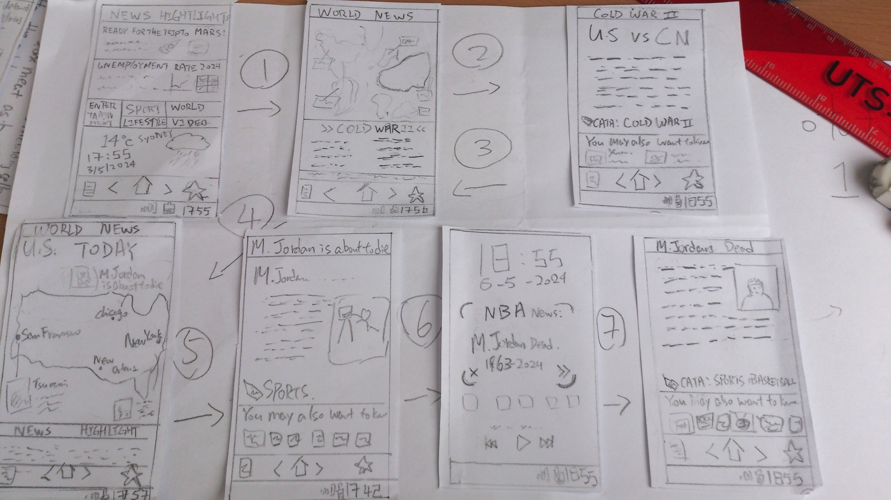
The design

Slide 7
Assumptions
Portable Projector built-in on mobile phone in 2024

Slide 8
Technology used
HTML5
CSS3
JavaScript
Bootstrap CSS Framework
JQuery Javascript library
Leaflet JS map library
Tested on Firefox 21

Slide 9
Prototype Demo

