Slide 1
Lean IT, Agile and DevOps
Reacting to the Forces of Change

Slide 2
Changing Business Strategy Drives Changes in IT
Remember this illustration at the beginning of class?
Many Businesses/IT Organizations have or are experiencing significant changes
Business Environment
People
Strategy
Business Processes
Applications
Organizational
Structure
IT Infrastructure
Adapted from Goodyear, 2000, Umar 1997)

Slide 3
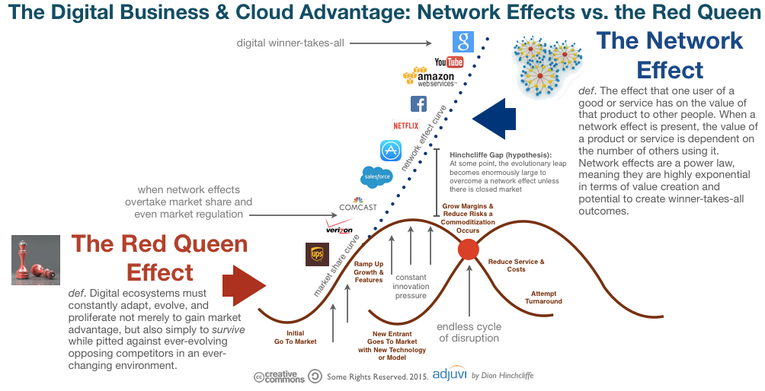
Business Change and Disruption Is Increasing

Slide 4
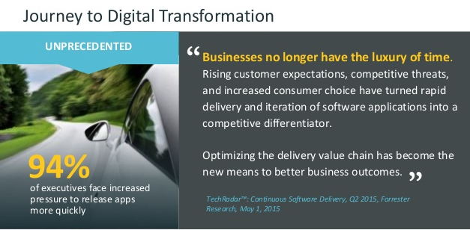
Business Change and Disruption Is Increasing

Slide 5
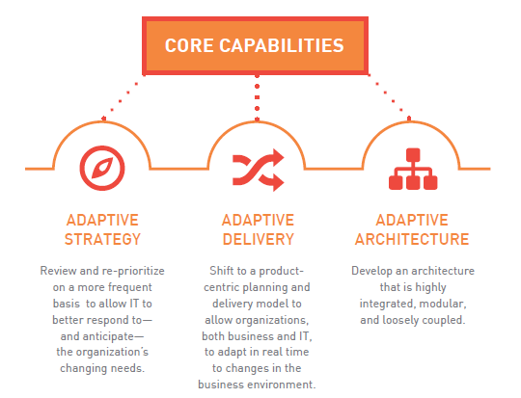
Leaders Value Adaptive Strategies in Business and IT
http://www.northhighland.com

Slide 6
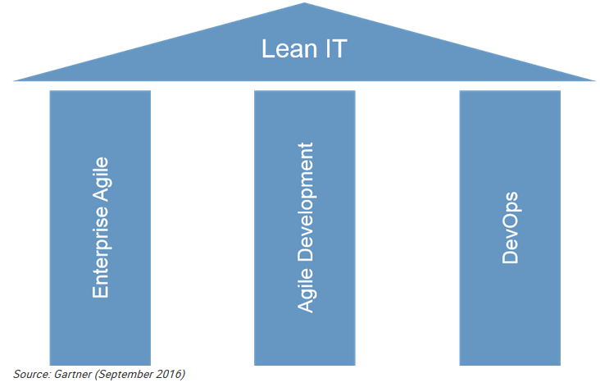
The Three Pillars of Lean IT

Slide 7
Agenda
The Move to Lean IT
The Role of Agile
DevOps
Agenda

Slide 8
Lean IT
Lean IT eliminates waste (muda) in key IT processes.
In manufacturing, Lean drove vendors away from large batch mass production to continuous flow. Encourages making frequent, smaller changes in manufacturing which can reduce risk and is more visible to the customer
It is moving to continuous flow by moving to small, incremental changes in software verses the large “upgrade”

Slide 9
Big Releases Can Cause Problems for IT and the Business
Large releases are risky. Combining 2 or more changes in a release more than doubles the risk of the release (nonlinear change).
Large releases are wasteful. Despite many decades of attempts to improve requirements, requirement defects are still the most common and expensive problems in software projects. Putting smaller changes into production limits the amount of time wasted building the wrong solution.
Large increase in the time to value in software development. Holding one change while the team completes all of the changes for a release prevents the business from quickly utilizing the value of that change.
Large releases are slow. Often, stakeholder priorities have changed by the time the software is created.

Slide 10
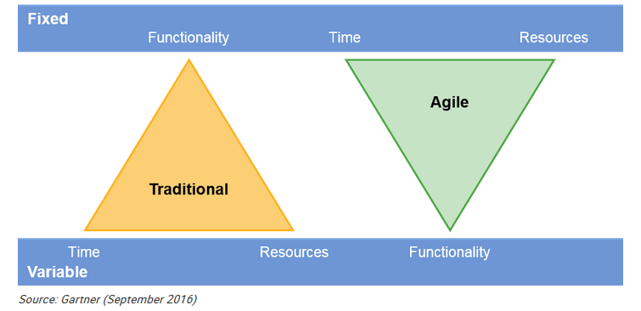
Shifting to Lean IT Governance

Slide 11
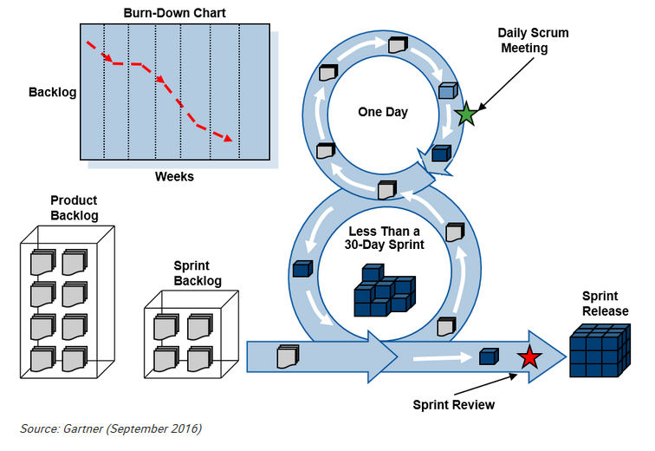
Agile Development is Designed to Continuously Produce Small Releases

Slide 12
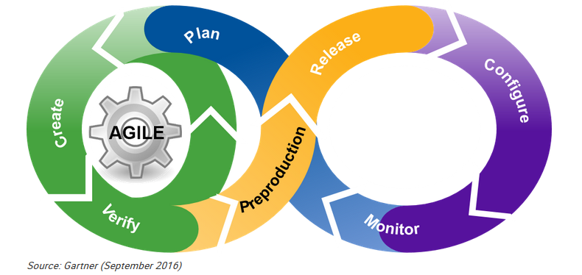
Adopt DevOps Practices to Enable Safe and Frequent Releases of New Software

Slide 13
What is DevOps?
Is a culture , movement or practice that emphasizes the collaboration and communication of both software developers and other information technology (IT) professionals while automating the process of software delivery and infrastructure changes. It aims at establishing a culture and environment where building, testing, and releasing software can happen rapidly, frequently, and more reliably.

Slide 14
Dev versus Ops in the past
“It works on my machine, I don’t see why it is not working on YOUR server!”
“It’s not the server, it’s YOUR code!”
“You want a new server instance TODAY? When did you know you need it? Why didn’t you let us know sooner?”
“You want a new database TODAY? When did you know you need it? Why didn’t you let us know sooner?”

Slide 15
What are the roles of Dev and Ops teams?
Dev
Create change in business processes through code
Modify or Add features
Ops
Create stability
Create or enhance services

Slide 16
Drivers and Enablers of DevOps
Driver: Demand for an increased rate of production releases from application and business stakeholders
Enabler: Use of agile and other development processes and methodologies
Enabler: Wide availability of virtualized and cloud infrastructure from internal and external providers
Enabler: Increased usage of data center automation and configuration management tools

Slide 17
Principles of DevOps
Develop and test in an environment similar to production.
Deploy builds frequently.
Validate operation quality continuously.

Slide 18
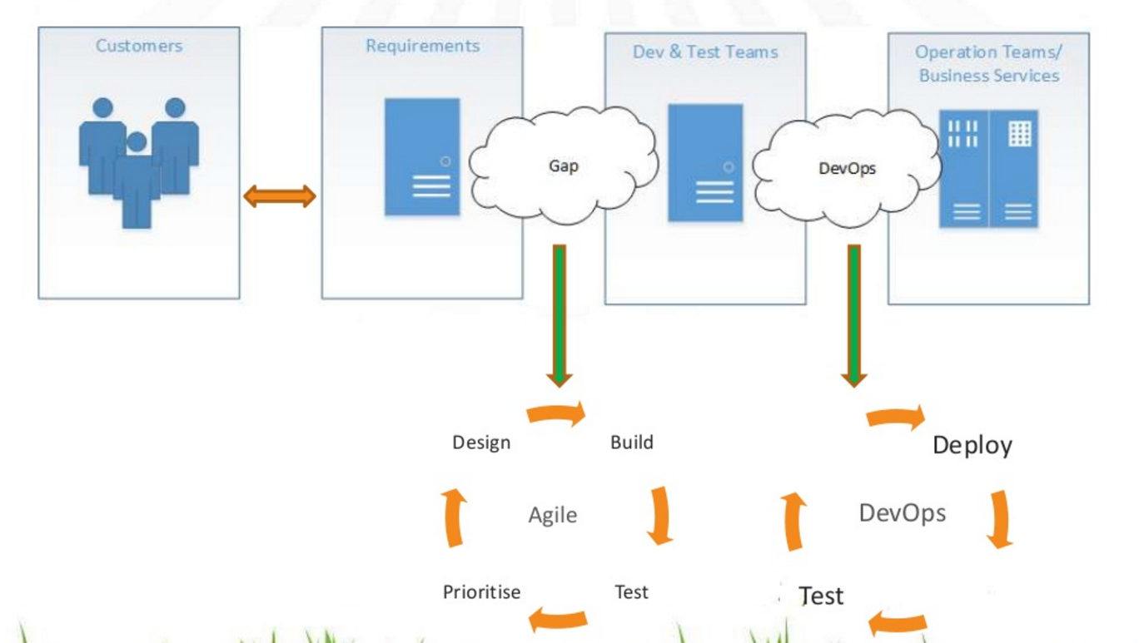
Agile and DevOps
http://www.slideshare.net/nishanthnow/introducing-devops

Slide 19
Agile and DevOps
Agile Development
Addresses the gap between customer requirements and dev + testing teams.
Cross-functional teams to design, develop, and test features/stories prioritized by the Product Owner (Customer)
Focuses more on functional and non-functional readiness
DevOps
Addresses the gap between dev + testing and Ops
Automated release management
Focuses on functional and non-functional plus operational and business readiness
Intensifies reusability and automation

Slide 20
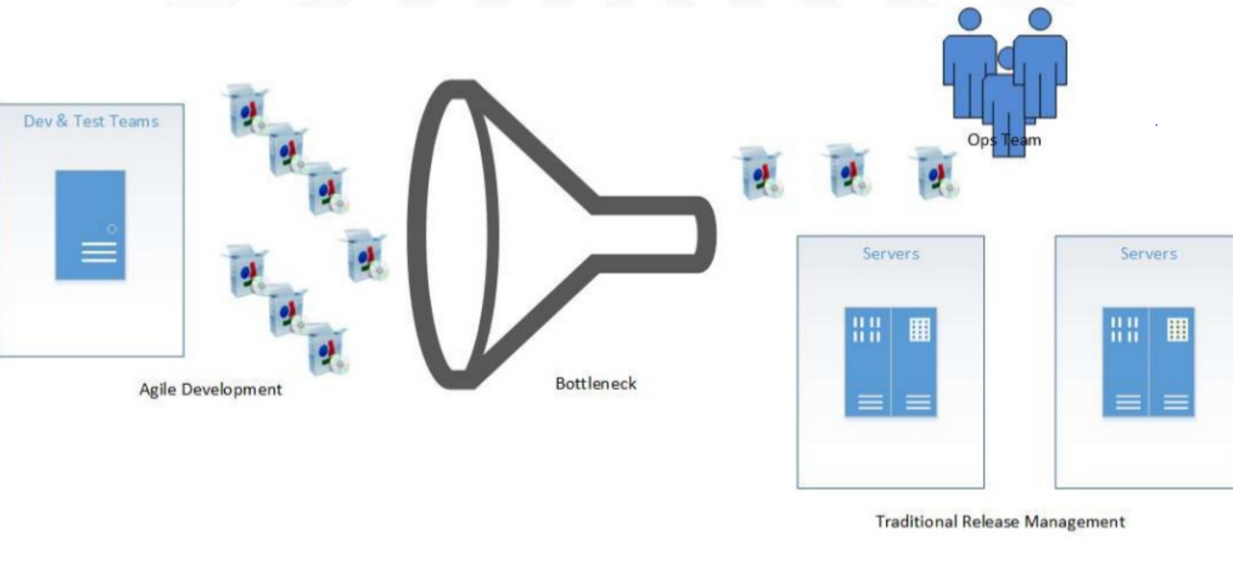
Agile + Traditional Release Management
http://www.slideshare.net/nishanthnow/introducing-devops

Slide 21
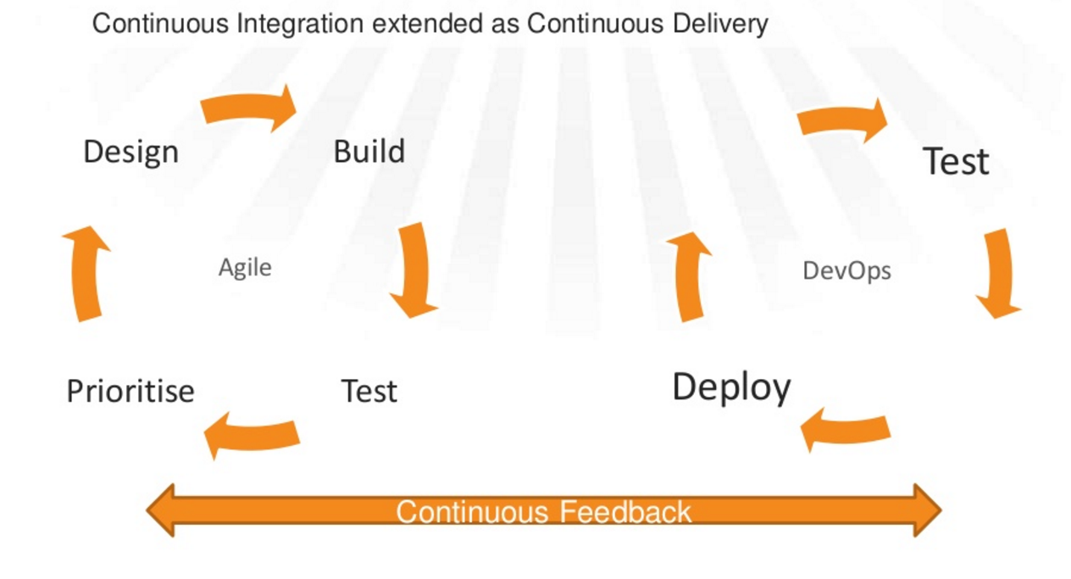
Agile + DevOps
http://www.slideshare.net/nishanthnow/introducing-devops

Slide 22
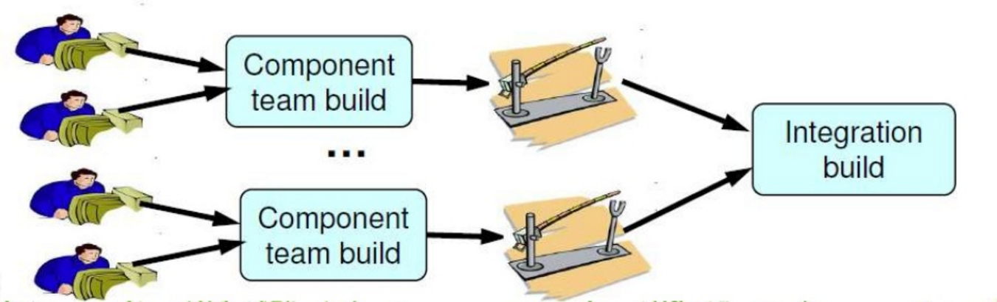
Continuous Integration
Integrate the code changes by each developer so that the main branch remains up-to-date
http://www.slideshare.net/nishanthnow/introducing-devops

Slide 23
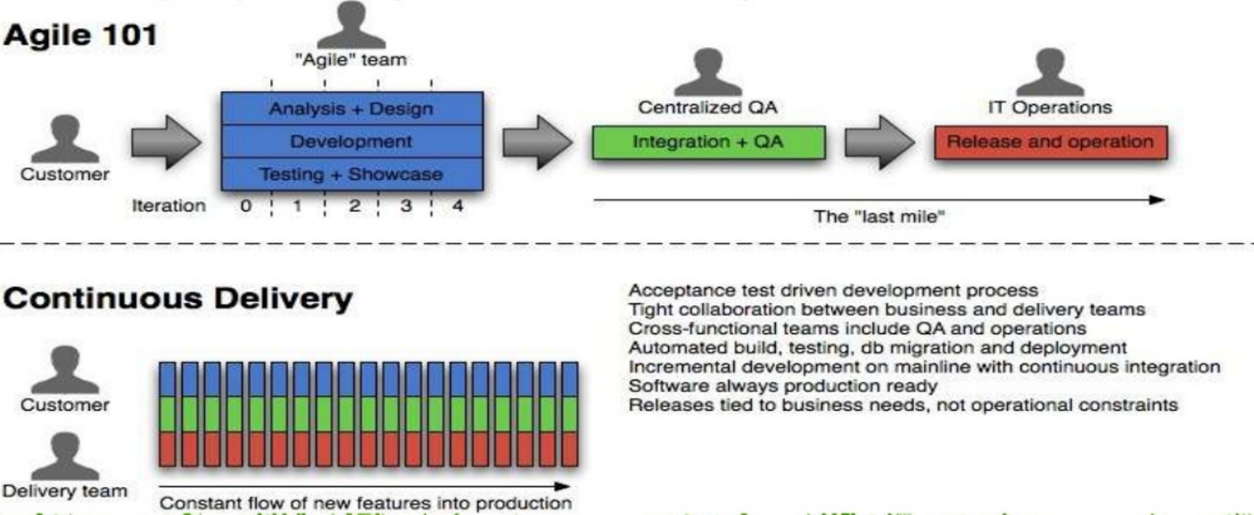
Continuous Delivery
http://www.slideshare.net/nishanthnow/introducing-devops

Slide 24
DevOps is a Fundamental Change in Process and Culture
Collaboration between development and operations
Improving and automating handoffs between silos
Removing constraints and opening up bottlenecks
Improving the flow of code from ideation to Delivery
Creating feedback loops at every stage
DEvOps: A culture of Transformation, More than Technology CA World 2014

Slide 25
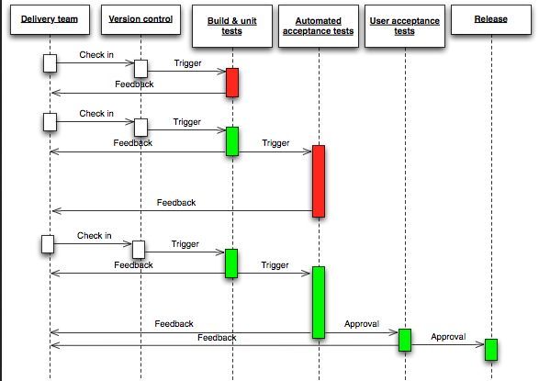
Continuous Integration Feedback Cycle

Slide 26
Tools to Enable Continuous Integration/Continuous Deployment
Build Tools: Rake, MSBuild, GNU Make, Pybuilder, etc..
Continuous Integration server: Jenkins, Hudson, Bamboo etc..
Issue and Project Management tools: Jira, Yodiz, Bugzilla, GitHub, etc..
Automated testing Tools: Selenium, Python unittest framework , MS Test, Junit, HP Quality Center, etc…

Slide 27
Summary
Lean IT is a movement to speed the delivery of product and eliminate waste in the process.
It means moving away from batch delivery to continuous flow.
Agile was designed to continuously produce small release and is a perfect fit to enable continuous flow.
DevOps is a culture and movement where building, testing, and releasing software can happen rapidly, frequently and more reliably.

