Slide 1
An Introduction to Python 3P1

Slide 2
Agenda
What is python? / Why python?
Installing python
Variables, Expressions, Statements
Conditional execution
Agenda

Slide 3
What is Python? Why Python?
Python is a general purpose programming language. It was created by Guido van Rossum and first released in 1991. An interpreted language, Python has a design philosophy which emphasizes code readability (notably using whitespace indentation to delimit code blocks rather than curly braces or keywords), and a syntax which allows programmers to express concepts in fewer lines of code than possible in languages such as C++ or Java. (Wikipedia)
Python is used in many areas including:
Web development
Bioinformatics
Data sciences, Data Mining, etc.
Growing use for new projects by a browing number of developers based on a number of indexes in 2017
TIOBE Index (https://www.tiobe.com)
PYPL Index (http://pypl.github.io/PYPL.html)

Slide 4
Installing Python
Go to Python.org to download python and following the instructions on the site to install python.
Ensure that you are downloading 3.5.x Python.
Windows 10 – Does not have python installed so simply install the 3.5.x version and you will be set.
Mac. Many Mac computers do have an older version of Python installed. Install the Mac python 3.5.x version.
Test the version by bringing up the command line (or terminal in the Mac).
You can also use the IDLE (Integrated Development Environment) for command line testing of python.
I find creating small test programs using PyCharm and running using the command line interface easier and it provide better feedback to help fix errors. PyCharm is at https://www.jetbrains.com/pycharm/ . Alternatives are
Atom https://atom.io/
Sublime Text https://www.sublimetext.com/
You are now ready to code and develop applications and with Django, great web applications.

Slide 5
GitHub and Assignments
All assignments and activities will be graded by individuals and teams pushing code to

Slide 6
Some basic Python Coding Rules
Python relies on proper indentation. Incorrect indentation causes an error.
The standard indentation is four spaces.
With implicit continuation, you can divide statements after parentheses, brackets, and braces, and before or after operators like plus or minus signs.
With explicit continuation, you can use the \ character to divide statements anywhere in a line.
Source: Murach’s Python Programming, 2016
get_scores.py

Slide 7
Syntax for calling any function
Source: Murach’s Python Programming, 2016

Slide 8
Three Python data types
Source: Murach’s Python Programming, 2016

Slide 9
Initializing Variables and Assigning Data
Source: Murach’s Python Programming, 2016

Slide 10
Naming Variables
Naming Styles for Variables
Source: Murach’s Python Programming, 2016

Slide 11
Python’s Arithmetic Operators
Source: Murach’s Python Programming, 2016

Slide 12
Compound Assignment Operators
Source: Murach’s Python Programming, 2016

Slide 13
Syntax of Print and Input functions
Print function
Input function
Source: Murach’s Python Programming, 2016

Slide 14
Now lets try out some functions with a MPG program
Source: Murach’s Python Programming, 2016

Slide 15
If statement in Python
Examples
invoice_total = 1200 discount = .15 if invoice_total >= 500: discount_percent = .2 print (invoice_total*discount_percent) elif invoice_total >= 250: discount_percent = .1 print(invoice_total * discount_percent) elif invoice_total > 0: discount_percent = 0 print(invoice_total * discount_percent) else: print("Invoice total must be greater than zero.")
Source: Murach’s Python Programming, 2016

Slide 16
Syntax of the while statement
Source: Murach’s Python Programming, 2016

Slide 17
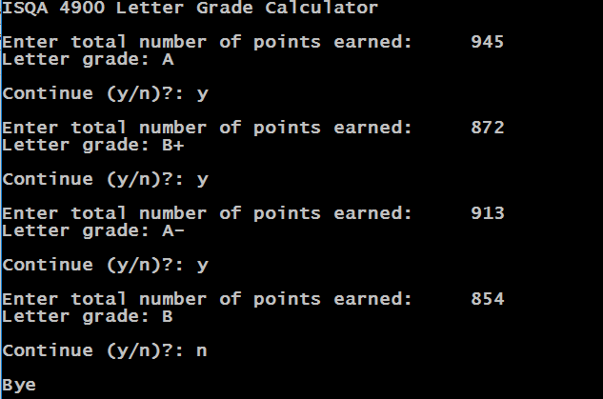
ACTIVITY: Activity 3
Time to practice what has been discussed. Create a program that uses control statements to convert our final points into a letter grade.
Points | Grade
97-100% | A+
93-96.99% | A
90-92.99% | A-
87-89.99% | B+
83-86.99% | B
80-82.99% | B-
77-79.99% | C+
73-76.99% | C
70-72.99% | C-
67-69.99% | D+
63-66.99% | D
60-62.99% | D-
< 60% | F

Slide 18
Python Resources
Murach’s Python Programming by Michael Urban and Joel Murach. Fresno, CA: Mike Murach and Associates, 2016. ISBN 978-1-890774-97-4. This should be available from Amazon or the UNO BookStore
Free tutorials on Youtube that students have told me were good:
Max Goodrich Python series: https://www.youtube.com/watch?v=ykqrOe3B0eM
https://www.youtube.com/watch?v=ykqrOe3B0eM
The NewBoston / Bucky Roberts
https://www.youtube.com/watch?v=HBxCHonP6Ro&index=1&list=PL6gx4Cwl9DGAcbMi1sH6oAMk4JHw91mC_&t=9s
One of the best ways to learn the basics of Python is to use Codecademy online Tutorials for Python
https://www.codecademy.com/learn/python

