Slide 1
Eagle Financial Services Assignment Start Up

Slide 2
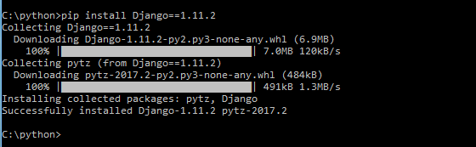
Activity: Build your Django EFS application.
You should have a system with python installed and in the path. If it is not installed go to https://www.python.org/downloads/release/python-361/
Be sure it is python 3.61 or above
Create a directory for the EFS project. I called it C:\python\efsblog
Use the command line interface and run the following command:
pip install Django==1.11.2 if you have not done so already
You should see:

Slide 3
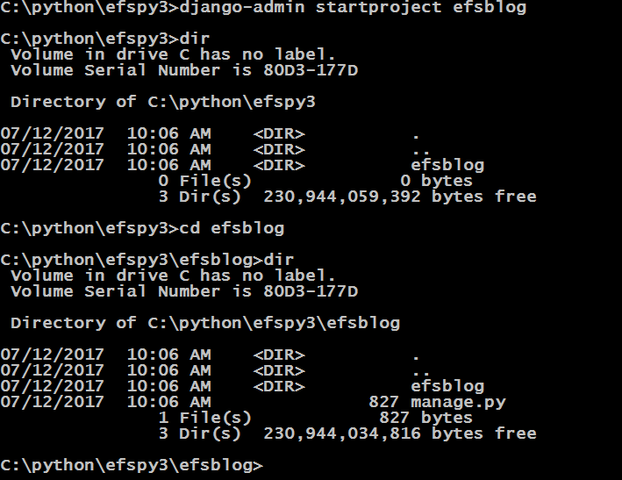
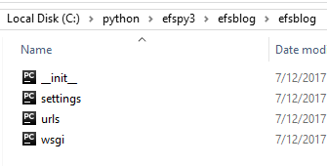
Create your Django project
With your chosen directory, run the following command to create a project called efsblog:
django-admin startproject efsblog

Slide 4
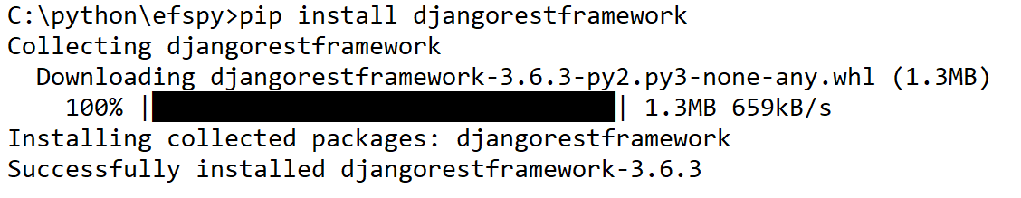
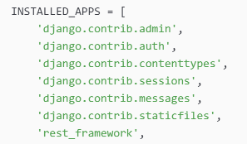
Add items you will eventually need for part 3 of project
pip install djangorestframework
Next you will need to add the following to the apps section of settings.py

Slide 5
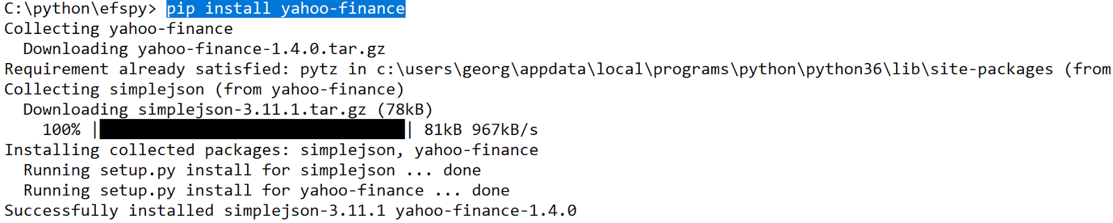
Add items you will eventually need for part 3 of project
pip install yahoo-finance

Slide 6
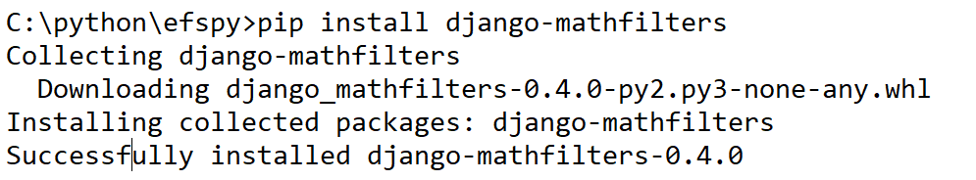
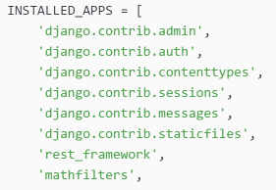
Add items you will eventually need for part 3 of project
pip install django-mathfilters
Next you will need to add the following to the apps section of settings.py

Slide 7
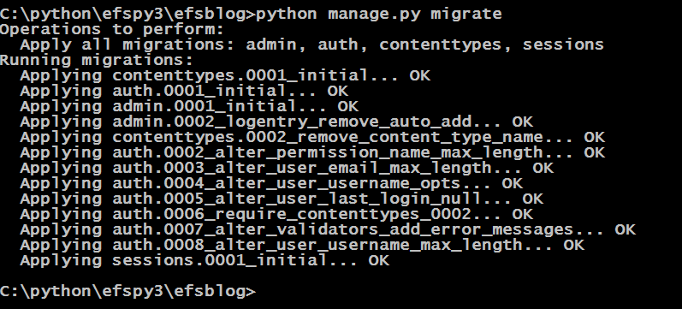
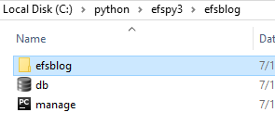
Time to do an initial migration and create the database
From the efsblog project directory (must have manage.py in directory, issue this command:
python manage.py migrate
You should see:

Slide 8
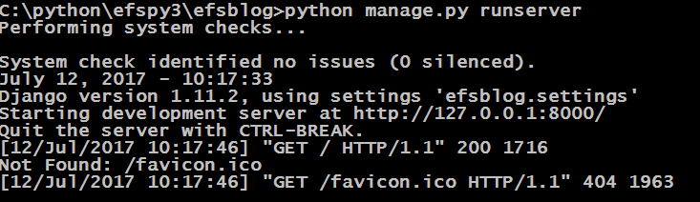
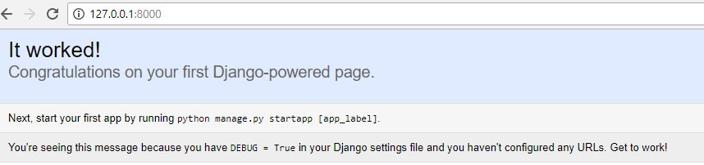
Run server to see initial output
Again, in the project directory, issue the following command: python manage.py runserver
Go to your browser and type in: http://127.0.0.1:8000/
You should see:

Slide 9
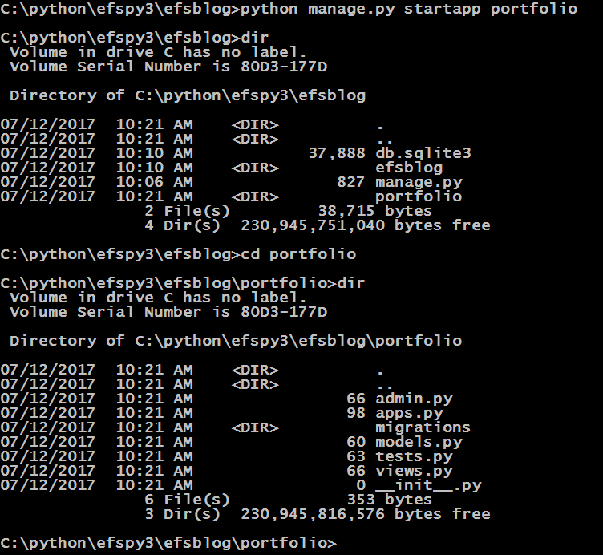
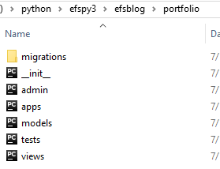
Now it is time to create the efsblog application
Again, in the project run the following command:
python manage.py startapp portfolio

Slide 10
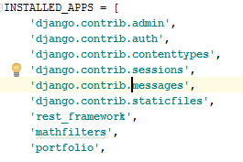

Now we need to edit the settings.py and add the portfolio application

Slide 11
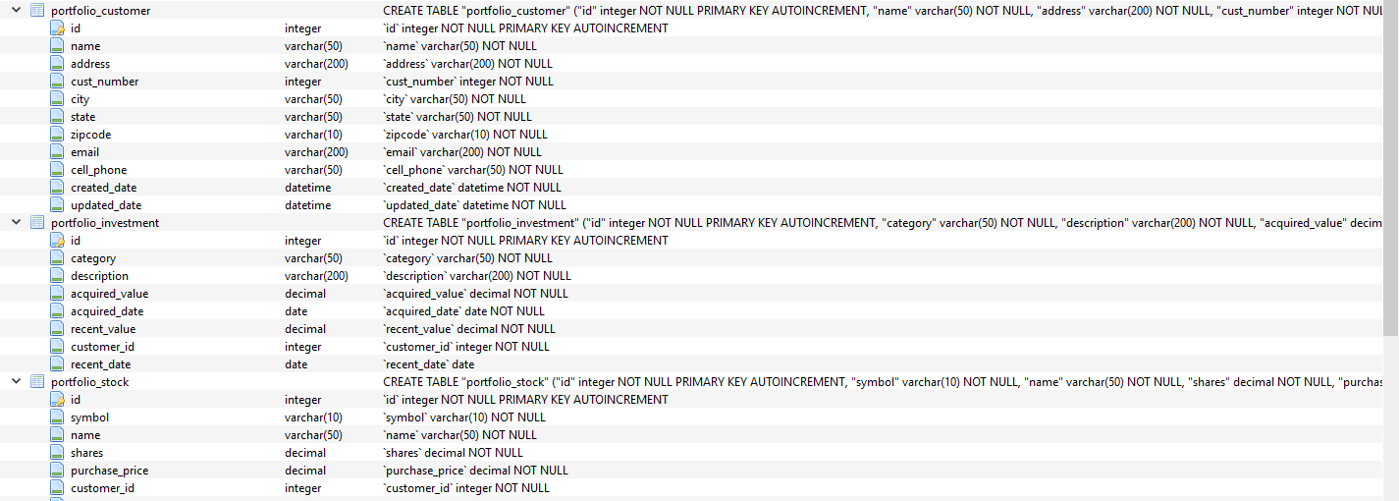
Now we need to add the data model for efsblog
Add the data model in the tutorial to models.py
Next, add the admin.py code in the tutorial

Slide 12
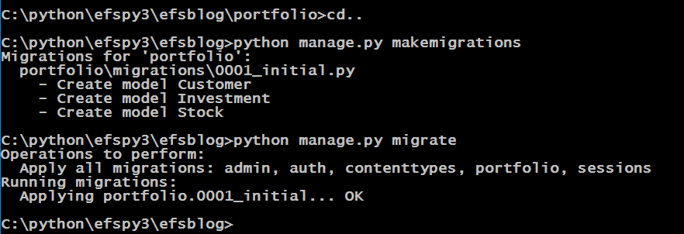
Next we makemigrations and migrate to update DB
python manage.py makemigrations
Python manage.py migrate
https://tutorial.djangogirls.org/en/django_models/

Slide 13
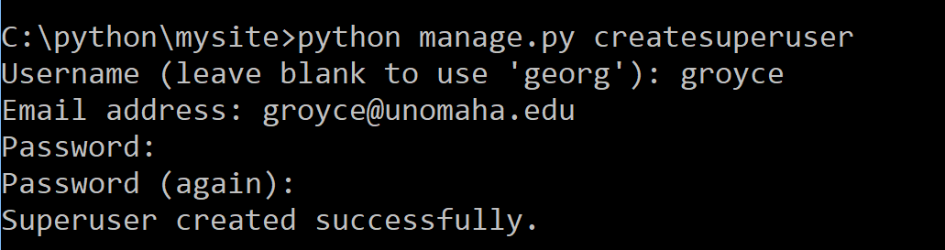
Now we add the following into admin.py and createsuperuser
from django.contrib import admin
from .models import Post
admin.site.register(Post)
createsuperuser

Slide 14
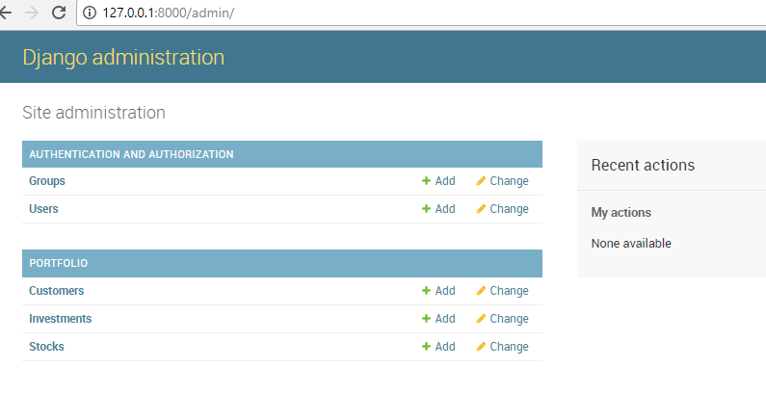
python manage.py runserver and type http://127.0.0.1:8000/admin/ in the browser
Do runserver so see the Admin Panel

Slide 15
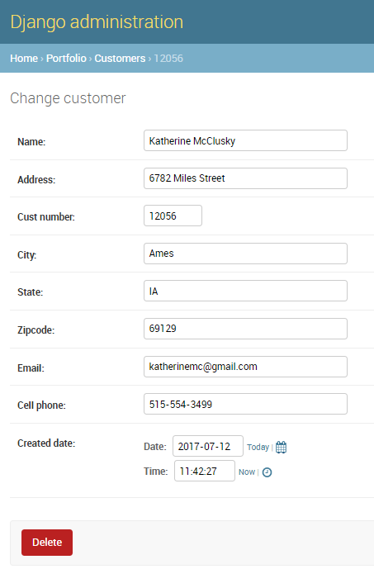
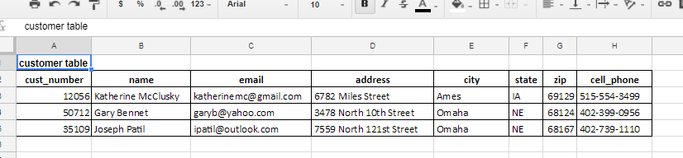
Finally add a couple of customers, stocks and investments

