Slide 1

SMARTM365 • DEVICES
Windows 11 Upgrade Toolkit
Installation and Configuration Guide
LOT / PsExec architecture • Guided diagnostics • Windows 10 → Windows 11 upgrade Technical document — SmartM365 Devices team
workplacecloudhub.com

Slide 2
OVERVIEW
Toolkit objective
The toolkit diagnoses Windows 10 devices that fail to migrate to Windows 11 through Intune, Windows Autopatch, or Windows Update for Business, explains why, then runs guarded repair or upgrade actions from LOT folders.
Simplified flow
Windows 10 diagnostics
1
Self-contained diagnostics
Blocker analysis
2
The endpoint script is a single PowerShell file, deployable via PsExec without any SmartM365 module on the target.
Guarded actions
Guarded actions
3
Each action (repair, WU reset, setup upgrade) only runs if the matching -Allow* switch is enabled.
Windows 11 upgrade
Batch operations
4
Designed to process campaigns of several hundred devices from a single operator workstation.
SmartM365 Devices — Windows 11 Upgrade Toolkit
2

Slide 3
POSITIONING
When to use this toolkit
This toolkit is the right fit when the following conditions apply:
1
Intune / Autopatch / WUfB devices
Devices enrolled in Intune, Windows Autopatch, or Windows Update for Business, where the Windows 11 migration must be explained and then unblocked.
2
Batch processing from an operator workstation
Campaigns of several hundred devices driven from a single GUI window or a single CLI launch.
3
Local evidence of the Windows 11 blocker needed
Detailed device-side diagnostics: compatibility, policy blockers, disk space, pending reboot status.
4
SYSTEM execution required via PsExec
Actions that require a SYSTEM context on the target, without deploying an extra agent.
5
Guided upgrade via -AllowSetupUpgrade
Controlled trigger of Windows Setup with validated media, once blockers are cleared.
SmartM365 Devices — Windows 11 Upgrade Toolkit
3

Slide 4
BEFORE YOU START
Prerequisites
1
Verified operator ZIP
2
Operator workstation
Download release 0.1.72, verify its SHA-256 using the README, then extract the complete ZIP to a new local folder. GitHub Desktop is optional.
WPF GUI: Windows PowerShell 5.1 / STA. LOT wrappers: PowerShell 7 preferred, with 5.1 fallback.
3
PsExec
4
Administrative rights
Obtain PsExec.exe from Microsoft Sysinternals; place it in Scripts or on PATH for SYSTEM execution on targets.
Account with local admin rights on target devices (admin share C$ reachable).
5
Network access to targets
6
Windows 11 media (optional)
DNS resolution and SMB/RPC connectivity to the Windows 10 devices in the LOT.
Required only if -AllowSetupUpgrade is enabled: valid setup.exe + sources\install.wim or .esd.
7
Intune / AD access (optional)
For the 'already Windows 11' precheck via Graph and/or Active Directory.
SmartM365 Devices — Windows 11 Upgrade Toolkit
4

Slide 5
ORGANIZATION
Toolkit folder structure
Windows11UpgradeToolkit\
Scripts\
Start-...-LotLauncher-GUI.cmd
PsExec orchestrator, self-contained endpoint script, worker, LOT launcher GUI.
Update-LotCmdWrappers.cmd
Export-IntuneDevicesCsv.cmd
Export-ADDevicesCsv.cmd
New-SetupMediaManifest.cmd
Lots\LOT-*\
Windows11UpgradeToolkit.config.template
Scripts\
Operational configuration and Computers.txt for each campaign (never committed).
SmartM365-Invoke-Windows11UpgradeRepair.ps1
...RepairWithPsExec.ps1 (orchestrator)
...LotLauncher-GUI.ps1 (WPF GUI)
...PsExecWorker.ps1
Lots\LOT-TEMPLATE\
Runs\<LOT>\<timestamp>\
Lots\LOT-<name>\ (operational, not committed)
Run data: logs, HTML reports, CentralLogs, inventory CSV files.
Runs\<LOT>\<timestamp>\
SetupSource\ (local media, not committed)
SmartM365 Devices — Windows 11 Upgrade Toolkit
5

Slide 6
1
STEP 1
Prepare the Windows 11 media
Only needed if campaigns must enable the Windows Setup upgrade (-AllowSetupUpgrade).
1
Download the Windows 11 media
Download the ISO image or the media creation tool from the official Microsoft page: https://www.microsoft.com/software-download/windows11.
2
Mount the ISO and copy the content
Mount the downloaded ISO image, then copy its full content into SetupSource\<language> (e.g. SetupSource\en-US or SetupSource\fr-FR) matching the media language.
3
Validate the media
The folder must contain setup.exe and sources\install.wim or install.esd, with a valid Microsoft Authenticode signature.
Share the network folders
4
SetupSource: share as SetupSource$ on the media server (or through a centralized file service), read access for all target devices. SetupSourceGates: share as SetupSourceGates$, write access required for target devices (copy concurrency gate).
5
Generate the SHA256 manifest
Run New-SetupMediaManifest.cmd (or the script with -MediaRoot / -SetupSourceRoot) to create SmartM365-SetupMediaManifest.sha256.csv at the root of the media.
Full documentation: GitHub README
SmartM365 Devices — Windows 11 Upgrade Toolkit
6

Slide 7
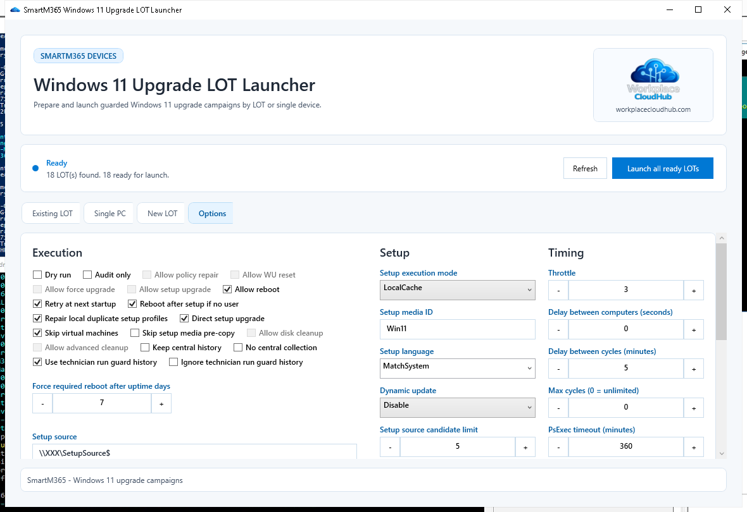
2
STEP 2
Configure the toolkit
Configuration is primarily done through the GUI's Options tab, which pre-fills and overrides Windows11UpgradeToolkit.config. Manual file-based configuration remains available for runs without the GUI and is detailed in the annex.
GUI — LOT Launcher — 'Options' tab
Key fields in the Options tab
Setup source — UNC path(s) to the media
Setup execution mode — LocalCache (default) / Share / Auto
Setup language — MatchSystem (default) or a specific culture
Dynamic update — Disable (default) / Enable / NoDrivers
Timing — throttle, delay between devices/cycles, PsExec timeout
Full documentation: GitHub README
SmartM365 Devices — Windows 11 Upgrade Toolkit
7

Slide 8
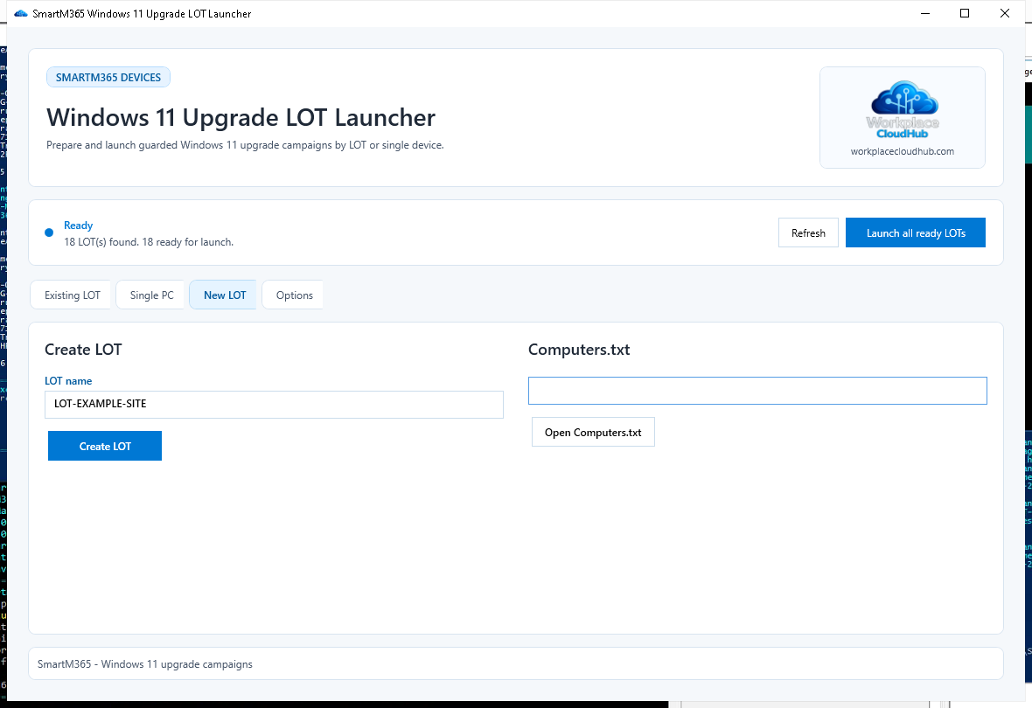
3
STEP 3
Create a LOT
A LOT groups the configuration and device list for one campaign. Create it via the GUI (New LOT tab) or manually from Lots\LOT-TEMPLATE.
GUI — LOT Launcher — 'New LOT' tab
'New LOT' tab: enter the LOT name, then 'Create LOT'
Open Computers.txt and list the target devices (one per line)
Optional: add AdDomain.txt to restrict the AD export
Optional: a LOT-local Windows11UpgradeToolkit.config
'Refresh wrappers' / Update-LotCmdWrappers.cmd if the LOT already existed
Full documentation: GitHub README
SmartM365 Devices — Windows 11 Upgrade Toolkit
8

Slide 9
4
STEP 4
Options and guardrails
The endpoint script is diagnostic-only unless -Allow* switches are explicitly enabled. LOT wrappers are action-ready by default; direct PowerShell calls stay disabled by default.
-AllowPolicyRepair
-AllowWUReset
Removes known legacy WU blockers (WSUS, UseWUServer, NoAutoUpdate, TargetReleaseVersion).
Resets the Windows Update cache and services.
-AllowForceUpgrade
-AllowSetupUpgrade
Triggers scan/download/install through the Windows Update APIs and UsoClient.
Starts the Windows Setup upgrade after media and readiness checks pass.
-AllowReboot
-AllowDiskCleanup
Permits a controlled reboot when a pending reboot blocks progress.
Safe cleanup (rebuildable caches, old logs) when free disk space is insufficient.
-AuditOnly
Reports what would be done, without running repair or upgrade actions.
SmartM365 Devices — Windows 11 Upgrade Toolkit
9

Slide 10
5
STEP 5
Launch a run
REM Open the GUI Start-Windows11UpgradeRepair-LotLauncher-GUI.cmd REM Run one LOT once (CMD) Lots\LOT-A\Run-...-PsExec-Once.cmd
GUI — LOT Launcher — 'Options' tab
Recommended: start with a -AuditOnly pass
.\Scripts\SmartM365-Invoke-Windows11UpgradeRepairWithPsExec.ps1 `
-ComputerListPath .\Lots\LOT-A\Computers.txt -RunOnce -AuditOnly
The GUI pre-fills its Options tab from Windows11UpgradeToolkit.config. Values visible in the GUI take precedence over the LOT config at launch.
SmartM365 Devices — Windows 11 Upgrade Toolkit
10

Slide 11
6
STEP 6
Monitor the run
Each run writes evidence under Runs\<LOT>\<timestamp> on the operator side, and under C:\ProgramData\SmartM365\Windows11UpgradeToolkit on the target device.
Logs
PsExecLogs
Reports
CentralLogs
Detailed logs from the orchestrator and every PsExec worker.
Raw output from each per-device PsExec call.
Cycle HTML reports (live then final) and a summary CSV.
Evidence by category: Success, Compatibility, InsufficientDisk, Errors, ...
HTML report: PsExec_Windows11Upgrade_Summary_<LOT>_<timestamp>.html under Reports\ — updated live during the cycle, finalized at the end.
CentralLogs categories (excerpt)
Success
Compatibility
InsufficientDisk
ADMIN_SHARE_UNREACHABLE
SetupSourceLanguageUnavailable
SetupMigrationProfileFailure
SetupMediaManifestFailure
Errors
SmartM365 Devices — Windows 11 Upgrade Toolkit
11

Slide 12
7
STEP 7
Special cases and troubleshooting
0x8007001F — Gather data
0x8007000B — Corrupt image
Duplicate profile in ProfileList. Targeted repair possible via -AllowSetupProfileRepair after safety checks.
Invalid WIM/ESD header. The local cache is purged automatically before a new copy.
0x8007007F — Migration plugin
INSUFFICIENT_DISK
Failure detected via Panther logs (CscMig.dll, WSManMigrationPlugin.dll, ...).
Not enough free space before copy or upgrade; -AllowDiskCleanup frees rebuildable caches.
Robocopy exit > 7
PENDING_REBOOT*
Media copy failed; the partial local cache is cleared to avoid an inconsistent WIM.
Pending reboot detected; deferred while a user is connected, unless the uptime threshold is exceeded.
SmartM365 Devices — Windows 11 Upgrade Toolkit
12

Slide 13
RECOMMENDATIONS
Best practices
1
2
3
Inventory precheck
-AuditOnly first
Global concurrency
Load/refresh the Intune then AD inventory before each cycle to exclude devices already on Windows 11.
Validate diagnostics on a sample before enabling corrective actions across the whole LOT.
The W11UT_GLOBAL_CONCURRENCY_LIMIT gate shares the limit across multiple LOT windows open in parallel.
4
5
6
Controlled bandwidth
SHA256 manifest
Never commit
Keep the default media-copy IPG/jitter values to spread out network load.
Generate and publish the manifest on every media update to detect corruption.
Real Computers.txt files, setup media, PsExec/CentralLogs, and *.local.json files stay out of Git.
SmartM365 Devices — Windows 11 Upgrade Toolkit
13

Slide 14
ANNEX
Manual configuration (.config file)
For LOT runs without the GUI, copy the template then set a setup source reachable by the targets.
copy Windows11UpgradeToolkit.config.template ^ Windows11UpgradeToolkit.config W11UT_SETUP_SOURCE=\\server\share\Windows11 W11UT_SETUP_DYNAMIC_UPDATE=Disable
Key variables
W11UT_SETUP_SOURCE
UNC path(s) to the media, semicolon-separated for multiple sites
W11UT_SETUP_EXECUTION_MODE
LocalCache (default) / Share / Auto
Configuration precedence
W11UT_SETUP_LANGUAGE
1
Environment variable set before launch
MatchSystem (default), a specific culture, or Any
2
LOT config (Lots\LOT-<name>\Windows11UpgradeToolkit.config)
W11UT_SETUP_DYNAMIC_UPDATE
Disable (default) / Enable / NoDrivers / NoLCU
3
Toolkit root config
W11UT_SETUP_MEDIA_ID
Local cache identifier, e.g. Win11-24H2
SmartM365 Devices — Windows 11 Upgrade Toolkit
14

Slide 15
ANNEX
Controlled bandwidth
Several levers control the network impact of copying the Windows 11 media into each device's local cache.
COPY PACING W11UT_SETUP_COPY_IPG_MS
Default 20. Per-device Robocopy inter-packet throttling: a higher value makes the copy slower and gentler on the network.
COPY PACING W11UT_SETUP_COPY_JITTER_SECONDS
Default 300. Randomly spreads copy starts over this window (seconds) to avoid a simultaneous spike when a LOT launches.
SOURCE SELECTION W11UT_SETUP_SOURCE_CANDIDATE_LIMIT
Caps the number of candidate sources actually tested/benchmarked per device, useful with multiple UNC paths.
SOURCE SELECTION (CSV MAP) W11UT_SETUP_SOURCE_MAP
SetupSourceMap.csv file (columns ScopeType, ScopeValue, SetupSourcePath, Priority) to automatically pick the nearest source by subnet, IP prefix, or device name, instead of listing every share in W11UT_SETUP_SOURCE.
CONCURRENCY PER SOURCE W11UT_SETUP_SOURCE_CONCURRENCY_LIMIT / _GATE_ROOT
Limits concurrent copies per media source through a shared gate on a writable UNC folder.
CONCURRENCY PER SUBNET W11UT_SETUP_SUBNET_CONCURRENCY_LIMIT / _GATE_ROOT
Default 1. Allows only one Robocopy at a time per subnet, to protect the narrowest site links.
SmartM365 Devices — Windows 11 Upgrade Toolkit
15

Slide 16
Summary
1. Prepare and validate the Windows 11 media, publish it to a UNC share
Documentation
2. Configure Windows11UpgradeToolkit.config (source, mode, language)
README.md and LOCAL_MEMORY.md in the Windows11UpgradeToolkit folder describe every option in detail.
3. Create the LOT via the GUI and fill in Computers.txt
4. Choose the -Allow* guardrails suited to the campaign
5. Launch in -AuditOnly, then in action mode
workplacecloudhub.com
6. Monitor the HTML reports and CentralLogs by category
SmartM365 Devices — Technical team

