Slide 1
CQRS/ES Architecture Overview
Shcherbyna A.

Slide 2
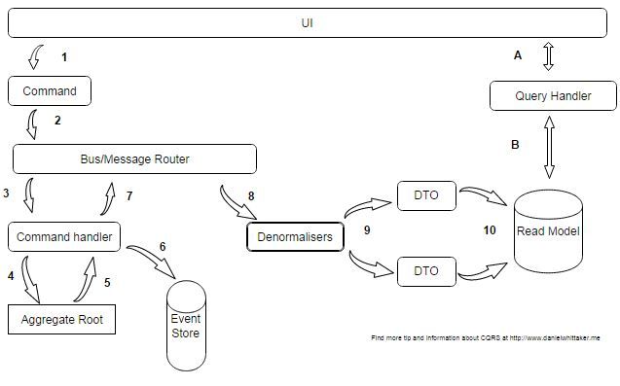
Introduction
The CQRS Architecture used to solve problem of blocking client, when many users try get limited amount of resources .
The Event Sourcing Architecture used to make possible to do not blocking transactions using append only changes in database and restore state of data to any previous state.

Slide 3
Key tenets of Onion Architecture
The application is built around an independent object model
Inner layers define interfaces. Outer layers implement interfaces
Direction of coupling is toward the center
All application core code can be compiled and run separate from infrastructure

Slide 4
Advantages of Onion Architecture
It provides better maintainability as all the codes depend on layers or the center.
It provides better testability as the unit test can be created for separate layers without an effect of other modules of the application.
It develops a loosely coupled application as the outer layer of the application always communicates with inner layer via interfaces.
Any concrete implantation would be provided to the application at run time
Domain entities are core and center part. It can have access to both database and UI layers.
The internal layers never depend on external layer. The code that may have changed should be part of an external layer.

Slide 5
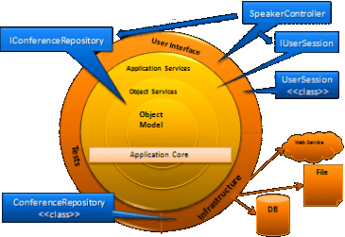
ONION CORE LAYERS
Domain
Service
ONION NOT CORE LAYERS
Infrastructure
User Interface
Tests

Slide 6
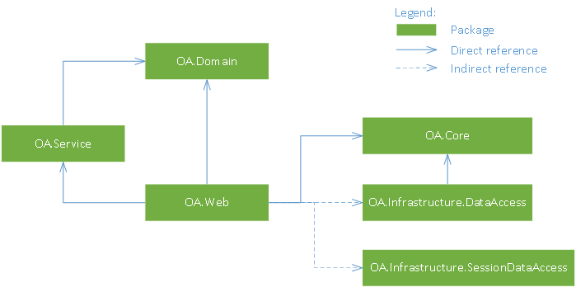
Onion Architecture Dependencies

Slide 7
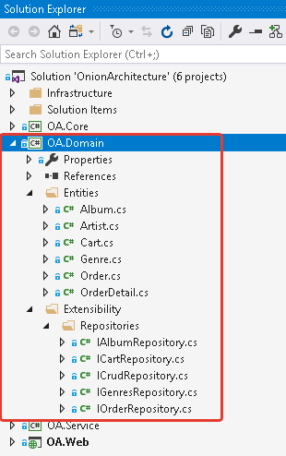
DOMAIN LAYEAR
It is the center part of the architecture. It holds all application domain objects. If an application is developed with ORM entity framework then this layer holds POCO classes (Code First) or Edmx (Database First) with entities.
Place DOMAIN LAYER SCREEN

Slide 8
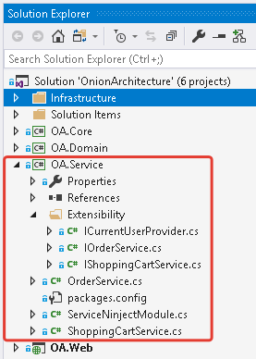
Place Repository LAYER SCREEN
SERVICE LAYEAR
The layer holds interfaces which are used to communicate between the UI layer and domain layer. It holds business logic for an entity so it’s called business logic layer as well.

Slide 9
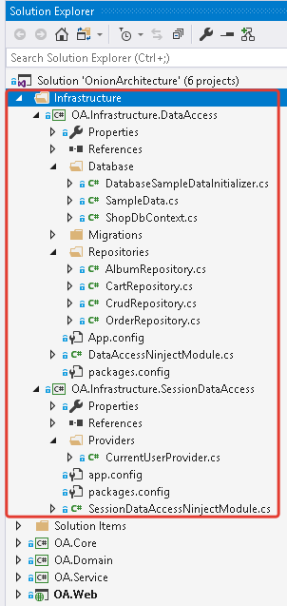
INFRASTRUCTURE LAYEAR
It implements not business logic requirements. It can contains Data access realization (PostgreSQL, Json). Remote client request handlers.

Slide 10
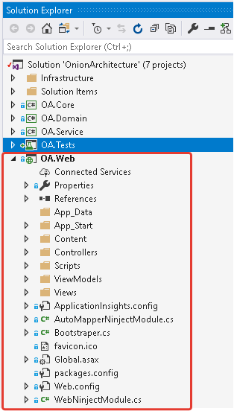
Place Repository LAYER SCREEN
USER INTERFACE LAYEAR
Is everything designed into an information device with which a person may interact. This can include display screens, keyboards, a mouse and the appearance of a desktop. It is also the way through which a user interacts with an application or a website.

Slide 11
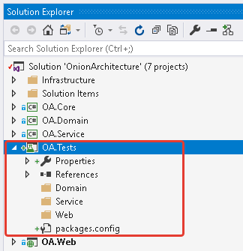
TESTS LAYEAR
Contains different types of tests (Unit, Integration, Performance).

Slide 12
Onion Architecture
Resources:
https://blog.thedigitalgroup.com/understanding-onion-architecture
https://jeffreypalermo.com/2008/07/the-onion-architecture-part-1/
https://social.technet.microsoft.com/wiki/contents/articles/36655.onion-architecture-in-asp-net-core-mvc.aspx
You can download application sample:
https://github.com/khdevnet/onion-architecture

