Slide 1
CQRS/ES Architecture Overview
You can download application sample:
https://github.com/khdevnet/sw-checkout
Shcherbyna A.

Slide 2
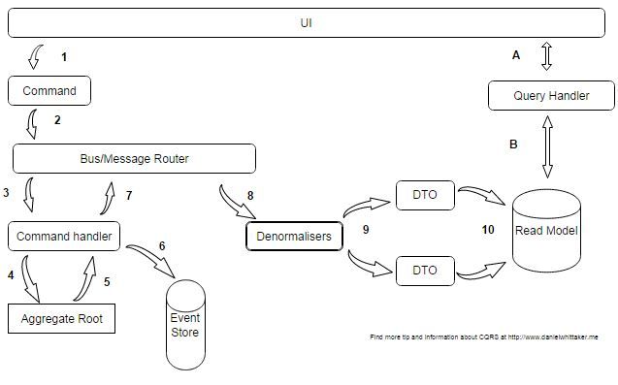
Introduction
The CQRS Architecture used to solve problem of blocking client, when many users try get limited amount of resources .
The Event Sourcing Architecture used to make possible to do not blocking transactions using append only changes in database and restore state of data to any previous state.

Slide 3
What is CQRS
CQRS means "Command-query responsibility segregation". We segregate the responsibility between commands (write requests) and queries(read requests). The write requests and the read requests are handled by different objects. We can further split up the data storage, having separate read and write stores. Once that happens, there may be many read stores, optimized for handling different types of queries or spanning many bounded contexts.

Slide 4
When to use CQRS
Collaborative domains where multiple operations are performed in parallel on the same.
Task-based user interfaces where users are guided through a complex process as a series of steps or with complex domain models.
Scenarios where performance of data reads must be fine tuned separately from performance of data writes, especially when the read/write ratio is very high, and when horizontal scaling is required

Slide 5
What is Event Sourcing
Storing all the changes (events) to the system, rather than just its current state. Almost all transactional RDBMS systems use a transactional log for storing all changes applied to the database. In a pinch, the current state of the database can be recreated from this transaction log. This is a kind of event store. Event sourcing just means following this idea to its conclusion and using such a log as the primary source of data.

Slide 6
When to use Event Sourcing
When you need ability to put the system in any prior state in past.
Having a true history of the system. Gives further benefits such as audit and traceability. In some fields this is required by law.
The kind of operations made on an event store is very limited, making the persistence very predictable and thus easing testing

Slide 7
CQRS combined with the ES
For most of the use cases, CQRS is required when we implement Event Sourcing because we may want to retrieve last state of entity without having to compute n different events
There will be some delay between the event being generated and the data store being updated, because of read/write separation.
Patterns adds complexity because code must be created to initiate and handle events, also update read models.

Slide 8
Thesaurus
Command represents an intention (modeled with the present tense like Create Customer).
Event represents a fact, something that already happened (modeled with the past tense like Customer Updated).
Aggregate is a cluster of domain objects which are considered as one unit with regard to data changes.
Command Handler process business logic operations with aggregates.
Saga is an independent component that reacts to domain events in a cross-aggregate, eventually consistent manner.

Slide 9
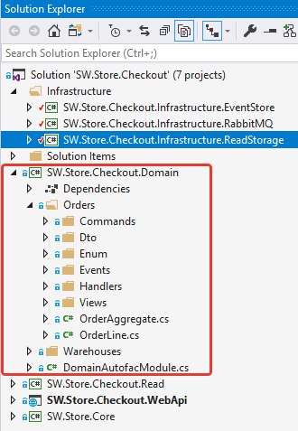
DOMAIN LAYEAR
It is the center part of the architecture. It holds all application domain entities, Aggregates, ValueObjects, Handlers, Sagas. It contains business logic of the application.
Place DOMAIN LAYER SCREEN

Slide 10
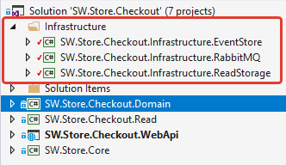
INFRASTRUCTURE LAYEAR
It implements not business logic requirements. It can contains Data access realization (PostgreSQL, EventStore), Message bus.

Slide 11
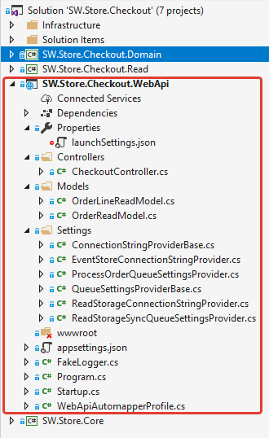
Place Repository LAYER SCREEN
USER INTERFACE LAYEAR
Is everything designed into an information device with which a person may interact.
This can include display screens, keyboards, a mouse and the appearance of a desktop. It is also the way through which a user interacts with an application or a website.

Slide 12
CQRS/ES Architecture
Resources:
https://docs.microsoft.com/en-us/previous-versions/msp-n-p/jj554200(v=pandp.10)
https://martinfowler.com/bliki/CQRS.html
https://martinfowler.com/eaaDev/EventSourcing.html
https://github.com/michaellperry/PharmaNet
https://github.com/oskardudycz/EventSourcing.NetCore
You can download application sample:
https://github.com/khdevnet/sw-checkout

