Slide 1
SignalR

Slide 2
This presentation was proposed as part of the 20% per sprint or the 5th sprint initiative. I had the opportunity to look into Azure Developer courses and that had lightly touch upon the Signal R.
This presented an opportunity to look at Signal R closer and see if it’s a worthwhile tool.

Slide 3
SignalR
An ASP.NET asynchronous, persistent signaling library that enables the real-time, multi-user web functionality for applications
Initially developed by members of the ASP.NET team
Now open source and hosted on GitHub
Available via NuGet
Simplifies the process of adding real-time web functionality to applications

Slide 4
Used to add any sort of "real-time" web functionality to your ASP.NET application
Client side support for (Java, Java Script and .NET):
  Edge
  Firefox
  Chrome, android
  Safari, iOS
  IE

Slide 5
Real-Time Web
Wherever a user would like to refresh a web page to receive up-to-date data, would pose an opportunity to use SignalR – use real-time functionality.
RTW apps are applications that functions within a time that the user sense as immediate or current.
  E.g.
    Stock ticker
    Live scores
    News Feeds
    Dashboards
    VoIP
    Chat
    Auctions
    Activity Streams

Slide 6
Examples of Real-time technologies
Polling
Long Polling
Forever Frame (IE only)
Sever Sent Event (SSE) (HTML5)
Web Sockets (HTML5)

Slide 7
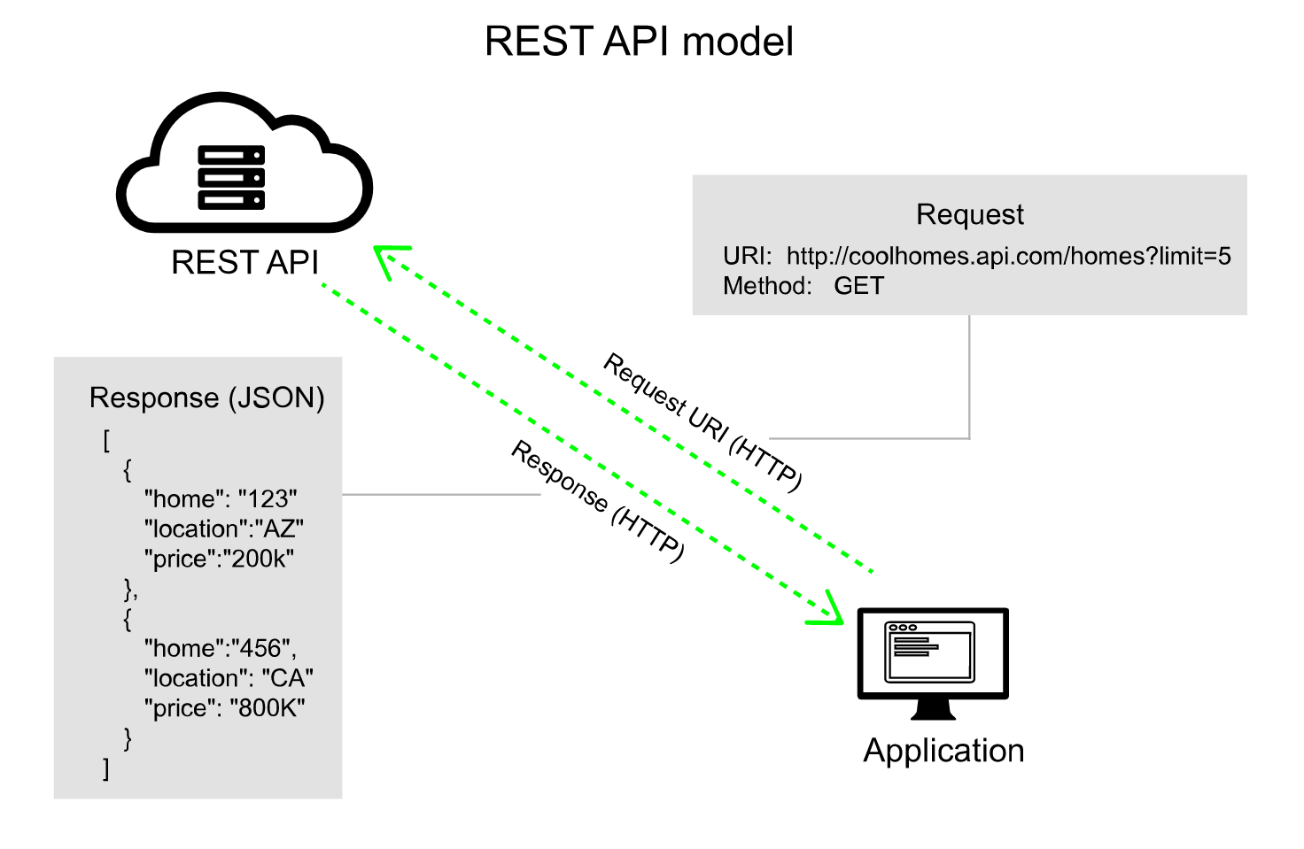

Slide 8
Polling
  Repeated cycles to check for responses.
  Needs predefined delays between requests to avoid overloading servers.
Long polling
  Polls the server with a request that stays open until the server responds, at which point the connection closes, and a new connection is requested immediately. This may introduce some latency while the connection resets.
SSE
  also known as EventSource, is a technology where a browser receives automatic updates from a server via HTTP connection
Forever Frame
  Creates a hidden iFrame which makes a request that does not complete. The server continuously sends scripts which execute immediately. One-way connection.

Slide 9
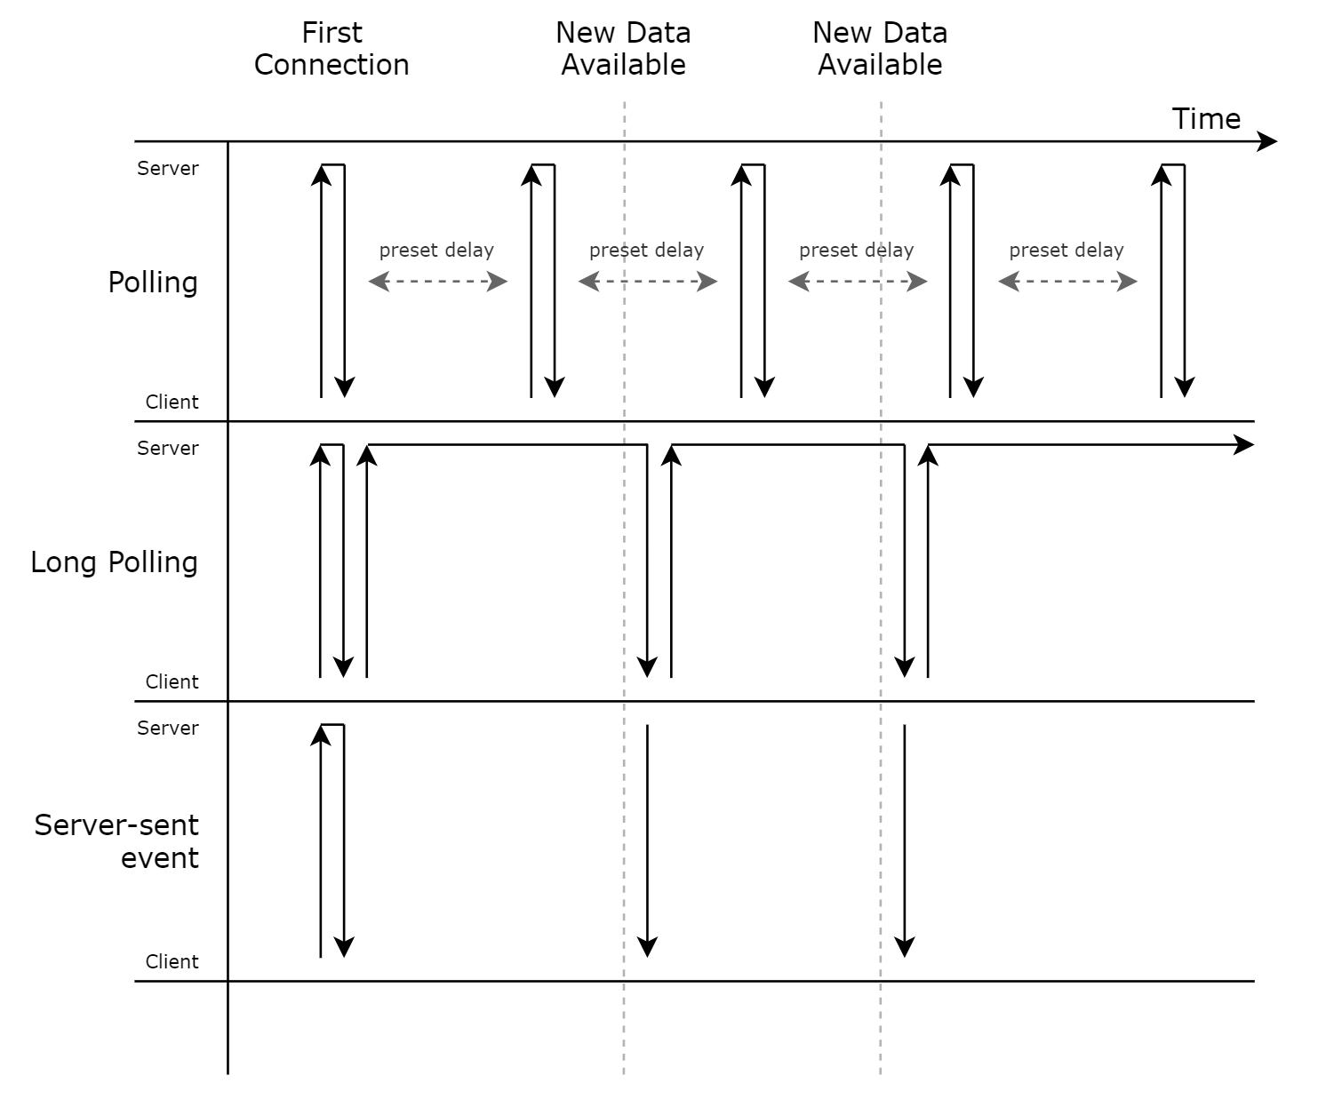

Slide 10
Web Sockets
  Is the only transport that establishes a true persistent, two-way connection between client and server (unlike HTTP).
  Built on top of HTTP – can share HTTP ports (i.e. 80 and 443)
  Full-duplex communication channel via TCP
  Server & Client support required

Slide 11
SignalR transports
SignalR encompasses all of the mentioned technologies.
It features transport fall back
  If the browser is Internet Explorer 8 or earlier, Long Polling is used.
  If JSONP is configured (that is, the jsonp parameter is set to true when the connection is started), Long Polling is used.
  If a cross-domain connection is being made (that is, if the SignalR endpoint is not in the same domain as the hosting page), then WebSocket will be used if the following criteria are met:
    The client supports CORS (Cross-Origin Resource Sharing). For details on which clients support CORS, see CORS at caniuse.com.
    The client supports WebSocket
    The server supports WebSocket
  If any of these criteria are not met, Long Polling will be used. For more information on cross-domain connections, see How to establish a cross-domain connection.
  If JSONP is not configured and the connection is not cross-domain, WebSocket will be used if both the client and server support it.
  If either the client or server do not support WebSocket, Server Sent Events is used if it is available.
  If Server Sent Events is not available, Forever Frame is attempted.
  If Forever Frame fails, Long Polling is used.

Slide 12
As Signal R encompasses many Real-time techniques, this means that you can code your app to take advantage of WebSocket without having to worry about creating a separate code path for older clients.
SignalR also shields you from having to worry about updates to WebSocket, since SignalR is updated to support changes in the underlying transport, providing your application a consistent interface across versions of WebSocket.
Easily customizable with SignalR options for set specifications. Settings such ClientTimeoutInterval, SupportedProtocols, or Transports etc.
  Compatibility requirements
  Message Data size requirements

Slide 13
Demo

Slide 14
SignalR Server hub options
ClientTimeoutInterval
HandshakeTimeout
KeepAliveInterval
SupportedProtocols
EnableDetailedErrors
StreamBufferCapacity
MaximumReceiveMessageSize

Slide 15
Server side options continued.
ApplicationMaxBufferSize
AuthorizationData
TransportMaxBufferSize
Transports
LongPolling
  PollTimeout
WebSockets
  CloseTimeout
  SubProtocolSelector
MinimumProtocolVersion

Slide 16
SignalR Client Side Options
Configure logging
  var connection = new HubConnectionBuilder()
  .WithUrl("https://example.com/myhub")
  .ConfigureLogging(logging => {
  logging.SetMinimumLevel(LogLevel.Information);
  logging.AddConsole();
  })
  .Build();
Configure allowed transports
  let connection = new signalR.HubConnectionBuilder()
  .withUrl("/myhub", { transport: signalR.HttpTransportType.WebSockets | signalR.HttpTransportType.LongPolling })
  .build();
Configure bearer authentication
  var connection = new HubConnectionBuilder()
  .WithUrl("https://example.com/myhub", options => {
  options.AccessTokenProvider = async () => {
  // Get and return the access token.
  };
  })
  .Build();

Slide 17
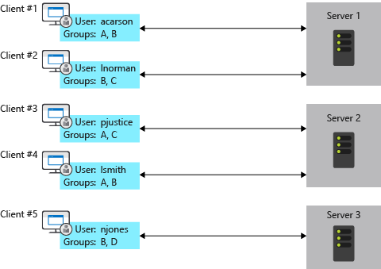
Limitations and Scale
In general, there are two ways to scale a web application: scale up and scale out.
  Scale up means using a larger server (or a larger VM) with more RAM, CPUs, etc.
  Scale out means adding more servers to handle the load
The problem with scaling up is that you quickly hit a limit on the size of the machine. Beyond that, you need to scale out. However, when you scale out, clients can get routed to different servers. A client that is connected to one server will not receive messages sent from another server.
One solution is to forward messages between servers, using a component called a backplane.

Slide 18
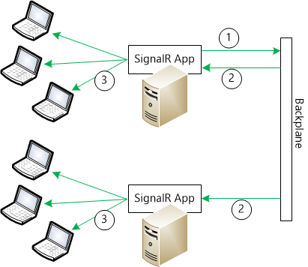
Three potential backplanes:
  Azure Service Bus. Service Bus is a messaging infrastructure that allows components to send messages in a loosely coupled way.
  Redis. Redis is an in-memory key-value store. Redis supports a publish/subscribe ("pub/sub") pattern for sending messages.
    services.AddSignalR().AddStackExchangeRedis("<your_Redis_connection_string>");
  SQL Server. The SQL Server backplane writes messages to SQL tables. The backplane uses Service Broker for efficient messaging. However, it also works if Service Broker is not enabled.

Slide 19
Limitations
Apps built with Swift and C++ do not have official client side releases, no current support and may never be. However there are unofficial and open source choices for these platforms hosted on GitHub.
  Swift (https://github.com/moozzyk/SignalR-Client-Swift)
  C++ (https://github.com/aspnet/SignalR-Client-Cpp)

Slide 20
Questions

