Slide 1

PROJECT DEFENSE · GROUP 1 — IASD
Fine-Tuning LLMs for Children's Story Generation
Domain adaptation of Gemma 4 E2B-IT and GPT-2 with QLoRA + GGUF edge deployment
Speciality
IASD — NLP
Benhammadi Lokmane · Khedim Youcef ESI-SBA · May 2026
Notes:
Welcome the jury and the audience. Introduce ourselves: I am Benhammadi Lokmane and my partner is Khedim Youcef, IASD group one. The topic is fine-tuning large language models to generate children's stories that adapt their vocabulary and sentence complexity to a target age band. Over the next ten minutes we will walk through the problem, our solution, our six-step approach, a live demo, and finally takeaways and limitations. I will keep slides short and pause for questions at the end.

Slide 2
AGENDA
Five acts, ten minutes
01
Problem
Why zero-shot LLMs miss the mark for kids' stories.
02
Solution
QLoRA-tune Gemma 4 E2B-IT, ship as GGUF for the edge.
03
Approach
Six concrete steps from dataset to deployment.
04
Live Demo
Switch age bands, watch tokens stream in real time.
05
Conclusion
What we built, what's still open, what comes next.
Notes:
Quick map of where we are going. Five acts. The first is framing the problem: domain-specific story generation is harder than it looks for a stock LLM. Second is our solution at a glance — what we picked and why. Third is our approach, broken into six concrete steps from dataset to deployment. Fourth is a live demo on the model running locally. Fifth is conclusions, limits and future work. Total target time is around ten minutes, leaving time for questions.

Slide 3

Powerful generalists, weak on age-specific writing
The gap
16+ GB
VRAM to fully fine-tune a 2B model in FP16 — out of reach on a Kaggle notebook, let alone a laptop.
And without fine-tuning, the model drifts toward an adult register every time.
What goes wrong
A zero-shot LLM…
ignores age-band prefixes such as Age 3–4 vs Age 11–12,
drifts to a generic adult register and complex vocabulary,
hallucinates details and breaks story structure,
trades safety for fluency without explicit constraints.
Fine-Tuning LLMs for Children's Story Generation — ESI-SBA, May 2026 · 3
Notes:
Large language models are remarkable zero-shot generalists, but when you ask them to write age-specific children's stories they drift. They ignore the age prefix, slip into adult vocabulary, and lose the simple beginning-middle-end structure that a child's storybook needs. The temptation is to fine-tune, but fully fine-tuning a 2-billion-parameter model in FP16 takes more than 16 gigabytes of VRAM. On a Kaggle T4, that is out of reach. So the real question becomes: how do we adapt a high-quality model under a hard hardware ceiling?

Slide 4
Three constraints, all binding at once
Style adaptation
Vocabulary and sentence complexity must shift across five age bands (3–4, 5–6, 7–8, 9–10, 11–12) — same model, different register.
Structural constraints
Stories need a clear beginning, middle, and end, with no inappropriate themes for the target age band.
Resource constraints
Consumer hardware: a 2B model needs ~16 GB of VRAM in FP16 for full fine-tuning, days on a single GPU.
Style
Form
Cost
Fine-Tuning LLMs for Children's Story Generation — ESI-SBA, May 2026 · 4
Notes:
Three constraints, and they all bite at once. First, style adaptation — the same model has to write very differently for a three-year-old and an eleven-year-old. Vocabulary, sentence length, even tone. Second, structural constraints — children's stories need a clear arc and safe themes, which is not something a generic instruction-tuned model gives you for free. Third, resource constraints — full fine-tuning of a 2B model needs more than 16 gigabytes of VRAM, more than a single Kaggle T4 holds. So we need a method that satisfies all three.

Slide 5
Two paths today, neither one fits
PATH A
Zero-shot LLMs
Ignore age-band prefixes
Generic adult register
Long, complex sentences
Drift away from kids' tone
Cheap. Fast. But style is not learned.
PATH B
Full fine-tuning
≥ 16 GB VRAM for a 2B model in FP16
Days on a single consumer GPU
Full-weight checkpoints (≥ 4 GB)
Hard to share, hard to iterate
Style is learned. But the cost is prohibitive.
We need a third path: cheap to train, full to deploy.
Fine-Tuning LLMs for Children's Story Generation — ESI-SBA, May 2026 · 5
Notes:
Today there are two paths and neither one fits. Path A is the easy one — keep the model frozen and prompt it. The catch is that style is not learned: the model ignores the age prefix and writes in a generic adult register. Path B is full fine-tuning. It works, but it needs more than 16 gigabytes of VRAM for a 2B model and produces a multi-gigabyte checkpoint that is hard to share. So we need a third path that combines the cheap training of A with the learned style of B. That is QLoRA, which is the next slide.

Slide 6
Our solution: QLoRA + GGUF, end to end
Fine-tune Gemma 4 E2B-IT with QLoRA, merge, quantize to GGUF, serve through FastAPI.
STAGE 1
Dataset
10K stories 5 age bands
STAGE 2
QLoRA Fine-Tune
NF4 + LoRA on 2×T4
STAGE 3
Merge FP16
merge_and_ unload()
STAGE 4
GGUF Quantize
Q4_K_M 3.42 GB
STAGE 5
FastAPI + Web UI
Streaming token-by-token
From a 16-GB-VRAM training need to a 3.42-GB CPU-runnable model — same quality, edge-deployable.
Fine-Tuning LLMs for Children's Story Generation — ESI-SBA, May 2026 · 6
Notes:
This is the pipeline in one picture. Five stages. We start with a curated children's story dataset of ten thousand examples across five age bands. We fine-tune Gemma 4 E2B-IT with QLoRA — that is the trick that lets us train a 2B model on a single Kaggle T4. We merge the LoRA adapter back into the base model in FP16 on CPU. We convert that to GGUF and quantize to Q4_K_M, which gets us from 9.27 gigabytes down to 3.42. Finally we serve it through a FastAPI app that streams tokens to a small web UI. Same quality as full fine-tuning, but it runs on consumer CPU.

Slide 7
Why Gemma 4 E2B-IT
Three architectural choices made it the right base for edge deployment.
Per-Layer Embeddings
A secondary embedding signal feeds every decoder layer — representational depth without paying for it in active parameters.
Sliding + global attention
Alternating local/full attention with shared KV cache keeps memory low across a 128 K-token context window.
Edge-optimized
Fits on a 16 GB GPU for QLoRA fine-tuning; runs entirely on consumer CPU after Q4_K_M quantization.
PLE
ATTN
EDGE
Fine-Tuning LLMs for Children's Story Generation — ESI-SBA, May 2026 · 7
Notes:
Why did we pick Gemma 4 E2B-IT specifically. Three reasons. First, per-layer embeddings — the E in E2B stands for effective: a secondary embedding feeds every decoder layer, so you get the depth of a larger model with the active-parameter cost of a 2B one. Second, the attention pattern alternates between sliding-window local attention and full global attention, with a shared KV cache; this is what lets it handle a 128 K-token context without blowing up memory. Third, it was designed for the edge — it fits on a 16 GB GPU for QLoRA fine-tuning, and after Q4_K_M quantization it runs on a CPU.

Slide 8
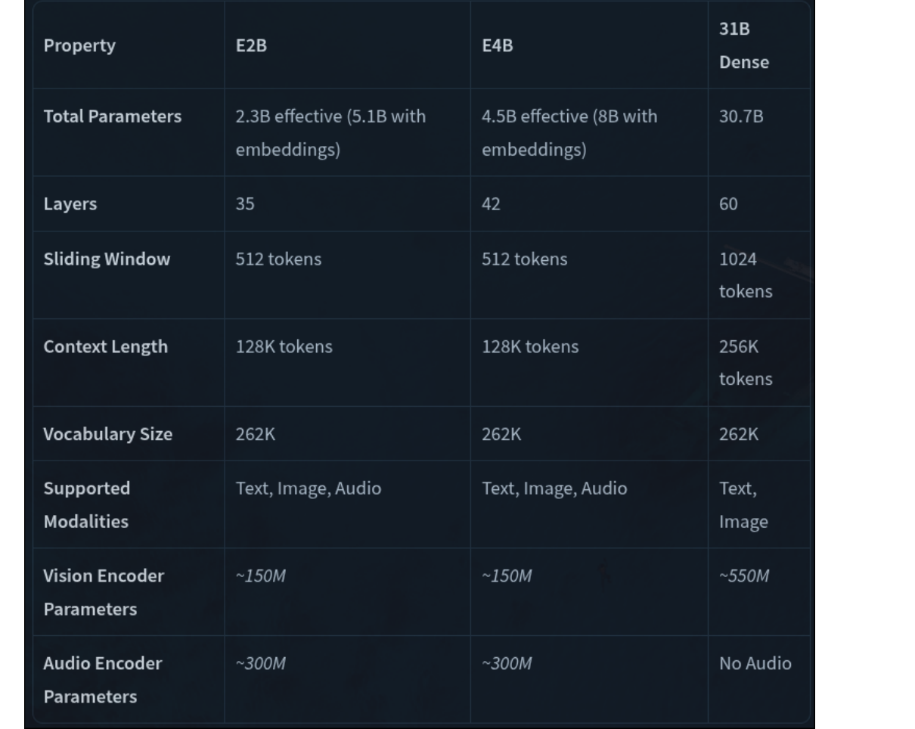
Gemma 4 family at a glance
OUR PICK
Gemma 4 E2B-IT
2.3 B effective · 35 layers · 128 K context
Smallest model in the family that still keeps the full Gemma 4 architecture — sliding attention, shared KV cache, 256 K vocabulary.
Fine-Tuning LLMs for Children's Story Generation — ESI-SBA, May 2026 · 8
Notes:
This is the table from the Gemma 4 model card. The family has E2B, E4B and a much larger 31B dense variant. We picked E2B because it is the smallest model that still keeps the full architecture: 35 layers, sliding and global attention, 128 K context, 262 K vocabulary, and 2.3 billion effective parameters. E4B doubles the active parameters but the marginal quality gain on children's stories did not justify doubling our memory budget. The 31B is well outside what we can fine-tune.

Slide 9
Dual-model strategy: isolate scale from fine-tuning
SMALL
LARGE
FINE-TUNED
GPT-2 Small
124 M params · full fine-tune
FINE-TUNED
Gemma 4 E2B-IT
2.3 B · QLoRA + Q4_K_M GGUF
Fine-tuned
BASELINE
GPT-2 XL
1.5 B · zero-shot
BASELINE
Gemma 4 E4B-IT
4.5 B · zero-shot, GGUF
Zero-shot baseline
Two scales × two regimes lets us separate "does fine-tuning help" from "is bigger always better."
Fine-Tuning LLMs for Children's Story Generation — ESI-SBA, May 2026 · 9
Notes:
We deliberately set up a two-by-two. Rows: fine-tuned versus zero-shot baseline. Columns: small versus large. Top-left, GPT-2 Small fully fine-tuned — small enough we did not need QLoRA. Top-right, Gemma 4 E2B-IT with QLoRA and GGUF, which is our headline model. Bottom-left, GPT-2 XL zero-shot — same family as top-left, ten times the parameters, no fine-tuning. Bottom-right, Gemma 4 E4B-IT zero-shot in GGUF. This grid lets us answer two questions separately: does fine-tuning help on this domain, and does scale alone make up for it.

Slide 10
Approach: six steps from dataset to deployment
Each next slide unpacks one of these steps in detail.
01
Dataset curation
02
Prefix conditioning
03
QLoRA setup
04
Kaggle training
05
Merge & quantize
06
Deploy & evaluate
Steps 1–4 are about training cheaply. Steps 5–6 are about deploying and judging the result.
Fine-Tuning LLMs for Children's Story Generation — ESI-SBA, May 2026 · 10
Notes:
This is the roadmap for the next thirteen slides. Six steps. The first four are about training the model cheaply: curate the dataset, condition it on age prefixes, set up QLoRA, run on Kaggle. The last two are about deploying and judging the result: merge and quantize the weights, then deploy and evaluate. I will spend the most time on steps 3, 4 and 5 — they are where the technical decisions live.

Slide 11
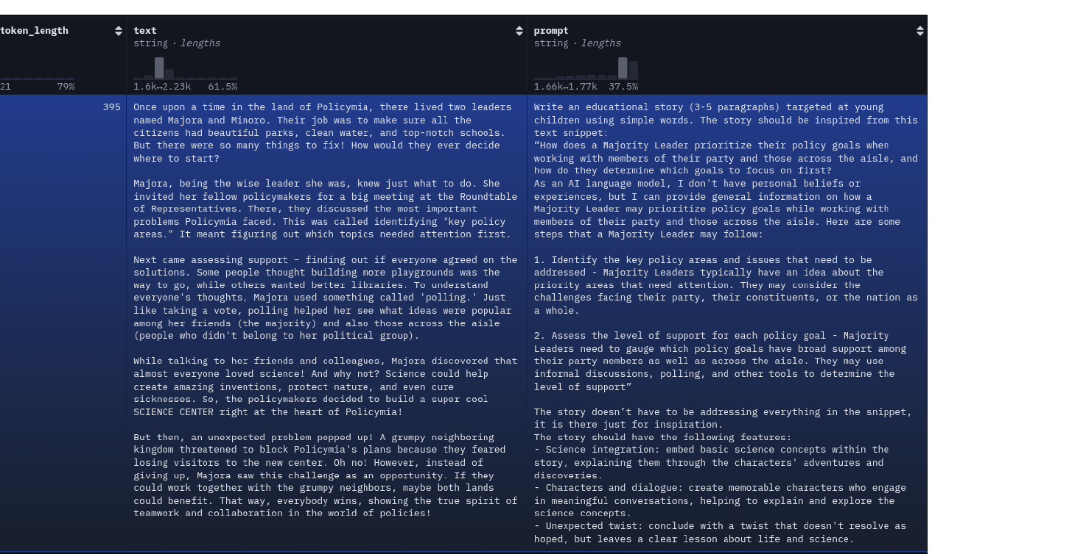
Step 1 · Dataset curation
STEP 1
ajibawa-2023/Children-Stories-Collection
Hugging Face dataset, ≈ 900 K children's stories.
10 000 stories subsampled to fit Kaggle quotas
95 % train / 5 % eval split
Five age levels: 3-4, 5-6, 7-8, 9-10, 11-12
Round-robin assignment → 2 000 per level (perfectly balanced)
Format: prompt-text pairs, ready for instruction tuning
HF dataset viewer — `text_token_length` distribution and prompt/text columns
Fine-Tuning LLMs for Children's Story Generation — ESI-SBA, May 2026 · 11
Notes:
Step one is the dataset. We started with the Children-Stories-Collection by user ajibawa-2023 on Hugging Face. Roughly nine hundred thousand stories — we did not need all of them. We subsampled ten thousand to fit Kaggle's compute quota, ninety-five percent for training and five percent for evaluation. We chose five age levels: 3-4, 5-6, 7-8, 9-10, and 11-12, and we used round-robin assignment so each level has exactly two thousand examples. The right side of the slide is a screenshot of the HF dataset viewer showing the prompt and text columns.

Slide 12
Step 2 · Prefix conditioning
One model, five age bands. The prefix tells the model who the story is for.
<start_of_turn>user
Level: Age5-6 — Short sentences.
Write a story about a brave little toaster.<end_of_turn>
<start_of_turn>model
Once upon a time, there was a little silver toaster…<end_of_turn>
Why a prefix and not five separate models?
The prefix tells the model the target reading level; the same checkpoint serves all five bands. We get style transfer at inference cost zero — and one weight file to ship.
Fine-Tuning LLMs for Children's Story Generation — ESI-SBA, May 2026 · 12
Notes:
Step two is how we tell the model which age we want. We wrap each training example in Gemma's native chat template. The user turn starts with a level prefix — Age 5-6, Age 11-12, and so on — and a short style hint such as "short sentences." The model turn starts with the actual story. The reason this matters is that we do not need five separate models. One checkpoint serves all five age bands, and switching age at inference time is just changing a string in the prompt.

Slide 13
Step 2 · Dataset statistics — balanced, varied lengths
TOKEN LENGTH
591 tokens
mean
Std. deviation ± 71
Min 386
Max 886
Median = 321 w · Mean = 324 w
Round-robin balancing → 2 000 stories per band
Variance is in style, not story length
Distributions are intentionally similar across age bands — the model has to learn style, not story length.
Fine-Tuning LLMs for Children's Story Generation — ESI-SBA, May 2026 · 13
Notes:
Step two also covers the dataset statistics. Three charts. Left, the distribution of story length in words — a bell shape centered around three hundred and twenty, median three hundred and twenty-one, mean three hundred and twenty-four. Middle, samples per age band — exactly two thousand per band thanks to round-robin assignment. Right, the token-length summary: mean five hundred and ninety-one tokens, standard deviation seventy-one, minimum three hundred and eighty-six, maximum eight hundred and eighty-six. The takeaway is that we deliberately balanced length across bands so the model must learn style, not story length.

Slide 14
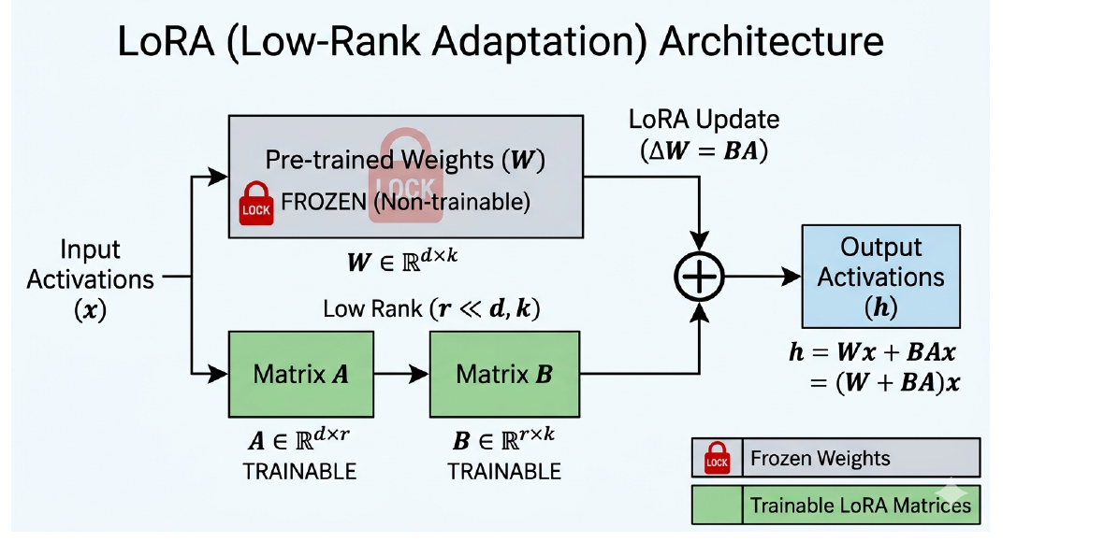
Step 3 · QLoRA in one diagram
WHAT CHANGES
QLoRA in 4 lines
Base loaded in NF4 (4-bit)
Only A · B matrices update
Optimizer states stay tiny
Merge happens after training
Frozen base + trainable rank decomposition (A · B)
Fine-Tuning LLMs for Children's Story Generation — ESI-SBA, May 2026 · 14
Notes:
Step three is the heart of the technical contribution: QLoRA. The diagram on the left shows the idea. The pre-trained weights — that gray box labeled W — stay frozen. We add two small trainable matrices, A and B, whose product is the same shape as W but has a much lower rank. During training only A and B receive gradients. The quantized part — the Q in QLoRA — is that we load the base weights in 4-bit NF4, which cuts the memory footprint by another factor of four. After training we merge A times B back into W, so at inference the model looks identical to a fully fine-tuned one.

Slide 15
Step 3 · Why this fits a single Kaggle T4
Memory needed to train a 2B model under three regimes.
FITS ONE T4
6 GB
for QLoRA NF4 training
FP16 full fine-tuning needs ≥ 16 GB — more than a single T4 holds.
Fine-Tuning LLMs for Children's Story Generation — ESI-SBA, May 2026 · 15
Notes:
Why does QLoRA matter? Because of this chart. Full fine-tuning of a 2B model in FP16 needs about sixteen gigabytes of VRAM — more than a single Kaggle T4 has. 8-bit gets us down to about nine. QLoRA in 4-bit NF4 drops it further to roughly six gigabytes. That number is what fits on one T4. Crossing that line is what makes the entire project doable on free-tier hardware.

Slide 16
Step 4 · Training configuration
training_args = TrainingArguments(
per_device_train_batch_size=1,
gradient_accumulation_steps=16, # effective batch = 16
optim='paged_adamw_8bit',
learning_rate=2e-4,
fp16=True,
gradient_checkpointing=True,
eval_strategy='no', # disabled to avoid OOM
)
WHY THESE FLAGS
Fighting CUDA fragmentation
Batch 1 + grad-accum 16 → effective batch 16
Paged 8-bit optimizer caps optimizer-state RAM
Gradient checkpointing trades compute for VRAM
PYTORCH_CUDA_ALLOC_CONF = expandable_segments:True
256 K vocabulary makes cross-entropy memory-hungry, so we disable in-loop eval and rely on offline qualitative checks.
Fine-Tuning LLMs for Children's Story Generation — ESI-SBA, May 2026 · 16
Notes:
Step four is training. These are our actual training arguments. Per-device batch size is one — that is forced by Gemma's two-hundred-and-fifty-six-thousand vocabulary, which makes cross-entropy memory-expensive. We use gradient accumulation of sixteen to simulate a true batch of sixteen. The optimizer is paged Adam in eight-bit, which keeps optimizer state on CPU when needed. Learning rate two-times-ten-to-the-minus-four, FP16 mixed precision, gradient checkpointing on, and we disable in-loop eval because every eval pass risked an OOM. The right side lists the four mitigations that kept us inside the memory budget.

Slide 17
Step 4 · Training environment
HARDWARE
2 × T4
16 GB each, Kaggle notebook
DATA
9 500 / 500
train / eval split
RUN
≈ 280 steps
1 epoch, optimizer steps
OOM MITIGATIONS
How we kept the run inside the memory budget
paged_adamw_8bit
gradient_checkpointing
expandable_segments
Optimizer state moves to CPU when not in use
Activations recomputed on backward pass
Allocator avoids CUDA fragmentation
Fine-Tuning LLMs for Children's Story Generation — ESI-SBA, May 2026 · 17
Notes:
Quick context for the run: dual T4 GPUs on Kaggle, sixteen gigabytes each. Nine thousand five hundred train examples, five hundred for evaluation. One epoch, which comes out to about two hundred and eighty optimizer steps with our gradient-accumulation setting. The bottom panel names the three things that kept us alive: a paged eight-bit optimizer that pages state to CPU, gradient checkpointing that trades compute for memory, and the expandable-segments CUDA allocator that avoids fragmentation when the vocabulary is enormous.

Slide 18
Step 4 · Training loss curve
TAKEAWAY
Rapid early convergence
Loss drops from 4.13 to ≈ 1.1 in the first 80 steps, then settles. A single epoch is enough for stylistic adaptation.
Fine-Tuning LLMs for Children's Story Generation — ESI-SBA, May 2026 · 18
Notes:
Here is the actual training loss curve from our run. The dramatic drop in the first eighty steps — from roughly four-point-one to one-point-one — is the model learning the chat-template and age-prefix structure. After that it settles into slow refinement, oscillating around one. We only ran one epoch; the curve flattens early, which suggests one epoch is enough for stylistic adaptation on this dataset. More epochs would buy us very little for the compute they cost.

Slide 19
Step 5 · Merge & quantize, four stages
Adapter weights → fused FP16 → GGUF → Q4_K_M, no GPU after stage 1.
Stage 1
Train LoRA adapter
Kaggle 2×T4
Stage 2
Merge into FP16 base
CPU 16 GB
Stage 3
Convert FP16 → GGUF
llama.cpp convert
Stage 4
Quantize to Q4_K_M
llama-quantize
After stage 1 we never touch a GPU again — merge, convert, and quantize all run on CPU.
Fine-Tuning LLMs for Children's Story Generation — ESI-SBA, May 2026 · 19
Notes:
Step five is the deployment pipeline. Four stages. Stage one was the Kaggle training run we just talked about — it produces a small LoRA adapter. Stage two merges that adapter back into the base model in FP16, which we did on CPU because the merged model is too big to fit in T4 memory in float-sixteen. Stage three calls llama.cpp's convert script to turn the safetensors model into GGUF, the format llama.cpp expects. Stage four quantizes that GGUF down to Q4_K_M — four-bit, K-quants, medium variant. Importantly, after stage one we never touch a GPU again.

Slide 20
Step 5 · Disk footprint after quantization
Three artifacts. The thing we ship is in the middle.
63 % SMALLER
3.42 GB
Q4_K_M GGUF, runs on CPU RAM
Quantize step ≈ 3.2 minutes on Kaggle.
Adapter alone is 120 MB — share it freely; merging happens once on the receiver's machine.
Fine-Tuning LLMs for Children's Story Generation — ESI-SBA, May 2026 · 20
Notes:
And here is the payoff. Three columns. The merged FP16 checkpoint is nine-point-two-seven gigabytes — already shippable but heavy. Quantizing to Q4_K_M brings it down to three-point-four-two gigabytes, sixty-three percent smaller, and that is what we actually deploy. The third column is the LoRA adapter alone, just one hundred and twenty megabytes — small enough to email. The quantize step itself took about three-point-two minutes on a Kaggle CPU.

Slide 21
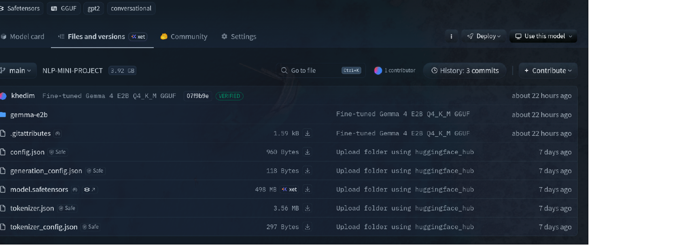
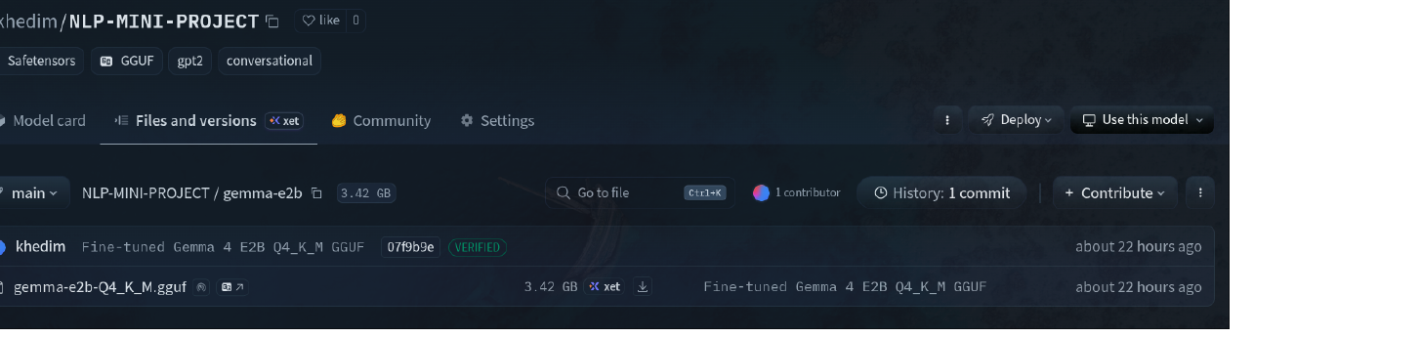
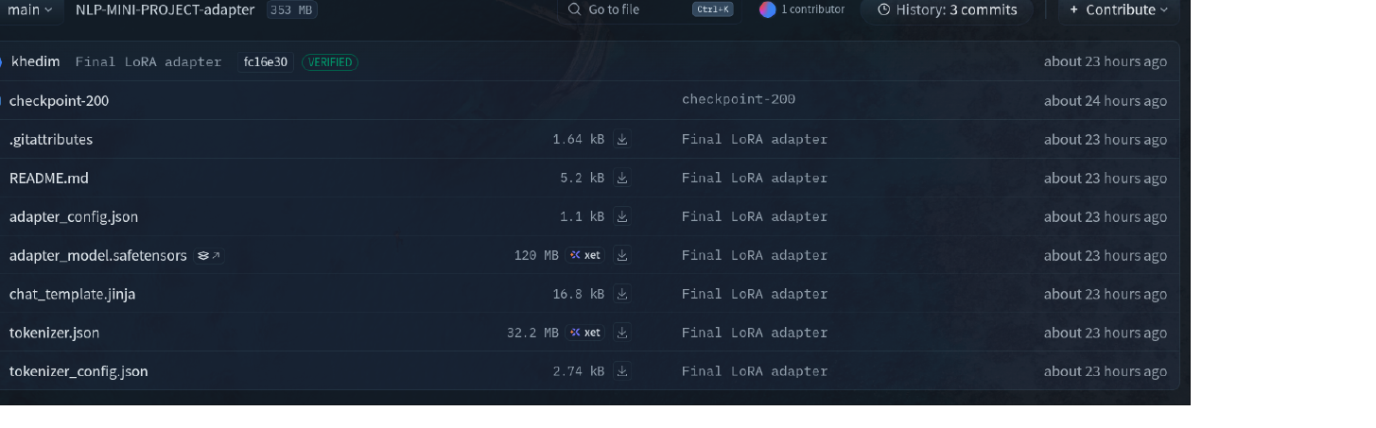
Step 6 · Three repos on Hugging Face
Everything lives at huggingface.co/khedim — open and reproducible.
…/gemma-e2b/
Gemma E2B Q4_K_M GGUF · 3.42 GB
khedim/NLP-MINI-PROJECT-adapter
khedim/NLP-MINI-PROJECT
LoRA adapter weights · 120 MB
Fine-tuned GPT-2 Small + Gemma GGUF root
Fine-Tuning LLMs for Children's Story Generation — ESI-SBA, May 2026 · 21
Notes:
Step six, deliverables. Everything we trained is on Hugging Face under the user khedim. Three repos. The first, NLP-MINI-PROJECT, holds the fine-tuned GPT-2 Small and the root for the Gemma GGUF folder. The second is the gemma-e2b subfolder inside that repo, containing the actual three-point-four-two-gigabyte GGUF file. The third, the adapter repo, holds just the LoRA adapter weights — one hundred and twenty megabytes — for anyone who wants to fuse it into their own copy of Gemma.

Slide 22
Step 6 · How we evaluate
BLEU and ROUGE are weak signals for creative writing — we lean on four explicit checks.
Age-prefix adherence
Does Age 3-4 produce simple sentences and Age 11-12 complex ones?
Vocabulary & sentence complexity
Sentence length, polysyllabic ratio, register — measured per band.
Narrative coherence
Does the story have a beginning, a middle, and a resolved ending?
Side-by-side baselines
Same prompt, same age — fine-tuned vs zero-shot at both scales.
A
B
C
D
Two of those — A and D — we will run live in the next two slides.
Fine-Tuning LLMs for Children's Story Generation — ESI-SBA, May 2026 · 22
Notes:
Step six also covers evaluation. We deliberately do not lean on BLEU or ROUGE because those metrics are weak for creative writing. Instead we look at four things. A: does the model actually obey the age prefix — does Age-3-4 give us simple short sentences and Age-11-12 complex ones. B: vocabulary and sentence complexity per band. C: narrative coherence — does the story have a clear arc with a resolved ending. D: side-by-side comparisons against the zero-shot baselines. The next two slides show A and D live, which is also our demo.

Slide 23
Serving the model · FastAPI + streaming
One process, two backends, swap protected by an asyncio.Lock.
HF Transformers · GPT-2
TextIteratorStreamer on a worker thread → text/plain
POST /generate
Browser
fetch + ReadableStream
FastAPI app
single-model resident, asyncio.Lock
llama-cpp-python · Gemma GGUF
create_chat_completion(stream=True) → text/plain
Streaming, end to end
Tokens leave the model and reach the browser one at a time — no waiting for the full story.
Fine-Tuning LLMs for Children's Story Generation — ESI-SBA, May 2026 · 23
Notes:
How do we serve the model. The browser hits POST /generate on a small FastAPI app. The app holds one model in memory at a time, and the swap between GPT-2 and Gemma is protected by an asyncio Lock so concurrent requests cannot collide. There are two backends. For GPT-2 we use Hugging Face Transformers' TextIteratorStreamer running on a worker thread. For the Gemma GGUF we use llama-cpp-python's create_chat_completion with stream equals True. Both backends stream text/plain back token by token, so the browser sees the story unfold in real time.

Slide 24
Frontend architecture · the same UI you'll see live
Vanilla HTML/JS/CSS, served at / by the same FastAPI app. Zero build step.
THEME
free text (theme + style)
AGE
Age3-4 / 5-6 / 7-8 9-10 / 11-12
MAX TOKENS
50 – 800
MODEL PICKER
/models → /activate-model
fetch('/generate', { method: 'POST', body: {…}, signal: abortController.signal }).then(r => r.body.getReader())
Story card · token-by-token render with a <think>…</think> sidecar for the reasoning trace
Fine-Tuning LLMs for Children's Story Generation — ESI-SBA, May 2026 · 24
Notes:
The frontend is intentionally simple. Single-page HTML with vanilla JavaScript and CSS, served by the same FastAPI app at the root URL — no separate frontend build, no framework. The user fills three inputs: a free-text theme, an age band from a dropdown, and a max-tokens slider. There is also a model picker that calls slash-models to list what is available and slash-activate-model to swap the resident model. On submit we fetch slash-generate, get a ReadableStream, and render tokens into a story card as they arrive. Anything inside think tags is shown in a separate panel as the model's reasoning trace.

Slide 25
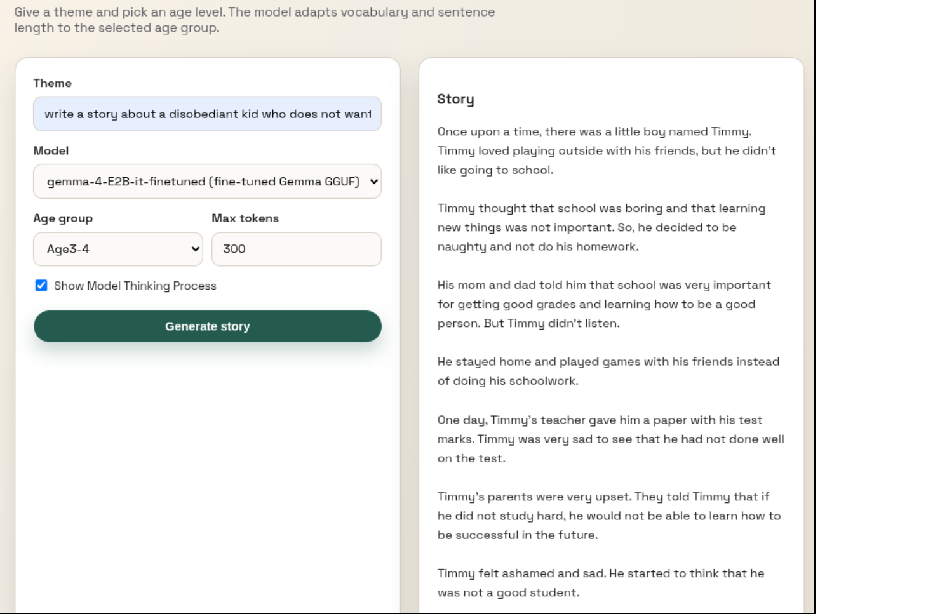
Demo · Age 3-4
WHAT TO SEE
Same prompt, age-3-4 prefix
Disobedient kid who doesn't want to study.
Simple words, positive resolution
Short sentences · happy ending — Timmy learns and gets an award.
Fine-Tuning LLMs for Children's Story Generation — ESI-SBA, May 2026 · 25
Notes:
Demo time. I will switch to the live UI now. Make sure the model picker is on gemma-4-E2B-it-finetuned, and the age-group dropdown is on Age 3-4. I will type the prompt: 'a disobedient kid who does not want to study.' Click Generate. While it streams, point the jury at two things: the sentence length is short and the vocabulary is simple — Timmy, school, homework. The ending wraps up positively, which is the tone we want for this age band. If the live demo fails, fall back to the screenshot on this slide.

Slide 26
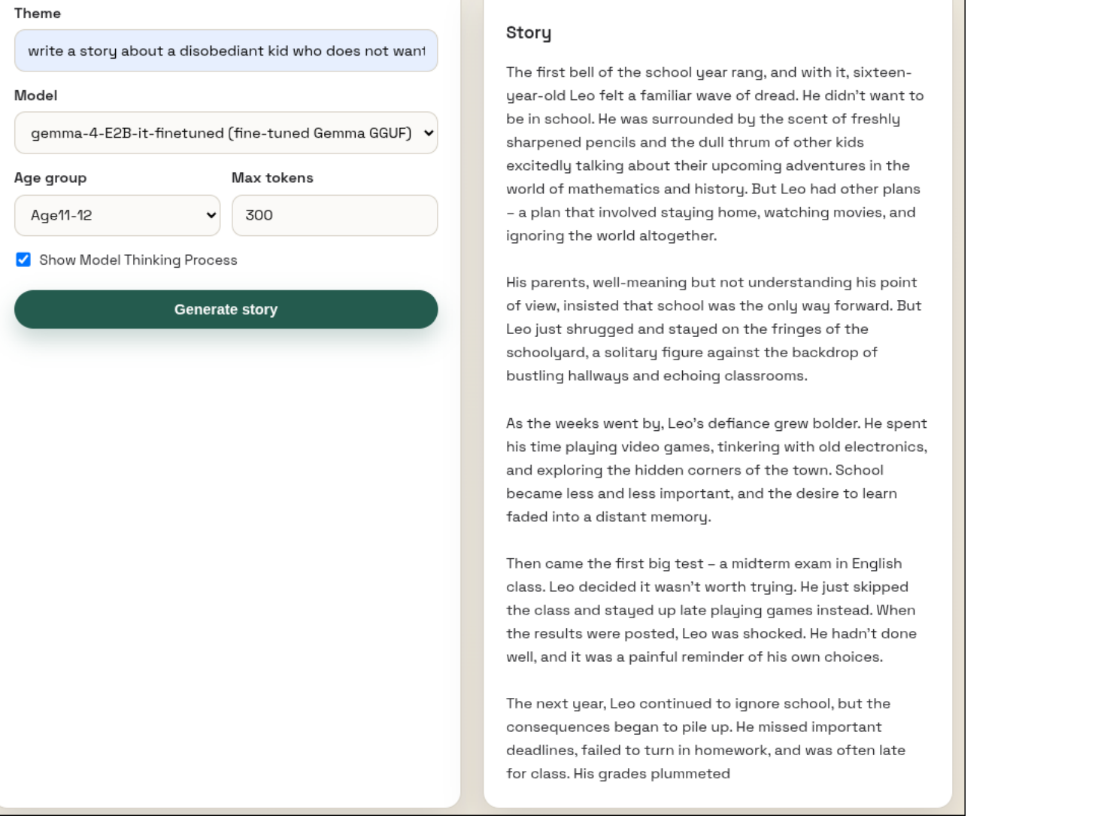
Demo · Age 11-12 · same prompt, different register
WHAT TO SEE
Same prompt, age-11-12 prefix
Only the age token differs.
Richer vocabulary, longer sentences
Sixteen-year-old Leo · midterm · plummeted.
Realistic, melancholic tone
No tidy moral — consequences pile up.
Fine-Tuning LLMs for Children's Story Generation — ESI-SBA, May 2026 · 26
Notes:
Now I will switch the age-group dropdown to Age 11-12 and re-run with the same theme. Notice the model produces a sixteen-year-old protagonist named Leo, longer sentences, richer vocabulary — words like 'midterm' and 'plummeted' that we did not see in the Age 3-4 version. The ending here is also different: more realistic, somewhat melancholic. The same model is doing both — only the prefix changed.

Slide 27
What you'll see in the live demo
Three things to watch for in the next minute.
Pick an age band, type a theme
Same model, same weights, different prefix — that is the whole point.
Tokens stream in real time
text/plain ReadableStream from FastAPI to the browser. No wait for the full story.
Switch to GPT-2 XL zero-shot
Feel the difference: zero-shot ignores the age prefix and drifts into adult register.
01
02
03
▶ Switch to live demo ◀
Fine-Tuning LLMs for Children's Story Generation — ESI-SBA, May 2026 · 27
Notes:
Quick recap before the live demo. Three things to watch for. One: I will pick an age band and type a theme. The same checkpoint, same weights, generates different stories purely from the prefix. Two: tokens stream in real time over the slash-generate endpoint — you do not wait for the full story to arrive. Three: I will then switch the model picker to GPT-2 XL zero-shot, same prompt, and you will hear the difference — the zero-shot model ignores the age prefix and drifts into adult vocabulary. After that we move to the conclusion.

Slide 28
ACT 5 · CONCLUSION
A 2.3-billion-parameter LLM, shrunk to 3.42 GB, that still writes for kids.
An age-conditioned children's-story generator that runs on consumer CPU and ships through a streaming web UI.
QLoRA on 2 × T4
trained on free-tier hardware
3.42 GB GGUF
Q4_K_M, CPU-runnable
Streaming tokens
real-time over text/plain
Fine-Tuning LLMs for Children's Story Generation — ESI-SBA, May 2026 · 28
Notes:
What did we build, in one sentence: an age-conditioned children's-story generator that brings a 2.3-billion-parameter LLM under 4 gigabytes on disk and serves it through a streaming web UI. Three concrete artifacts: we trained with QLoRA on a free Kaggle account using two T4 GPUs; we ship a Q4_K_M GGUF that runs on consumer CPU; and the front-end streams tokens in real time. That, plus the open weights on Hugging Face, is the deliverable.

Slide 29
Limitations · what we'd flag to a reviewer
256 K vocabulary
Memory overhead
Cross-entropy on a 256 K vocab is memory-hungry — forced batch = 1 and disabled in-loop eval.
Domain narrowing
Catastrophic forgetting
Fine-tuning purely on children's stories may degrade general instruction-following outside this domain.
Plot hallucinations
No grounding
Without retrieval or factual constraints, the model occasionally invents details — fine for fiction, risky for education.
Fine-Tuning LLMs for Children's Story Generation — ESI-SBA, May 2026 · 29
Notes:
Three honest limitations. First, the 256 K vocabulary of Gemma 4 makes cross-entropy expensive to compute — we had to use a batch size of one and disable in-loop evaluation, which means we cannot watch validation loss during training. Second, catastrophic forgetting — by fine-tuning purely on children's stories we probably degraded the model's general instruction-following ability outside this domain. Third, there is no grounding — the model can occasionally hallucinate details, which is acceptable for fiction but risky for educational content.

Slide 30
Future work
RAG grounding
Tie generated stories to a curated corpus of facts so the model stops inventing.
Multi-epoch training
Once memory tooling improves, train multiple epochs with an active eval split.
01
02
Multilingual stories
Arabic and French — directly relevant to ESI-SBA's bilingual audience.
Curriculum-aware arcs
Link generated stories to explicit learning objectives — vocabulary targets, moral lessons.
03
04
Fine-Tuning LLMs for Children's Story Generation — ESI-SBA, May 2026 · 30
Notes:
Four directions for future work. One: retrieval-augmented generation, so the stories are grounded in a curated factual corpus and stop inventing details. Two: multi-epoch training with a real evaluation split, once we have better memory tooling — likely a different loss formulation that does not blow up on the 256 K vocabulary. Three: multilingual stories — Arabic and French would be directly relevant to ESI-SBA's audience. Four: curriculum-aware arcs that tie generated stories to explicit learning objectives, so this becomes an actual educational tool.

Slide 31
Tech stack
Open-source, end to end.
PyTorch
Transformers
PEFT
BitsAndBytes
llama.cpp
Kaggle
FastAPI
Docker
GitHub
Fine-Tuning LLMs for Children's Story Generation — ESI-SBA, May 2026 · 31
Notes:
The stack, briefly. PyTorch for the tensor math. Transformers for model loading and the trainer abstraction. PEFT for LoRA adapter injection. BitsAndBytes for NF4 quantization during training. llama.cpp for the GGUF conversion and final quantization. Kaggle for the dual-T4 training environment. FastAPI for the inference server. Docker for environment consistency. GitHub for source control. All open-source, all reproducible from the links on the next slide.

Slide 32
ESI-SBA · GROUP 1 — IASD · MAY 2026
Thank you.
Questions welcome.
CODE
github.com/khedimyoucef/ NLP-MINI-PROJECT
MODELS
huggingface.co/khedim
CONTACT
i.benhammadi@esi-sba.dz
Notes:
Thank the jury. Briefly restate the headline: a 2.3 billion parameter LLM, fine-tuned on free Kaggle hardware, shrunk to 3.42 gigabytes, that adapts its writing to five children's age bands and runs on CPU. Open code on GitHub, open weights on Hugging Face. Invite questions. Have the live demo still up on a second screen in case a question lands on it.

