Slide 1
The State of Ethics in Computer Science
Jared Moore (jared@jaredmoore.org)
Wadhwani Institute for Artificial Intelligence

Slide 2

Fake news on Facebook during 2017 U.S. presidential election. paid for by Russians
Widely agreed that this influenced the election
But Zuckerberg said this was “a pretty crazy idea”
N. T. Vogelstein Fred, “Inside Facebook’s Two Years of Hell,” Wired, 12-Feb-2018.
Notes:
Not just Facebook as a corporate entity but literally the manners with which the Facebook newsfeed algorithms displayed content
How many of you heard about this?
Use facebook?
Do we agree that this is a significant impact of technology on society?

Slide 3
Fake news on Facebook during 2017 U.S. presidential election. paid for by Russians
Widely agreed that this influenced the election
But Zuckerberg said this was “a pretty crazy idea”
N. T. Vogelstein Fred, “Inside Facebook’s Two Years of Hell,” Wired, 12-Feb-2018.
Notes:
Not just Facebook as a corporate entity but literally the manners with which the Facebook newsfeed algorithms displayed content
How many of you heard about this?
Use facebook?
Do we agree that this is a significant impact of technology on society?

Slide 4
Framing Example Direction

Slide 5
Common thoughts:
“Move fast and break things”
“It’s not my job”
“It’s just the way it is”
“There’s no algorithm to solve it!”
Notes:
The thinking goes that a tech employee has no responsibility to consider the societal implications of her work. To do so would disrupt the ideal, in Facebook’s words, to “move fast and break things.”

Slide 6
Claim
If:
(1) Computing technologies pervade and influence society.
(2) A few companies control most of these technologies.
(3) These companies’ employees are the instruments of control.
Notes:
Do you agree?
Why does this matter to you?

Slide 7
Claim
If:
(1) Computing technologies pervade and influence society.
(2) A few companies control most of these technologies.
(3) These companies’ employees are the instruments of control.
Then:
(4) Tech employees have significant influence over and responsibility to society.
Notes:
You are all beginning to understand the technical aspects of these companies and many of you will soon be in these roles

Slide 8
Why listen to me?
Researcher at WadhwaniAI
Worked at Microsoft and Tableau
Masters in Computer science from University of Washington
Taught a computer ethics class there
Written about ethics for TechCrunch

Slide 9
From the ACM Code of Ethics:
“Avoid harm to others....Well-intended actions, including those that accomplish assigned duties, may lead to harm unexpectedly. In such an event the responsible person or persons are obligated to undo or mitigate the negative consequences as much as possible. One way to avoid unintentional harm is to carefully consider potential impacts on all those affected by decisions made during design and implementation.”
Notes:
The governing body of computer science professionals agrees as well!

Slide 10
ethics

Slide 11
Husserl
Nietzsche
deontology
standards
Kant
utilitarianism
ethics
navel-gazing
Aristotle
trolley problem
values
social impacts
professionalism

Slide 12
ethics

Slide 13
How do you convince someone about the importance of privacy who doesn’t believe in it?
Can we hold technical systems to a higher standard than we would human systems?
Does an employee’s opinion matter if it would negative affect the bottom line?
Notes:
These are questions that the change audience asks themselves all of the time
One of the few groups for whom a consideration of ethics is core to the research area

Slide 14
ethics

Slide 15
ethics
a) An intentional approach to address human debates
b) A shorthand to discuss values like
privacy
ownership
expression
accountability
justice
etc.
Notes:
Yes this means I am suggesting a kind of relativism
Officially:
ethics: moral principles that govern a person's behavior or the conducting of an activity

Slide 16
Framing Example Direction

Slide 17
“If computers could accurately predict which defendants were likely to commit new crimes, the criminal justice system could be fairer and more selective about who is incarcerated and for how long."

Slide 18
Accurately predict who will recommit
Assume you have some data
Defendants, prior offenses, zip code, age, etc.
And can run it through a black box algorithm

Slide 19
Accurately predict who will recommit
Assume you have some data
Defendants, prior offenses, zip code, age, etc.
And can run it through a black box algorithm
What questions do you consider?
Notes:
Think Pair Share

Slide 20
Recidivism Scores
“the tendency of a convicted criminal to reoffend”
Northpointe developed the COMPAS algorithm to produce such scores
Used across the country in
Sentencing
Parole hearings
Probation

Slide 21
ProPublica:
“If computers could accurately predict which defendants were likely to commit new crimes, the criminal justice system could be fairer and more selective about who is incarcerated and for how long.

Slide 22
ProPublica:
“If computers could accurately predict which defendants were likely to commit new crimes, the criminal justice system could be fairer and more selective about who is incarcerated and for how long. The trick, of course, is to make sure the computer gets it right. If it’s wrong in one direction, a dangerous criminal could go free. If it’s wrong in another direction, it could result in someone unfairly receiving a harsher sentence or waiting longer for parole than is appropriate.”

Slide 23
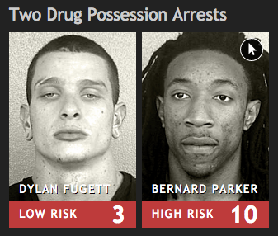

Slide 24
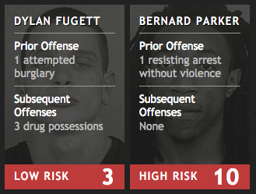

Slide 25
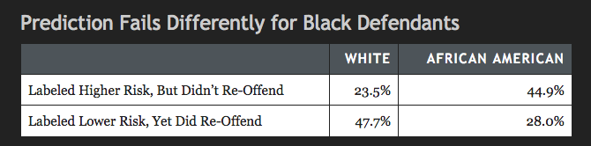

Slide 26
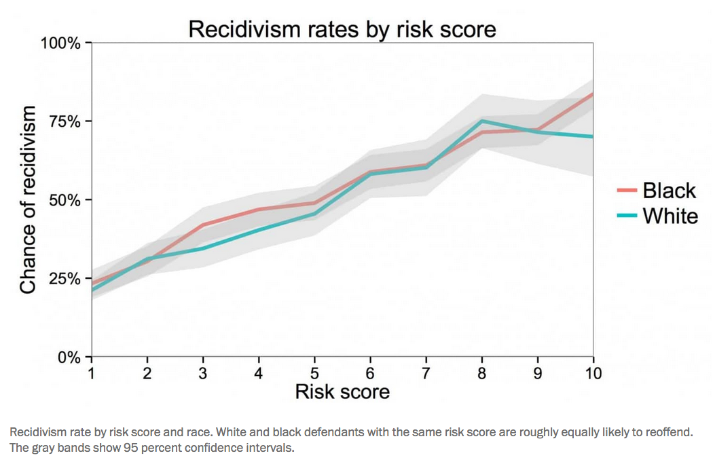

Slide 27
Researchers’ response:
“ProPublica compared false positive rates and false negative rates for blacks and whites and found them to be skewed in favor of whites. Northpointe, in contrast, compared the PPVs [percentage of true positives] for different races and found them to be similar. In part because the recidivism rates for blacks and whites do in fact differ, it is mathematically likely that the positive predictive values for people in each group will be similar while the rates of false negatives are not.”
Notes:
https://www.technologyreview.com/s/607955/inspecting-algorithms-for-bias/

Slide 28
What is fair?
Equal false negatives between races?
Equal percentage of all positives that are true between races?
Neither?

Slide 29
Reaction
“the bias seems to be based on data, rather than the algorithm. If that is the case….This issue seems more like a social justice issue than a technical issue”
Notes:
Does this reduce the merit of discussion? If you are asked to make a similar decision is this not a great opportunity?

Slide 30
Reaction
“This causes me to feel even more confused than I did before. In a way, this problem almost feels like a case that is impossible to solve because we will always be choosing between one option or another, but never getting both.”

Slide 31
What’s the point?
How do we define fairness?
True positive or false negative?
Who decides?
Should an algorithm do this at all?

Slide 32
What’s the point?
How do we define fairness?
True positive or false negative?
Who decides?
Should an algorithm do this at all?
Consider ethics

Slide 33
Framing Example Direction

Slide 34

Icons made Freepik https://www.flaticon.com
ethics
Notes:
One lever…

Slide 35

Icons made Freepik https://www.flaticon.com
market
activism
ethics
regulation
education
tech. capability
Notes:
Out of many:
That channel different values, groups of people, etc. That’s the point.
We can’t expect that by having engineers who can talk about ethics that we arrive somewhere we want, but it does help

Slide 36
Icons made Freepik https://www.flaticon.com
market
activism
regulation
education
tech. capability
ethics
Notes:
White washing means we conflate the importance of this lever

Slide 37
ethics means exploring agency
Speaking out
Choosing employers
Building in constraints
Administrative discretion
Quitting
Boycotting
Petitions and open letters

Slide 38
ethics means exploring agency based on one’s values
Speaking out
Choosing employers
Building in constraints
Administrative discretion
Quitting
Boycotting
Petitions and open letters

Slide 39

Facebook changed
Newsfeed algorithm now favors friends more than articles
“the place that you can put the most pressure on the [tech] executives comes from the engineers” Wired editor on the change
Notes:
https://newsroom.fb.com/news/2018/01/news-feed-fyi-bringing-people-closer-together/
Internally, his employees disagreed, worrying about Facebook becoming an Uber-like pariah. Through complaints, employees led Zuckerberg to change course: the newsfeed algorithm switched from favoring inflammatory stories–clickbait–to focusing on friends

Slide 40
Facebook changed
Newsfeed algorithm now favors friends more than articles
“the place that you can put the most pressure on the [tech] executives comes from the engineers” Wired editor on the change
Notes:
TPS
Internally, his employees disagreed, worrying about Facebook becoming an Uber-like pariah. Through complaints, employees led Zuckerberg to change course: the newsfeed algorithm switched from favoring inflammatory stories–clickbait–to focusing on friends

Slide 41
AI Now, Stanford Human AI, conferences, etc.
Tech Worker’s Coalition,
#TechWontBuildIt
Mozilla Ethics Grant (+many courses)
IEEE AI ethics standards, PAI
General Data Protection Rules
(+many local proposals)
Where’s the pressure?
Notes:
Many of us are computing professionals
Values, and discussions about them, undergird our work
To realize one set of values (say climate justice) you might want to be systematic about knowing which levers to pull and what has happened with them before

Slide 42
AI Now, Stanford Human AI, conferences, etc.
Tech Worker’s Coalition,
#TechWontBuildIt
Mozilla Ethics Grant (+many courses)
IEEE AI ethics standards, PAI
General Data Protection Rules
(+many local proposals)
-> research, activism
-> tech. capability, activism
-> education
-> self-regulation
-> regulation
Where’s the pressure?
Notes:
Many of us are computing professionals
Values, and discussions about them, undergird our work
To realize one set of values (say climate justice) you might want to be systematic about knowing which levers to pull and what has happened with them before

Slide 43
AI Now, Stanford Human AI, conferences, etc.
Tech Worker’s Coalition,
#TechWontBuildIt
Mozilla Ethics Grant (+many courses)
IEEE AI ethics standards, PAI
General Data Protection Rules
(+many local proposals)
-> research, activism
-> tech. capability, activism
-> education
-> self-regulation
-> regulation
Where’s the pressure?
ethics
Notes:
Many of us are computing professionals
Values, and discussions about them, undergird our work
To realize one set of values (say climate justice) you might want to be systematic about knowing which levers to pull and what has happened with them before

Slide 44
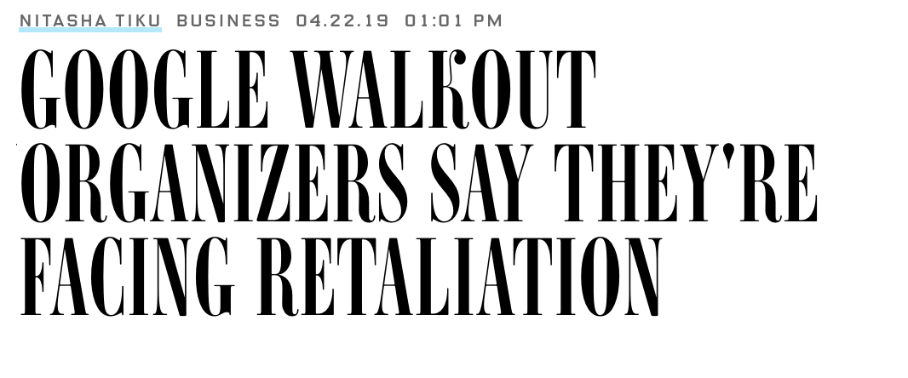
*
Notes:
https://www.wired.com/story/google-walkout-organizers-say-theyre-facing-retaliation/?mbid=social_twitter_onsiteshare

Slide 45
Common Thoughts:
“Move fast and break things”
“It’s not my job”
“It’s just the way it is”
“There’s no algorithm to solve it!”

Slide 46
Common Thoughts:
“Move fast and break things” → Always?
“It’s not my job” → Then whose?
“It’s just the way it is” → Why?
“There’s no algorithm to solve it!” → So?
Notes:
Programs are not just text on a computer
If you don’t want to consider ethics, don’t work on problems involving people
Tech is privileged … so act like it
Ask questions
Speak up

Slide 47
Thanks!
Notes:
[thank you slide; allow for clapping]

Slide 48

The State of Ethics in Computer Science
Questions?
TechCrunch article on agency of engineers
Syllabus of the class I taught
Pay attention to:
Tech Worker’s Coalition
Ethics courses
(some) media
Levers available:
Ethics
Legislation
Market forces
Activism
Education
Tech. capability
Jared Moore (jared@jaredmoore.org)
Wadhwani Institute for Artificial Intelligence
Notes:
Questions? And here’s a summary

