Slide 1

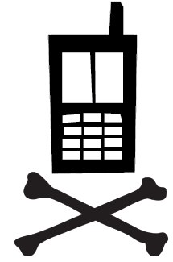

Umati
Help Grade Exams for Candy
What is this thing?
This is a crowdsourcing kiosk. It allows is to investigate “Communitysourcing”; the use of latent skills in a population when crowdsourcing.
In particular, we’re trying to understand how to use the deep computer science knowledge that should be available in this very hallway.
Ok, how?
We’re having students grade example CS61B undergraduate exams.
Wait, why?
It’s our hypothesis that students here should be better than average at grading these exams, among other factors.
How do you evaluate that?
We’ll tell you later.
How do I participate?
Just walk up and use the machine. Hopefully the UI will be intuitive enough to be used without a lot of guidance.
Who can participate?
You. Anyone with a CAL1 card. We want to hear your voice.
Who worked on this project?
Oh, lots of people.
Kurtis Heimerl <kheimerl@cs>
Bryan Trinh
Kuang Chen <kuangc@cs>
Bjoern Hartmann <bjoern@cs>
Tapan Parikh <parikh@ischool>
Whom should I complain/give suggestions to?
Kurtis Heimerl built this thing, and you should blame him for every fault. He also likes feedback.
Berkeley Institute of Design

