Slide 1
AI for Childhood TB diagnosis based on clinical symptoms
By: Ismael KONE & Sani Amadou
Supervised By:
Dr Bubacarr Bah
Friday 23 May, 2025

Slide 2
Agenda
1 Problem description
2 Data description
3 Work done
4 Preliminary results
5 Next steps

Slide 3
1 Problem description
Recap of meeting with Pr Toyin (16/05/25):
The dataset is not suited for MDR-TB study (Accuracy of GenXpert)
New objective: build an AI model to predict TB based on clinical information and identify driving factors
Given the limited size of the data (228), validation will be done on external dataset from his team at MRC to evaluate the effectiveness of the AI model.
Met (22/05/25) with Dr Edem from Pr Toyin team to check the compatibility between both data:
  Dr Edem: they roughly the same
  I’ve shared data dictionary for precise answer.

Slide 4
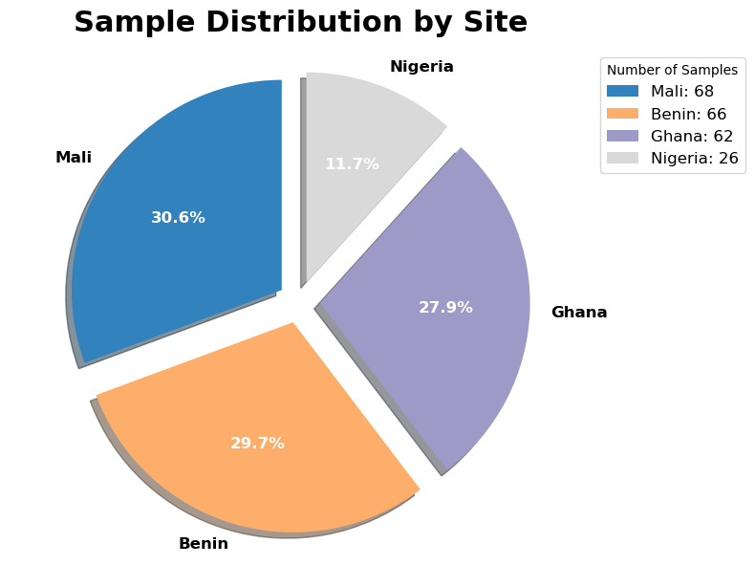
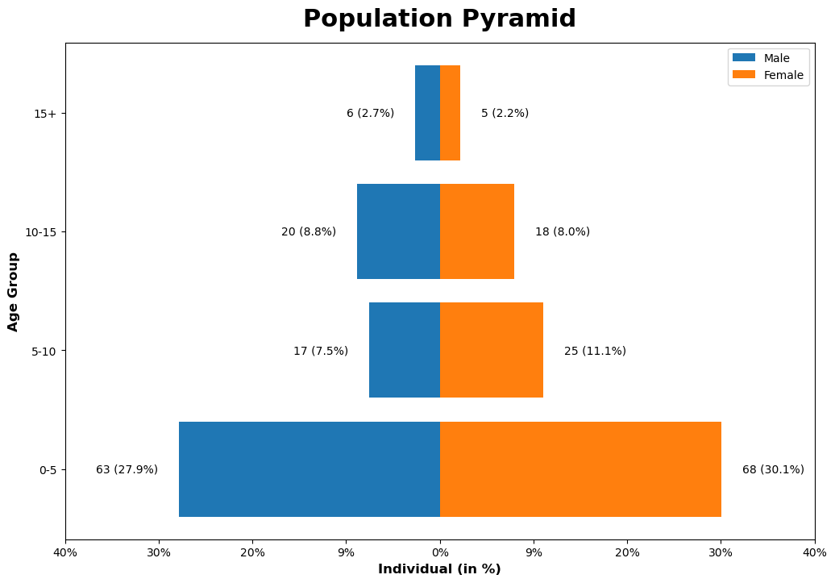
2 Data description
Dataset size: 228
Male: 106 (47.7%)
Female: 116 (52.3%)

Slide 5
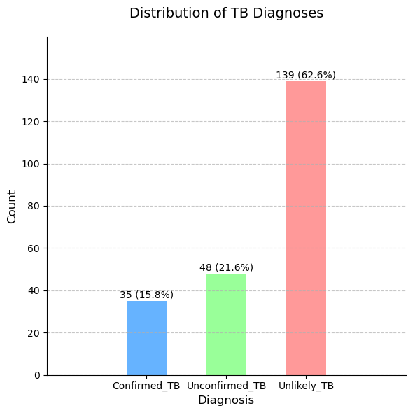
2 Data description
How to determine Positive TB and Negative TB ?
Microbiology Standard Reference (MRS):
Positive TB = Confirmed TB
Negative TB = Unconfirmed TB + Unlikely TB
Clinical Standard Reference (CRS):
Positive TB = Confirmed TB + Unconfirmed TB
Negative TB = Unlikely TB

Slide 6
3 Work done
Cleaning the data for modelling
Split the data into train/test based on age/gender/diagnosis
Baseline models (using CRS label)

Slide 7
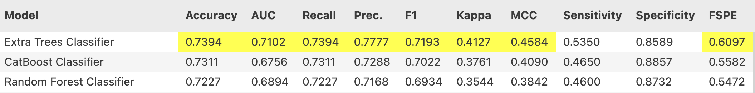
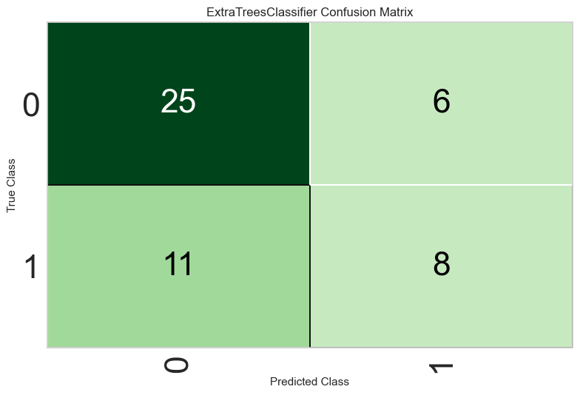
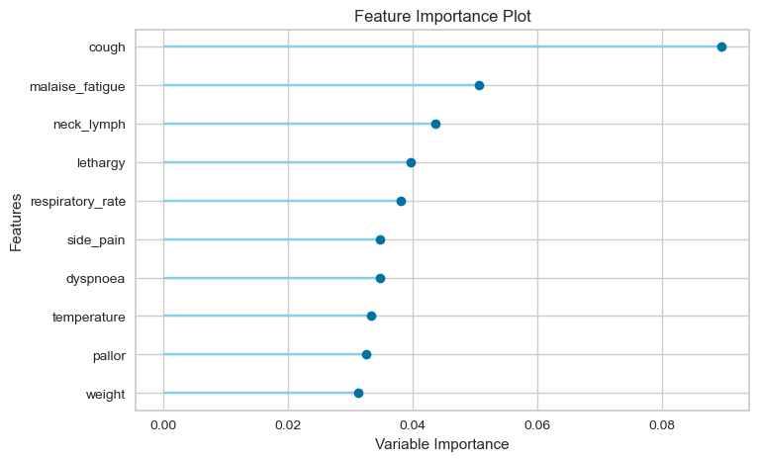
4 Preliminary results

Slide 8
5 Next steps
Improve the model with more features engineering
Discuss results with Edem to get more insights

Slide 9

Questions ?
MRC Unit The Gambia at the London School of Hygiene & Tropical Medicine
@mrcunitgambia
@mrcunitgambia
www.mrc.gm

