Slide 1

Plant Disease Classification using AI
This presentation will delve into the world of AI-powered plant disease classification, outlining the key steps involved in building a robust and accurate model. From data collection and preparation to model training and evaluation, we'll explore the practical aspects of this cutting-edge technology.

Slide 2
Introduction to Plant Diseases
Economic Impact
Types of Diseases
Plant diseases pose a significant threat to global food security, causing substantial crop losses and economic repercussions. Accurate disease identification and timely intervention are crucial for mitigating these impacts.
Plant diseases can be caused by various factors, including fungal, bacterial, viral, and parasitic infections. Each type of disease exhibits unique symptoms and requires specific management strategies.

Slide 3
Data Loading and Preprocessing
1
Data Source
2
Label Encoding
We'll leverage the power of Kaggle, a renowned platform for data science competitions and datasets, to access a comprehensive collection of plant disease images and labels.
The image labels will be encoded into numerical representations, allowing for efficient processing and training by the AI model.

Slide 4
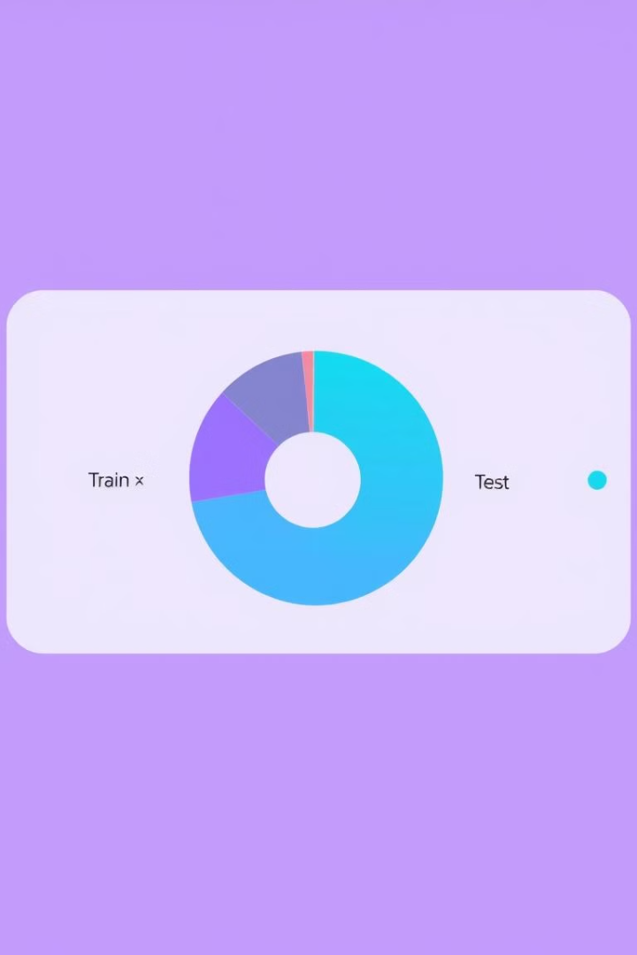
Data Splitting for Training
Training Set
Validation Set
A significant portion of the data will be used for training the AI model, allowing it to learn the intricate patterns and relationships between images and their corresponding disease labels.
A smaller subset of the data will be used for validating the model's performance during training, ensuring that it generalizes well to unseen data.
Test Set
The final portion of the data will be reserved for evaluating the model's accuracy on completely unseen data, providing an objective measure of its real-world performance.

Slide 5
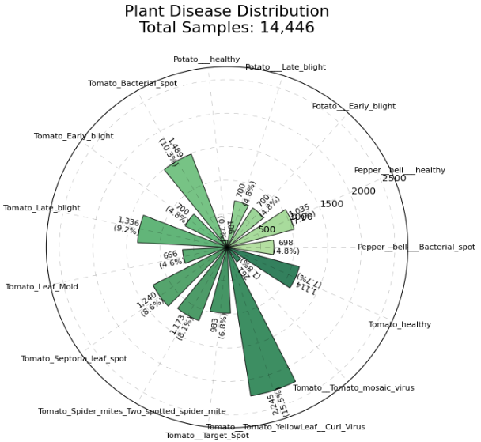
Classes Distribution

Slide 6
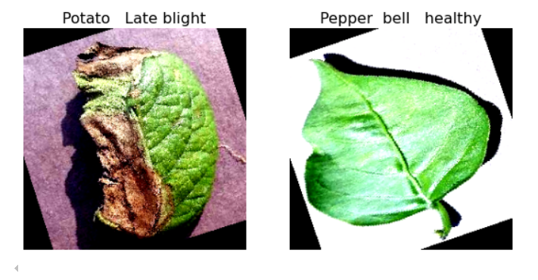


Visualizing the Data
Data Exploration
Data Balancing
Visualizing the data is essential for gaining insights into its characteristics, identifying potential biases, and understanding the distribution of different disease types.
Visualizing the data can help identify any imbalances in the dataset, ensuring that the model is not biased towards specific disease types.

Slide 7
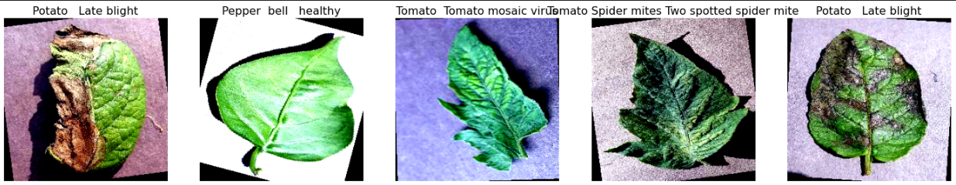
Visualizing the Data

Slide 8
Data Augmentation and Transformations
1
Image Augmentation
Techniques like random cropping, flipping, rotation, and color adjustments will be applied to the training data to artificially increase its size and improve the model's ability to generalize.
2
Image Transformations
Appropriate transformations, such as resizing and normalization, will be applied to ensure that the input images are in a format that the model can effectively process.

Slide 9
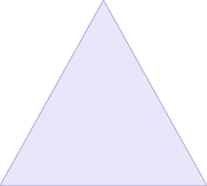


Model Architecture
Convolutional Layers
1
These layers will extract features from the input images, identifying patterns and edges that are crucial for disease identification.
Pooling Layers
2
Pooling layers will downsample the extracted features, reducing dimensionality and computational complexity while preserving important information.
Fully Connected Layers
3
These layers will combine the extracted features and make predictions about the disease category.

Slide 10
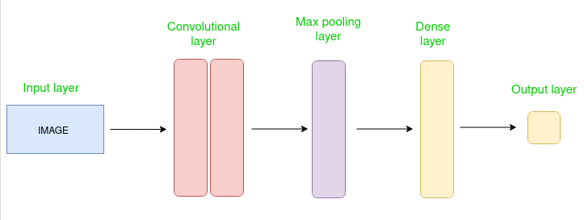

Model Architecture

Slide 11
Initializing Model, Loss, Optimizer
Model Initialization
1
The convolutional neural network will be initialized with appropriate parameters and weights, providing a starting point for the training process.
Loss Function
2
A suitable loss function, such as categorical cross-entropy, will be chosen to measure the model's performance during training and guide its optimization.
Optimizer
3
An optimizer, such as Adam or SGD, will be selected to update the model's weights during training, minimizing the loss function and improving its accuracy.

Slide 12
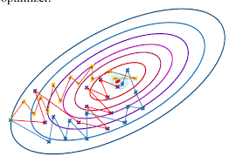
Initializing Model, Loss, Optimizer

Slide 13
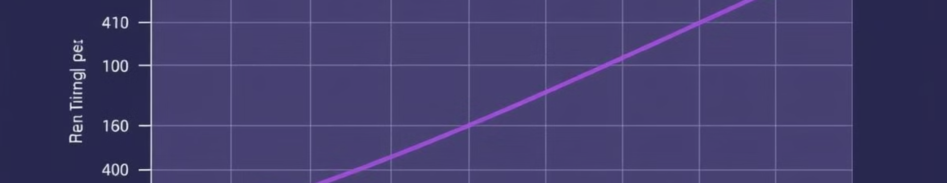
Training the Model
31
32
Epochs with early stopping
Batch Size
The model will be trained for a specified number of epochs, iterating through the training data multiple times to refine its parameters.
The data will be processed in batches to optimize computational efficiency, enabling the model to learn from smaller chunks of data at a time.

Slide 14

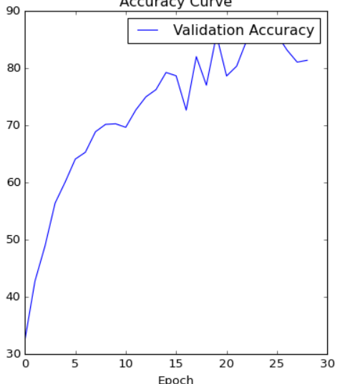


Evaluating the Model

