Slide 1

Why Data quality is important
Data is only useful if it’s of high quality

Slide 2
WHAT IS DATA QUALITY AND WHY IT’S IMPORTANT
The Data Management Body of Knowledge (DMBOK) defines Data Quality (DQ) as “the planning, implementation, and control of activities that apply quality management techniques to data, in order to assure it is fit for consumption and meet the needs of data consumers.”
Improved data quality leads to better decision-making across an organization. The more high-quality data you have, the more confidence you can have in your decisions. Good data decreases risk and can result in consistent improvements in results.
When data is of excellent quality, it can be easily processed and analyzed, leading to insights that help the organization make better decisions. High-quality data is essential to business intelligence efforts and other types of data analytics, as well as better operational efficiency.

Slide 3
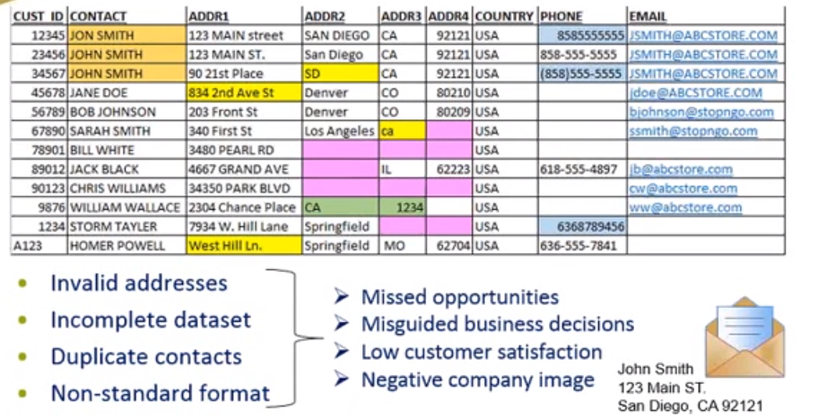
POOR DATA QUALITY EXAMPLE

Slide 4

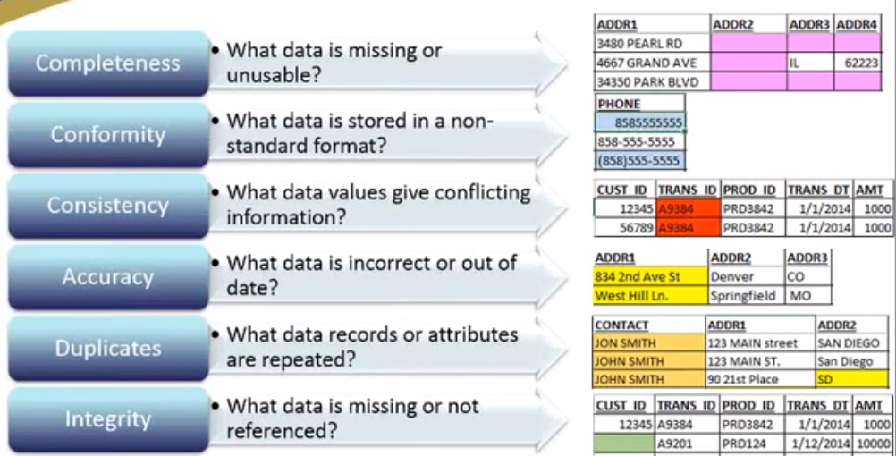
Digital Communications
Data quality dimensions
Cloud
Local
Hybrid

Slide 5

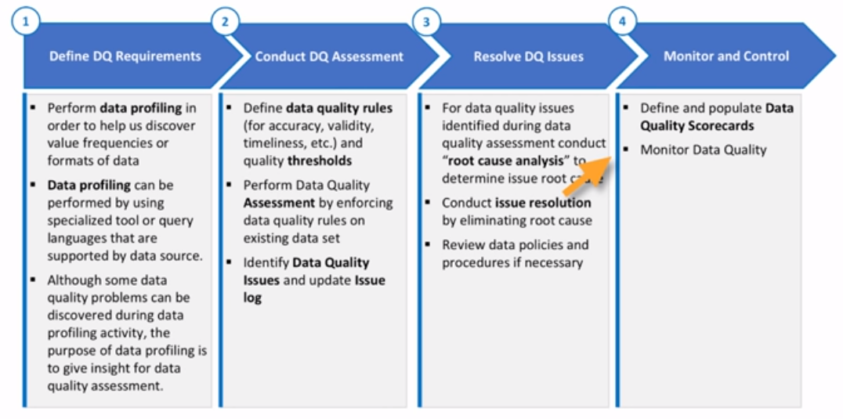

Slide 6


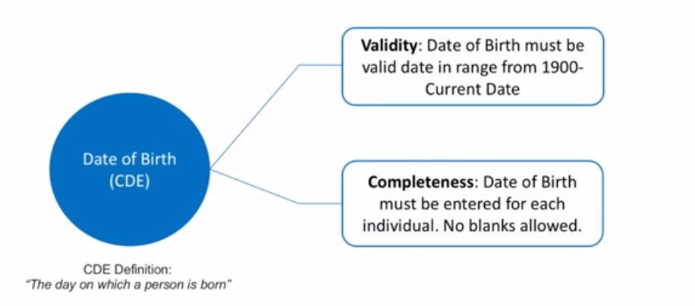

Slide 7
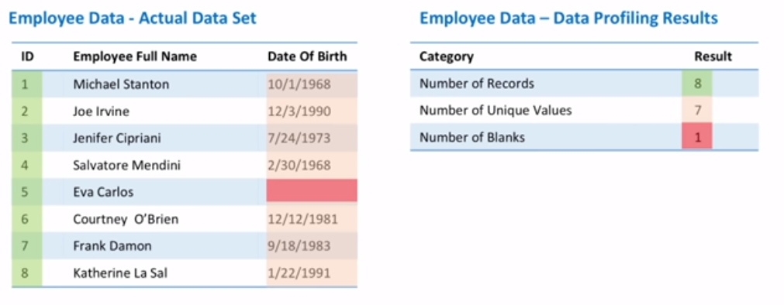

Slide 8
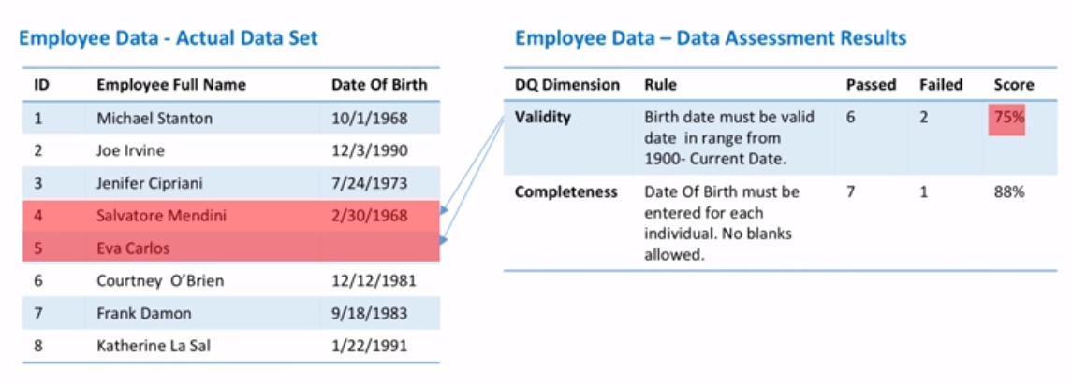

Slide 9

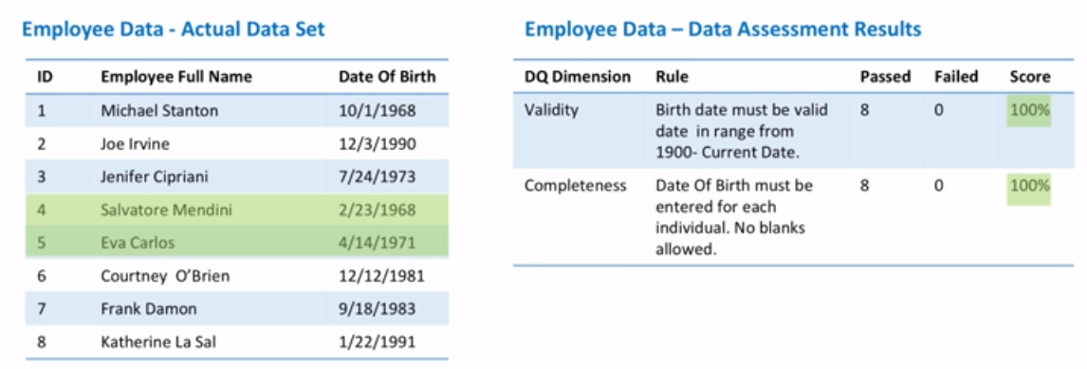

Slide 10
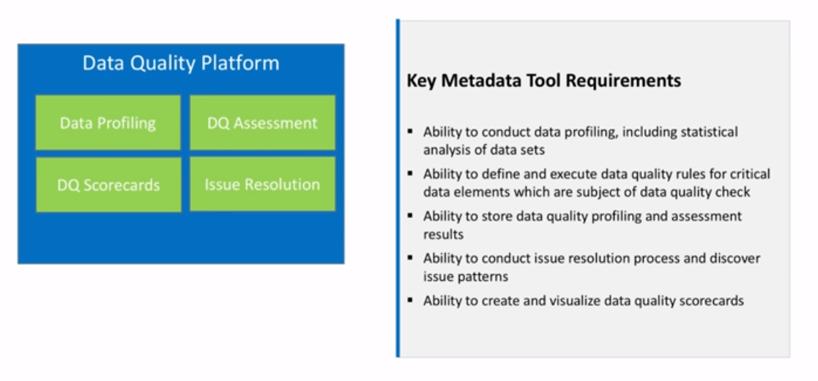

Slide 11
